Slide 1


Understanding Structural and Social Determinants of Health and IECMHC
FORWARD CONSULTANTS

Slide 2
Agenda
Background on Structural and Social Determinants of Health (SSDOH)
Prevalence of Adverse SSDOH Issues in Delaware
What Home Visitors Can Do/Have Done to Address Adverse SSDOH Issues
Examples of How IECMHC Model Also Helps Address Adverse SSDOH Issues

Slide 3
Background on SSDOH
Social Determinants of Health (SDOH): The conditions under which people are born, grow, live, work, and age. Healthy People 2030 sets data-driven national objectives in five key areas of SDOH:
  Healthcare access and quality;
  Education access and quality;
  Social and community context;
  Economic stability; and
  Neighborhood and built environment.
Structural Determinants of Health Inequities: The social, economic, and political mechanisms which generate social class inequalities in society.
American Academy of Family Physicians. Social determinants of health policy.
CDC Social Determinants of Health. https://www.cdc.gov/about/priorities/why-is-addressing-sdoh-important.html
World Health Organization. A conceptual framework for action on the social determinants of health.

Slide 4
Background on SSDOH
Dr. Camara Jones, MD, MPH, PhD
“The Cliff of Good Health”
https://www.youtube.com/watch?v=to7Yrl50iHI

Slide 5
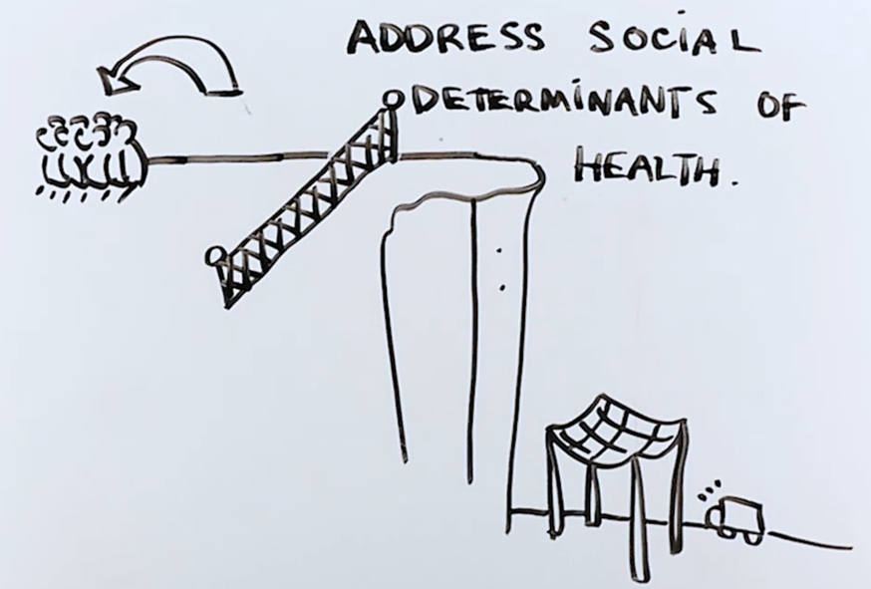
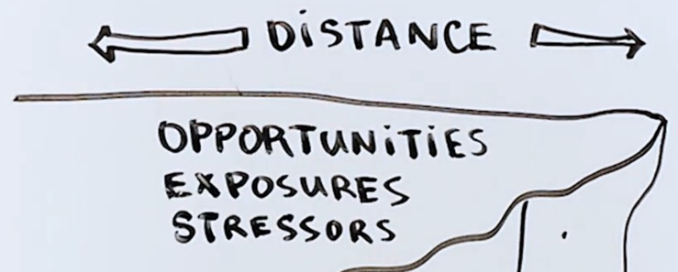
Background on SSDOH

Slide 6
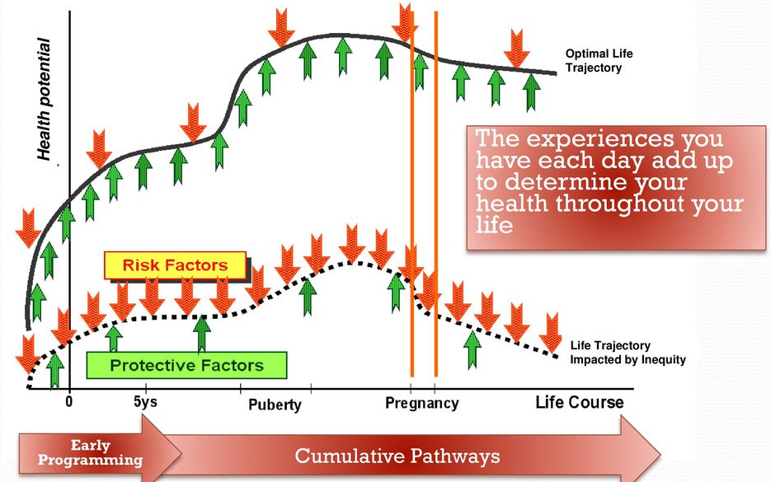
Background on SSDOH
Life Course Perspective
Lu M, Halfon N. Racial and ethnic disparities in birth outcomes: a life-course perspective. Matern Child Health J. 2003; 7:13-30.

Slide 7
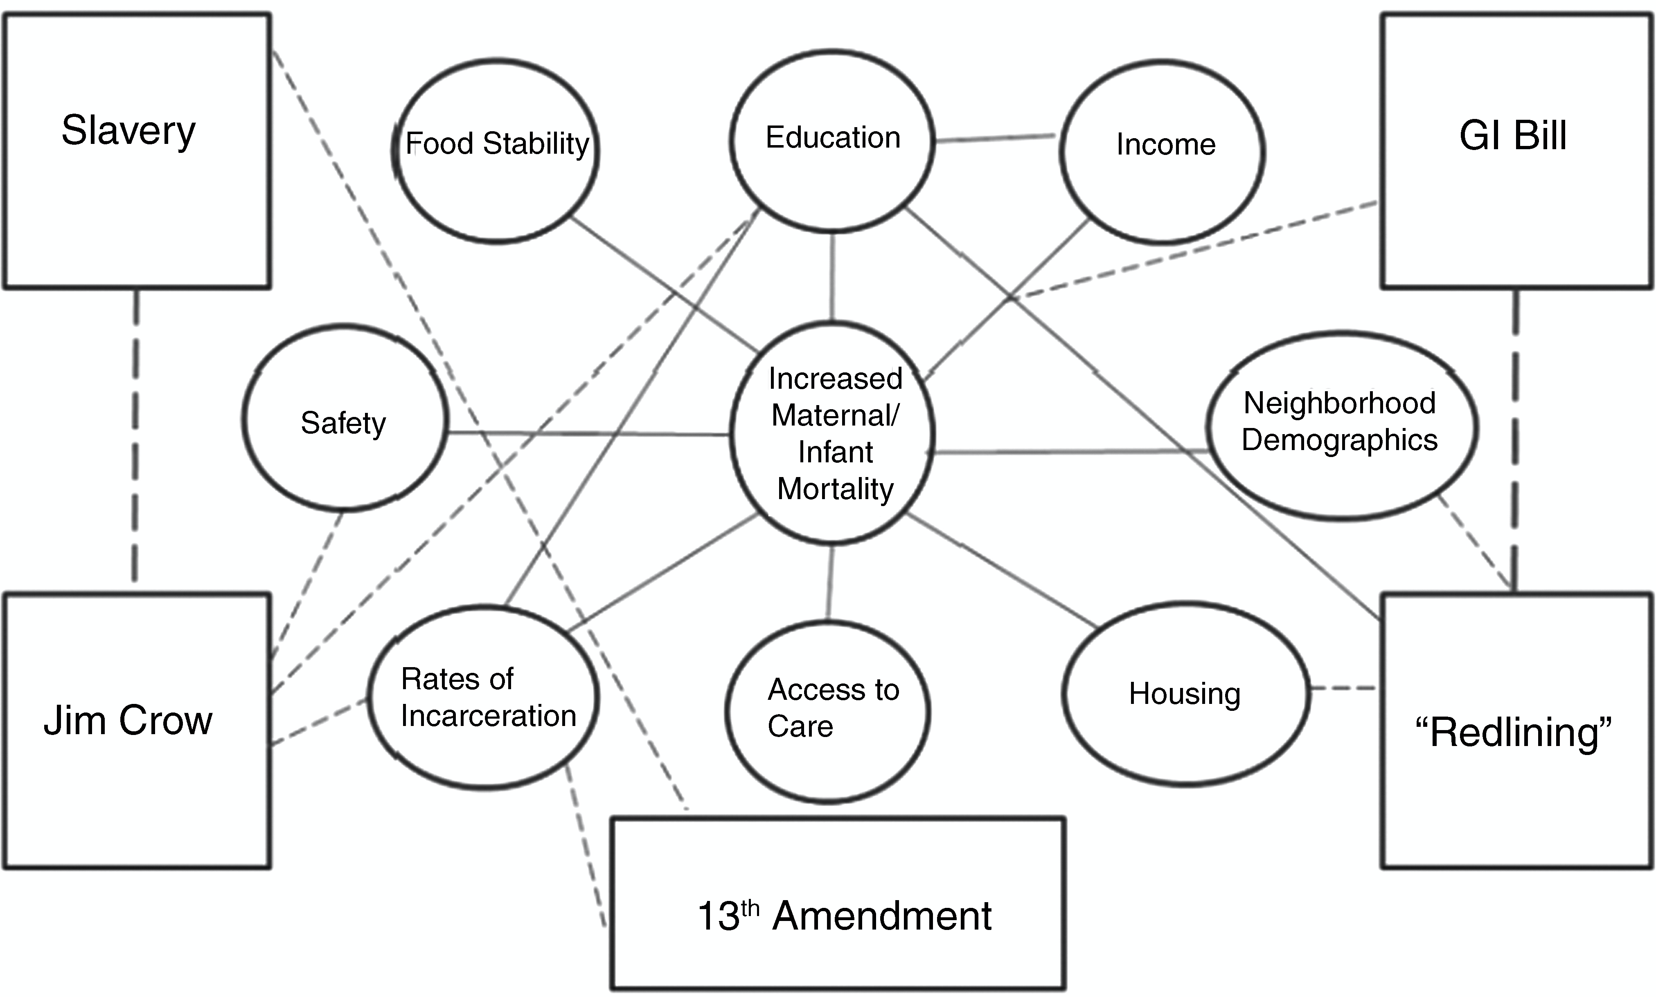
Background on SSDOH
Restoring Our Own Through Transformation (ROOTT) Framework
Roach J. ROOTT's theoretical framework of the web of causation between structural and social determinants of health and wellness—2016. Restoring Our Own Through Transformation (ROOTT), 2016.

Slide 8
Prevalence of Adverse SSDOH Issues
Many Different Sources
We Used 2-1-1 Data
  Segmented by Request, Geography (Wilmington, Western Sussex)
  Referrals Can Link to Help Me Grow -> Home Visiting
Time Frame of January 1, 202X – April 30, 202X
  Allows Comparison Across Years
  Assess Requests in the Next Few Months
Six Most Common Requests Presented (75-80 percent of requests)
In 2021, Impact of COVID-19
Delaware 2-1-1 Data Used to Inform Slides 9-14.

Slide 9
Prevalence of Adverse SSDOH Issues
State-Level

Slide 10
Prevalence of Adverse SSDOH Issues
Wilmington Area (19720, 19801, 19802, 19804, 19805, 19806, 19809)

Slide 11
Prevalence of Adverse SSDOH Issues
Western Sussex (19933, 19940, 19947, 19956, 19973)

Slide 12
Prevalence of Adverse SSDOH Issues
Wilmington and Western Sussex comprise 12 of 66 state zip codes.
Table shows that these requests disproportionately come from these zip codes (January-April 2024 data).
Top Requests | % Total Statewide
Housing & Shelter | 2,772 (54.8%)
Utilities | 1,796 (59.6%)
Food | 425 (44.7%)
Healthcare & COVID-19 | 364 (38.6%)
Employment & Income | 267 (47.5%)
Government & Legal | 218 (45.3%)

Slide 13
Prevalence of Adverse SSDOH Issues
Housing & Shelter Composition (statewide; three most common in blue)

Slide 14
Prevalence of Adverse SSDOH Issues
Utilities Composition (statewide)

Slide 15
What Home Visitors Can Do
Screening and Reporting on SSDOH
  Form 1 Measures (Employment, Education, Housing)
  SDOH-Screening Tools (e.g., PRAPARE)
Carrying Out Program Models w/Fidelity
  NFP STARS
  PAT LSP
Making Referrals
  Community Health Workers/Health Ambassadors
  Legal Aid (CLASI)
  2-1-1 Help Me Grow

Slide 16
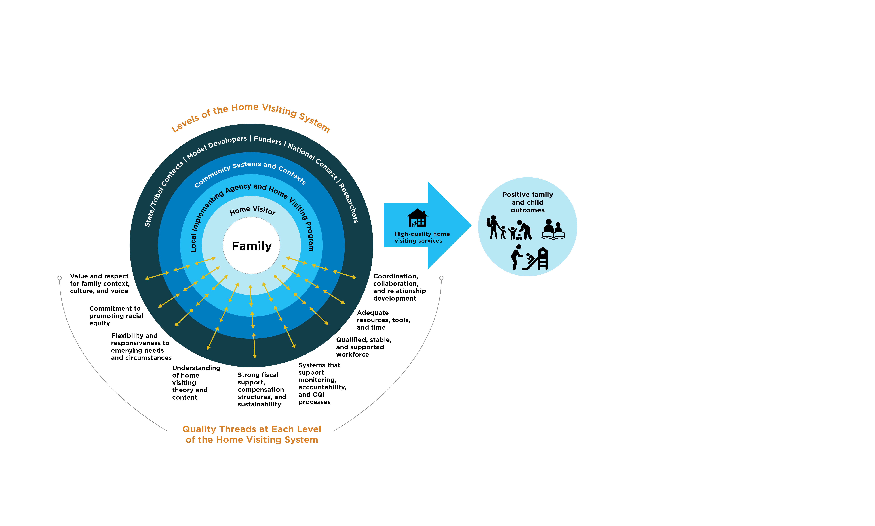
What Home Visitors Can Do
Conceptual Framework for Implementation Quality in Home Visiting
HRSA. A Conceptual Framework for Implementation Quality in Home Visiting, December 2021.

Slide 17
What Home Visitors Can Do
Be an Advocate for Statewide Policy
Help Enroll Potential, Eligible Families
Encourage Families Graduating from Home Visiting to Help Enrollment and Serve as Future Home Visitors
Always Tell Your Story – Data Speaks but Stories Stay
Continue to Evolve and Pivot – e.g., Virtual Meetings During COVID-19.

Slide 18
What Home Visitors Have Done
Identify Inequities then Work on Systemic Barriers (Miami-Dade)
  Gathered data/listened to families on the barriers they are experiencing when accessing community resources.
  Raised awareness about inequities and increased trust with HVs.
  Frustration w/inequities surrounding access to childcare (e.g., difficulty applying for aid).
  “A parent expressed that she was not able to receive services because she was not employed—but the mother was not able to find a job because she didn’t have a safe place to leave her baby.”
HRSA. Health Equity in Home Visiting, The HV CoIIN Health Equity Toolkit.

Slide 19
What Home Visitors Have Done
Identify Inequities then Work on Systemic Barriers (Miami-Dade)
  To combat this barrier, the team strove to simplify the application process by creating video tutorials to post on YouTube, in both English and Spanish, to walk parents through each step of filling out the application.
  Created a checklist of documents that parents needed when applying for childcare programs.
  Actively built partnerships with local day-care providers to create a more accessible and trustworthy path for families in need of childcare.
HRSA. Health Equity in Home Visiting, The HV CoIIN Health Equity Toolkit.

Slide 20
How IECMHC Has Helped Address Adverse SSDOH
Arizona: Helped Reduce Racial and Gender Discipline Disparities between Black and White Pre-Schoolers.
Arkansas: Helped Reduce Expulsion Rates Among Children.
New York: Focus on Improving Racial and Ethnic Justice in ECE Settings.
Shivers E. The role of infant and early childhood mental health consultation in reducing racial and gender relational discipline disparities between Black and White preschoolers. Psych in Schools, 2021, https://doi.org/10.1002/pits.22573
Conners N., Kyzer A., Abney A., Freshwater A., Sutton M., Whitman K. Evaluation of a statewide initiative to reduce expulsion of young children. Inf Men Hea Jour, 2020. https://onlinelibrary.wiley.com/doi/10.1002/imhj.21894
Trivedi P & Horen N. New York State’s agency partnerships to support infant and early childhood mental health consultation scale-up for infants and toddlers. PDG B-5 TA Center, 2021. https://www.acf.hhs.gov/sites/default/files/documents/ecd/New%20York%20State%E2%80%99s%20Agency%20Partnerships%20to%20Support%20Infant%20and%20Early%20Childhood%20Mental%20Health%20Consultation%20Scale-Up%20for%20Infants%20and%20Toddlers.pdf

Slide 21
THANK YOU

