Slide 1



Delaware Family Support Hub
Presenter: Melissa Pitts,
Director of Client Services

Slide 2


Introduction
Delaware Family Support Hub was developed by Tapp Network in partnership with the Delaware Division of Public Health to address challenges faced by Family Support Specialists.
The app streamlines workﬂows, improves communication, and supports the Home Visiting program enabling them to provide high-quality care for families.
I tappnetwork.com

Slide 3



Key Challenges for Family Support Specialists
Resource Preparation
Limited access to centralized resources.
Difﬁculty addressing unplanned issues during visits.
Communication Gaps
Lack of real-time communication with peers for advice or support.
Administrative Burdens
Streamline resources and communications to make your job easier!

Slide 4





Solution — Delaware Family Support Hub
Centralized information for easy access.
Real-time messaging for seamless collaboration.
Resource-sharing capabilities to address immediate family needs.
Streamlined administrative tasks with proﬁle customization and data management tools.

Slide 5

Introducing Delaware Family Support Hub

Slide 6

Features for Family Support Specialists and Supervisors

Slide 7




Resource Library
Access comprehensive resources and guides organized by subjects, topics, languages, and benchmarks.
Easily search for relevant resources during or before visits.
Submit new resources to expand the library.

Slide 8
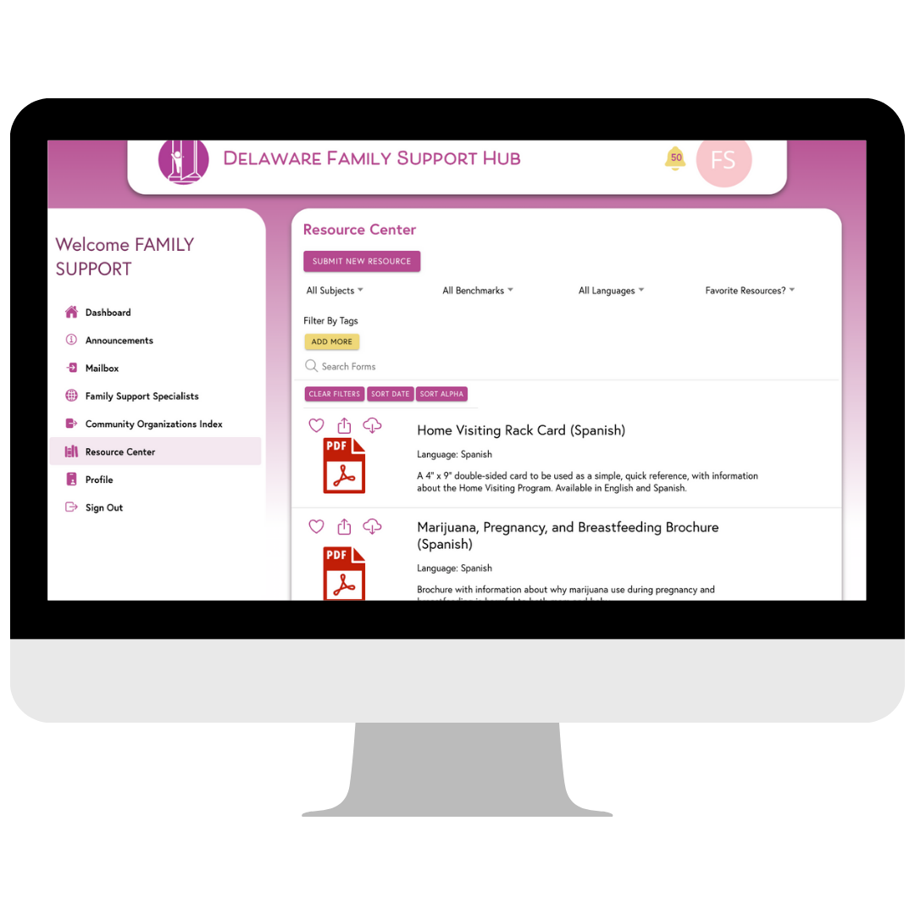
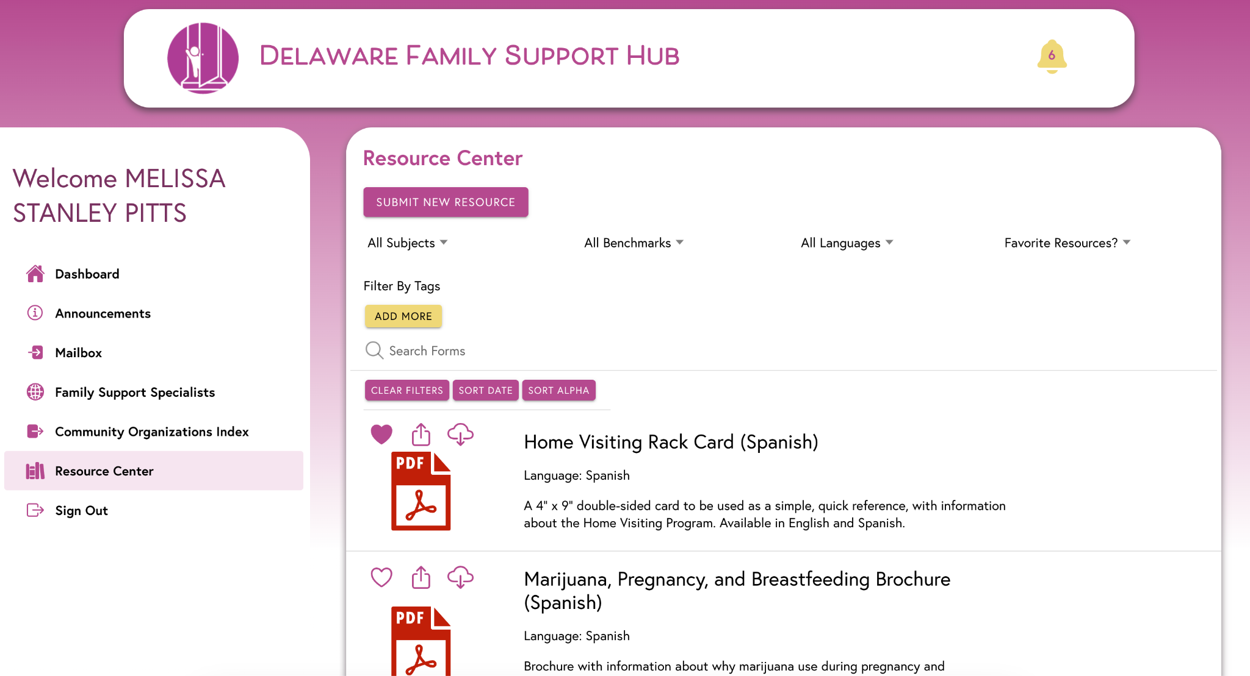

Slide 9



Community Resource Locations
Find nearby services for families.
Connect families to critical community resources quickly and effectively.

Slide 10
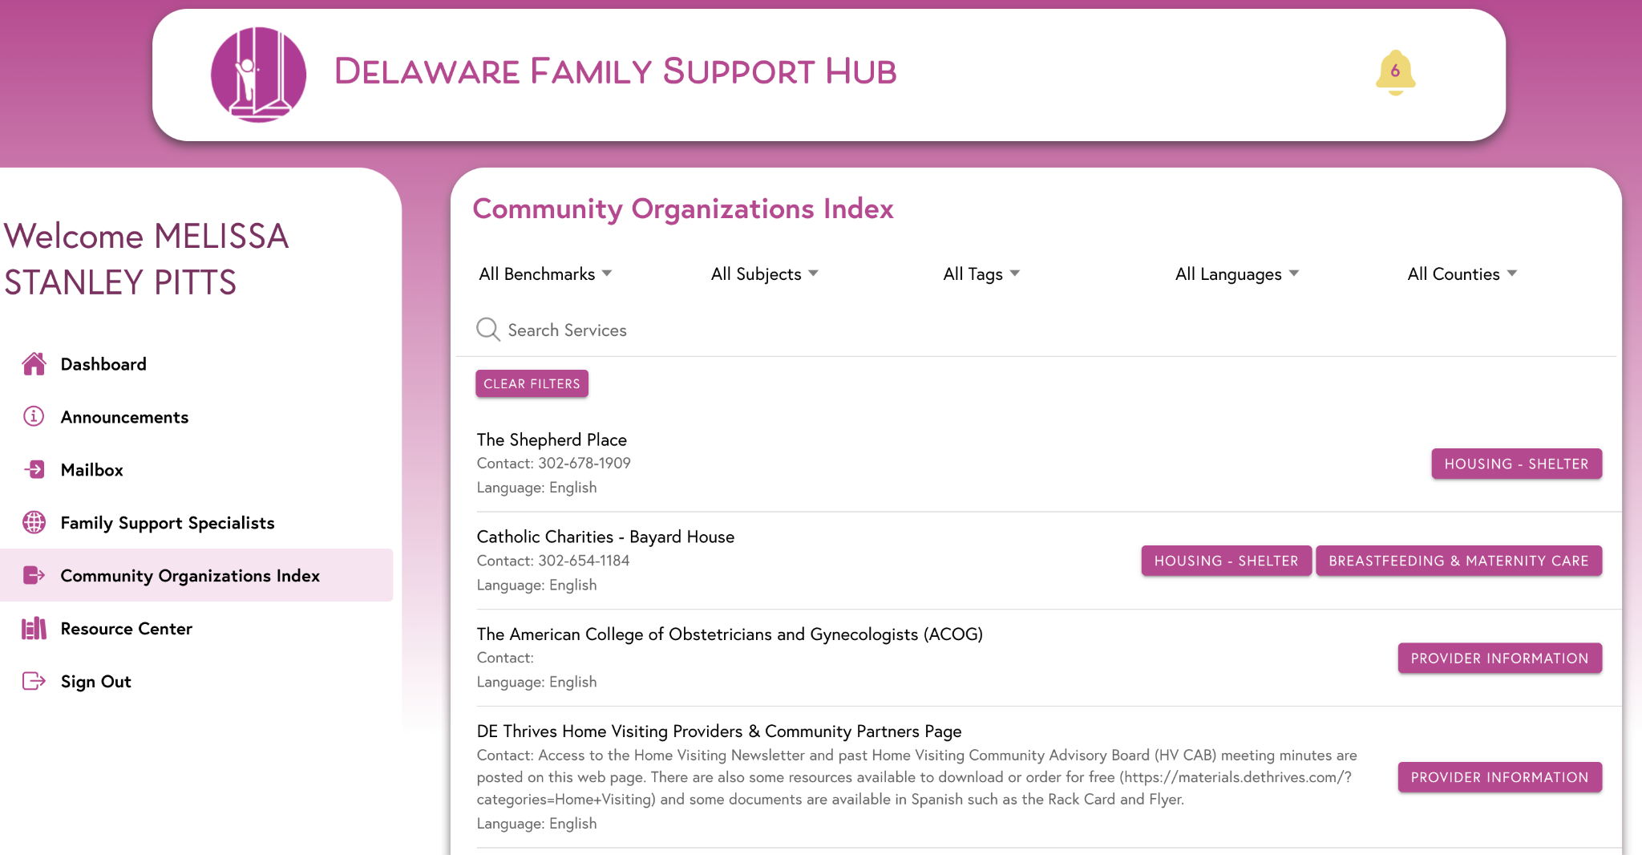

Slide 11
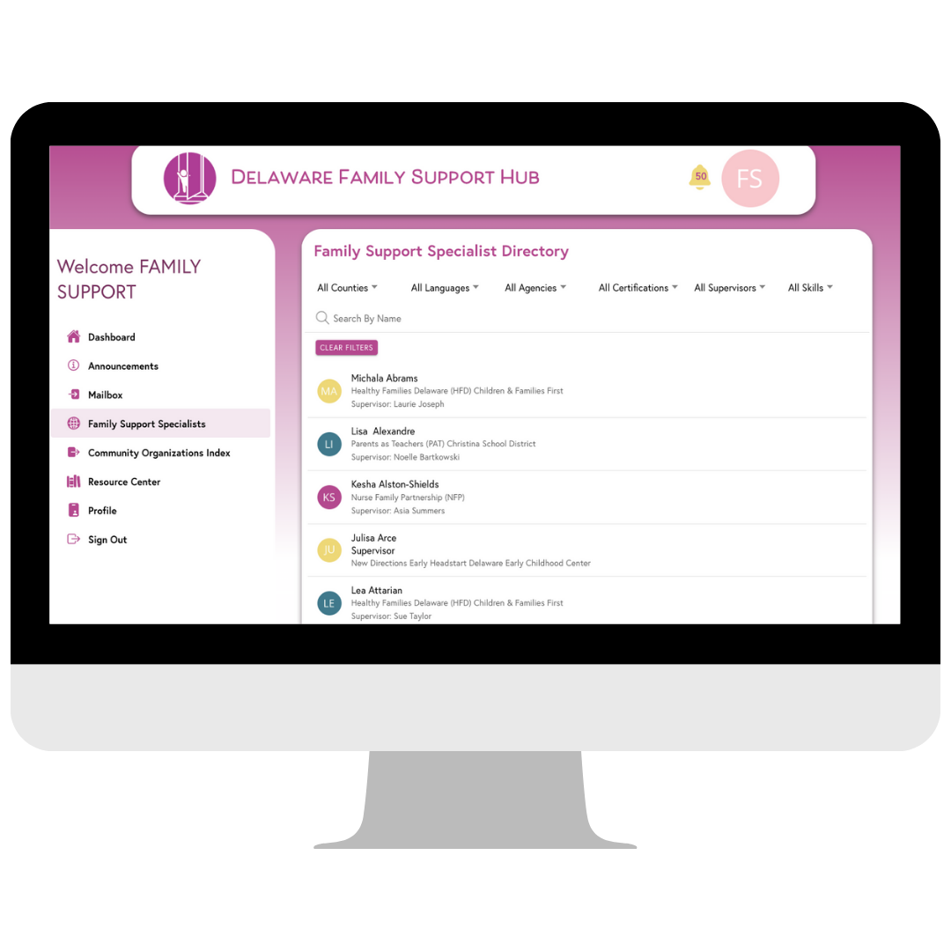
FSS Directory
Edit Proﬁle
Showcase your skills and areas of expertise, making connections more personalized.
Browse a Directory
Connect with other Family Support Specialists statewide in real-time. Share tips and get insights from your peers anytime you need.
I tappnetwork.com

Slide 12
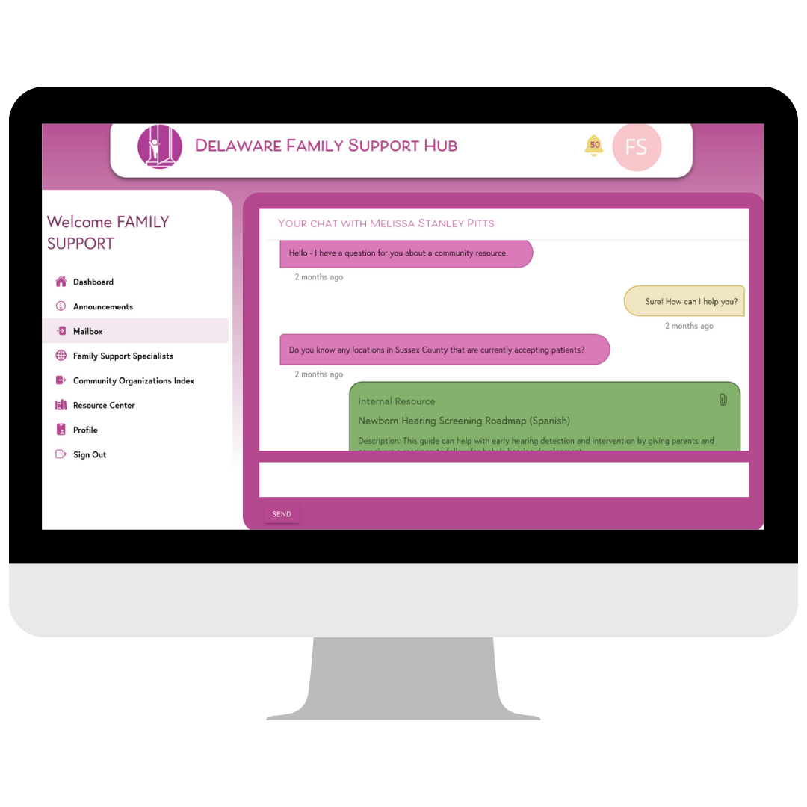
Communications
Messaging
Connect with colleagues instantly.
Share insights, ask questions, and collaborate to solve challenges in real time.
Announcements
Receive important updates and program notiﬁcations directly in the app.

Slide 13
Features for Supervisors
Features for Supervisors
View & edit user account
Communicate efﬁciently with all team members at once.
I tappnetwork.com

Slide 14

Get Started

Slide 15
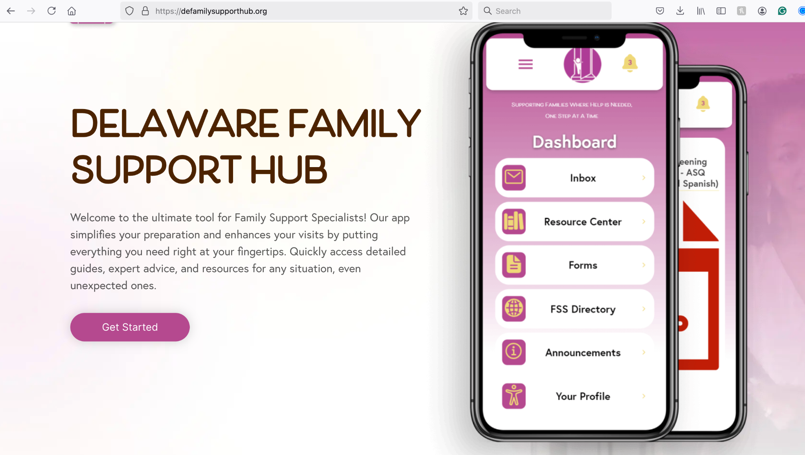

How to Access the App: Web & Mobile Browser Access
Log in at defamilysupporthub.org
Login Credentials
Use your professional email address to log in.
Reset your password via the “Forgot Password” option.
Remember to check SPAM/Junk folders
For new user accounts, contact your supervisor.
Supervisors, contact DPH or use the form on the landing page.
COMING SOON!

Slide 16
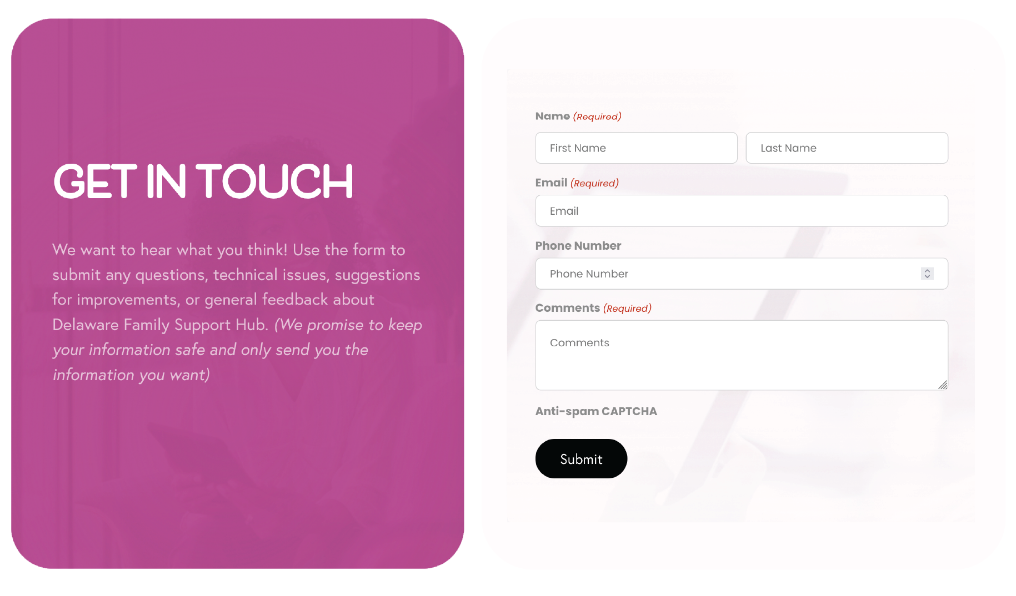
Support Available
Contact Form
Use the form at defamilysupporthub.org
to submit feedback and ask questions directly.
I tappnetwork.com

Slide 17
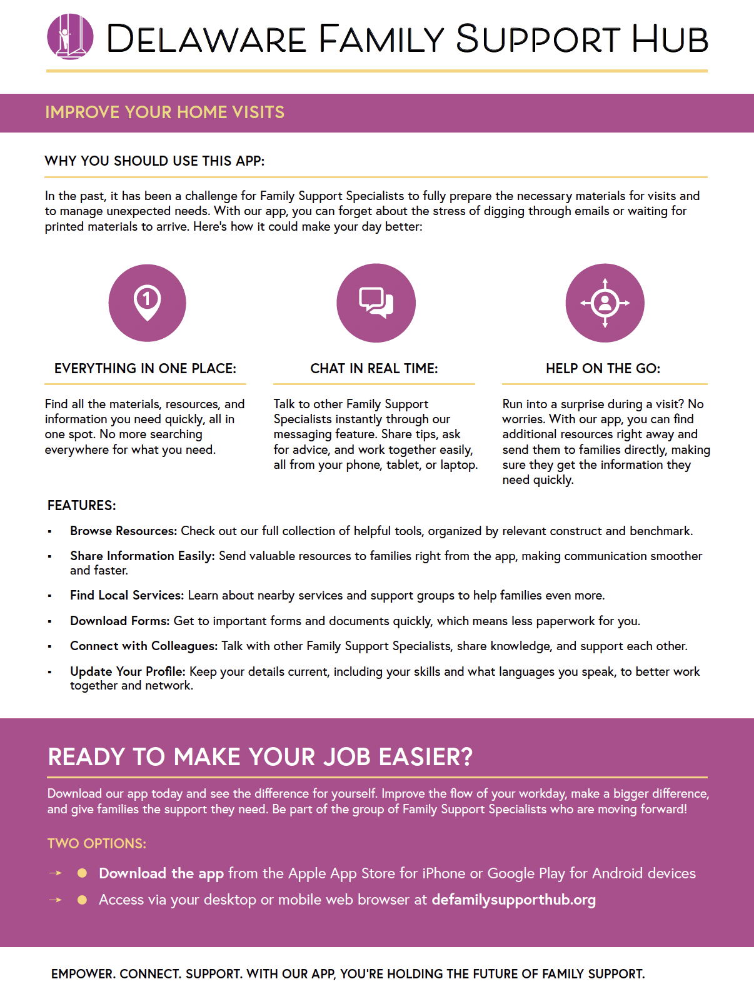

Training Available Support
Training Sessions
Promotional Materials
Live Training Sessions
On-Demand Training
I tappnetwork.com

Slide 18

What's Next?
Streamlined Training & Onboarding: Learning Management System (LMS)
Comprehensive on-demand training for onboarding new Family Support Specialists.
Interactive training modules designed to ensure smooth app adoption.
Improved Engagement
Leaderboards and point systems to encourage consistent app use.
Rewards for engagement and completion of speciﬁc tasks.

Slide 19
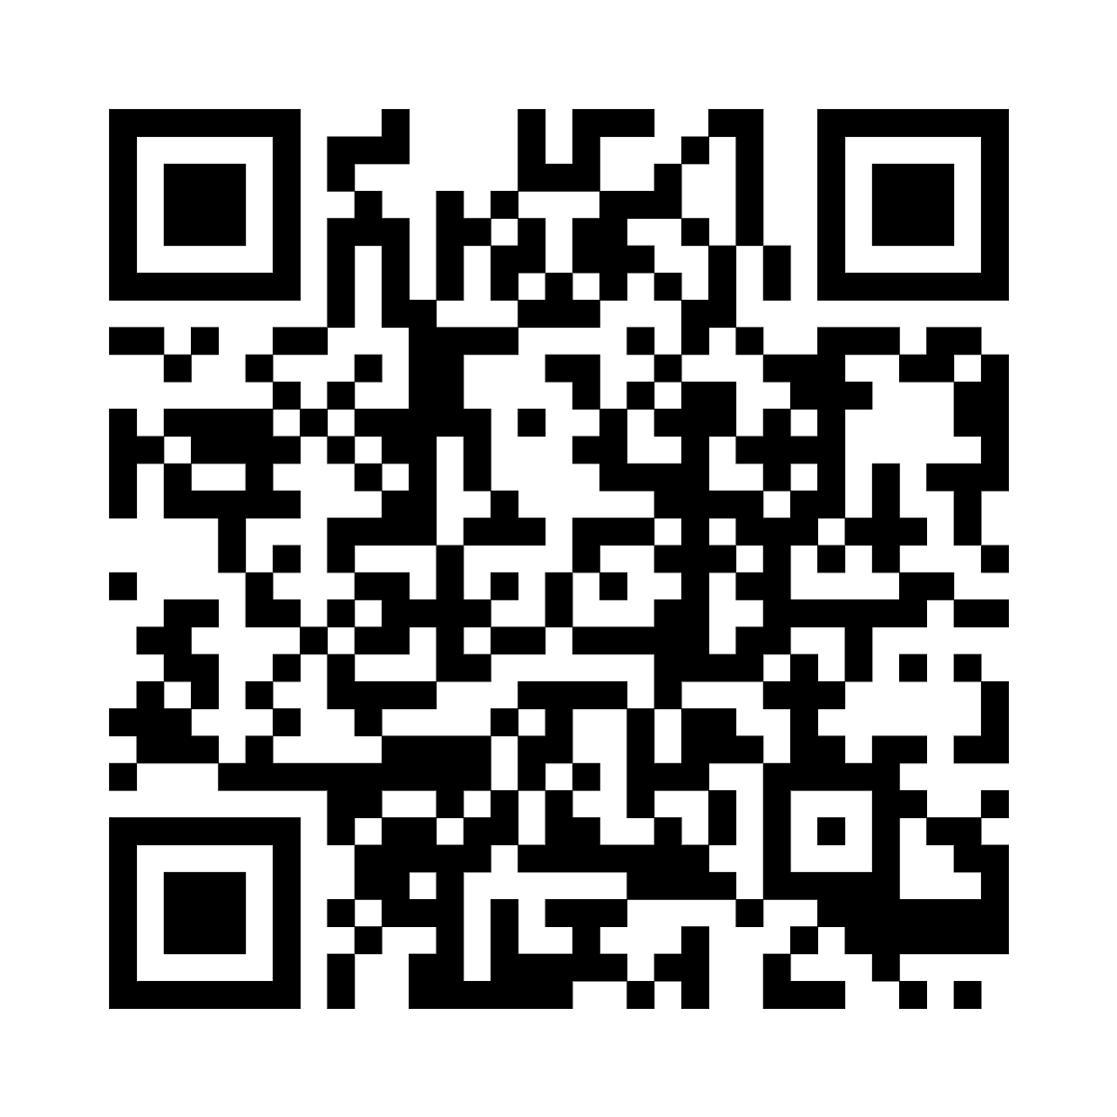
Call to Action
Access the app, submit feedback, and get support.
defamilysupporthub.org
Thank you for your time!
Melissa Pitts
melissa.pitts@tappnetwork.com

