Slide 1
Let’s Thrive: Home Visiting Workforce Symposium
January 24, 2025

Slide 2



OUR TEAM
Linda Delimata,
Illinois
Consultant
June Hall, Michigan
Consultant
Mary Mackrain,
Michigan
Consultant

Slide 3

Who is here today?
If you work in Education, please stand up.
If you work in home visiting, please stand up.
If you work in business, please stand up.
If you work in Public Health, please stand up.
If you are a parent, please stand up.
If you are a health care professional, please stand up.
Who else?
We welcome you all.
Notes:
We are very excited to have everyone here today for this IECMHC in Home Visiting Orientation Series, Welcome!
[if virtual]- ask participants to use their cameras
We will be spending time together over the next few months and we hope to be able to develop connections and build a peer support network of those of you doing IECMHC in HV.
Lets start by getting to know on another, We will go around and share our name, role and 1 fun fact or joyful activity we have engaged in over the last week.

Slide 4
What We Will Address Together
What are Social Determinants of Health (SDOH)?
How does home visiting help to mitigate those factors?
How Can Infant and Early Childhood Mental Health Consultation Support Home Visitors As they Support Families?
What Are We Learning about IECMHC in Delaware and Where Are We Headed Next?
Notes:
Remind people they will get to engage in the afternoon to learn more about IECMHC practices & then Turn over to DE team to transition us to SOH Deep Dive

Slide 5
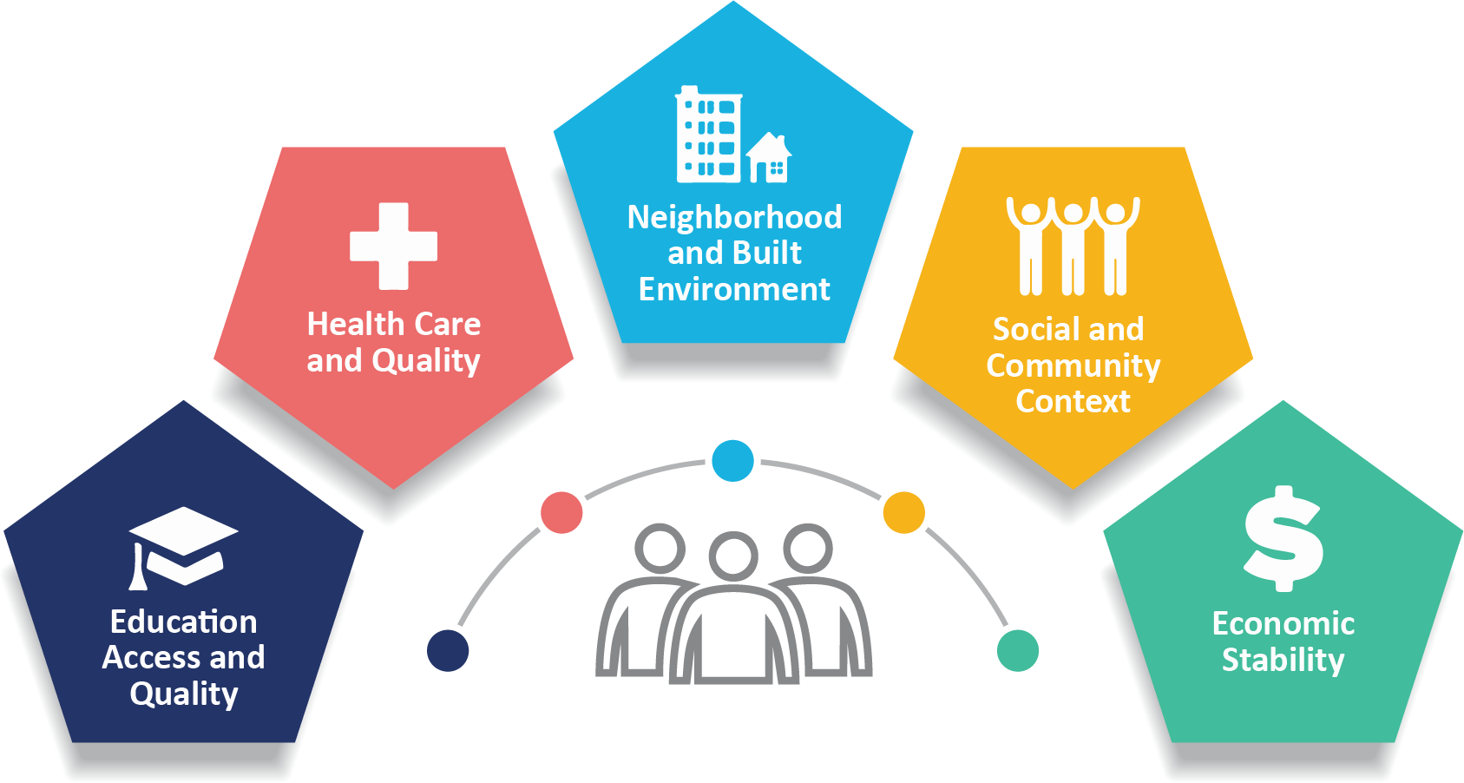
Brief Overview of Social Determinants of Health
Social Determinants of Health are non-medical factors that influence health outcomes.
CDC, 2025

Slide 6
Education
Literacy
Language
Early Childhood Education
Vocational Training
Higher Education

Slide 7
Health Care Quality
Access to health care coverage
Provider availability
Provider bias
Provider cultural and linguistic competency
Quality of care

Slide 8
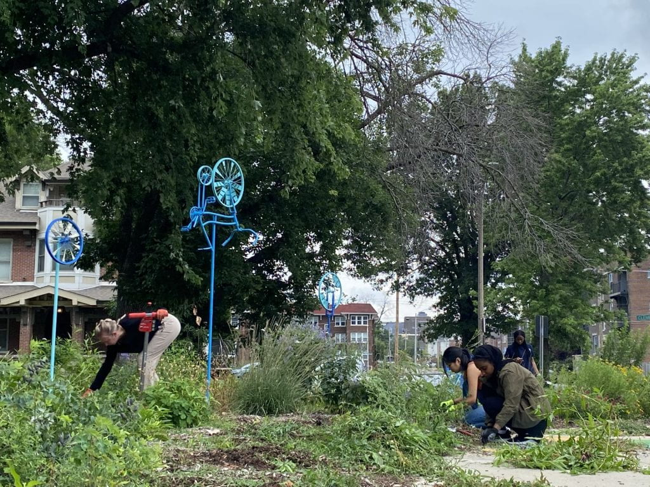
Neighborhood and Built Environment
Housing
Transportation
Safety
Parks
Playgrounds
Walkability

Slide 9

Social and Community Context
Social Integration
Support Systems
Community Engagement
Discrimination

Slide 10
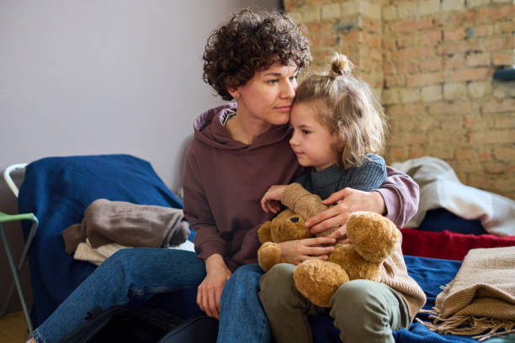
Economic Stability
Employment
Income
Food security
Expenses
Medical bills
Support

Slide 11
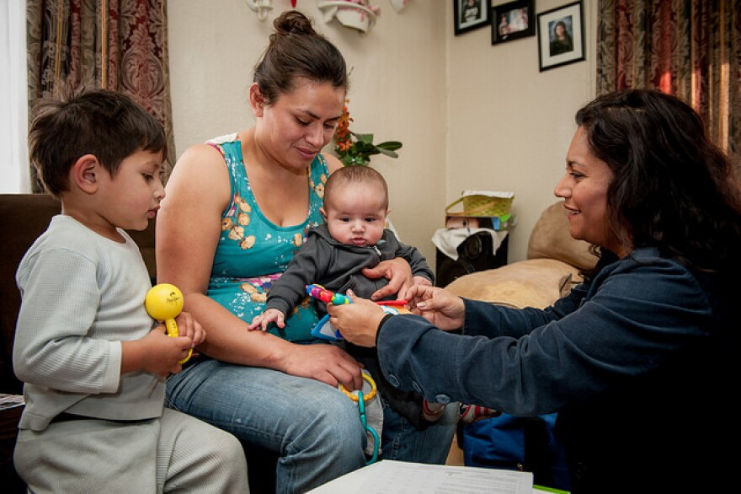
Home Visiting Makes a Difference
Home visits can improve quality of care and health outcomes and provide a unique opportunity to learn more about family’s social context and assess various social determinants of health.

Slide 12
Ways Home Visitors Address SDOH
Routine screenings that help understand a family’s challenges
Linking to services
Parenting education
Addressing barriers to health care
Advocacy and referrals
Early intervention

Slide 13
Brief Overview of Social Determinants of Health
Turn and Share: Which of these areas stand out for you in your work with families and why? How are you making inroads in partnering with families to support stability and access to resources?
CDC, 2025

Slide 14

Home visiting acts as a bridge between families and the community resources they need to address social determinants of health, ultimately promoting better health outcomes for children and their families.

Slide 15
Supporting Home Visitors
This is important work and can be challenging. Home visitors work closely with their supervisor to address issues that arise.
Another support that is recognized widely is Infant and Early Childhood Mental Health Consultation or IECMHC.

Slide 16
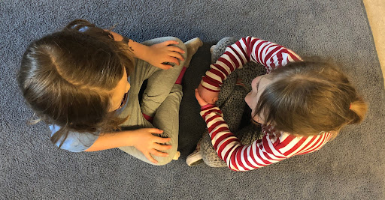
Pair and Share
How does being that “bridge’ for families impact you?
In what ways has it been challenging and how are you or would you like to be supported in your work when these challenges occur?

Slide 17

What is IECMHC?
“A prevention-based service pairing a mental health consultant with families and adults that work with infants and young children in care settings. The aim is to build adult capacity to strengthen and nurture the social and emotional development early”
Adapted from SAMHSA
Notes:
Infant/Early Childhood Mental Health Consultation is a prevention approach, not an intervention. This service pairs someone who is qualified as a mental health consultant with those who work with very young children. It can be in a preschool, a child care, or a home visitor supporting families, etc. Wherever people work to help the social and emotional development of very young children a mental health consultant can help the staff build capacity to develop those essential social and emotional skills.

Slide 18
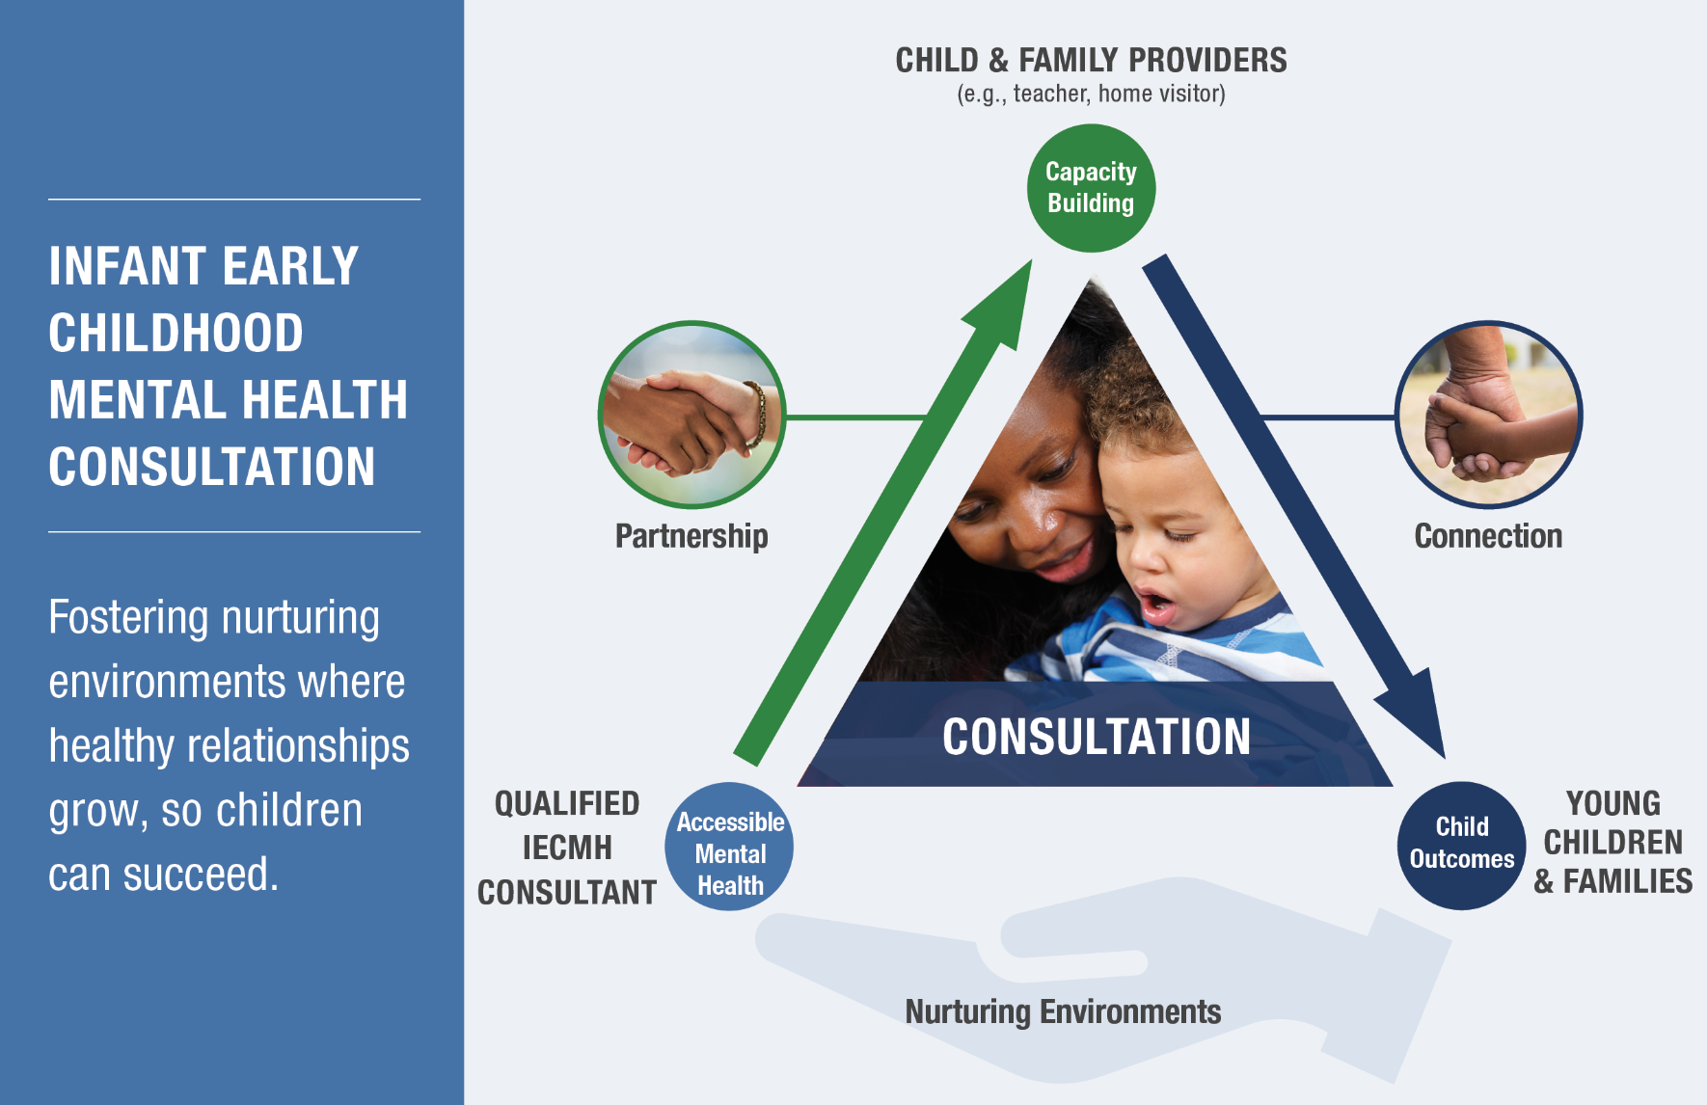
From SAMHSA

Slide 19
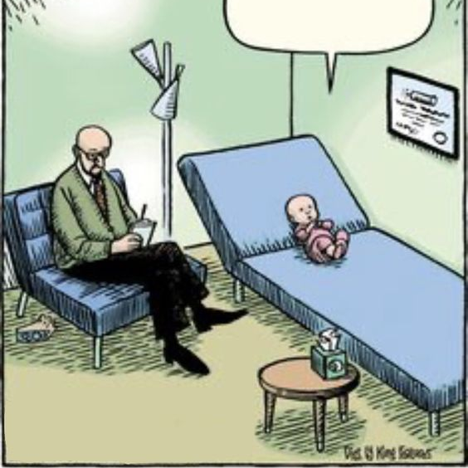
What Infant and early childhood mental health consultation is not.

Slide 20


Why is IECMHC important?
The average turnover rate for Early Head Start teachers and home visitors increased from approximately 19% in 2019 to nearly 29% in 2022. Additionally, the proportion of programs experiencing high turnover rates (over 20%) rose from 38% to 57% during the same period. URBAN INSTITUTE
Intent to Leave: A national survey conducted in 2018 found that 28% of home visitors were very or somewhat likely to seek employment outside of home visiting within the next two years. ADMINISTRATION FOR CHILDREN AND FAMILIES
Stress Factors: Home visitors often face significant stress due to exposure to families' trauma, leading to burnout and secondary traumatic stress. URBAN INSTITUTE

Slide 21
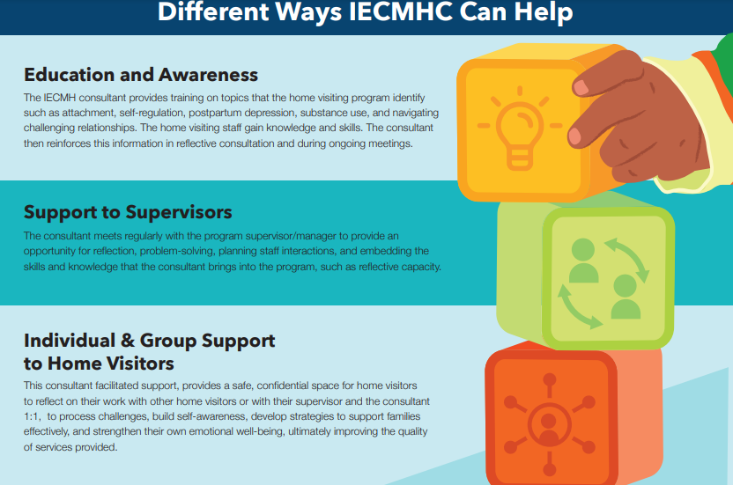
In Home Visiting:
Notes:
Photo: https://online.notredamecollege.edu/wp-content/uploads/2019/07/Perceived-Social-Support-NDC.jpg
Share some examples, letting participants know these come from MI/IL and other best practices across the country.
Service providers in each early childhood system—including home visiting–are in a prime position to recognize the mental health needs of young children and families, strengthen a caregiver’s capacity to address the social emotional needs of the child, reduce mental health stigma, and create linkages to services when needed (Zero to Three Policy Center, 2004). However, early childhood providers do not always feel prepared to address these needs. For this reason, IECMHC is a key strategy for improving the mental health outcomes of young children and their families (Center for Prevention Research and Development, 2011).

Slide 22
Delaware’s IECMHC in Home Visiting Work
Mary Mackrain and June Hall

Slide 23
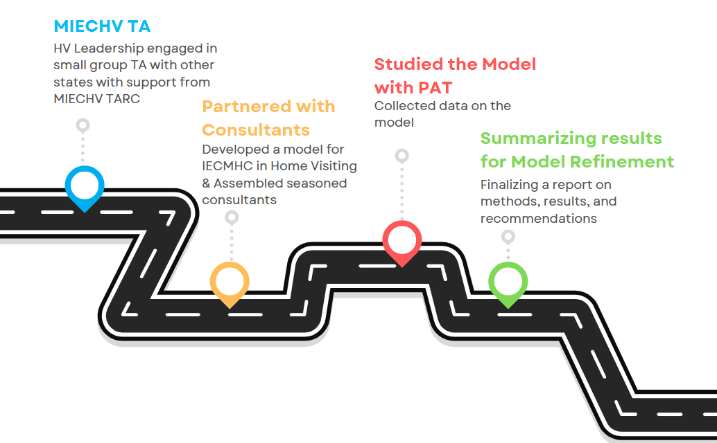

Slide 24

Vision for IECMHC in Delaware
All infants, young children, their families, and those that support them in Delaware have access to high-quality, equitable, and culturally sensitive infant and early childhood mental health consultation, creating environments where child and adult social, emotional, and mental wellness and capacity for mutually beneficial, nurturing relationships thrive.

Slide 25
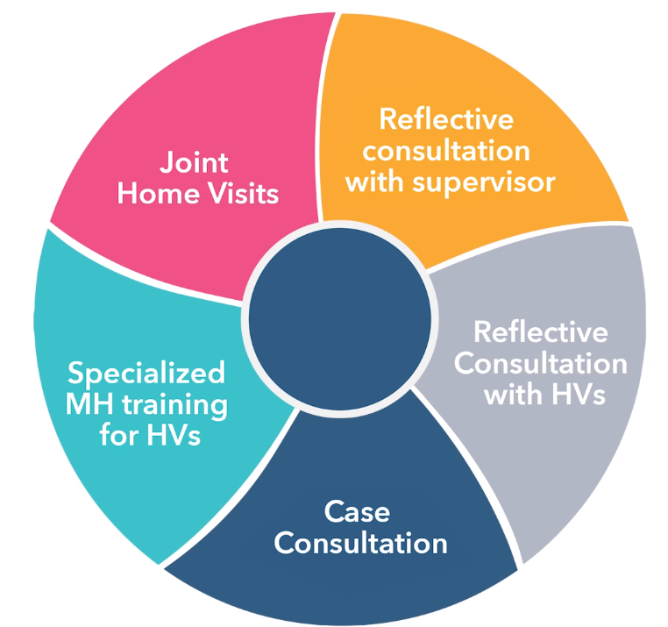
*Were not part of the model study as consultation was virtual
You will see a bit of this reflective work in practice in the afternoon session!
Notes:
In the Delaware Model for providing IECMHC within home visiting, the IECMH consultant may engage in five main activities. Depending on the needs of the provider, the consultant may enter the work in any of the activities as they build rapport and explore the needs of the program.
Lets watch a short video to learn more about these 5 activities.
Link to MI Part 1 video

Slide 26
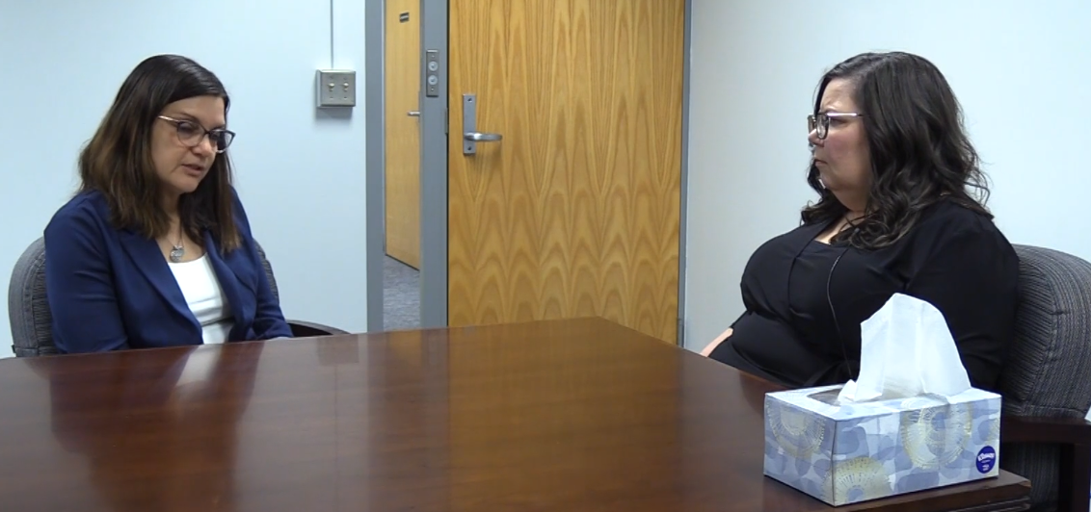
Reflective Consultation with Supervisors
The consultant and the supervisor connect one on one.
The supervisor can reflect and process. Together they can problem-solve and plan around day-to-day and longer-term issues.
Notes:
Supervisors have a big job, and at times it can be overwhelming. It helps to have someone with whom you can share ideas, think through issues or concerns, and reflect on what is happening in your program.
The role of supervisor can be isolating and at times you may feel caught between how to ensure compliance and how to support the home visitors. A consultant may help you reflect on your work and what comes up for you, consider multiple angles of a problem or situation, and think through next steps.

Slide 27
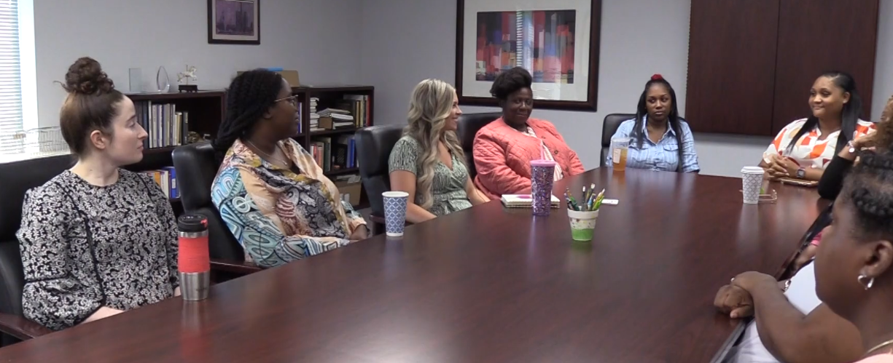
Reflective Consultation with Home Visitors
Together the team of consultant and home visiting staff reflect as a group.
The staff discuss their responses and reactions to situations and problem-solve challenges.
Notes:
Most home visiting models require reflective supervision, and many times there are regularly scheduled team meetings. In the team meetings you are able to think together about situations and/or topics that are of value to all members. This provides a space to talk openly about what has happened, questions about what might come up, or ways to support a family with input from other team members.
If one home visitor is dealing with a family where one person is experiencing depression, another home visitor may have already experienced that situation and can share their approach. The consultant adds a mental health lens to the discussion and helps the reflection to move forward by asking questions or helping the team to strategize.

Slide 28

Case Consultation
The consultant and supervisor connect with the home visitor to discuss how to best support a family.
Notes:
The consultant offers individual reflective consultation to home visitors in order to think through how to best support a family. The program may decide when to include the supervisor in the individual meetings, as it is important to make sure that the supervisor is aware of any issues that will impact the work. By going deeper and thickening the story of this family, the home visitor may discover more about this family, and it will help them as they plan for their work together.
They might:
share resources with each other
develop strategies to support healthy social and emotional development
decide that a referral to another program may be necessary

Slide 29
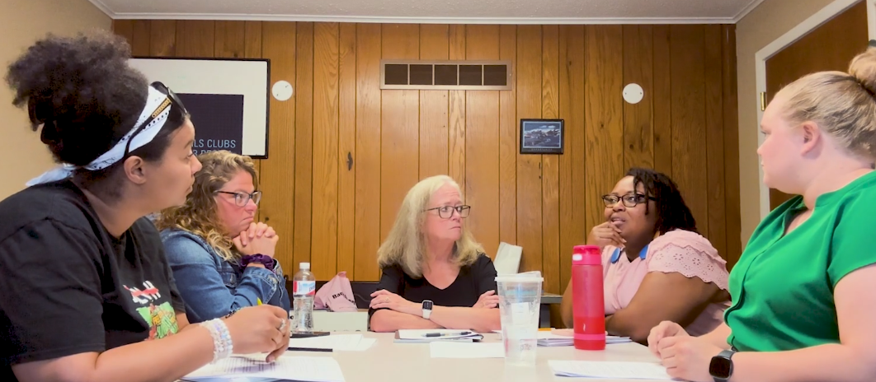
Specialized Mental Health Trainings for Home Visitors
The consultant offers group training on emerging needs. Home visitors and their supervisors list topics to explore, including mental health topics.
developmental delays
necessary screenings
handling stress
how to talk about sensitive issues
maternal depression
Notes:
As home visitors you are working closely with families in order to help the development of social and emotional skills. At times mental health issues may impact the development of the child and influence the ways to approach the families.
The program may want to ask the mental health consultant to provide some training on a topic that might come up as they work with the families.
Some examples might be handling depression, the impact of substance use on children, necessary screenings and follow-up steps, developmental delays and Autism Spectrum Disorder, how to talk about sensitive issues with families, and maternal depression.
These trainings are connected to the work of the home visitors and are collaborative in nature. Consultants can serve as facilitators to make the information come to life by inviting home visitors to reflect on their own cases.

Slide 30

Joint Home Visits
The consultant may join the home visitor during a regular session in the home.
Though most home visitor and consultant work occurs outside a family’s home, there may be exceptions.
Notes:
Most of the time consultants can support home visitors by listening, asking reflective questions, offering some suggestions, and problem solving together.
There may be a time when the home visitor and supervisor determine that including the mental health consultant on a visit would be an important next step. To prepare for that there would need to be some explanation for the family about the role of the consultant. It should be clear that the consultant is not there to counsel the family, but instead as a member of a team that is pulled together to support them. The role is to observe and reflect afterward with the home visitor. It can be explained that the consultant is there to help the home visitor as they may want some feedback on how to best support that family.

Slide 31
Reflection in Home Visiting
Taking the time to wonder what the experience really means.
What does it tell us
  About the family
  About ourselves
Using our thoughts and feelings to identify the intervention/response that best meets the family’s needs for self-sufficiency, growth, and development
Notes:
Reflection – describes the environment of the session – safe holding environment
Allows for exploration – focus is on the supervisee (not the supervisor!)
Sara a home visitor shared that she was frustrated with a family, particularly a mother who was often late to pick up her child and had missed a few recent meeting- she mentioned- I just don’t think she cares or wants our help…
I hear you saying you are feeling frustrated, tell me more about that.. Shared she feels she will fail this family
I wonder what life is like right now for Lisa, you mentioned she was recently divorced and has sole custody of the two children
Yes, it is hard for them t=right now Lisa has to get another job. I wonder how this might be impacting her emotions and daily life…
HV got to the point of meeting at moms work when she had a break and doing more fregenwt check ins

Slide 32
Reflection
Is NOT therapy
Does involve exploring experiences, feelings, and thoughts directly connected with the work
Does involve helping supervisees manage stress
Allows the supervisee to experience the kind of relationship that she is expected to provide to the children and their families
Notes:
Fear that it is therapy – may be therapeutic – like a cup of coffee and a chat with a girl friend – but it is NOT therapy – need to refer out if topics surface repeatedly that need MH support (story divorce situation)
Parallel process – ripple effect – where the how is important

Slide 33
Productive Reflection
Requires a foundation of acceptance and trust
Characterized by safety, calmness, and support
An environment where people do their best thinking (reflecting)
Notes:
This depicts how the reflective supervision environment allows for professional (and personal) growth – which in turn enhances “productivity, efficency -- outcome”

Slide 34
Activity: Being Together
Sit with one other person. One of you is the person who talks, and the other listens. As a listener you can only listen, not respond. Do this for 2 minutes. Then switch, and have the other person talk and one person listen.
Discuss: What is your current job like for you?
Reflect:
What was it like for you to just listen?
What was it like for you to be talking to someone who is listening intently to you?

Slide 35
Getting Started
Training for Supervisors on IECMHC
Assembled Consultants
Oriented the Consultants
Started the work and study of the model
Notes:
A training about IECMHC was designed and shared with supervisors of the PAT programs so they could share the information about IECMHC with the home visitors
IECMHC consultants were chosen to implement the Delaware IECMHC model in PAT programs
A training for the IECMHC consultants was designed and implemented to familiarize them with the DE model

Slide 36

The Aim of the Study
To explore the IECMHC model for home visiting with PAT Programs in Delaware to learn more about what works and what needs to be changed prior to scale.
All components were implemented, including:
Reflective consultation with
  Supervisors
  Home visitors 1:1 and in Groups
  Specialized Training

Slide 37

Thank you to the PAT Programs for being the boots on the ground in the 1st ever Study on IECMHC in Home Visiting in DE to help learn about what works.
Notes:
The results indicate areas where we can enhance our approach to better support staff and families. We also identified strengths that can serve as a foundation for future improvements.

Slide 38


What did the study team Collect from consultants?
 | Why? | What was collected?
Information from Consultants providing the model components | To learn more about if the consultants met model requirements for the model. To learn more about if their qualifications were enough and the right fit to support the needs of home visiting programs. | Information on education, training, race, ethnicity, languages spoken and IECMH competencies.
Information on the consultation provided | So, we could learn more about duration and frequency and what topics consultants need to be prepared to address. | Type of consultation provided by date, by program, number of minutes and major topics addressed via a drop-down menu (no case notes!)

Slide 39



What did the study team Collect from Supervisors and Home Visitors?
 | Why? | What was collected?
Information on Quality of Life | To better understand the well-being of the teams being supported to adjust and respond through consultation and to see if model components were supportive to staff. | De-identifed ProQOL surveys.
Focus Group Feedback on the Model | To hear from all participants more about what worked and what could improve in the model components. | Focus group notes, de-identified and transcribed by the evaluation team.
Training Evaluations | Training is part of most models of IECMHC, we wanted to learn if the training was meaningful and useful to those who participated- your time is valuable! | De-identified satisfaction surveys.

Slide 40

What did the study team collect from the state team?
Focus group feedback using a set of questions similar to supervisor and home visitor questions. Collected themes from notes taken via monthly calls.

Slide 41

Here are Some Early Examples of findings
All teams got all components of the model which helped us to learn more- some received more hours than others. Diversity is the spice of learning.
For some, the reflection with a consultant was seen as valuable when centered on a specific case.
Reflective case consultation on family dynamics was a top topic of focus across programs.
There was a high level of overall satisfaction with Reflective supervision training (89%). Participants highlighted the value of strategies for self-care and mindfulness.
We learned that certain aspects of the program, like up-front communication about IECMHC, scheduling and virtual implementation, could benefit from additional support, resources and refinement. These insights will help us make adjustments to serve everyone better.
We Heard You.

Slide 42

Examples of several recommendations
Engagement
Consider interim time for consultant and supervisor to partner.
Consider engaging in strategies with the HV program to choose consultant for goodness of fit.
Methods
Consider a hybrid approach to consultation.
Deeply consider cultural and linguistic experience of consultant in requirements.
Communication
Consider consistent check ins with program staff and leadership to maintain alignment on goals.
Consider strengthening resources and methods for pre-education of what IECMHC is and the roles of all participating.

Slide 43

Next Steps
Finalize Study Report
Share Results
Make necessary refinements to the Model of IECMHC in Delaware
Sustain current support of PAT programs with consultants as DE moves to engage Delaware based consultants.
Begin plans for expansion in other evidence-based home visiting programs.

Slide 44

Table Time
Each Wall Has a Flip Chart and Markers
Reflect at your table about your Top 2-3 hopes for IECMHC in Delaware
  For Your Role
  For Families
  For your State
When Ready a few representatives from each table can draw or write these hopes on the Flip charts

Slide 45

Reviewing our Hopes

Slide 46
What are Your Wonderings?
We Thank You!

