Slide 1




Empowering Healthy Choices:
The Preconception Peer Educator Program
LaToya Brathwaite-Washington MSN, APRN-FNP
Women, Infant, Family Nurse Consultant
Delaware Healthy Mother Infant Consortium
Div. of Public Health-Family Health Systems

Slide 2

Introduction to the Preconception Peer Educator (PPE) program
Our Delaware Preconception Peer Educator (PPE) program empowers young people to make informed decisions about their reproductive health.
Benefits include increased knowledge, confidence, and advocacy skills as well as overall promotion and improvement of maternal child health.
This program aims to educate teens and young adults on the importance of preconception health education and how to become effective peer educators in this area

Slide 3

Program Objectives
  Raise awareness about the significance of preconception health.
  Empower young adults to make informed health decisions.
  Provide education on family planning and reproductive health.
  Foster peer educators to spread awareness within their communities.

Slide 4
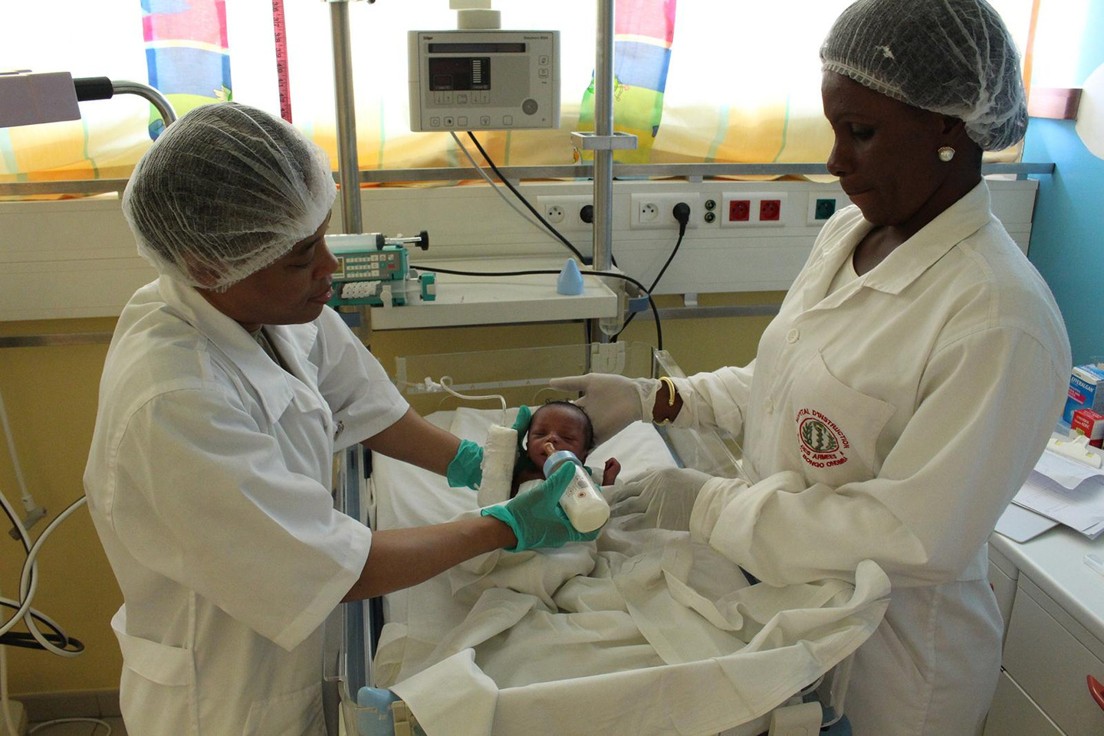
Module 1:
Infant Mortality and Prematurity

Slide 5

Exploring Factors Contributing to Infant Mortality
  Factors influencing infant mortality rates
  Multifactorial: Socioeconomic, healthcare access, and maternal health aspects
Notes:
Infant mortality is a complex issue influenced by multiple factors.
Individual level behavior factors
Individual level psychosocial factors
Neighborhood social characteristics
Environmental exposures
Medical conditions
Infertility treatments
Biologic factors
Genetic factors
Understanding these factors helps us devise strategies to improve infant health outcomes.
Medical/Health reasons are not entirely clear or simple.
Could be due to prenatal Infection (i.e. chorioamnionitis) or a
sub-clinical infection
- Medical indicated birth
Preeclampsia
Poor growth of fetus

Slide 6

Importance of Prenatal Care and Healthy Pregnancies
  Whats the significance of early prenatal care?
  Role of healthy pregnancies in reducing infant mortality
Notes:
Early prenatal care and maintaining a healthy pregnancy are crucial to prevent complications that may contribute to infant mortality.

Slide 7

How are we doing in DE?

Slide 8
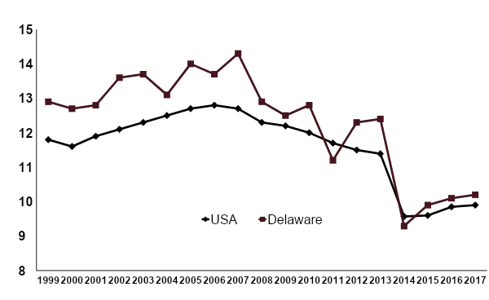
PREMATURE BIRTHS IN DELAWARE
%
CDC
Notes:
DE has been about parallel with the national average. There contiues to be much room for improvement on a state and national level

Slide 9
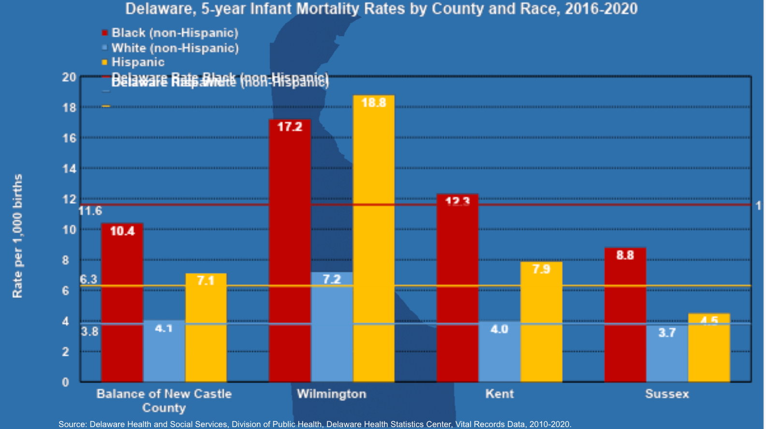
Delaware Infant Mortality
2016-2020
Notes:
Note from data report:
Definition: Infant Mortality Rate (IMR) is infant deaths 0-364 days per 1,000 live births. IMR is further divided into neonatal mortality (i.e., deaths to infants aged 0–27 days); and postneonatal mortality (i.e., 28-364 days).
Causes: Causes of infant mortality are: 1) birth defects; 2) preterm birth and low birth weight; 3) maternal pregnancy complications; 4) sudden infant death syndrome (SIDS); and injuries
Stat: Delaware saw a 34% decline in IMR between 2015 from 9.0 per 1,000 live births to 5.9 per 1,000 live births. However, in 2019 there was a 1-percentage point difference in Delaware’s IMR and U.S. IMR in 2019. Delaware’s IMR fluctuates due to small numbers.

Slide 10

Rate of Preterm Birth USA
2022
  Increased 4% from 2020
  Non-Hispanic White 9.49%
  Non-Hispanic Black 14.74%
  Hispanic 10.23%
Notes:
US rate has INCREASED since this rating

Slide 11

Promoting Awareness and Education
  Raising awareness about infant mortality and prematurity
  Peer educators' role in disseminating accurate information
Notes:
As peer educators, you play a vital role in educating your peers about the importance of prenatal care, healthy pregnancies, and the prevention of premature births.

Slide 12

Group Activity: Designing Outreach Initiatives
  Work together to design potential outreach initiatives for promoting infant health
  Brainstorm creative ways to reach out to the community
Notes:
Divide participants into groups and challenge them to devise initiatives that raise awareness about infant health and the importance of prenatal care.

Slide 13

Empowering Parents and Families
  What are some strategies to empower parents and families for healthier pregnancies
  Provide information on nutrition, prenatal care, and stress management
Notes:
Discuss approaches like offering workshops, resources, and support networks to help parents and families make informed choices for healthier pregnancies.

Slide 14

Q&A and Discussion
  Open floor for questions and discussion on the module content
  Share your insights and experiences
Notes:
Invite participants to ask questions and discuss how they can contribute to promoting infant health and reducing infant mortality.

Slide 15

Module 2:
Maternal Mortality and Morbidity

Slide 16

Understanding Maternal Mortality and Morbidity
  What is maternal mortality and morbidity?
  How are we doing?
Notes:
Maternal mortality refers to the death of a woman during pregnancy, childbirth, or within 42 days postpartum. Morbidity refers to the various health issues and complications women may face during pregnancy and childbirth.

Slide 17
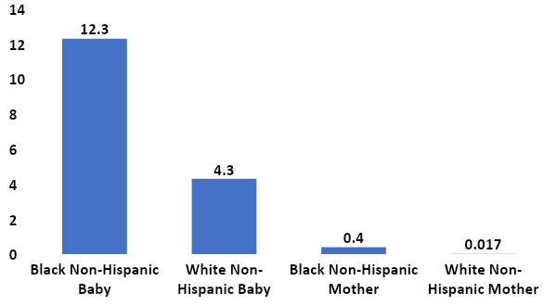
Comparison of Infant and Maternal Morality in Delaware, 2019, when Normalized per 1000 Live Births
Maternal morality rates based on US Data
Deaths/1000 live births
Notes:
Data Conclusions
The maternal mortality rate is measured per 100,000 while the infant mortality rate is measured per 1000.
If you use the US rate, and extrapolate to Delaware, Black mothers would be twice as likely to die compared to white mothers
The overall rate of maternal morality is high in the US compared to other nations, and the disparity ratio is high at 2/1

Slide 18
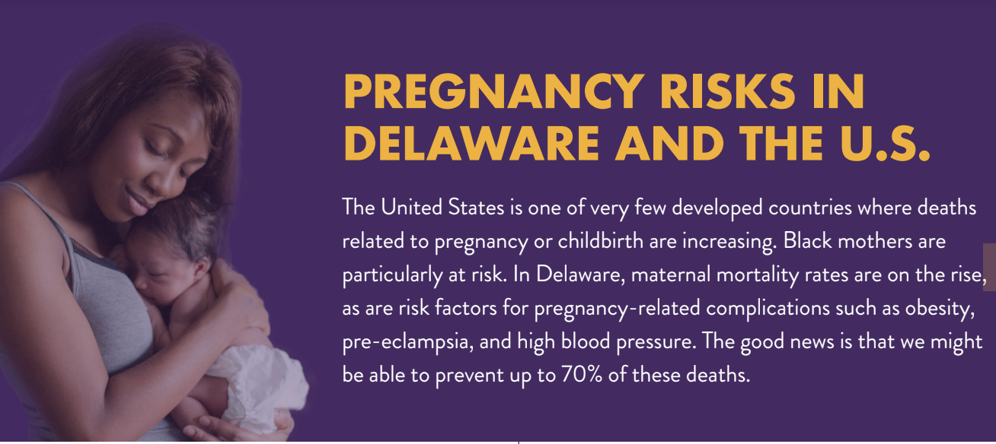

Slide 19
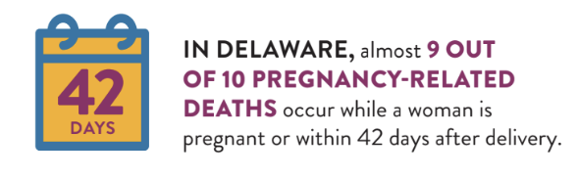
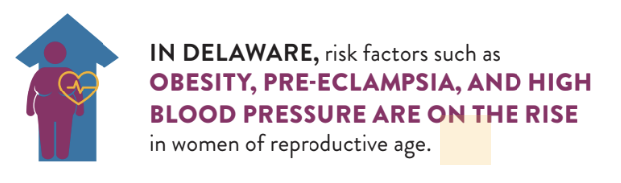

Slide 20
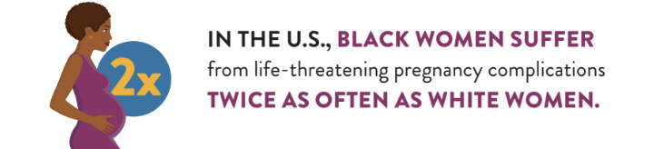
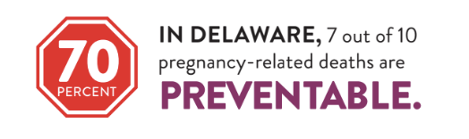

Slide 21
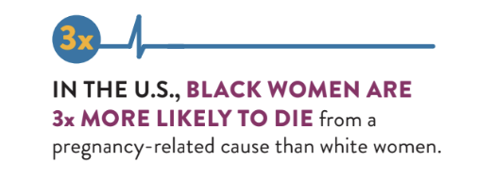
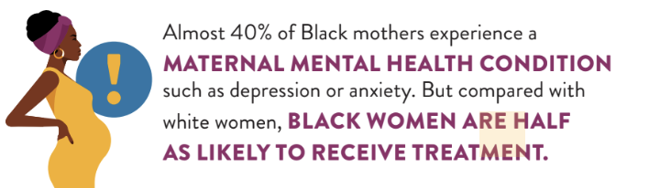

Slide 22
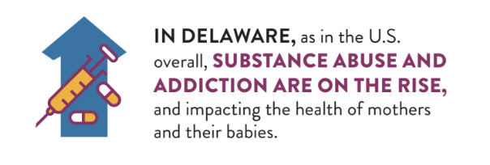
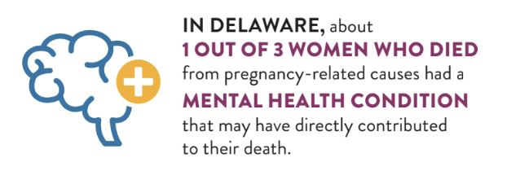

Slide 23
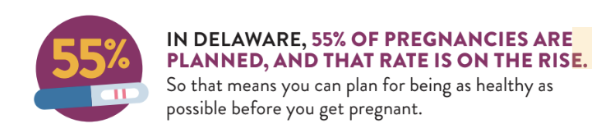
This is great news!
This is why peer education is key!

Slide 24

Recognizing Risk Factors and Disparities
  What are some risk factors contributing to maternal health issues
  Address disparities based on race, ethnicity, and socioeconomic factors
Notes:
Maternal health is influenced by various factors, including access to healthcare, socioeconomic status, age, and medical conditions. It's crucial to recognize and address these disparities to ensure equitable care.

Slide 25

Promoting Awareness and Education
  Important to raise awareness about maternal mortality and morbidity
  Preconception peer education plays a pivotal role in improving maternal health outcomes
Notes:
Raising awareness helps communities understand the importance of maternal health. As peer educators, your role is pivotal in disseminating accurate information and encouraging women to seek timely care.

Slide 26

Promoting Equitable Maternal Health Care
  Strategies to promote equitable maternal healthcare
    Increase access to care
    Address cultural barriers
    Reproductive Health Education
  Empower women to be proactive in seeking care
Notes:
Discuss strategies like increasing access to prenatal care, addressing cultural barriers, and ensuring comprehensive education to empower women and improve their health outcomes.

Slide 27
Q&A and Discussion
  Open floor for questions and discussion on the module content
  Share your insights and experiences
Notes:
- Invite participants to ask questions and share their thoughts on how they can contribute to promoting maternal health awareness and education.
- Recap of key takeaways from Module
- Emphasize the significance of addressing maternal mortality and morbidity
Transition to the next module

Slide 28

Module 3:
Life Planning and Reproductive Health

Slide 29

Why Reproductive Health Education Matters
  Empowers decision-making
  Prevents unintended pregnancies
  Reduces STI transmission
  Nurtures lifelong health
  Promotes self-esteem and gender equality
Notes:
Empowering Peers: Reproductive health education empowers peers to make informed decisions about their bodies and lives. By providing knowledge and resources, we help our peers take control of their reproductive health, leading to better outcomes for themselves and their families.
Reducing Unintended Pregnancies: Access to comprehensive reproductive health education equips individuals with knowledge of contraception methods, reducing unintended pregnancies. This enables women to plan pregnancies according to their circumstances and goals.
Preventing STIs and HIV/AIDS: Reproductive health education is vital in preventing the spread of STIs and HIV/AIDS. By promoting safe sexual practices, like condom use and testing, we empower individuals to protect themselves and their partners.
Improving Maternal and Child Health: Reproductive health education positively impacts maternal and child health. Educating women about prenatal care, safe delivery practices, and child-rearing techniques improves pregnancy health, reduces maternal mortality, and enhances child development.
Promoting self-esteem and Gender Equality: Reproductive health education is linked to promoting gender equality. When women have information about their reproductive health rights, they can advocate for themselves, challenge societal norms, and participate fully in decision-making processes.
(Source: Guttmacher Institute, "Why Invest in Reproductive Health and Rights?")

Slide 30

The Women's Life Plan - Your Tool for Empowering your Peers!
  Comprehensive resource for women's life planning
  Empower informed decision-making on reproductive health
  Appropriate and engaging content for women's health education
  Plan for a thriving future
  An accessible and valuable tool for women's well-being
Lets go through it together!
Notes:
We will go through this together and I'll show you where you can get copies of this life plan for yourself and your peers as well as to share in the community.
*Life plans also available for teens and men on DEThrives.com

Slide 31



MY LIFE MY PLAN:
WOMEN
http://dethrives.com/mlmpw/overview

Slide 32

This book can
help your peers
make a plan
that works!

Slide 33

What do you want out of life?
Your Future
Notes:
3

Slide 34
Choose the words that describe your future.
Exciting
Successful
Volunteer
Easy
Relaxing
My own
apartment
Serious
relationship
Values
Love
Responsible
Calm
Dating
Make my own
decisions
Parenting
Education
Leader
Study
Travel
Satisfying
career
Goals
Healthy
Happy
Enthusiastic
Children
Going places
Service
Notes:
Warm-Up Activity: “Life Words” Handout (available on DEThrives).
Important centering question to get peers thinking about what they want out of their future. Maybe the first time they have really considered it. Orients them to future goal setting

Slide 35
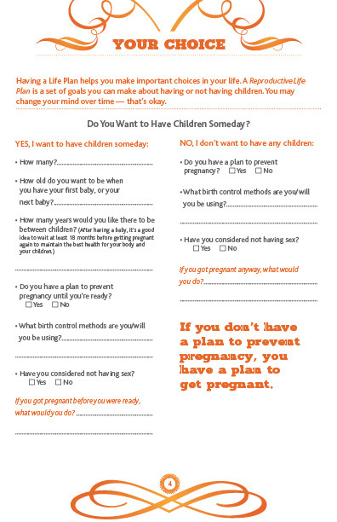
Would you
like to be
pregnant in
the next year?

Slide 36



Slide 37

It’s better when a woman plans her pregnancy. Delaware recently had the highest rate – 60% - of unplanned pregnancies in the nation.
Notes:
Due to implementations such as the DelawareCan campaign and partnerships with Upstream unintended pregnancies in Delaware dropped from 106 per 1,000 in 2014 to 80 per 1,000 in 2017. The simulations are based on contraception use among Title X Family Planning patients aged 20 to 39.

Slide 38
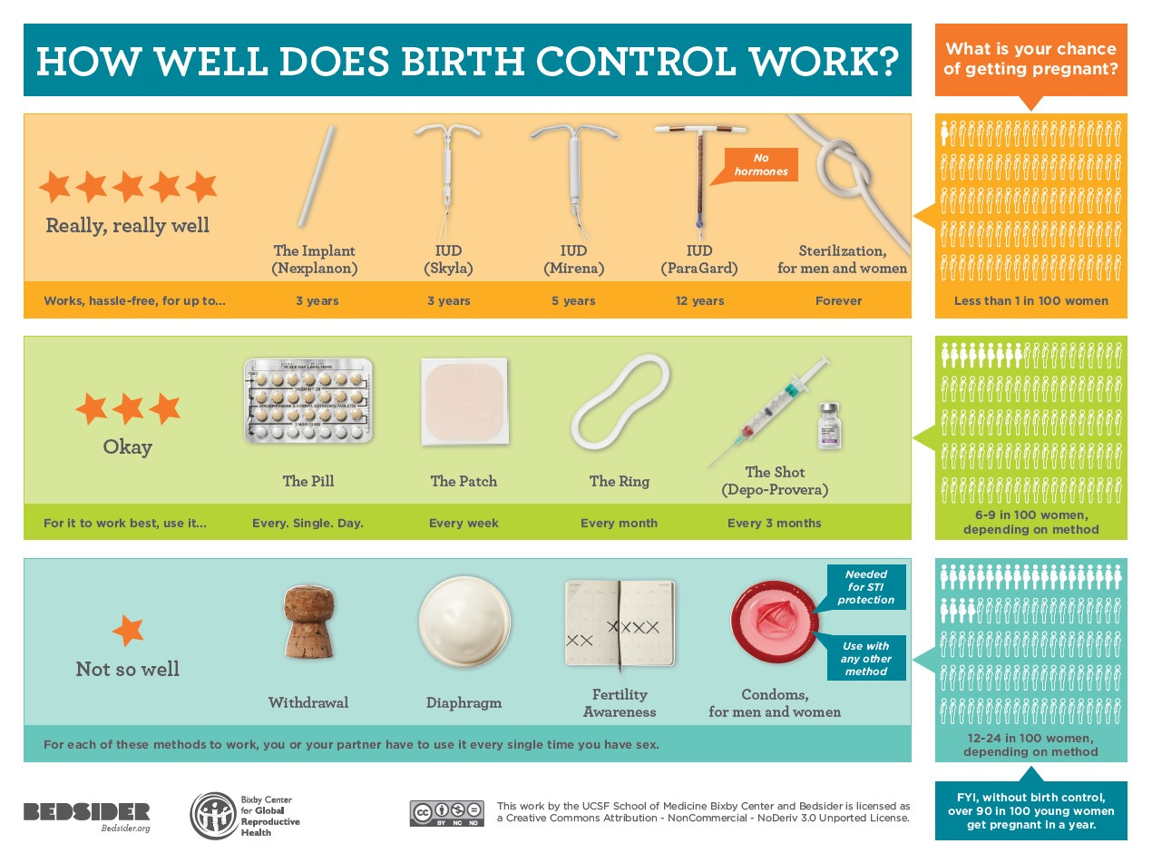

If you are not ready to be pregnant, there are so many effective methods. Talk to a health care professional!
https://bedsider.org/methods
Notes:
For women without a healthcare provider, there are several options for reproductive health questions:
- Planned Parenthood: A non-profit organization providing reproductive health services like contraception, STI testing, pregnancy testing, and general information. They have clinics nationwide, offering services based on income.
- Local Health Department: Many provide reproductive health services such as family planning, STI testing, and prenatal care. Contact your local health department or visit their website for more info.
- Community Health Centers: Federally funded clinics offering comprehensive primary care services, including reproductive health. Services often provided on a sliding scale based on income.
- Online Resources: Trustworthy websites like WebMD, Mayo Clinic, and the American Sexual Health Association provide reliable reproductive health information.
- Hotlines and Helplines: Helplines like Planned Parenthood (1-800-230-PLAN) offer confidential and accurate information about reproductive health.
Remember, personalized advice and care from a healthcare professional is always recommended.

Slide 39

After having a baby, it’s a good idea to wait at least 18 months before getting pregnant again to be in the best health for your body and your children.
Notes:
Birth spacing resources available on DE Thrives

Slide 40

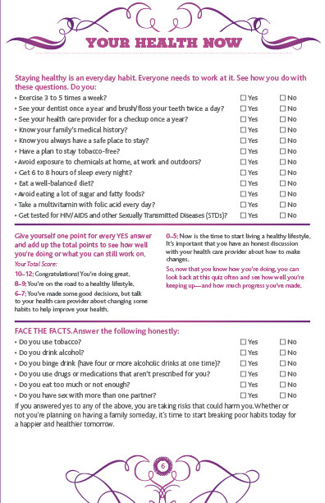
Your Health Now
What are things that you do now to stay healthy?

Slide 41

Regular exercise and a healthy
diet can prevent
many types of diseases.
Taking folic acid promotes
women’s health,
especially heart health.
Notes:
Modifications to improve health are always helpful when implemented at any point, however the more healthy lifestyle habits you can implement now the better outcome for the woman and her future children.

Slide 42

3 days after you miss a period,
your unborn baby
can be affected by your
health habits.
Notes:
A baby born too soon (before 37 weeks) or too small (less than 5 1/2 pounds) faces an increased risk of serious health problems (such as cerebral palsy intellectual disabilities and learning problems) and even death.
Smoking nearly doubles the woman's risk of having a low birth weight baby

Slide 43
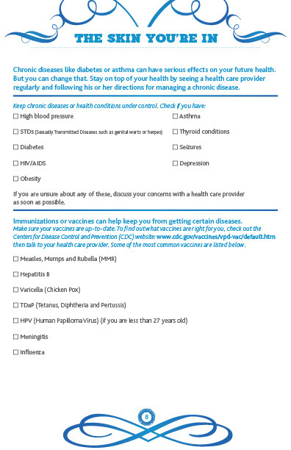

Keep chronic diseases and
health conditions like asthma,
diabetes, STIs &
high blood pressure
under control.
Make sure your vaccines
are up to date.
Notes:
Important to know if you have any chronic health conditions or allergies. Chronic diseases like diabetes or asthma can have serious effects on future health. It is important to stay on top of your health by seeing a healthcare provider regularly and following their directives for managing chronic disease.

Slide 44
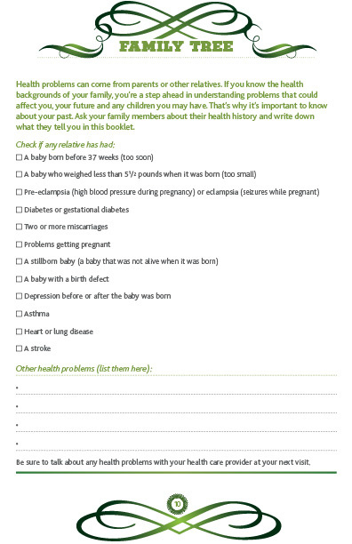

Family Tree
Learn your family’s medical history.
Notes:
Health problems can come from parents or other relatives. Knowing the health backgrounds of family members allows you to be a step ahead in understanding problems that could affect you, your future, and any children you may have. That's why it's important to know about your past. Asking family members about their health history (when possible) and keep track of what you are told

Slide 45

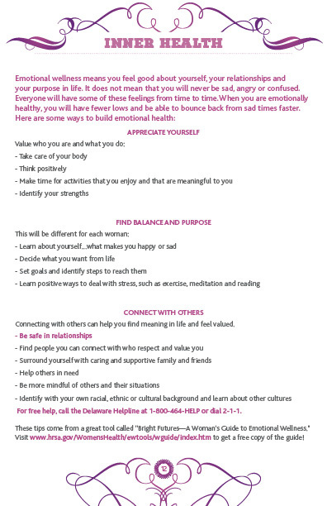
EMOTIONAL WELLNESS
INNER HEALTH
Appreciate yourself.
Find balance & purpose.
Connect with others.

Slide 46

Drinking alcohol and using tobacco or drugs while pregnant harms your baby. If you are pregnant, might be pregnant, or are trying to get pregnant, STOP using alcohol, tobacco and drugs. Even if you are having sex without using birth control, STOP using alcohol, tobacco, and drugs. Or, start having safe sex.

Slide 47
If you are struggling with drugs, alcohol, and, or tobacco and need help, please call the following numbers:
If you are struggling with domestic violence, suicide, or are in crisis and need help, please call the following numbers:
New Castle County
(drugs/alcohol)
1.800.652.2929
Kent and Sussex Counties
(drugs/alcohol)
1.800.345.6785
Delaware Quitline
(smoking)
1.866.409.1858
New Castle County (bilingual)
(domestic violence)
302.762.6110
Kent and Sussex Counties (bilingual)
(domestic violence)
302.422.8058 OR 302.745.9874
Delaware’s Contact Lifeline
(suicide/crisis)
1.800.262.9800

Slide 48
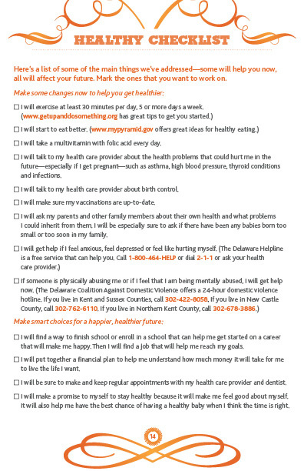
What do YOU
want to work on?
Notes:
After reviewing the life plan help peers identify 2 to 3 goals that they want to work on. Encourage the use of the life plan as an ongoing resource

Slide 49
Embark on your journey to a healthy lifestyle by making personal commitments.
When you find yourself losing focus or feeling uncertain, turn to your life plan to reignite your passion for a joyful and healthful life.

Slide 50
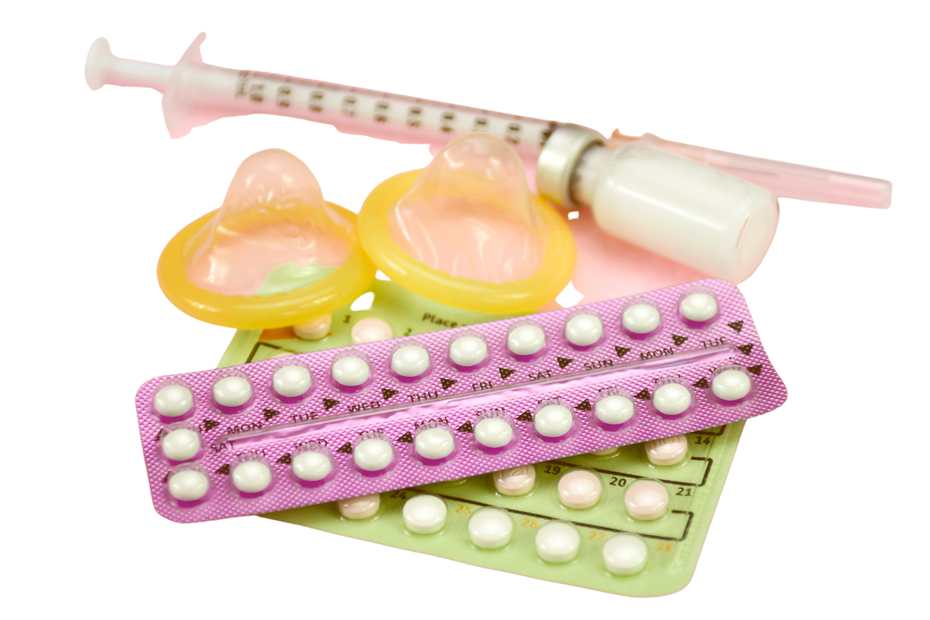
Module 4: Family Planning Pocket Guide
Your Tool for Educating your Peers on Reproductive Choice
"Contraceptive education and access are fundamental human rights, enabling individuals to plan their families, pursue education and careers, and break the cycle of poverty."
Contraception is KEY!
Notes:
This tool was developed by DPH in collaboration with ASTHO originally for Community Health workers and can easily be adapted for PPE use.
This pocket guide is designed to help PPEs provide information about contraception access and reproductive choice in their communities. It provides an overview of the different types of contraception, including short-term and long-term options, as well as side effects and contraindications that women should be aware of before choosing a method.
PPEs can use this pocket guide to counsel peers on family planning and contraception access, helping them make informed decisions about their reproductive health.
Additionally, the pocket guide includes resources for finding local providers of contraceptive services as well as contact information for national organizations that can provide further assistance.
With this pocket guide, PPEs can play an important role in providing comprehensive reproductive health education to thier peers and in the community.

Slide 51

Let's Discuss!
What are common questions or issues your peers have about reproductive health that you often encounter during your interactions?
Notes:
Before we transition to Contraception and discuss the different contraceptive options available, let's discuss...

Slide 52
Pregnancy Intention Screening Questions:
Do you think you might want to have (more) children at some point?
When do you think that might be?
How important is it to you to prevent pregnancy until then?
Notes:
Introduce the PATH framework-
Reference the CHW pocket guide
Have them refer to handouts for the PATH framework which is similar to the One Key Question.
What is PATH: The PATH Framework is a person-centered model designed to help health care providers engage in conversations with people about their sexual and reproductive health. It can be used with clients of any demographic without judgement.
WHY PATH?
In health care visits people are rarely directly asked about their reproductive desires. This may be attributed to time constraints or lack of provider skill. Perhaps it also reflects underlying bias about who should and who should not have children.
If reproductive desires are brought up, it is frequently in the context of “planning,” which is a limited perspective that neither acknowledges or respects the nuanced nature of people’s attitudes and feelings having, or not having, children.
PATH allows the person to interpret the questions and respond to them in a way that is relevant to their own lives. This gives an opportunity for people to consider, often for the first time, their reproductive desires and facilitates an honest dialogue between them and their providers.

Slide 53
Follow up questions:
Do you currently have a method that you are using for pregnancy prevention?
Yes
No
Are you happy with your choice of pregnancy prevention?
Review the different types of contraceptive options and share the Family Planning Contraceptive Options (Family Planning Handbook) brochure
Are you connected with someone who can offer you family planning services?
Yes
Yes, but I’m interested in learning about other options
No
Yes
No
Review the list of family planning providers
Done! You can move on to other topics
Notes:
go through PATH framework flow with nurses and reference this slide

Slide 54

Contraceptive Options
Notes:
Review QUICKLY

Slide 55

What is the Implant???
The implant (brand name Nexplanon) is a tiny rod (same size as a matchstick) that’s inserted under the skin of your upper arm. It’s so small, in fact, most people can’t see it once it’s inserted.
The implant releases progestin, a hormone that keeps your ovaries from releasing eggs and thickens your cervical mucus—which helps block sperm from getting to the egg . It prevents pregnancy for up to 5 years.

Slide 56
Quick Facts on The Implant . . .
The Implant is invisible to the world but not to you. It’s easy, incredibly effective, long lasting, and reversible.
Effectiveness:
The implant is among the most effective methods (99.9% effective).
Side effects:
Irregular bleeding is the most common side effect of the implant.
Effort:
You need to see a provider to get it inserted. It’s a quick insertion and you’re set for 5 years.

Slide 57
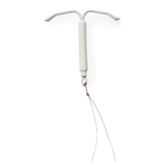
What is an IUD (intrauterine device)???
The IUD is a small, t-shaped piece of plastic or copper that gets put in your uterus to prevent sperm from fertilizing an egg. IUDs offer years of protection—between three and ten years, depending on the type you get.
If you want to get pregnant, you can have the IUD removed at any time. There are five IUDs: Mirena, Paragard, Skyla, LILETTA, and Kyleena.

Slide 58
Quick Facts on the IUD . . .
An IUD is invisible and easy. You can choose hormonal (Mirena, Skyla, LILETTA, and Kyleena) or non-hormonal (Paragard).
Effectiveness:
It’s one of the most effective methods (99.4 - 99.9% effective).
Side effects:
With a hormonal IUD you might have irregular bleeding for several months; lighter or shorter periods or no periods at all; symptoms of PMS (premenstrual syndrome) such as headaches, nausea and breast tenderness
With Paragard you might have increased blood flow, irregular bleeding and cramping.
Effort:
You need to see a provider for insertion. It’s inserted once and lasts for years.
Notes:
The Paragard IUD is the most effective type of emergency contraception. It works up to 5 days after unprotected sex, and it keeps on preventing pregnancy for up to 12 years.

Slide 59
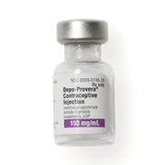
What is the birth control shot???
The birth control shot keeps you from getting pregnant. Once you get it, your birth control is covered for three full months. Some people call the shot “Depo,” short for Depo-Provera.
The shot contains progestin, a hormone that prevents your ovaries from releasing eggs. It also thickens your cervical mucus, which helps block sperm from getting to the egg .

Slide 60
Quick facts on the shot . . .
Long-lasting, private, and good hormonal option for those who can't take estrogen.
Effectiveness:
The shot is super effective—as long as you get each shot on time (99.8% effective).
Side effects:
Most common are irregular bleeding and increased appetite, leading to weight gain.
Effort:
You need to head to the doctor or clinic for each shot (have to get a shot every 3 months).

Slide 61

What is the birth control ring???
The ring (brand names: Annovera and NuvaRing) is a small, bendable ring that you insert into your vagina. You leave it in place for three weeks at a time, then take it out for the fourth week.
The ring works by giving off hormones that prevent your ovaries from releasing eggs. The hormones also thicken your cervical mucus, which helps to block sperm from getting to the egg in the first place.

Slide 62
Quick facts on the ring . . .
Easy to insert, works like the pill. Choose from Annovera or NuvaRing.
Effectiveness:
When used correctly, the ring’s is 99.7% effective.
Side effects:
Most common effects are irregular bleeding, breast tenderness and nausea.
Effort:
Need to visit a health care provider for a prescription. Ring in (3 weeks), 1 week no ring and repeat.

Slide 63

What is the birth control patch?
The patch is a thin, beige piece of plastic that looks like a Band-Aid. All of the patch options are a little less than two inches across, two are square and one is round.
You stick the patch on your skin, and it gives off hormones that prevent your ovaries from releasing eggs. The hormones also thicken your cervical mucus, which helps to block sperm from getting to the egg.

Slide 64
Quick facts on the patch ... .
Easy to use and works like the pill, but you only have to worry about it once a week.
Effectiveness:
When used correctly, the patch is 99.7% effective.
Side effects:
Most common side effects are nausea, irregular bleeding and breast tenderness.
Effort:
You need to get a prescription from your doctor or clinic. Patch change required once a week.

Slide 65
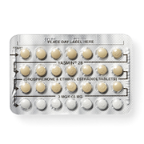
What is the birth control pill?
“The Pill” is a pill. Some people call it “oral contraception.” You take it once a day, at the same time every day.
Most work by releasing hormones that keep your ovaries from releasing eggs. The hormones also thicken your cervical mucus, which helps to block sperm from getting to the egg.

Slide 66
Quick facts on the birth control pill . . .
Been around for 50 years, easy to swallow, can have positive side effects.
Effectiveness:
When taken correctly, the is pill 91% effective.
Side effects:
Most common are sore breasts, nausea, spotting, and decreased sex drive.
Effort:
Need a prescription and must take pill everyday.

Slide 67

What about the new Opill?
Opill is an innovative contraceptive pill that has received FDA approval. It offers an effective and convenient method of birth control, containing progestin-only, making it suitable for adolescents and adults alike.
With its over-the-counter availability, Opill does not require a prescription, providing individuals with greater accessibility and autonomy in managing their reproductive health.
Notes:
Opill is estimated to be available early 2024.
The company has yet to reveal how much it will cost.
Prescription birth control pills on the market range from $10 to $50 without insurance, depending on the type of pill and brand.
Not specifically on the tool however the BC pill teaching points will suffice (keeping in mind this is a progestin-only pill)

Slide 68
Using Opill. . .
  Daily intake
  Same time each day
  Continuous use - no breaks
  Prevents ovulation
  24-hour window if late
  Consult healthcare provider for questions
Notes:
-Daily intake
Explain that Opill should be taken once a day, at the same time each day, for optimal effectiveness.
Stress the importance of consistency to maintain continuous contraceptive coverage.
-Same time each day
Elaborate on the significance of taking Opill at the same time daily to regulate hormone levels and maintain its effectiveness.
Recommend setting a daily reminder to help users establish a consistent routine.
-Continuous use - no breaks
Clarify that Opill should be taken continuously without any break days, even during menstruation.
Emphasize that its continuous usage ensures consistent protection against unintended pregnancies.
-Prevents ovulation
Describe how the progestin in Opill suppresses ovulation, preventing the release of an egg from the ovary.
Explain that without ovulation, fertilization and pregnancy cannot occur.
-24-hour window if late
Inform users that if they miss taking a pill, they have a 24-hour window to take it without compromising its effectiveness.
Caution against taking double doses if a pill is missed or forgotten.
Consult healthcare provider for questions
Stress the importance of seeking guidance from a healthcare provider if users have any concerns or questions about Opill.
Encourage open communication with healthcare professionals to ensure optimal contraceptive use and address individual needs.
*Teens can utilize school health centers and ARC to get access to a provider

Slide 69

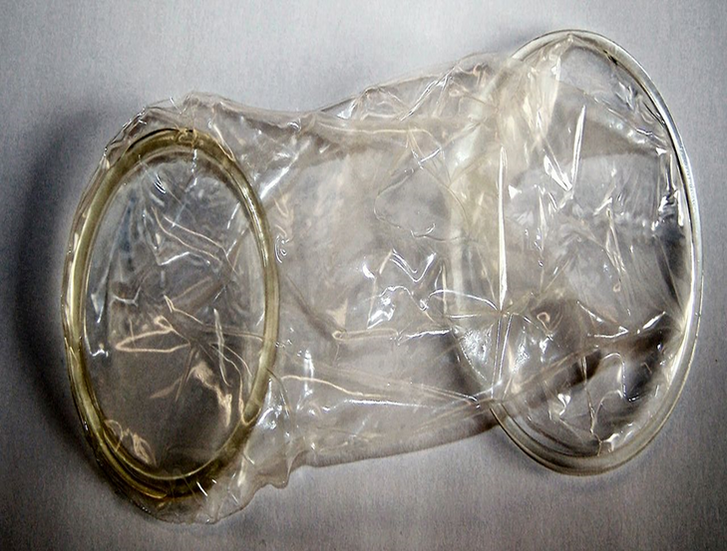
What are Condoms???
Condoms are one of the most popular forms of birth control out there. They slip over the penis to prevent pregnancy and lower the risk of STIs (sexually transmitted infections) by keeping sperm inside the condom and out of the vagina. (There are also internal condoms that go inside the vagina.)
Condoms come in different sizes, colors, with lube and without.

Slide 70
Quick facts on condoms . . .
They protect against STIs, don't require a prescription, and are inexpensive.
Effectiveness:
When used correctly, the condom is 98% effective.
Side effects:
Usually none, unless you have a latex allergy.
Effort:
Easy to get (drug stores, clinics, supermarkets). You have to use one EVERY time!

Slide 71
What is emergency contraception???
Emergency Contraception (EC) can stop a pregnancy before it starts. (That means the EC pills are not the same as the abortion pill.)
There are four types of EC to choose from and they all work up to 5 days (or 120 hours) after unprotected sex. But use it sooner rather than later to reduce the possibility of getting pregnant.

Slide 72
Quick facts on emergency contraception . . .
Emergency contraception provides the possibility of prevention after the fact.
Effectiveness:
Paragard as emergency contraception is 99% effective. Emergency contraception pills when taken correctly can be up to 95% effective (less effective in those weighing more than 185 pounds).
Side effects:
With Paragard you might have increased blood flow and cramping. Emergency contraception pills can cause an upset stomach and cause vomiting.
Effort:
Paragard must be inserted by a provider (it’s inserted once and lasts for years). Ella and Yuzpe require a prescription; Plan B One-Step is available without a prescription; generic levonorgestrel-based pills are available without a prescription. For emergency contraception pills, the number and dose of pills depend on the brand.

Slide 73
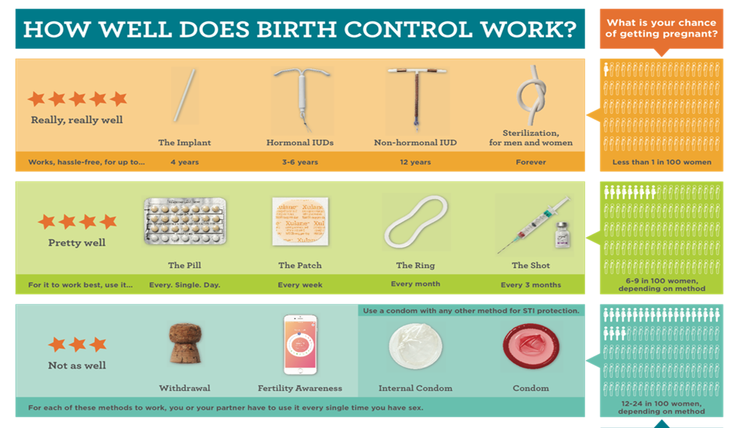
Notes:
Important to review the effectiveness of the different methods for comprehensive education and informed decision making

Slide 74
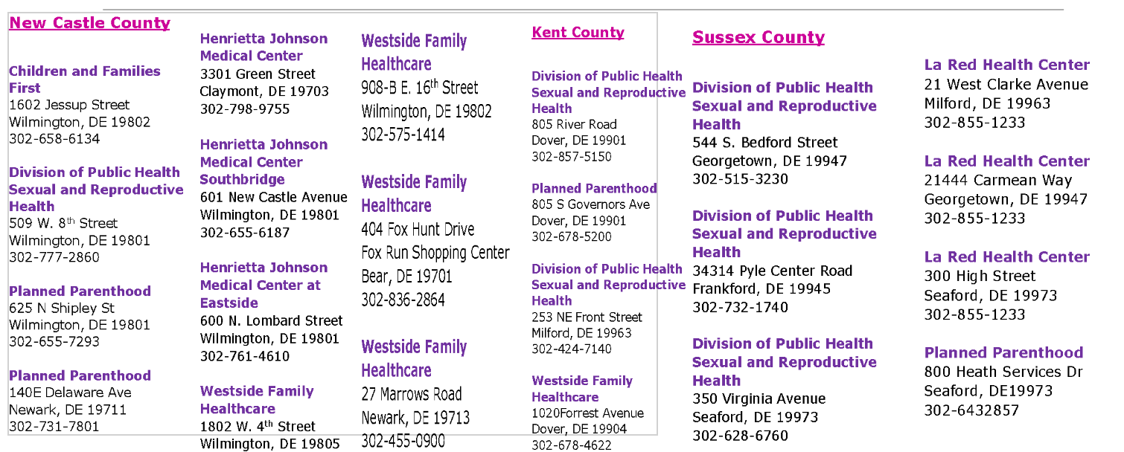
Family Planning Providers

Slide 75
Family Planning Providers
Family Planning sites are for EVERYONE of reproductive age. Provider sites listed in the previous slide provide care for not only the insured but the uninsured and underinsured as well. These sites work with a sliding fee scale to determine if and how much you will pay for services.
Family Planning care includes exams, STI testing and treatment, confidential HIV testing, oral contraception, patch, ring, shot, implant and IUD’s. Hours and services provided at each site vary (not all sites provide all services).

Slide 76
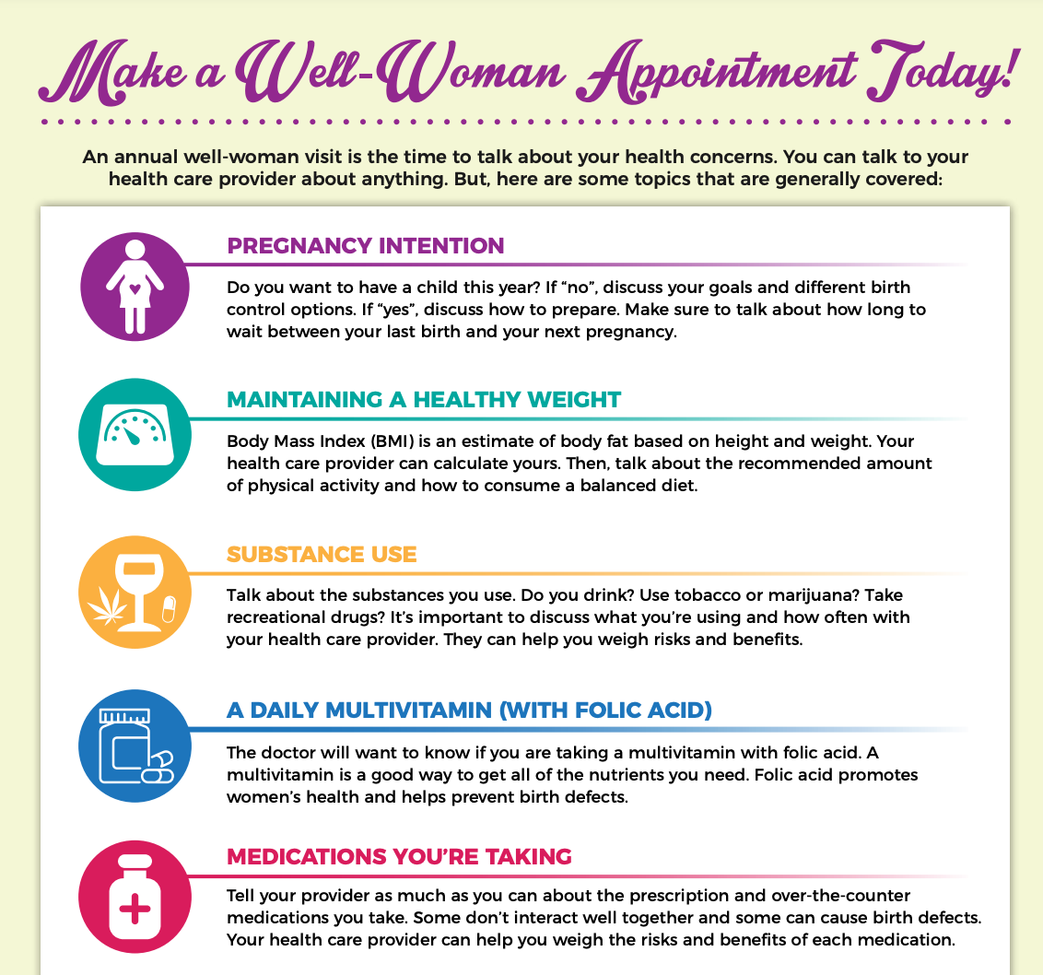
Enhancing Women's Health: Importance of Well-Woman Care
  Promoting Women's Wellness
  Early Detection for Better Outcomes
  Comprehensive Reproductive Health
Notes:
Overview: The Importance of Well-Woman Care and Annual Visits
Well-woman care and annual visits are vital for women's health. They include preventive screenings, reproductive healthcare, overall health assessments, mental health support, and education. These visits help detect health issues early, promote reproductive health, assess overall well-being, and provide guidance on various health topics.
Review: Key Components of Well-Woman Care and Community Resources in Delaware
Well-woman care involves comprehensive health assessments, preventive screenings, reproductive health services, immunizations, counseling, and education. In Delaware, the Healthy Women Healthy Babies (HWHB) program supports maternal and child health through prenatal care, education, and community resources like prenatal vitamins, nurse home visits, parenting classes, and breastfeeding support. Encouraging annual visits ensures access to these valuable resources for women's health.

Slide 77
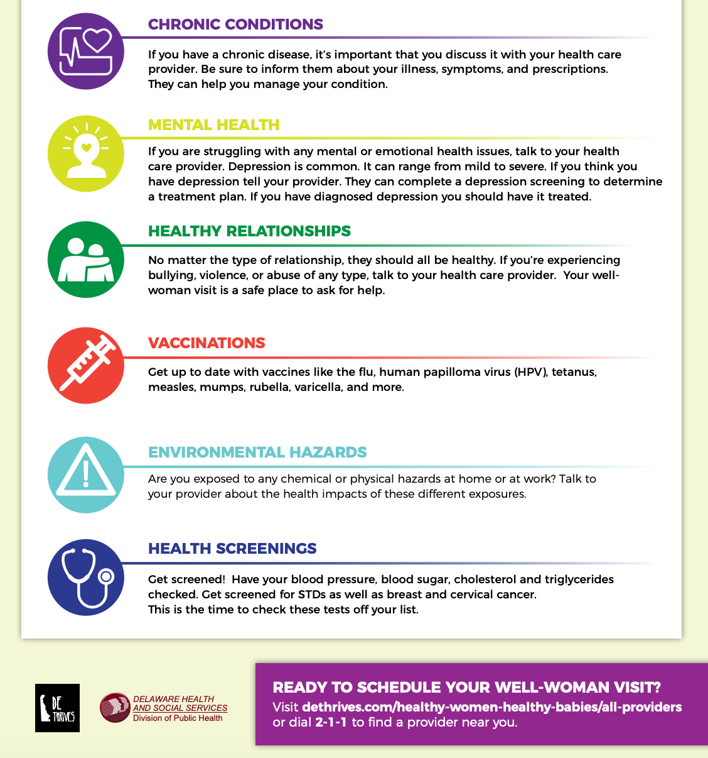
Enhancing Women's Health: Importance of Well-Woman Care
  Holistic Health Assessment
  Empowering Women Through Health Education
Notes:
Available on DE Thrives

Slide 78

Resources
Where can you refer peers for additional support?
DEThrives: Delawares resource to support healthy choices and healthy communites
https://www.dethrives.com
Bedsider: Birth Control & Reproductive Health
https://www.bedsider.org/

Slide 79







Slide 80

Module 5:
Communicating Reproductive Health to Peers

Slide 81

Importance of Effective Communication
  Importance of conveying reproductive health information effectively
  Clear communication for promoting informed decision-making

Slide 82

Active Listening Techniques
  Active listening defined
  Benefits of active listening in peer education
Notes:
Active listening involves fully concentrating, understanding, responding, and remembering what is being said. It encourages open dialogue and helps peers feel valued.

Slide 83



Non-Verbal Communication
  Non-verbal cues that enhance communication
  Importance of body language, facial expressions, and eye contact
Notes:
Non-verbal cues often convey emotions and sincerity. They play a significant role in building trust and connecting with peers.

Slide 84

Building Trust and Rapport
  Importance of trust in effective communication
  Establishing a supportive and comfortable environment
Notes:
Trust is the foundation of meaningful conversations. It's crucial to create a safe space where peers feel free to ask questions and share concerns.

Slide 85
Q&A and Discussion
  Open floor for questions and discussion on the module content
  Share your insights and experiences

Slide 86

Our impact
Our preconception peer educator program equips young adults with the knowledge and skills to make informed decisions about their sexual and reproductive health.
Together we can build a healthier future!

Slide 87

Get involved
Be a part of our Preconception Peer Educator Program to help promote healthy behaviors and positive reproductive health outcomes in your community.

Slide 88
Thank you for considering our Preconception Peer Educator Program!

