Slide 1
Infant and Early Childhood mental health consultation in Home Visiting
Mary Mackrain, PhD, IMH-E (P)
Infant and Early Childhood Mental Health Consultant

Slide 2
My Journey

Slide 3
Checking In
Share one joyful activity you have engaged in over the last week
Notes:
We are very excited to have everyone here today for this IECMHC in Home Visiting Orientation Series, Welcome!
[if virtual]- ask participants to use their cameras
We will be spending time together over the next few months and we hope to be able to develop connections and build a peer support network of those of you doing IECMHC in HV.
Lets start by getting to know on another, We will go around and share our name, role and 1 fun fact or joyful activity we have engaged in over the last week.

Slide 4
Core Objectives
Background
Learn about the development of Delaware’s model for IECMHC.
Early Relationships
Identify the importance of early relationships.
What is IECMH?
The DE IECMHC Model
Exploring the types of IECMHC support that are in Delaware’s model.
Defining Infant and Early Childhood Mental Health and IECMHC.
Notes:
The core objectives of this training are to:
- Review the objectives briefly.

Slide 5
Background and Part 1
Introduction to Infant and Early Childhood Mental Health Consultation in Home Visiting
Notes:
Picture from: https://commons.wikimedia.org/wiki/File:Fatherandchild.png
Welcome to Part 1 where, you will learn about how Delaware’s Model for IECMHC developed and also explore the important context for this important work.
Introduce facilitators.

Slide 6
Developing Delaware’s Model for IECMHC
DE MIECHV Leadership and PAT Explore Model Development within TARC Peer Community
DDE and DDPH Decide to Pursue!
Model Drafted in 2023 with Consultant Support and Resources from IL, MI and the COE for IECMHC and check ins with existing IECMHC in early care and education team
Kicking off our Orientation!
See Appendix A. in your DE Model for IECMHC Guide for more information on consultants and advisors.
Notes:
In 2022, Delaware leaders from the Maternal Infant and Early Childhood Home Visiting (MIECHV) Program and Parents as Teachers (PAT) program model explored the potential of integrating infant and early childhood mental health consultation services as an enhancement to home visiting. Together, MIECHV and PAT leaders, along with other awardees, attended a six-week peer group facilitated by the MIECHV TA Resource Center (TARC). The purpose of this peer group was to explore development and implementation of a model.
Following the conclusion of the peer group, the Delaware Department of Education (DDE), Office of Early Learning (OEL), and the Delaware Department of Public Health (DDPH) embarked on developing a model for IECMHC. By December 2023, a team of national IECMHC consultants developed the Delaware Model for Infant and Early Childhood Mental Health Consultation in partnership with the Delaware Department of Education, Office of Early Learning, the Department of Public Health and in collaboration with the Home Visiting Community Advisory Board (HV CAB). The HV CAB oversees home visiting services coordination within the early childhood system and ensures quality service delivery. The HV CAB also promotes a cross-sector collaboration among relevant state and community-based organizations to reduce duplication and advance common goals.
This model has the potential to support infants, young children, family and provider social emotional health and well-being for years to come. Additionally, we want to thank the Illinois Mental Health Consultation Initiative and the Michigan Department of Health and Human Services, Division of Program and Grant Development and Quality Monitoring within the Bureau of Children’s Coordinated Health Policy and Supports, for sharing their models. These models are based on state and national best practices, evaluation results, and lessons learned and create the foundation for Delaware’s approach to IECMHC in Home Visiting. See Appendix A in your Model Guide for a full list of consultants and advisory members.

Slide 7
home visiting is part of Delaware’s Overall System of Care for families and young children
Home visiting is part of Delaware’s early childhood system of care that addresses all aspects of early childhood health and well-being, improves health equity, and puts family needs and experiences first.
Notes:
Photo: https://www.hebisd.edu/domain/129
Help to stress that home visiting is not a stand alone and integrates into a system of support for families as they learn and grow.
Pregnancy and early childhood are optimal periods for adult learning and intervention to set the foundation for positive health and developmental trajectories for parents and children.
The Maternal, Infant, and Early Childhood Home Visiting (MIECHV) Programs in Delaware support pregnant people and parents with young children in achieving positive maternal and child health outcomes during this period. Home visiting is part of Delaware’s early childhood system of care that addresses all aspects of early childhood health and well-being, improves health equity, and puts family needs and experiences first.

Slide 8
Reflection
How do you see home visiting connecting with other early childhood programs?
How might families be supported by multiple programs?
Notes:
Photo: https://journals.rcni.com/nursing-standard/feature/reflective-practice-your-questions-ns.34.5.40.s16/abs
Engage in a reflection activity. Allow a minute for participants to reflect on the questions and their own thoughts and then ask them to chat at their tables
Use this activity to summarize the work that home visitors do often connects to the larger EC system of care so consultants need to be familiar with the larger system and linkages that may be helpful for families.

Slide 9
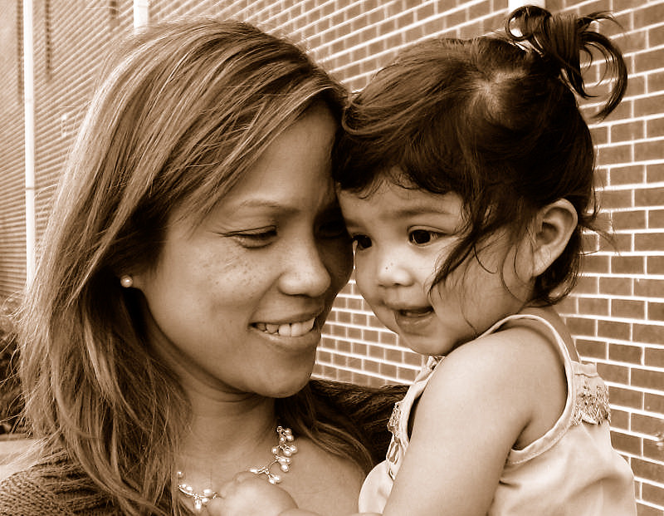
Part 1
The Importance of Early Relationships and Defining Infant and Early Childhood Mental Health
Notes:
Photo: https://www.flickr.com/photos/onilad/1389353469
Transition from Objective 1 to Objective 2- the Importance of relationships

Slide 10
What is one of your early relationship memories?
Notes:
Ask participants to take a minute to think about a simple early childhood attachment memory of their own- they do not need to put too much thought into it, just simple interaction with a familiar caregiver that they remember.
Ask a few people to share
Discuss how these early in the moment day to day interactions stay with us and help to form our own way of being and sense of security that impacts throughout life.

Slide 11
The Power of Human Connections
Even one human relationship can help us weather adversity and protect our youngest from harm
The power of human relationships comes from simple and ordinary interactions
We do not need to be perfect in every human interaction to be helpful
Notes:
Share some of the points on the slide emphasizing the impact relationships have on infant and young child development- healthy relationships can serve as buffers to adversity and stress.

Slide 12
Video
12
Notes:
Watch the video: https://www.youtube.com/watch?v=Uyw9F7FrQkA
Discuss:
For babies and young children, these nurturing back and forth(day to day) relationships with their caregivers build infant and early childhood mental health. Infant and early childhood mental health is deﬁned as the developing capacity of a child from birth to age ﬁve to:
experience, regulate, and express emotions;
form and secure close, interpersonal relationships; and
explore the environment and learn in the context of family, community, and cultural expectations for young children. (Zero to Three).
Children who experience positive and nurturing interactions with parents in infancy and early childhood develop healthy and secure attachments and are significantly better prepared to succeed in school (Connell & Prinz, 2002; Pianta et al., 1997).

Slide 13
Shape the well-being of both the child and the caregiver!
The two-way nature of early relationships affects two-generational health and well-being in the moment and long term.
When we focus on this foundation and support the contexts around these relationships, children and their caregivers thrive—now and into the future.
For infants, 1 million neural connections are formed per minute through serve and return!
Frameworks Institute. Building Relationships: Framing Early Relational Health. Prepared in collaboration with the Center for the Study of Social Policy. 2020
Notes:
Not only are relationships critical to children they also benefit the overall happiness and well being of caregivers impacting the whole family.
13

Slide 14
What if relationships are Missed?
14
Notes:
Watch video: https://www.youtube.com/watch?v=7Pcr1Rmr1rM
Discuss the impact of what can happen if relationships are missed or not developing in a healthy way…
The absence of nurturing care can lead to long-term physical and emotional health challenges such as anxiety and depression throughout life.
For families with young children, access to intervention in the current mental health environment can be challenging due to the multitude of barriers that exist between them and necessary services and supports. These barriers include mental health stigma; a lack of awareness and understanding of infant and early childhood mental health; lack of an adequately trained workforce with specialization in early childhood mental health; complicated or unnecessary paperwork and other administrative issues that decrease the “family friendliness” of the mental health system; and funding policies that do not recognize the mental health needs of young children. One strategy to address these barriers is infant and early childhood mental health consultation (IECMHC).

Slide 15
Reflection
What gets in the way of your ability to support early relationships and Infant and Early Childhood Mental Health of children and families?
Notes:
Photo: https://journals.rcni.com/nursing-standard/feature/reflective-practice-your-questions-ns.34.5.40.s16/abs
Engage in a reflection activity. Allow a minute for participants to reflect on the question and then do a group share on their feedback bringing back to the key message that home visitors face challenges when supporting families mental health needs and relationships and IECMHC can help to offset those challenges.

Slide 16
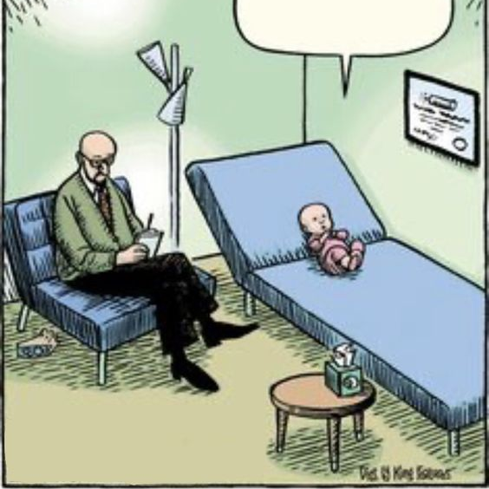
Part 2: What is Infant and Early Childhood Mental Health Consultation?
Defining

Slide 17
Activity
What comes to mind when you hear the Term Infant and Early Childhood Mental Health Consultation?
Notes:
Take time to let participants reflect. Introduce the activity letting participants know there are no wrong answers, and we are just dipping into wondering about the work of IECMHC together.

Slide 18
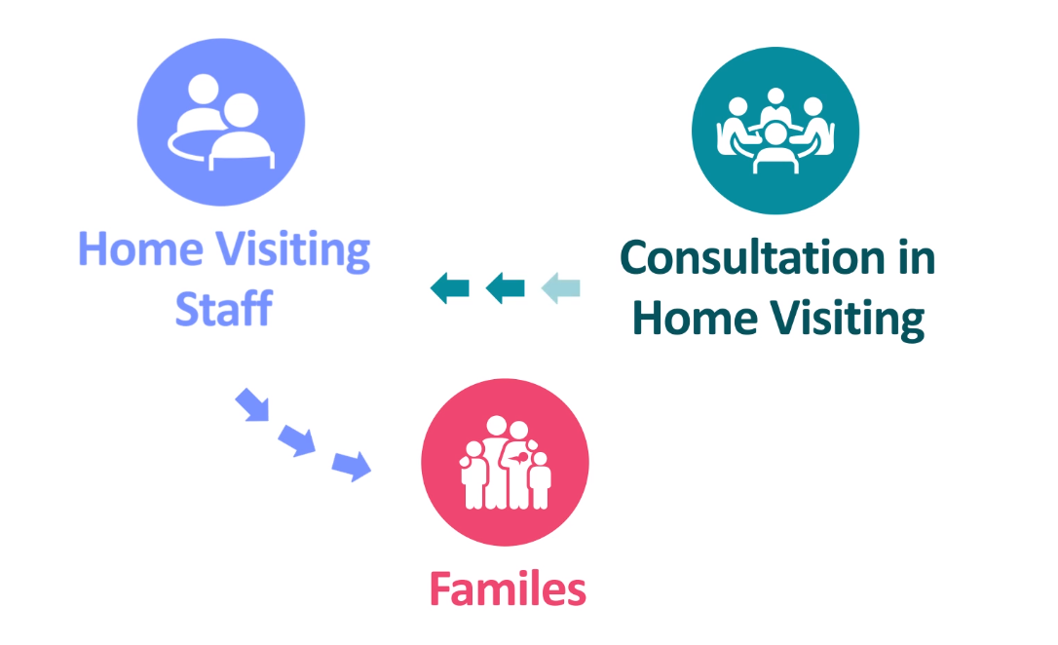
What is IECMHC in Home Visiting?
IECMHC in home visiting is deﬁned as a prevention-based process to enhance the capacity of those that provide direct care to children and their families through training, reﬂective supervision, reﬂective group learning, case consultation or, at times, joint visits with the home visitor.
Notes:
Share the definition and pause for any questions or reactions .

Slide 19
Examples of how consultants can help home visiting programs include:
Strengthening policies and procedures for supporting and linking families to services for mental health.
Building home visitor capacity to recognize, interpret, and support the mental health needs of children and families.
Assisting home visitors to support families in creating emotionally safe home environments that support children’s learning and growth.
Providing an ongoing and regular opportunity for supervisor and home visitor reflection to sort out and cope with strong feelings brought on by complex work with families
Notes:
Photo: https://online.notredamecollege.edu/wp-content/uploads/2019/07/Perceived-Social-Support-NDC.jpg
Share some examples, letting participants know these come from MI/IL and other best practices across the country.
Service providers in each early childhood system—including home visiting–are in a prime position to recognize the mental health needs of young children and families, strengthen a caregiver’s capacity to address the social emotional needs of the child, reduce mental health stigma, and create linkages to services when needed (Zero to Three Policy Center, 2004). However, early childhood providers do not always feel prepared to address these needs. For this reason, IECMHC is a key strategy for improving the mental health outcomes of young children and their families (Center for Prevention Research and Development, 2011).

Slide 20
What Do You Need to Feel Valued and Supported so That you Can Support Families?
Write one thing on a post it note and put it on the flip chart closest to you
Notes:
Have each person reflect on their own and write what comes to mind on a large sticky note- then everyone can post on flip charts posted around the room- ask volunteers to share

Slide 21
Vision for IECMHC in Delaware
All infants, young children, their families, and those that support them [within home visiting] in Delaware have access to high-quality, equitable, and culturally sensitive infant and early childhood mental health consultation, creating environments where child and adult social, emotional, and mental wellness and capacity for mutually beneficial, nurturing relationships thrive.

Slide 22
Mindfulness Moment
Triangle Breathing
https://www.youtube.com/watch?v=RpI9bm3lTQw
Notes:
Let’s pause for a final moment of stillness before we continue with our day.
Thank you all for joining!

Slide 23
The Complexities of Home Visiting
The Primary Goal of Home Visiting: Home visitors support the ability of caregiver(s) to create a nurturing, caring and responsive environment so the caregiver(s) can support the development of their child.
The Role of a Home Visitor: Home visitors assess and address issues that impact the parent-child relationship, including issues involving mental health and stressful life experiences.
Notes:
One of the primary goals for home visiting is to support the ability of adults to create a nurturing, caring, and responsive environment that supports the cognitive, physical, social, and emotional development of children, leading to positive health, including mental health.
As a result, the home visitor must assess and address any issues that impact the parent-child relationship. The home visitor is not always trained in mental health issues, and yet they face them routinely.

Slide 24
Large Group Discussion
Envision yourself in the role of a home visitor who is feeling overwhelmed and unsure how to support a father of two children under the age of three. The mother of the children recently died from an overdose, the father has a history of mental illness, and the children are showing signs of developmental delays from their most recent screening.
How would you want an Infant and Early Childhood Mental Health Consultant to support you with this family?
Notes:
As a large group, please listen to the following story and respond to the question.
Envision yourself in the role of a home visitor who is feeling overwhelmed and unsure how to support a father of two children under the age of three. The mother of the children recently died from an overdose, the father has a history of mental illness, and the children are showing signs of developmental delays from their most recent screening.
How would you want an Infant and Early Childhood Mental Health Consultant to support you with this family?

Slide 25
The Importance of Reflective Consultation to Home Visitors
Support from an Infant and Early Childhood Mental Health Consultant Is Essential to Home Visiting
Reflective consultation provides an opportunity for home visitors to:
Think deeply about each family system.
Pause for self-awareness to acknowledge the impact of their work.
Explore mental health concerns of families.
Notes:
IECMH consultants offer reflective consultation to home visitors as they explore mental health concerns with families and search for greater understanding of the child, the parent/family, and oneself. Reflection offers the home visitor valuable space to process the work and their own experiences as they address sensitive issues and think through options and subsequent next steps.
Additionally, reflective consultation:
Allows the home visitor to consider their reactions and emotions that have surfaced during their interactions and experiences with the family. What is coming up for them?
Helps home visitors to become more self-aware, and able to process how they can best support this family without allowing their issues to interfere, thus being more objective.
Allows the home visitor to slow down, better understand the story of the family, and think through options and actions with an IECMH consultant.

Slide 26
Qualifications, Skills and Attributes
Let’s create an IECMH Consultant for home visiting.
What Qualification, Skills and Attributes are critical to do this work?
Use materials on the table to “build” your Consultant as a table team
Notes:
Qualifications show that a professional has the knowledge necessary to understand the intention of the IECMHC role.
Lets create what we would want for an IECMHC serving HV programs in DE.
Participants will use materials on tables to create their IECH consultant! Mary can bring construction paper, scissors, glue etc.

Slide 27
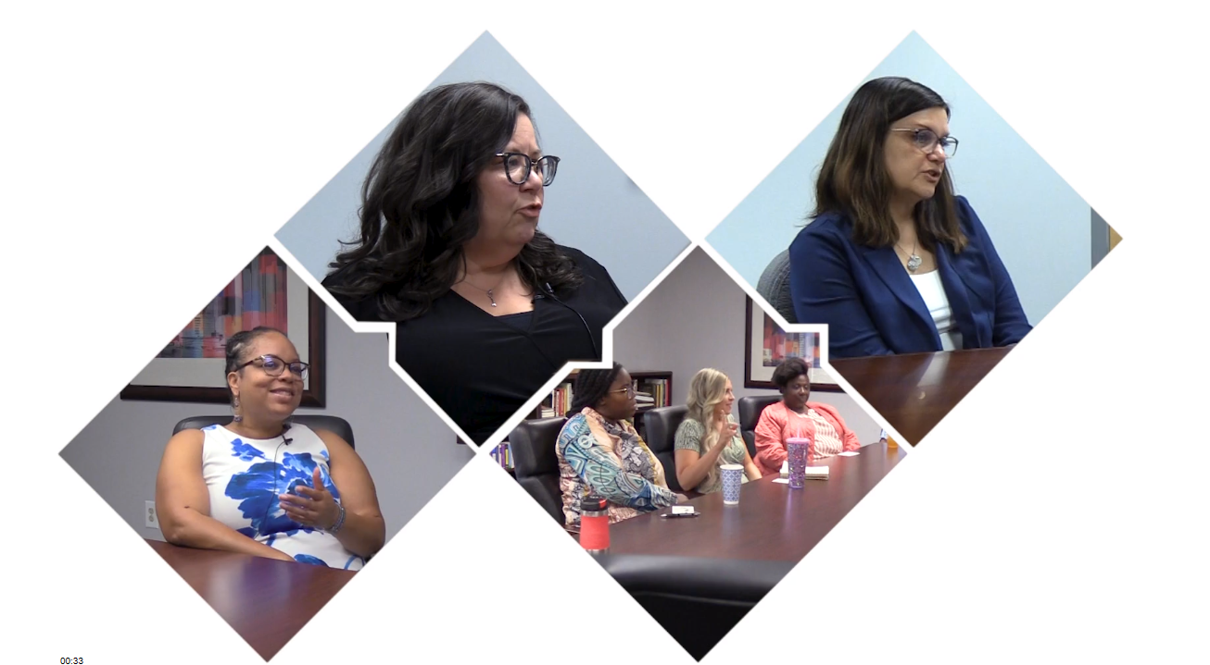
Part 3
Delivering Infant and Early Childhood Mental Health Consultation in Home Visiting
Notes:
Picture from: https://commons.wikimedia.org/wiki/File:Fatherandchild.png

Slide 28
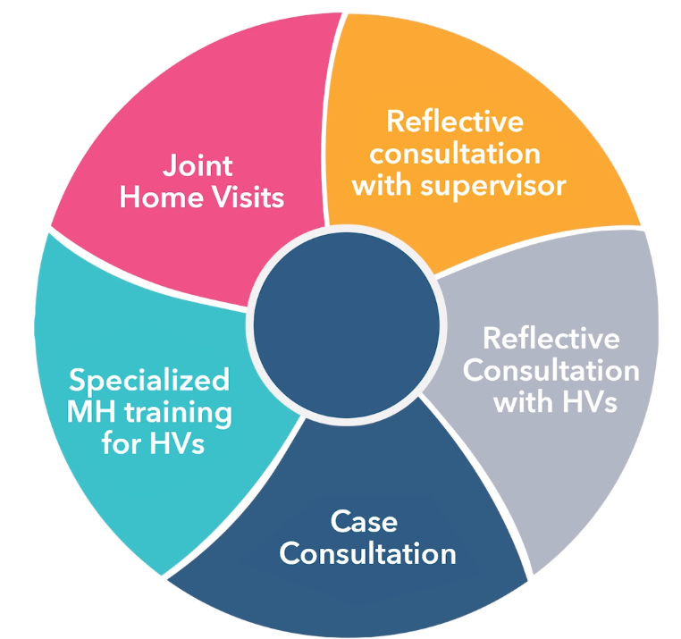
Main Activities in the Delaware Model for IECMHC in Home Visiting
Let’s Watch!
IECMHC in Home Visiting Video Part 1:
https://vimeo.com/823722243/75ef918e19
Notes:
In the Delaware Model for providing IECMHC within home visiting, the IECMH consultant may engage in five main activities. Depending on the needs of the provider, the consultant may enter the work in any of the activities as they build rapport and explore the needs of the program.
Lets watch a short video to learn more about these 5 activities.
Link to MI Part 1 video

Slide 29
Reflection
What resonated for you?
Let’s team and talk:
What excites you about these activities?
What are you wondering about?
Notes:
Photo: https://journals.rcni.com/nursing-standard/feature/reflective-practice-your-questions-ns.34.5.40.s16/abs
Engage in a reflection activity. Allow a minute for participants to reflect on the questions and their own thoughts and then join w/2 people to discuss, come back and ask for people to share and the facilitator can answer questions posed.

Slide 30
Reflective consultation with the home visiting program manager/supervisor
Notes:
The consultant meets at a minimum monthly with the program supervisor/manager to provide an opportunity for reflection, problem-solving, planning staff interactions, and embedding the skills and knowledge that the consultant brings into the program. These meetings help develop an agreement between the consultant and the supervisor and clarify the differences between consultation and supervision, reinforcing the supervisor’s ongoing commitment to the consultation process. This is an essential step that helps to sustain the work by promoting reflective practice within the supervisory activities.

Slide 31
Reflection
What comes to mind when you think of one of your most meaningful supports, what made this connection (e.g. with a supervisor or mentor) so successful.
What did you do? What did the other person do?
Notes:
Photo: https://journals.rcni.com/nursing-standard/feature/reflective-practice-your-questions-ns.34.5.40.s16/abs
Engage in a reflection activity. Allow a minute for participants to reflect on the question and then do a group share on their feedback and making the point that those same characteristics are aligned with our work in HV.

Slide 32
Reflection Stages
Although your work with a consultant is not a prescribed, linear process, it can be helpful to develop a predictable, trustworthy routine.
Consider:
Preparation
Greeting and reconnecting
Finding the agenda
Telling the story
Understanding perspectives
Considering next steps
Closing
Notes:
Discuss the non linear approach to this work and talk about some helpful tips for entering into a rapport and structure to get started.

Slide 33
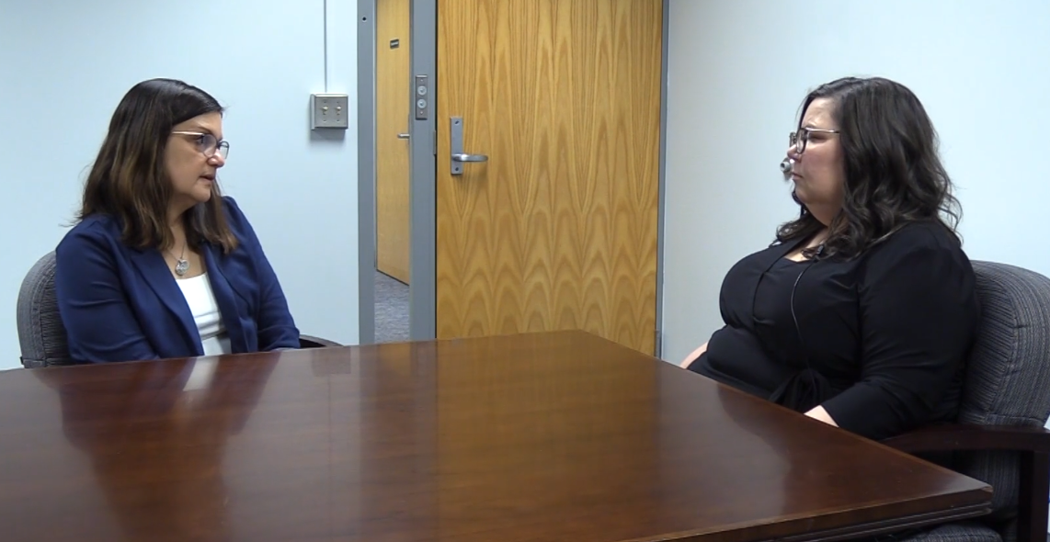
Let’s Watch and Discuss
What stages did you see in this example?
Notes:
Watch Supervisor-Consultant in action and then reflect on their approach pros and any cons

Slide 34
Reflective consultation with the home visitors via groups or 1:1 case consultation
Notes:
Reflective case consultation with individual staff: In a parallel process, the consultant and the supervisor meet with individual staff monthly to provide reflective consultation as described previously. Home visiting staff may have little prior training on mental health topics, and sometimes struggle with issues of boundaries and judgments regarding a parent’s life choices or parenting practices. A reflective mental health approach can assist home visitors in thinking about the impacts of issues such as a history of abuse or living with a parent with mental illness and how to address these issues within their role as a home visitor. Consultation helps staff gain confidence when raising mental health concerns, using the trusting relationship that they have established with a parent/family to make a referral to mental health services and addressing how the parent’s mental health issues impact the relationship with their infant or young child. Consultants and program supervisors alike report that training is more effective when it happens naturally. If a subject comes up during a case consultation, the consultant may spend time relying upon their knowledge and experience to share information with the team. The consultant may return to the next visit with additional information and materials, if appropriate.
Group reflective case consultation: Like reflective consultation with individual staff, the consultant works with the supervisor and the staff monthly. Often staff members present cases for discussion. The consultant helps the group to wonder aloud, thinking about the meaning of behaviors. The home visitors are encouraged to hold steady, observe, and wonder with their clients (parents/families), as opposed to problem solving and finding a “solution”.

Slide 35
Reflective + Consultation
A relationship
that aims at creating a climate
where both the client’s and the helper’s needs are being considered
so that the effectiveness of the intervention is optimized
Notes:
35
There are many definitions of RC out there – this is the one that I think captures it the best in a succinct manner – read slowly pause at end of each word cluster

Slide 36
Reflective Consultation- Group and 1:1
Partnership in which the home visitors(s):
Do not feel alone in the work
Are not overwhelmed by fear or uncertainty
Feel safe to express
Fears
Uncertainties
Thoughts
Feelings
Reactions
Notes:
36
In interviews conducted with individuals who participate in reflective consultation.

Slide 37
Reflective Consultation (cont.)
Learns more about
Him/herself
The client
Co-workers/colleagues
The work
Notes:
37
Continuation of list – highlight that not only is the supervisee growing as a professional in regards to the services they provide or the work they do – that is in their interactions with the client (Be it a child, parent or other) -- but also with their colleagues – so that reflective practice and RS has a positive impact on the work environment as well

Slide 38
3 Key Components of Quality Reflective Consultation
Reflection
Collaboration
Regularity
Notes:
38
Briefly list

Slide 39
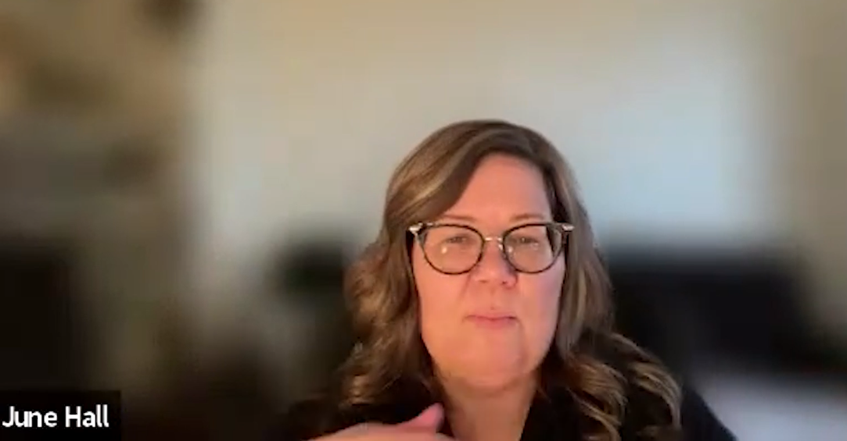
Let’s Watch Reflective Case Consultation
Did you see reflection and collaboration?
Notes:
Have consultant watch this segment of the MI video part 2- IECMHC in action then reflect and discuss what they saw

Slide 40
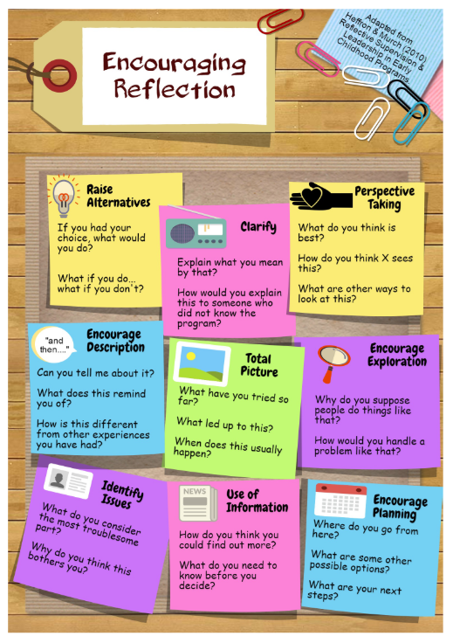
Reflection Tips
Sherry Hellar, Tulane University

Slide 41
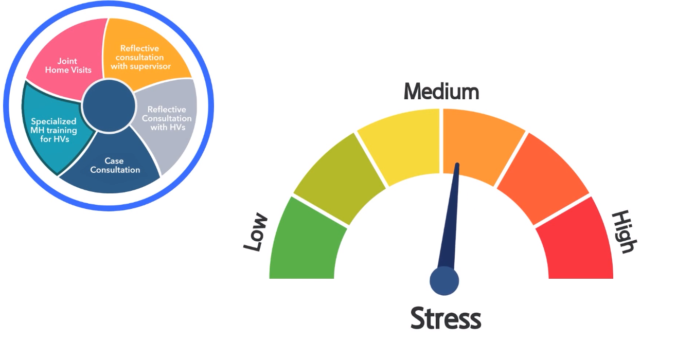
Specialized Training for Home Visitors
Notes:
The reflective approach is balanced with training that is content specific. The IECMH consultant develops “mini trainings” on topics that staff members identify such as attachment, self-regulation, postpartum depression, substance abuse, and sleep disturbance. The home visiting staff gain knowledge and skills. The consultant then reinforces this information in supervision and during ongoing meetings.

Slide 42
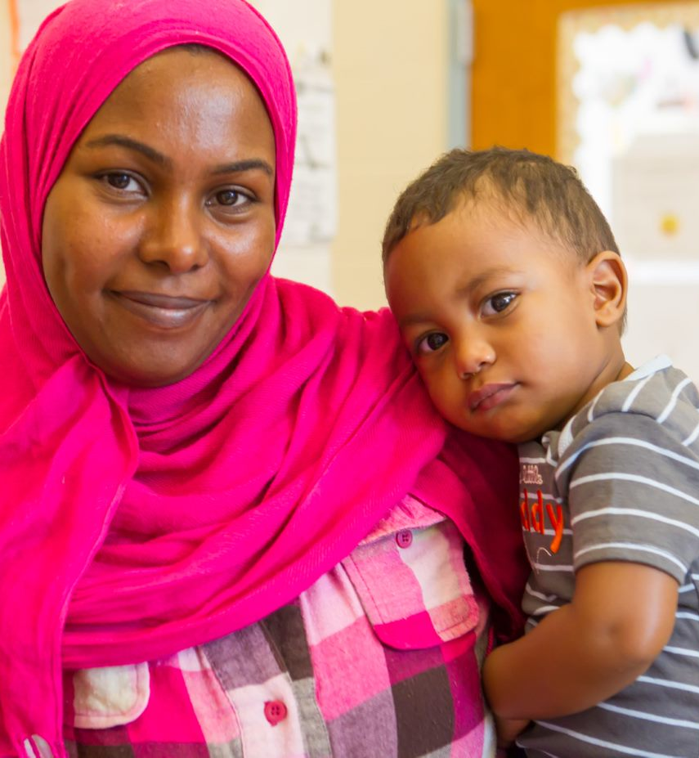
Which Risk Factors are Families Facing that Can Compromise Healthy Relationships and Safe Environments? How might these impact training?
Notes:
The focus of home visiting is often on the dyad (or relationship) between the caregiver(s) in the home and the child, often addressing issues or concerns that might impact the child's development and the caregivers ability to provide nurturing and responsive caregiving. The work of the home visitor often includes promotion and prevention strategies focused on relationship building, health and child development, parenting practices, and helping the parent identify and work toward various short- and long-term family goals. It is important that the IECMH consultant be aware of challenges that the home visitor may face. In addition to training on Delaware’s Model for IECMHC, consultants should access ongoing training to hone their knowledge and skills in areas critical to home visitors’’ work such as;
Historical Trauma
Toxic Stress
Domestic Abuse
Substance Abuse
Adult Mental Health Concerns
Financial Stress
Chronic Health issues

Slide 43
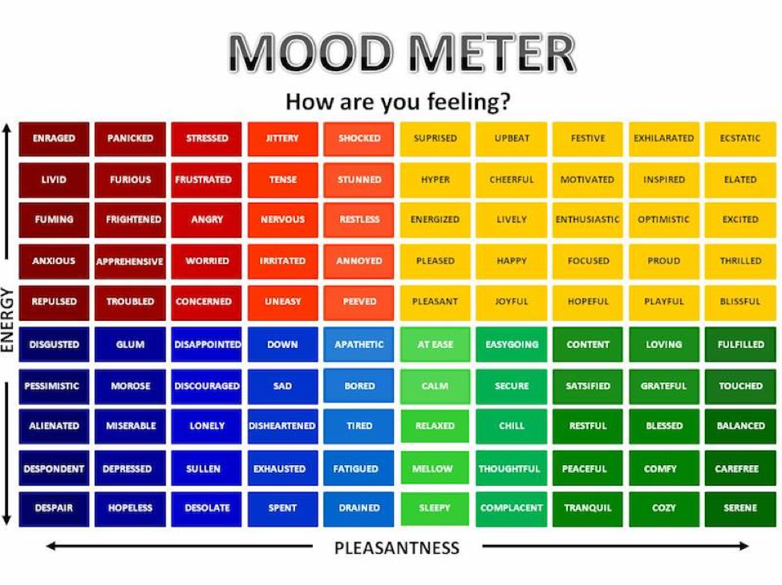
Wrap up
How are you feeling about this support coming to Delaware?
Notes:
We look forward to continuing our support to this group.
This concludes the overview of the model.
Reach out to XX for any questions or follow up.

Slide 44
Questions and Answers
What are you wondering about?
Thank you for our time learning together today!
Linda Delimata
lindadelimata@hotmail.com
Mary Mackrain
mackrainm@michigan.gov

