Slide 1
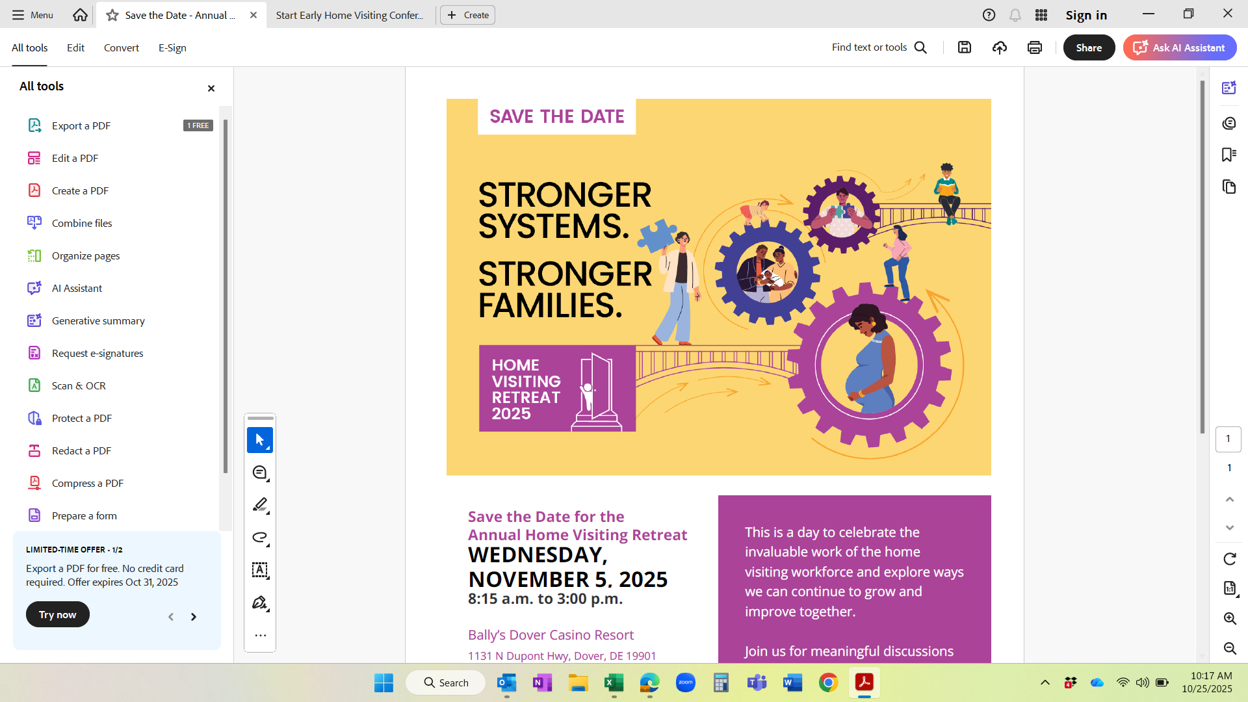

Connecting Systems, Communities, and Families:
Early Childhood from
the Ground Up
2025 Kaitlin Watts / Institute for Child Success. All rights reserved.

Slide 2
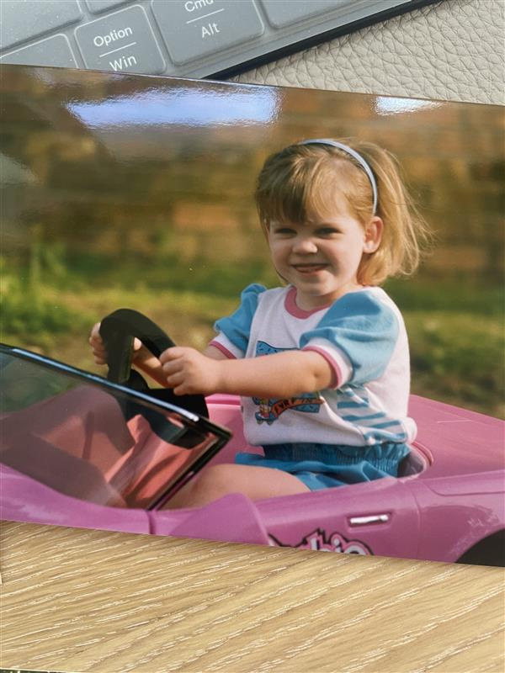




Who Am I
Early childhood has my heart.
Passionate about advocating for frontline workers and making sure their voices guide the system.
Focused on connecting the dots so families can get the support they deserve.
2025 Kaitlin Watts / Institute for Child Success. All rights reserved.
Notes:
I like this slide, I feel like for the people who have not met you or heard about you, it makes you more human

Slide 3

What’s Happening: The Heart of Home Visiting
Home Visiting Programs
Nurse Family Partnership
Parents as Teachers
Attachment & Biobehavioral Catch-up (ABC)
Early Head Start
Healthy Familes
2025 Kaitlin Watts / Institute for Child Success. All rights reserved.
Notes:
You are the ground floor of early childhood.
You meet families where they are.
You build trust that changes outcomes.
You carry the heart of the work.
“You are the first connection — the first trusted voice that can change a family’s trajectory

Slide 4





Delaware Data Dive:
14,138 home visits provided including 2,150 virtual visits.
71.9% of infants under 12 months of age were always put to sleep safely.
70.7% of prenatally
enrolled mothers received a postpartum care visit within three months of delivery.
1,426 families served.
1,375 children served.
66.7% of infants 6 to 12 months of age (enrolled in home visiting for at least six months) were breastfed.
Sources: Delaware Thrives,
NRHVAC Delaware Handout
2025 Kaitlin Watts / Institute for Child Success. All rights reserved.
Notes:
5, 11, 12, 19 colors cohesive

Slide 5

Activity: Family Matters
Let’s take a minute to remember your ‘why.’
Reflect on one family that reminds you why you do this work.
Share one word that captures your connection.
2025 Kaitlin Watts / Institute for Child Success. All rights reserved.
Notes:
Let’s pause to celebrate the work you’re doing every day.
§“So before we go any further today, just take a second and think about one family you’ve worked with recently — the connection you’ve built, the progress they’ve made. That’s what this is all about.”
·You are the trusted voice in a family’s home.
·You’re often the first one to see a concern, celebrate a milestone, or recognize a strength.
·You carry the weight of this work with professionalism, compassion, and skill.
Slide 6: Word Cloud Display
Visual: Live feed from Mentimeter / Poll Everywhere
🗣️ Cue:
“Look at those words — trust, growth, resilience, hope. That’s your impact.”
Slide 7: Transition Slide
Visual: Image of a bridge being built
Text:
“You’ve built something strong. Now — let’s talk about what’s next.”
🗣️ Cue:
“Let’s explore how our field is evolving — and what ingredients make this work thrive everywhere.”

Slide 6



What’s Next: The Secret Sauce
“What’s the secret sauce?”
“What makes early childhood systems thrive?”
Let’s break it down — three ingredients that work anywhere.
2025 Kaitlin Watts / Institute for Child Success. All rights reserved.
Notes:
Objective: Highlight momentum and opportunities for growth.
I’ll showcase ongoing initiatives and how they’re building on current success.
I’ll introduce new elements, using data examples from the Home Visiting Conference to show how real-time insights can inform and adjust practice.
The goal is to inspire reflection and action based on what the data tells us.

Slide 7
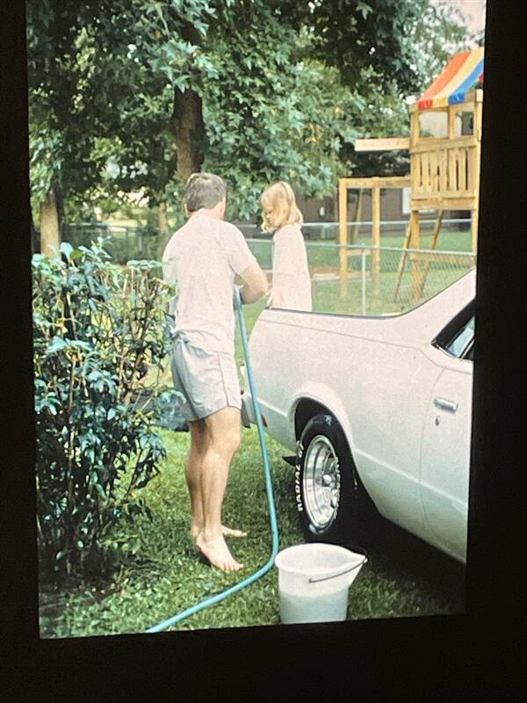
Activity: Share a Moment
Think about your earliest memory.
Where were you?
Who were you with?
What were you doing?
2025 Kaitlin Watts / Institute for Child Success. All rights reserved.
Notes:
Slide 9: Early Memory Reflection
“Think back to your earliest memory…”
“Mine was kayaking with my dad — seeing a deer on a quiet creek. I don’t remember it because of the deer, but because of the connection.”

Slide 8

Ingredient 1: Start Early
To change outcomes, we have to start early and support parents before, during, and after birth.
2025 Kaitlin Watts / Institute for Child Success. All rights reserved.
Notes:
Slide 10: Why Early Experiences Matter
Visual: Brain development chart (0–3 years = 80% growth)
Text: 80% of brain growth by age 3, Early moments shape lifelong outcomes
Relationships = architecture of the brain
“Every early experience — every moment of connection — shapes the adult that child becomes.”

Slide 9


Ingredient 2: Bundle Support
Families don’t live in silos.
It is important to connect services and to simplify access.
Home Visiting
Health
Childcare
Mental
Health
2025 Kaitlin Watts / Institute for Child Success. All rights reserved.
Notes:
Slide 10: Why Early Experiences Matter
“Families shouldn’t have to navigate 10 doors for one need. When we bundle supports, families thrive.”
Visual: Brain development chart (0–3 years = 80% growth)
Text: 80% of brain growth by age 3, Early moments shape lifelong outcomes
Relationships = architecture of the brain
“Every early experience — every moment of connection — shapes the adult that child becomes.”
Silos ➡ Bridges ➡ Continuum of Care
“Families don’t live in silos — so neither can we.”

Slide 10

Ingredient 3: Collaborate Boldy
No one can do it alone.
My program ⟶ Our families.
Collective impact creates shared success. When we align around one mission, families succeed.
2025 Kaitlin Watts / Institute for Child Success. All rights reserved.
Notes:
Slide 10: Why Early Experiences Matter
Visual: Brain development chart (0–3 years = 80% growth)
Text: 80% of brain growth by age 3, Early moments shape lifelong outcomes
Relationships = architecture of the brain
“Every early experience — every moment of connection — shapes the adult that child becomes.”

Slide 11
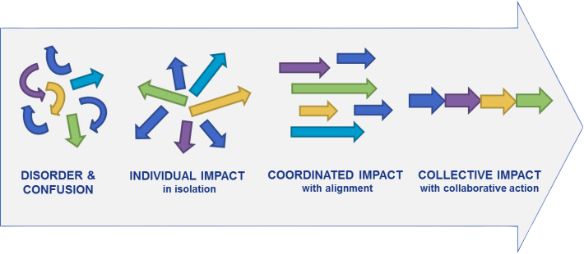
What is Collective Impact?
Collective Impact is a way for different organizations to work together so they can solve big problems that no single group can fix alone.
When done right, it creates real, lasting change.
Source: Homelessplan.org
2025 Kaitlin Watts / Institute for Child Success. All rights reserved.
Notes:
I like this slide, I feel like for the people who have not met you or heard about you, it makes you more human

Slide 12

What is Collective Impact?
Five key ingredients make it work:
A Common Agenda
Shared Measurement
Mutually Reinforcing Activities
Continuous Communication
Backbone Support Organization
Why It Works:
It brings everyone together around a shared goal.
It coordinates different strengths, so efforts don’t overlap or get lost.
It helps organizations stay focused, communicate, and adapt over time.
2025 Kaitlin Watts / Institute for Child Success. All rights reserved.
Notes:
I would just read off each of the descriptions because it is very wordy if it is on the slide together
A Common Agenda – Everyone agrees on the same goal and understands the problem in the same way. You don’t have to agree on everything, but you need to agree on the main outcome you’re working toward.
Shared Measurement – Everyone agrees on how success will be measured. Collecting and sharing the same data helps groups stay aligned, learn from each other, and hold each other accountable.
Mutually Reinforcing Activities – Each group does what it does best, but in a way that supports the efforts of others. The work of one organization strengthens the work of another, creating a coordinated approach instead of isolated actions.
Continuous Communication – Groups keep talking and sharing regularly. This builds trust, helps prevent misunderstandings, and ensures everyone stays focused on the common goal.
Backbone Support
Organization – There’s a dedicated team whose job is to keep the whole initiative running smoothly. They manage logistics, communication, data, and help solve conflicts so the other groups can focus on their work.

Slide 13

Activity: Applying the Ingredients
Where are we right now?
Which ingredient do we do best?
Which could we strengthen?
Bundle Support
Collaborate Boldly
Start Early
Now that we know the ingredients, let’s imagine how we can use them to connect systems, communities, and families.
2025 Kaitlin Watts / Institute for Child Success. All rights reserved.
Notes:
Take 5 minutes and brainstorm — which ingredient is your strength, and which one could grow?

Slide 14

Connecting Systems, Communities, and Families
Systems are people.
Systems aren’t abstract — they are...
You
Me
People behind the work
A system’s strength is measured by how easily families move through it.
2025 Kaitlin Watts / Institute for Child Success. All rights reserved.
Notes:
Let’s dive into the continuum of care.
What does it look like and why does it matter?
We’ll focus on how families experience the system and identify opportunities to connect services more effectively.
- how connected, consistent, and supportive their experience feels.

Slide 15

Building Systems:
From the Ground Up
Weaving together evidence-based programs, staff expertise, and family trust creates a seamless continuum of care.
Focus on actionable priorities:
Explore the challenge
Map the system
Brainstorm solutions
2025 Kaitlin Watts / Institute for Child Success. All rights reserved.
Notes:
Explore the challenge: Identify where families face barriers to timely prenatal visits and developmental screenings.
Map the system: Look at how healthcare, early childhood, and community programs connect—or don’t—and where coordination can improve.
Brainstorm solutions: Generate and prioritize practical ideas to make care more seamless, equitable, and family-friendly.
I edited the slide but I kept the information the sameish
Building Systems from the Ground Up
Title: Continuity, Trust, and Relationships
Visual: Tree with roots labeled “evidence-based programs” and “staff expertise,” branches labeled “family outcomes”
Talking Points:
“Weaving together programs, staff expertise, and family trust creates a seamless continuum of care.”
Focus on actionable priorities:
Prenatal care integration
Consistent developmental screenings
Relationship-based engagement
“Systems change happens from the ground up, through every visit and partnership.”

Slide 16








Real Life: South Carolina
Year 2
100%
46
avoided ER visits and overnight hospital stays
34%
Year 1
of mothers were enrolled at 5 months postpartum.
Year 1
Year 3
26%
25%
44%
reduction in low
birth weights.
70%
of mothers were still enrolled at 9 months postpartum.
Cesarean Section Rates
Moms delayed by WIC can’t get formula, and the hospital can’t give it.
BirthMatters will provide formula until WIC benefits begin.
Hospital staff trained to enroll patients in the hospital and pick up their card from DPH after discharge.
2025 Kaitlin Watts / Institute for Child Success. All rights reserved.
Notes:
I would just read off each of the descriptions because it is very wordy if it is on the slide together
A Common Agenda – Everyone agrees on the same goal and understands the problem in the same way. You don’t have to agree on everything, but you need to agree on the main outcome you’re working toward.
Shared Measurement – Everyone agrees on how success will be measured. Collecting and sharing the same data helps groups stay aligned, learn from each other, and hold each other accountable.
Mutually Reinforcing Activities – Each group does what it does best, but in a way that supports the efforts of others. The work of one organization strengthens the work of another, creating a coordinated approach instead of isolated actions.
Continuous Communication – Groups keep talking and sharing regularly. This builds trust, helps prevent misunderstandings, and ensures everyone stays focused on the common goal.
Backbone Support
Organization – There’s a dedicated team whose job is to keep the whole initiative running smoothly. They manage logistics, communication, data, and help solve conflicts so the other groups can focus on their work.

Slide 17




Real Life: Florida
Parent Education via Family Connects
Pediatrician Support via
Reach Out & Read
Educate parents in high-ER zip codes.
Use home visits proven to cut avoidable ER use.
Link families to a pediatrician early.
Reinforce consistent care messages through pediatricians.
Expand participating offices as funding grows.
Hospital Communication
Mobile Health Unit
Notify pediatricians of ER visits.
Track timing and reasons to spot avoidable cases.
Use ER data to target high-need areas.
Offer after-hours care to reduce ER use.
2025 Kaitlin Watts / Institute for Child Success. All rights reserved.

Slide 18
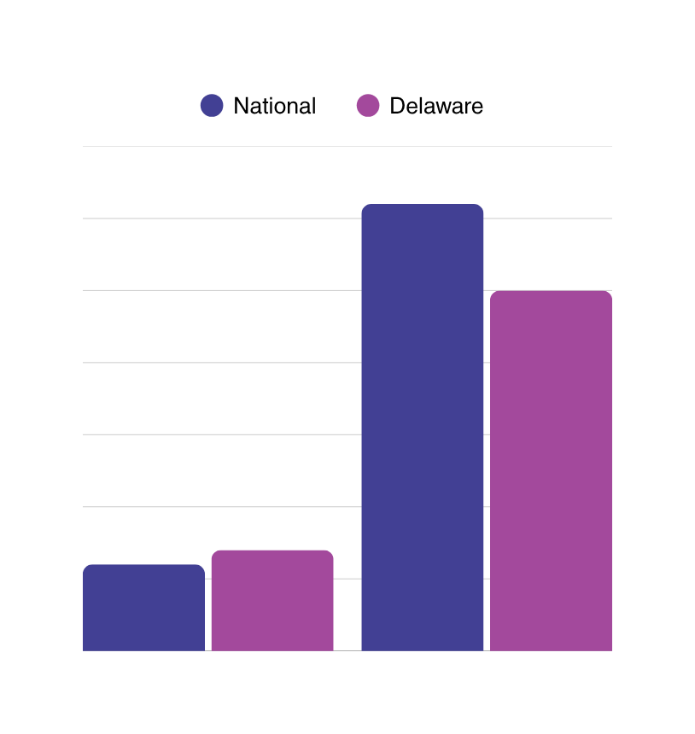
Areas for Growth: Delaware
In Delaware, 7% of mothers receive late or no prenatal care, and only 24.8% of children receive developmental screenings.
How can we build or improve systems to reduce the number of mothers missing timely prenatal care and increase the number of children receiving screenings?
Systems change happens from the ground up - through every visit and partnership.
31.1%
24.8%
7%
6.2%
Late or No Prenatal Care Developmental Screening
Source: Zero to Three: State of Babies Yearbook
2025 Kaitlin Watts / Institute for Child Success. All rights reserved.
Notes:
“Many moms are not accessing prenatal care—this is a critical gap in the early childhood continuum.” “Early intervention begins prenatally; our programs can help connect families to these services.”
“Developmental screenings are low in infancy and toddlerhood, leaving opportunities for early identification and support unmet.” “Integrating screenings into home visits and pediatric handoffs can close this gap.”
baby rattle and literacy skill example

Slide 19

Activity: Exploring the Root Causes Behind Low Prenatal Care Attendance
Awareness
Trust
Access
Low Prenatal Visit Rates
System
Life Factors
2025 Kaitlin Watts / Institute for Child Success. All rights reserved.

Slide 20

Activity: Brainstorming System Changes: Start, Continue, More, Change
Start
More
Continue
Change
2025 Kaitlin Watts / Institute for Child Success. All rights reserved.

Slide 21

One Step Forward
Your work is the foundation of everything that follows.
You are the ground up.
Thank you for your passion, your expertise, and your impact.
What’s one step you can take this month to strengthen connections in your work?
2025 Kaitlin Watts / Institute for Child Success. All rights reserved.

