Slide 1
Self-Care and Wellness on Your Own Terms
Jennifer Clement
Educere Institute
Jennifer@educereinstitute.org

Slide 2
What is self-care/wellness?
Wellness encompasses a holistic approach to health and overall well-being. It is a dynamic that varies from person to person. Wellness is the act of practicing healthy habits on a daily basis to attain better outcomes, so instead of just surviving, you’re thriving.
Self-care is the art of nurturing and tending to the various dimensions of our existence—physical, mental, emotional, and spiritual. It’s not a mere luxury; rather, it is an essential practice that contributes to our overall well-being.

Slide 3
WHY??
Improves concentration
Increases resiliency
Increases happiness
Increases energy
Improved physical health
Enhanced mental and emotional well-being
Improves social connections/relationships
Increases self-esteem
Reduces stress
Reduces or eliminates anxiety and depression
Reduces frustration and anger
Reduces heart disease, stroke, and cancer
Helps prevent burnout

Slide 4
How do I catch it…wellness??
Knowing yourself - reflective practice
Wanting to see something different
Openness to do the work
Acknowledging that it is hard

Slide 5
Prioritizing You!
Why is it important to you?
Dig a little deeper ☺
Whole person concept – what is below the surface?
Self-care – what does it look like to/on me?
What are the barriers?
What does forward movement look like?
How will I give myself some grace?

Slide 6
Whole Person Concept
POSITION/WANTS
20%
Positions Vs. Interests
INTERESTS/NEEDS
80%
Values
Fears
Beliefs

Slide 7
So, why don’t we???
Barriers:

Slide 8
24 Hours

Slide 9
Finding the Time / How do you spend your time?
Self Work
Family Friends

Slide 10
Reality Checks!!

Slide 11
Give Yourself Some Grace!
Law of averages
Hypocrisy – practice what you preach or what you advise of others
Have patience with yourself
Celebrate ALL of your progress, big and small!

Slide 12
Wellness is a Mindset

Slide 13
Self-Talk
Your self-talk either sabotages (negative) or supports (positive) you.
Negative self-talk can result in unnecessary stress, anxiety, depression, and self-doubt.
Positive self-talk encourages self-confidence, effective coping, achievement, and a general feeling of well-being.
“Is my self-talk building me up or tearing me down?” “Is my way of thinking helping me or is it hindering me?”

Slide 14
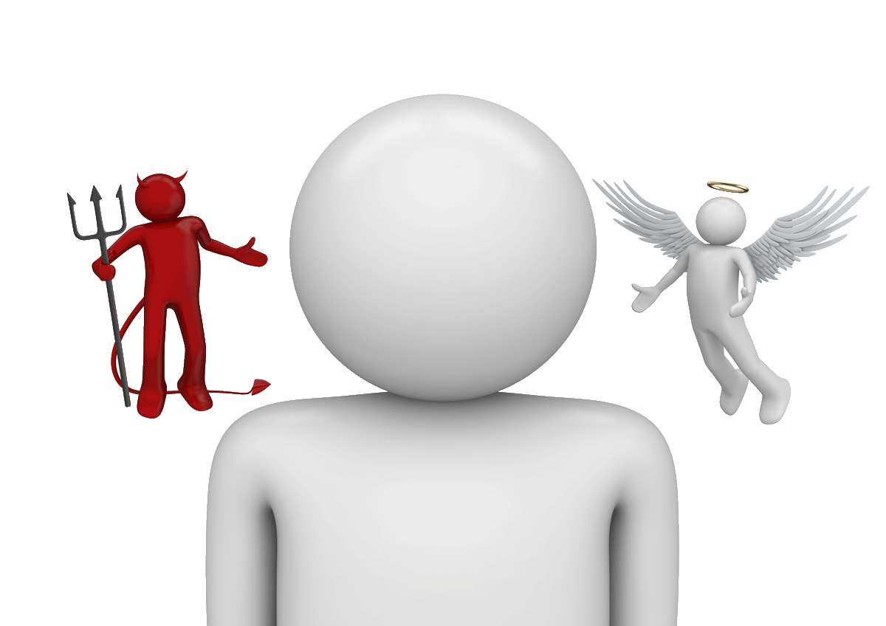
Changing Your Self-Talk
Catch it
Control it
Challenge it
Change it
Cherish it

Slide 15
Challenging Your Thoughts
Is this thought helpful? What is a healthier thought?
What would I tell a friend in this situation?
What evidence do I have that what I’m thinking is true?
What is the evidence against it?
Is there another way of looking at this situation? What are some other points of view?
What is the worst/best/most likely outcome?
If the worst did happen, how could I cope? Would I live through it?

Slide 16
Promoting Positivity & Addressing Negativity
Positivity
Show/practice gratitude
Appreciate the little wins
Model positive behavior
Use positive communication
SMILE & LAUGH
Negativity
Lack of:
Control
Confidence
Community

Slide 17
Positive Mind-Set
Present
Magical
Freedom
Elated
Adorable
Liberty
Beautiful
Treasure
Friendly
Romantic
Carefree
Prestige
Satisfied
Relaxed
Abundance
Amazing
Impressed
Dignified
Affection
Excitement
Optimism
Hopeful
Confident
Excellent

Slide 18
I am…

Slide 19
Boundaries

Slide 20
Seek Support

Slide 21
Essentials
Prioritizing self
Shifting mindset
Reality checks and new habits
Gratitude

Slide 22
3, 2, 1 – 1, 2, 3!
Thank you!

