Slide 1




WELCOME! We’re glad you’re here.
STRONGER SYSTEMS.
STRONGER FAMILIES.

Slide 2



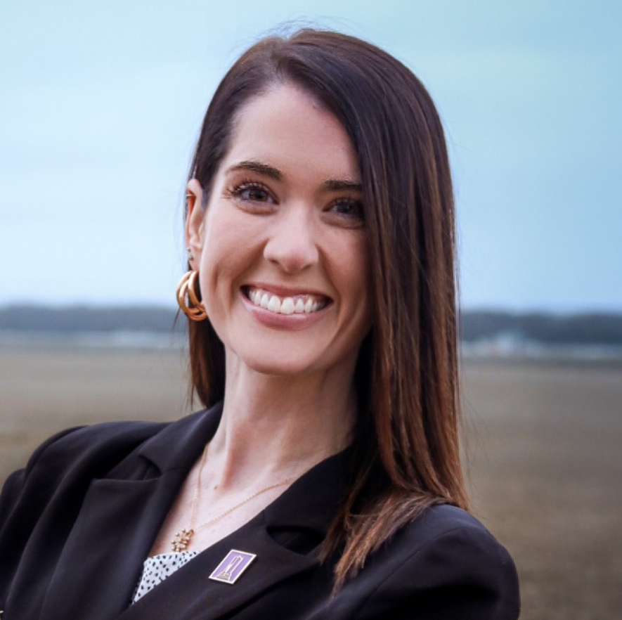
OPENING REMARKS
EMILY A. THOMPSON, MSM
Home Visiting Program Administrator
Division of Public Health
Delaware Department of Health and Social Services

Slide 3
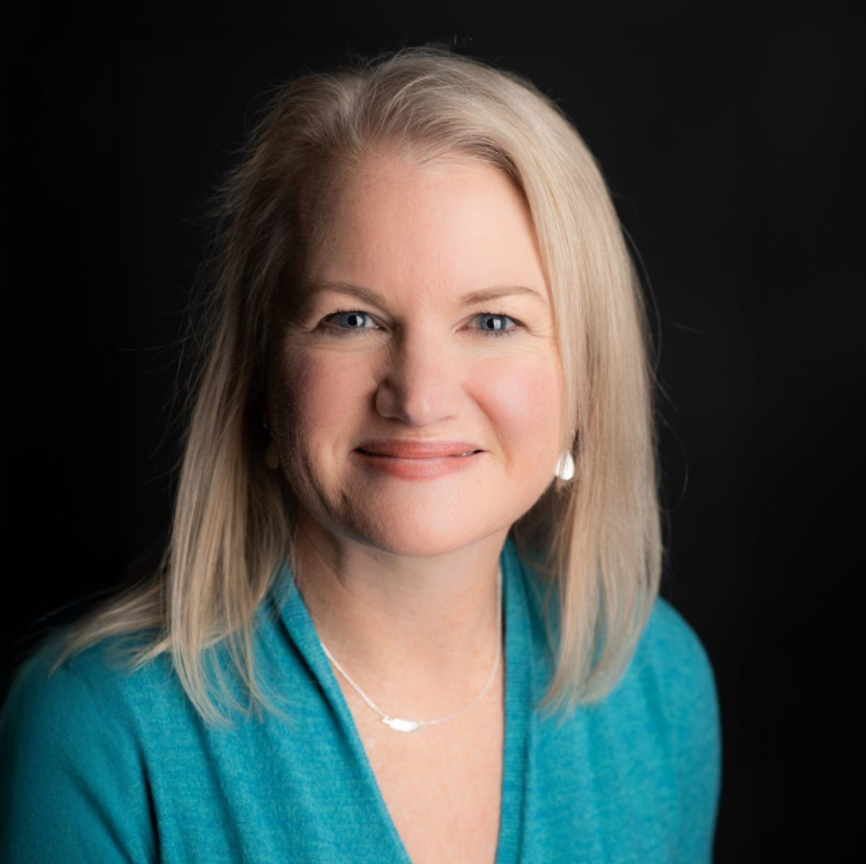
WELCOME REMARKS
KELLY ENSSLIN, ESQ.
Child Advocate
Office of the Child Advocate
Chair, Home Visiting Community
Advisory Board

Slide 4
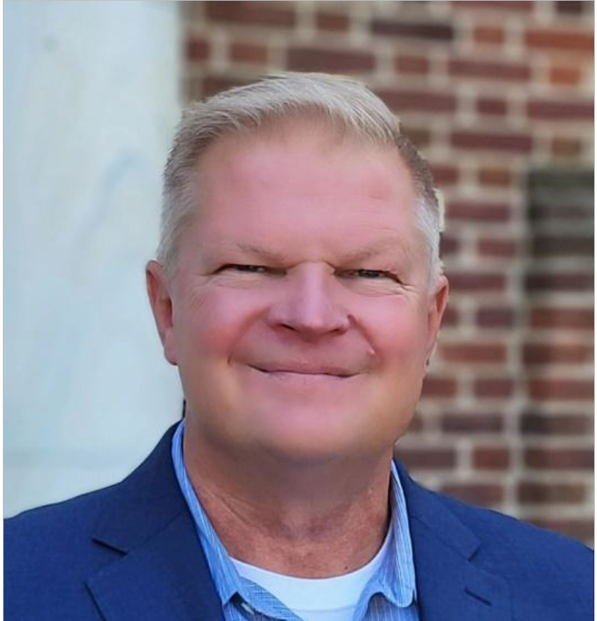
WELCOME REMARKS
Introduction of Lieutenant Governor
STEVEN BLESSING, MA
Director
Division of Public Health
Delaware Department of Health and Social Services

Slide 5
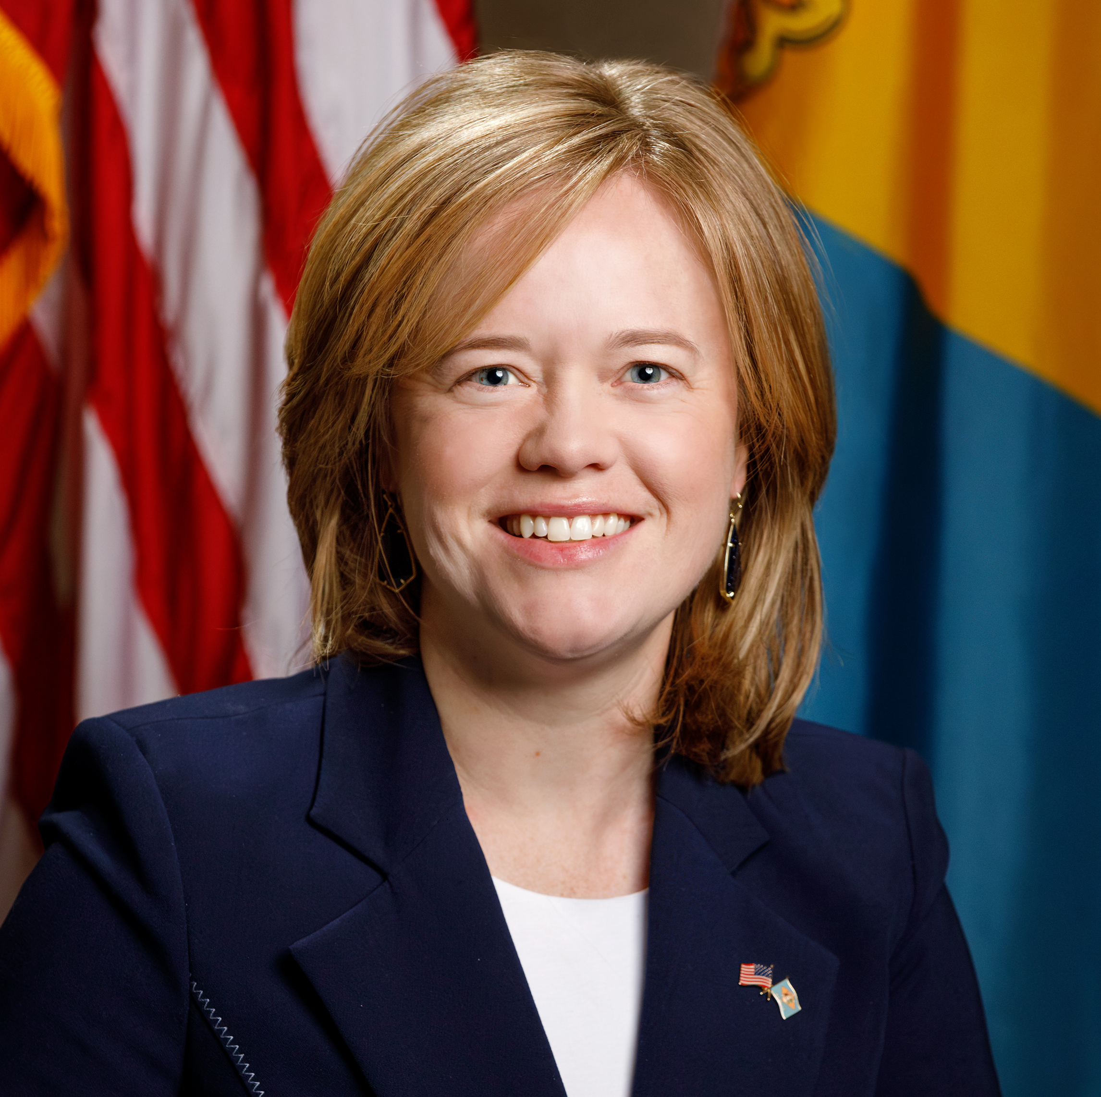
REMARKS
THE HONORABLE KYLE EVANS GAY
Lieutenant Governor
State of Delaware

Slide 6

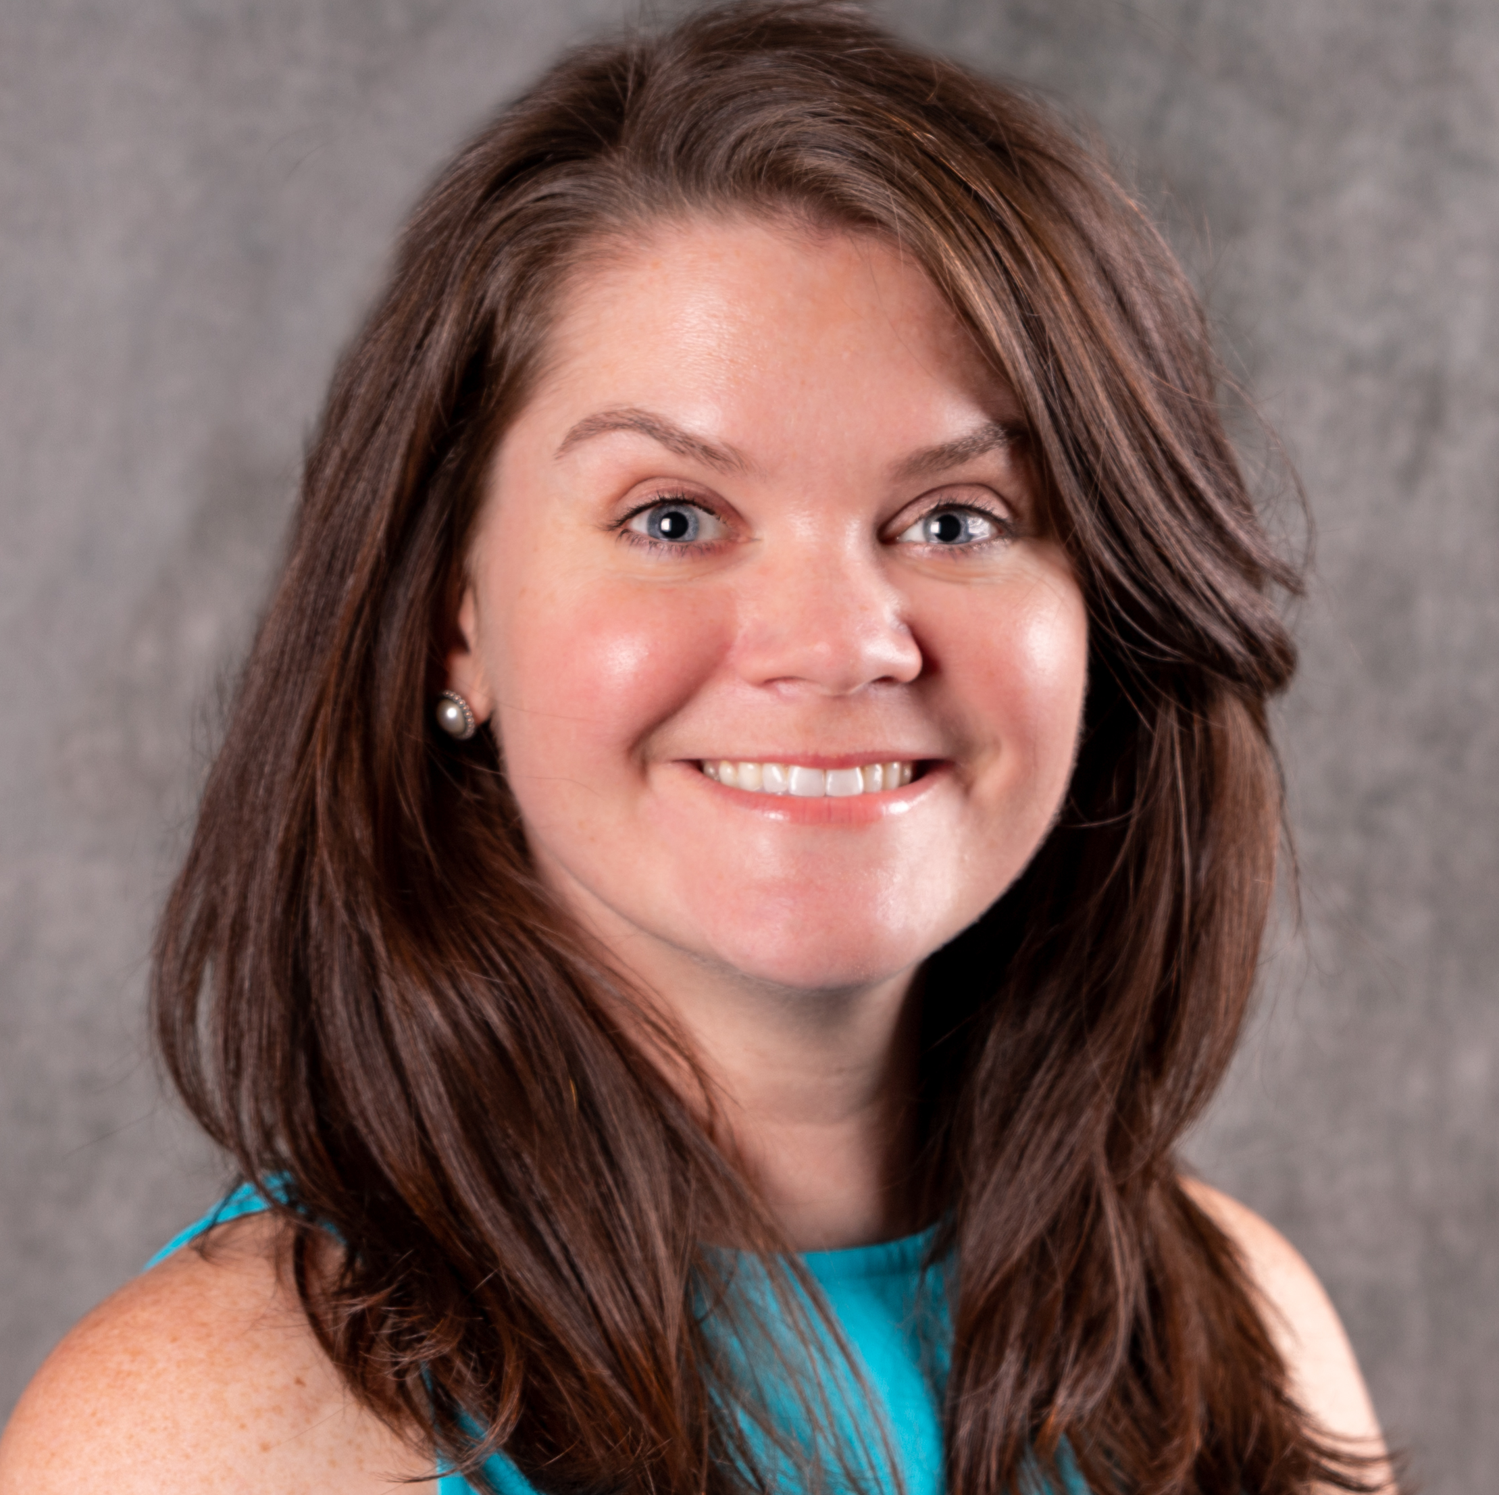
KEYNOTE PRESENTATION
Connecting Systems, Communities, and Families: Early Childhood from the Ground Up
KAITLIN WATTS
Director of Innovative Finance, The Institute for Child Success

Slide 7

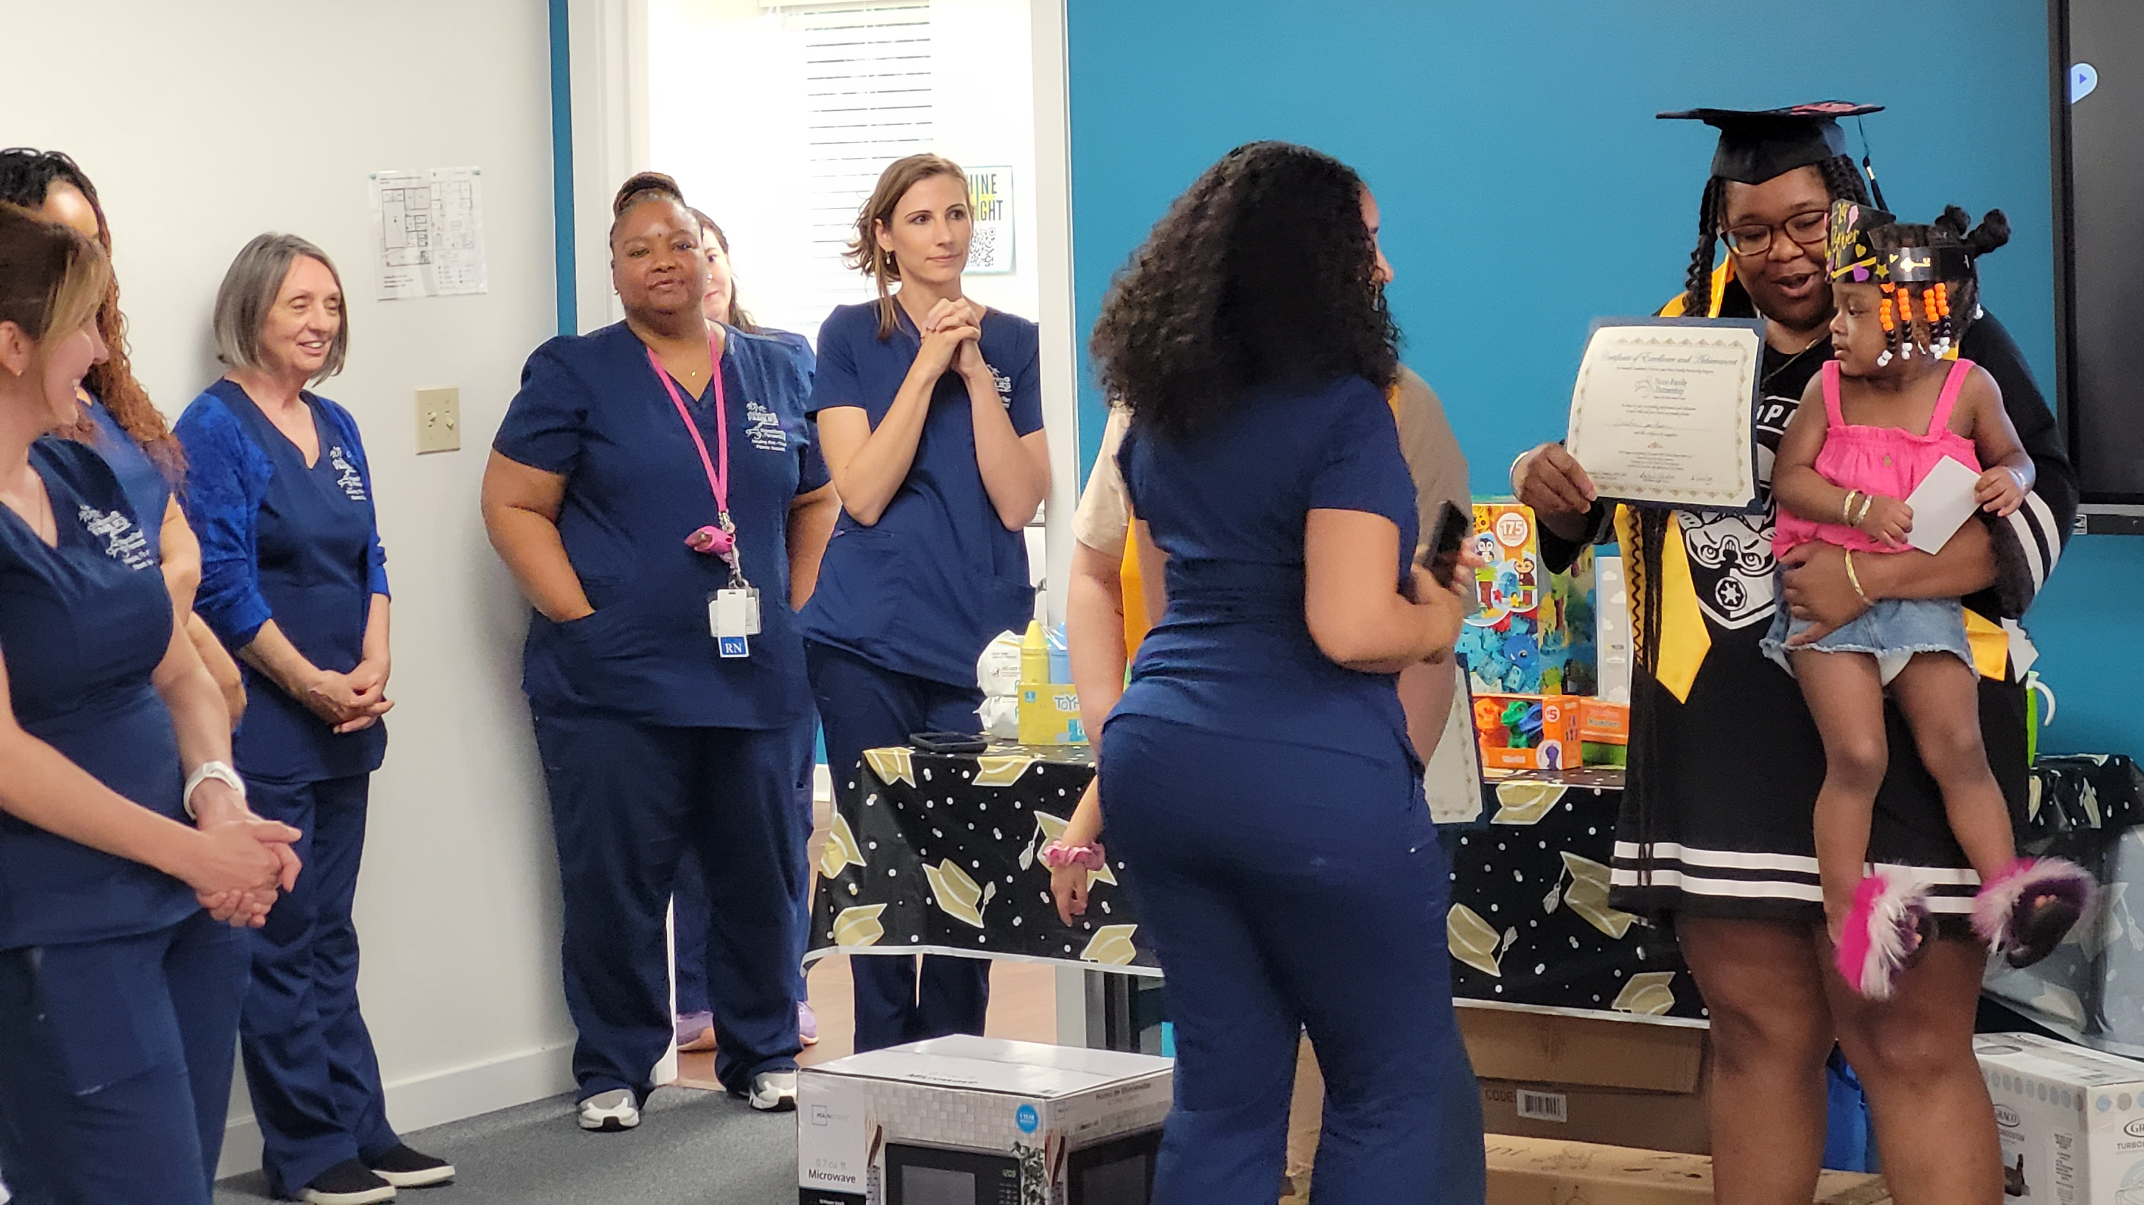
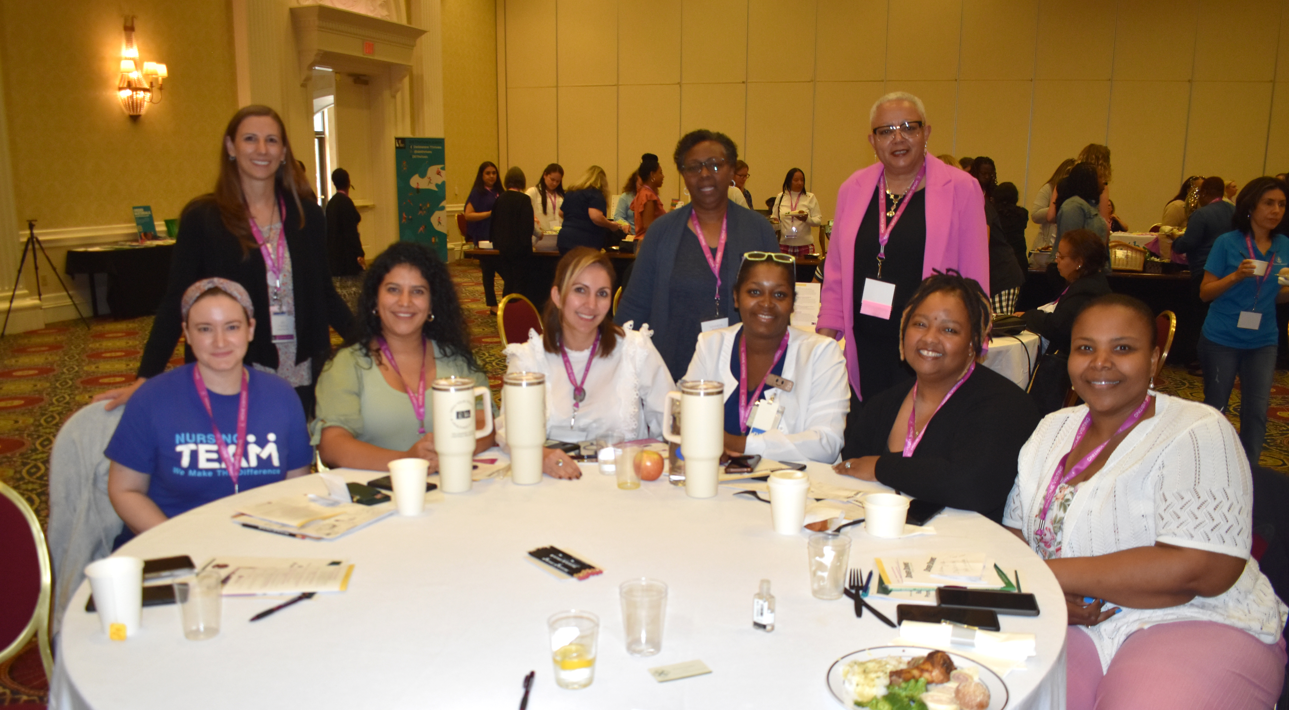

Slide 8
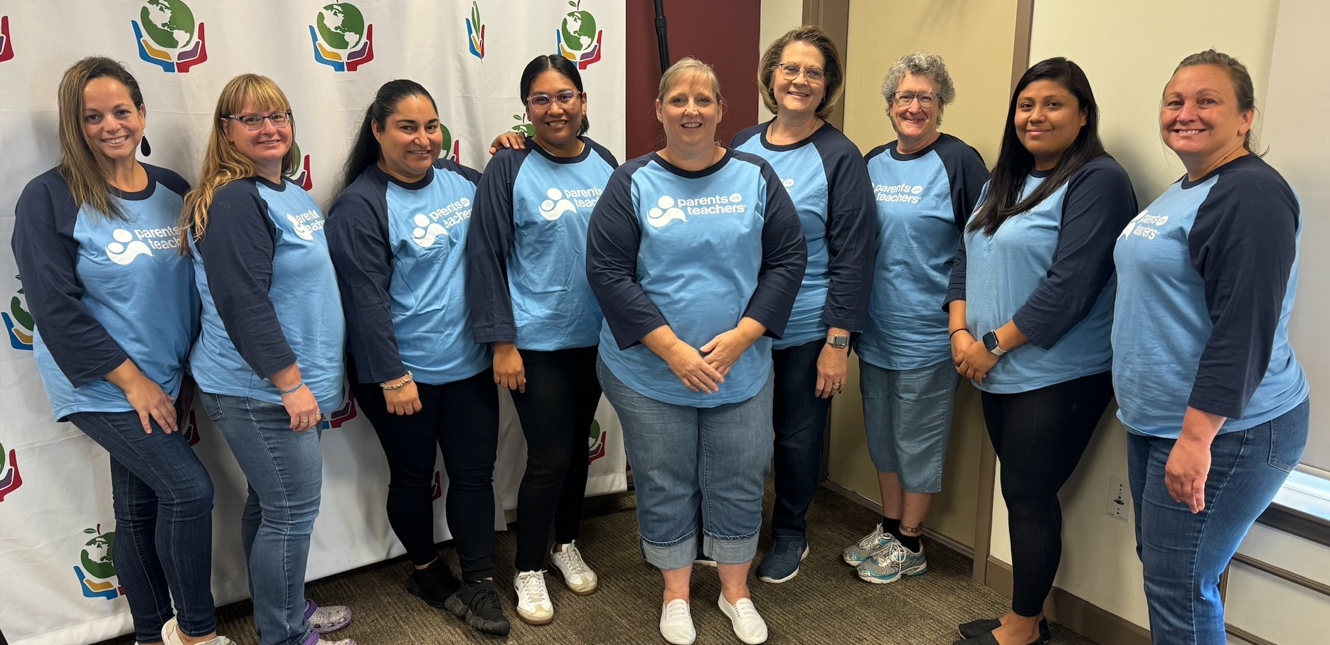
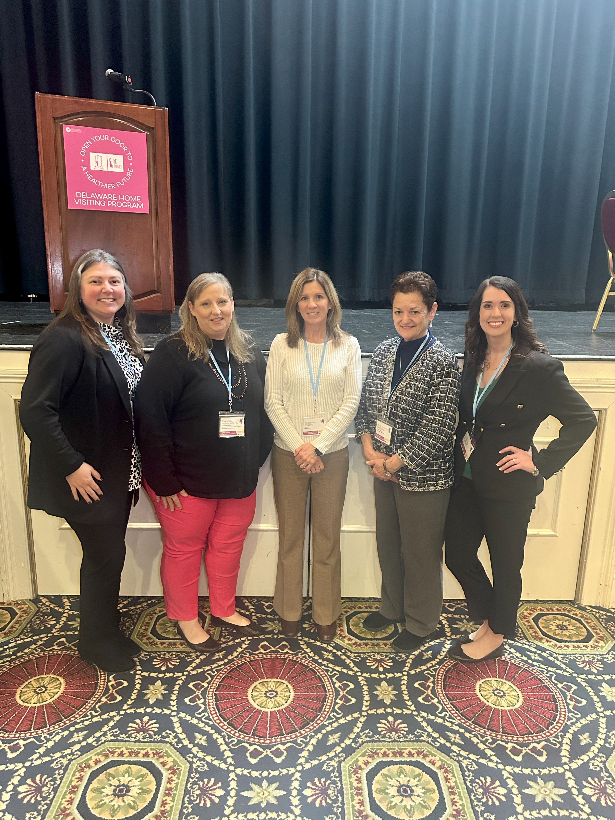
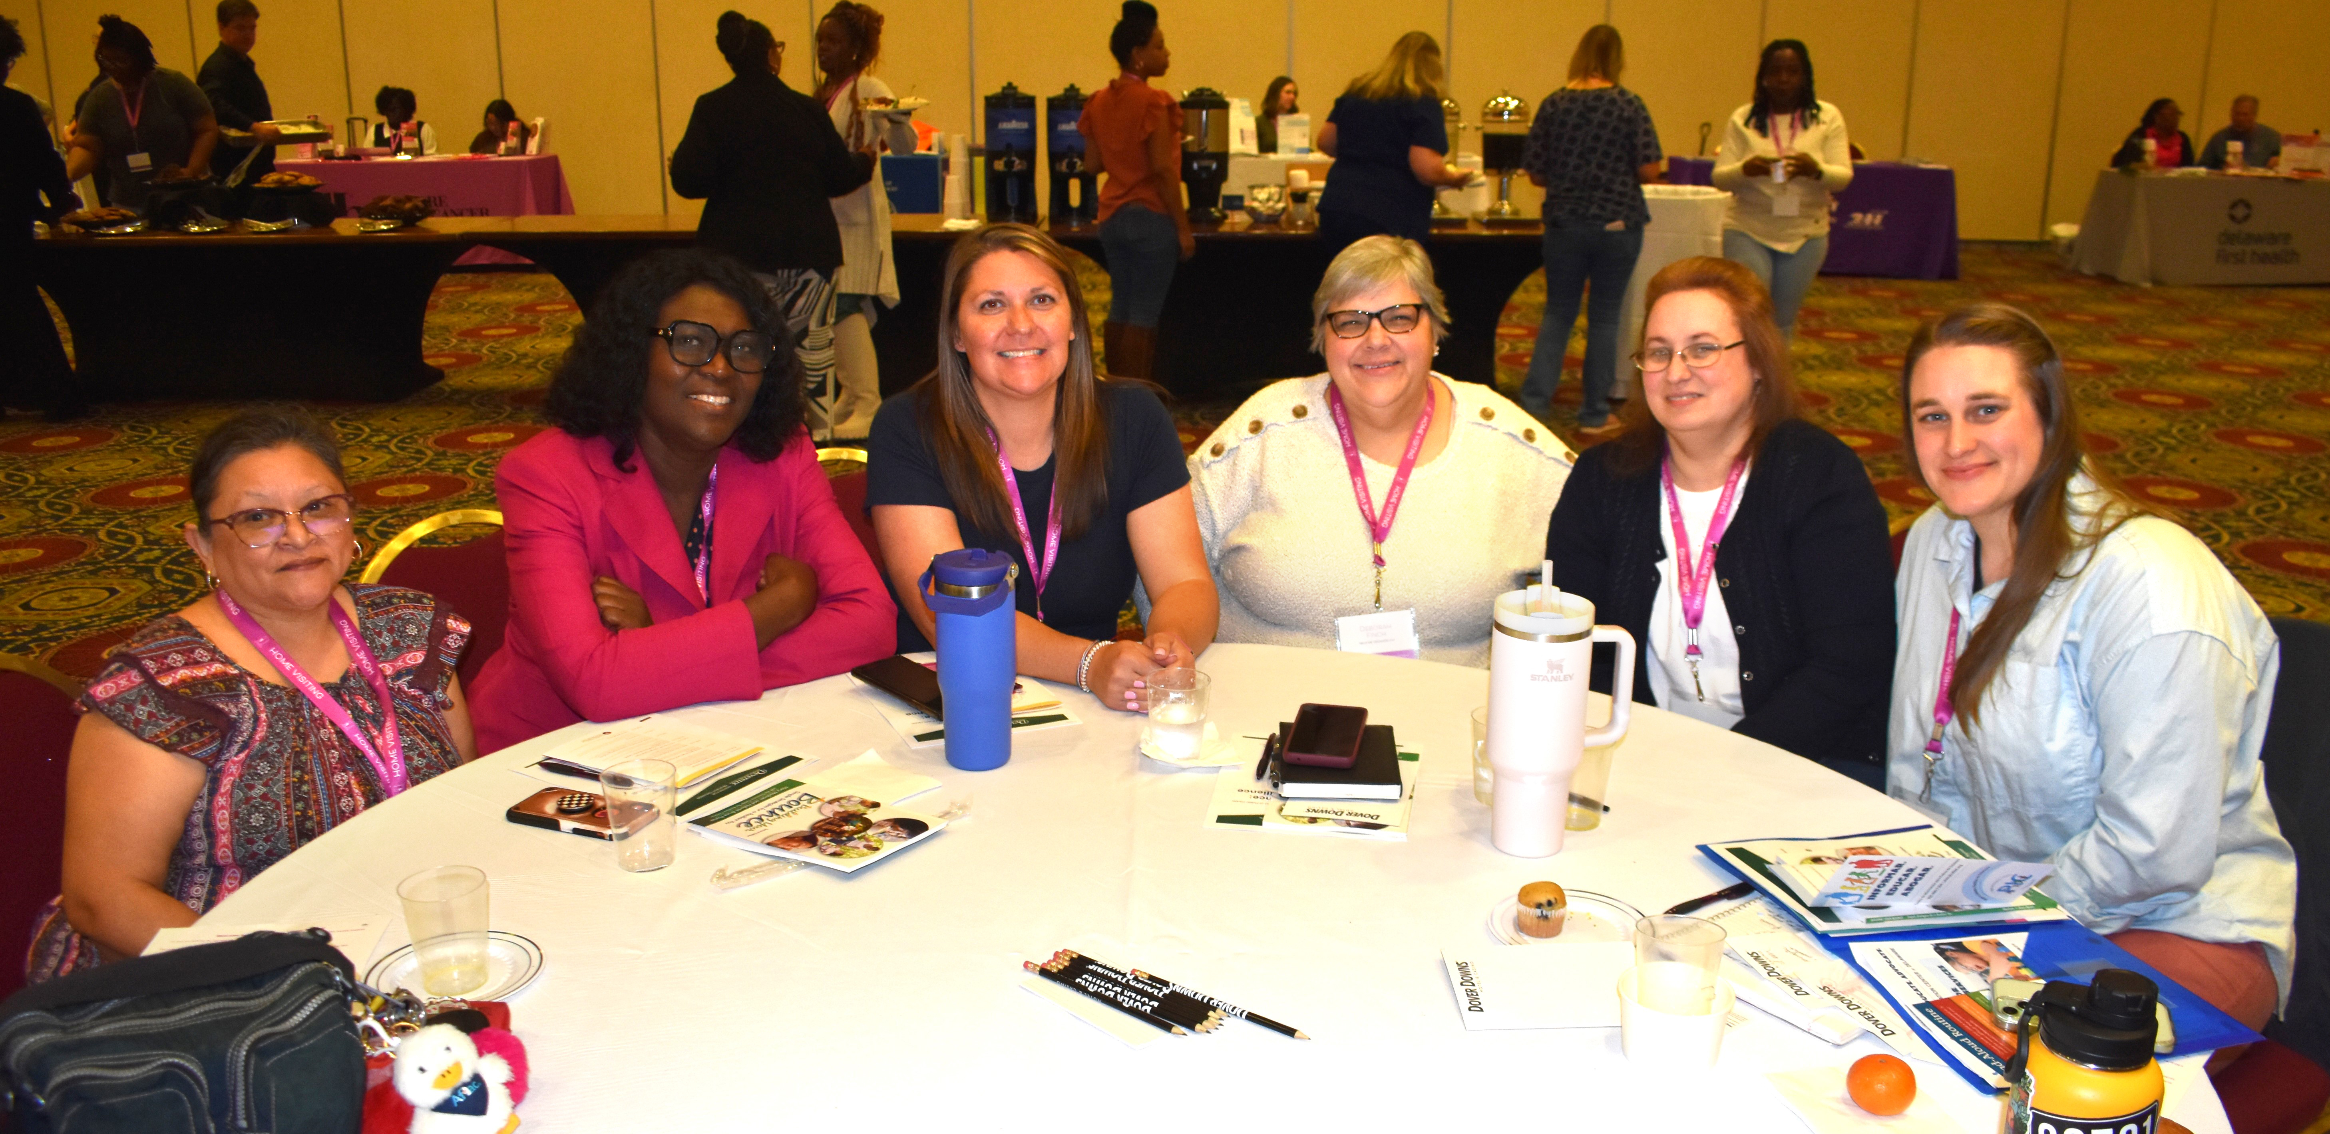

Slide 9
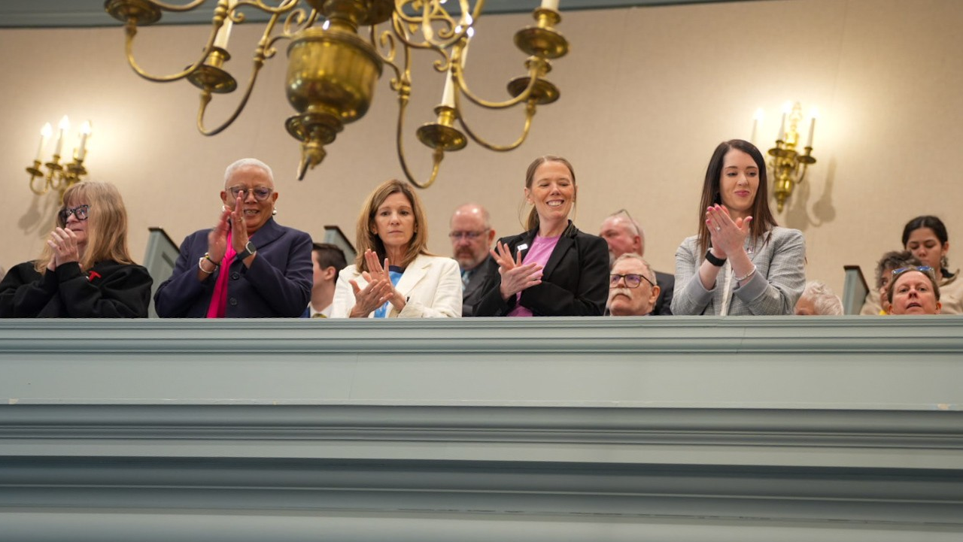
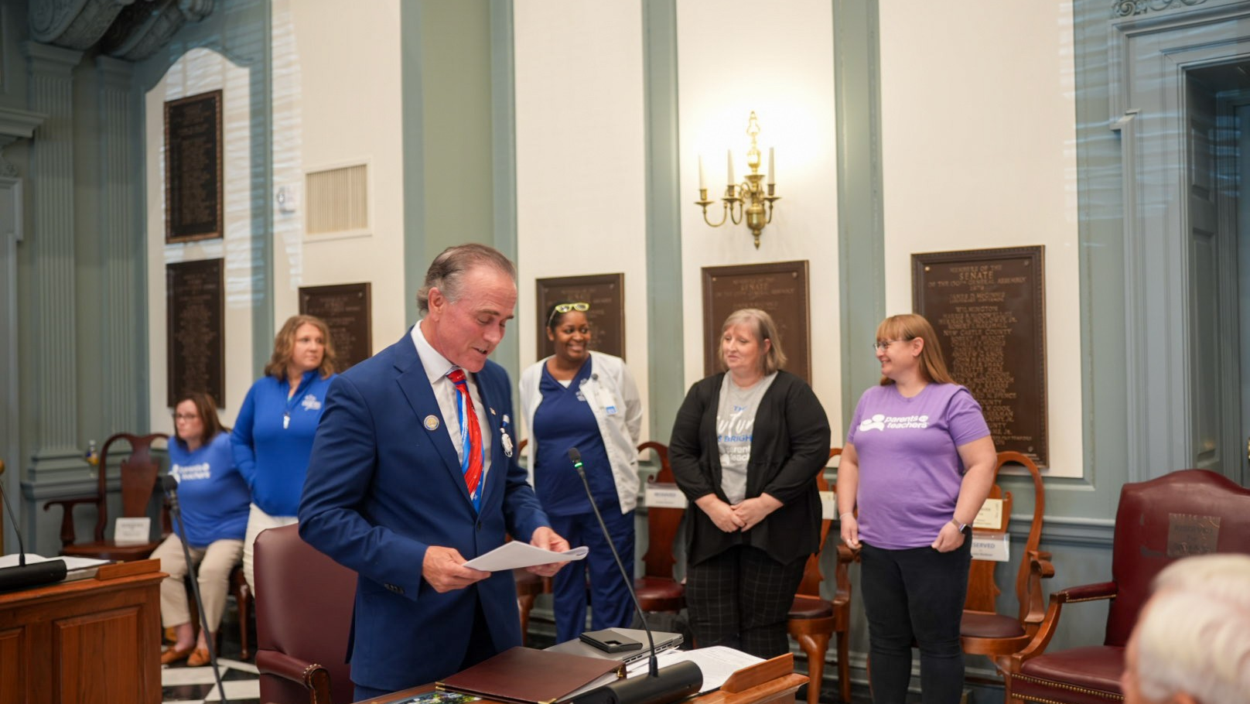
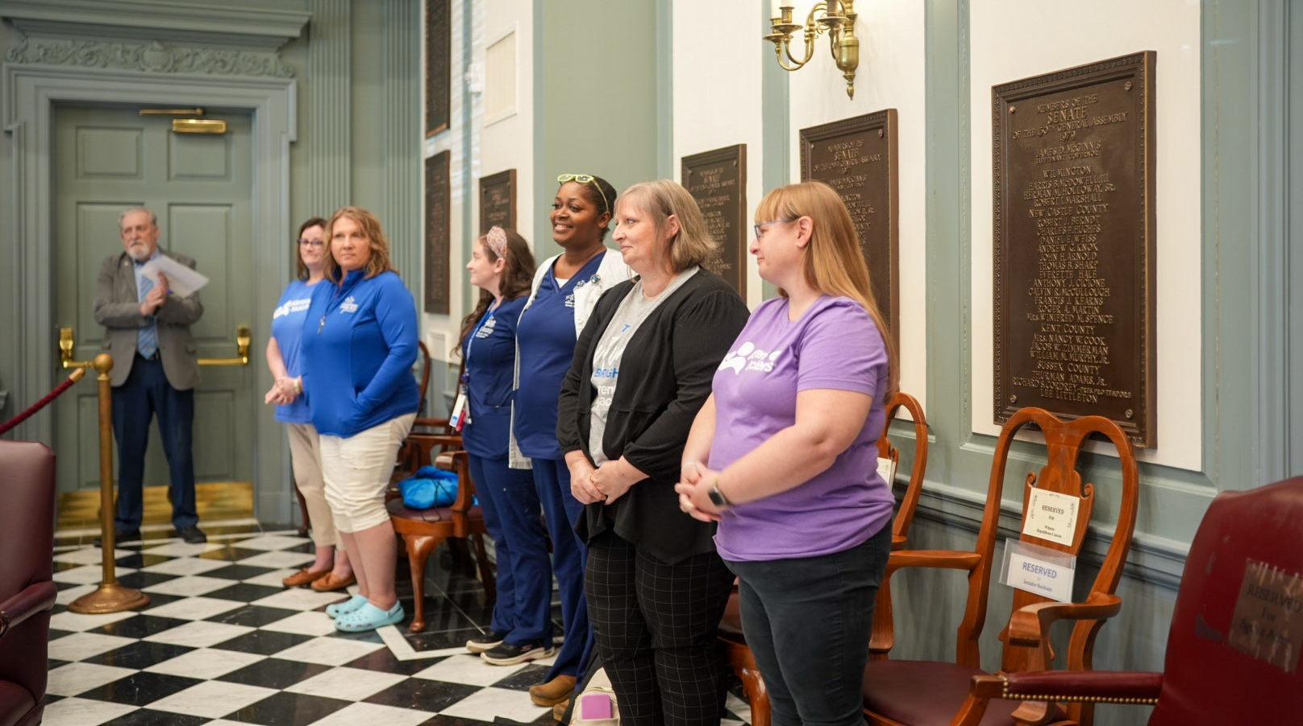
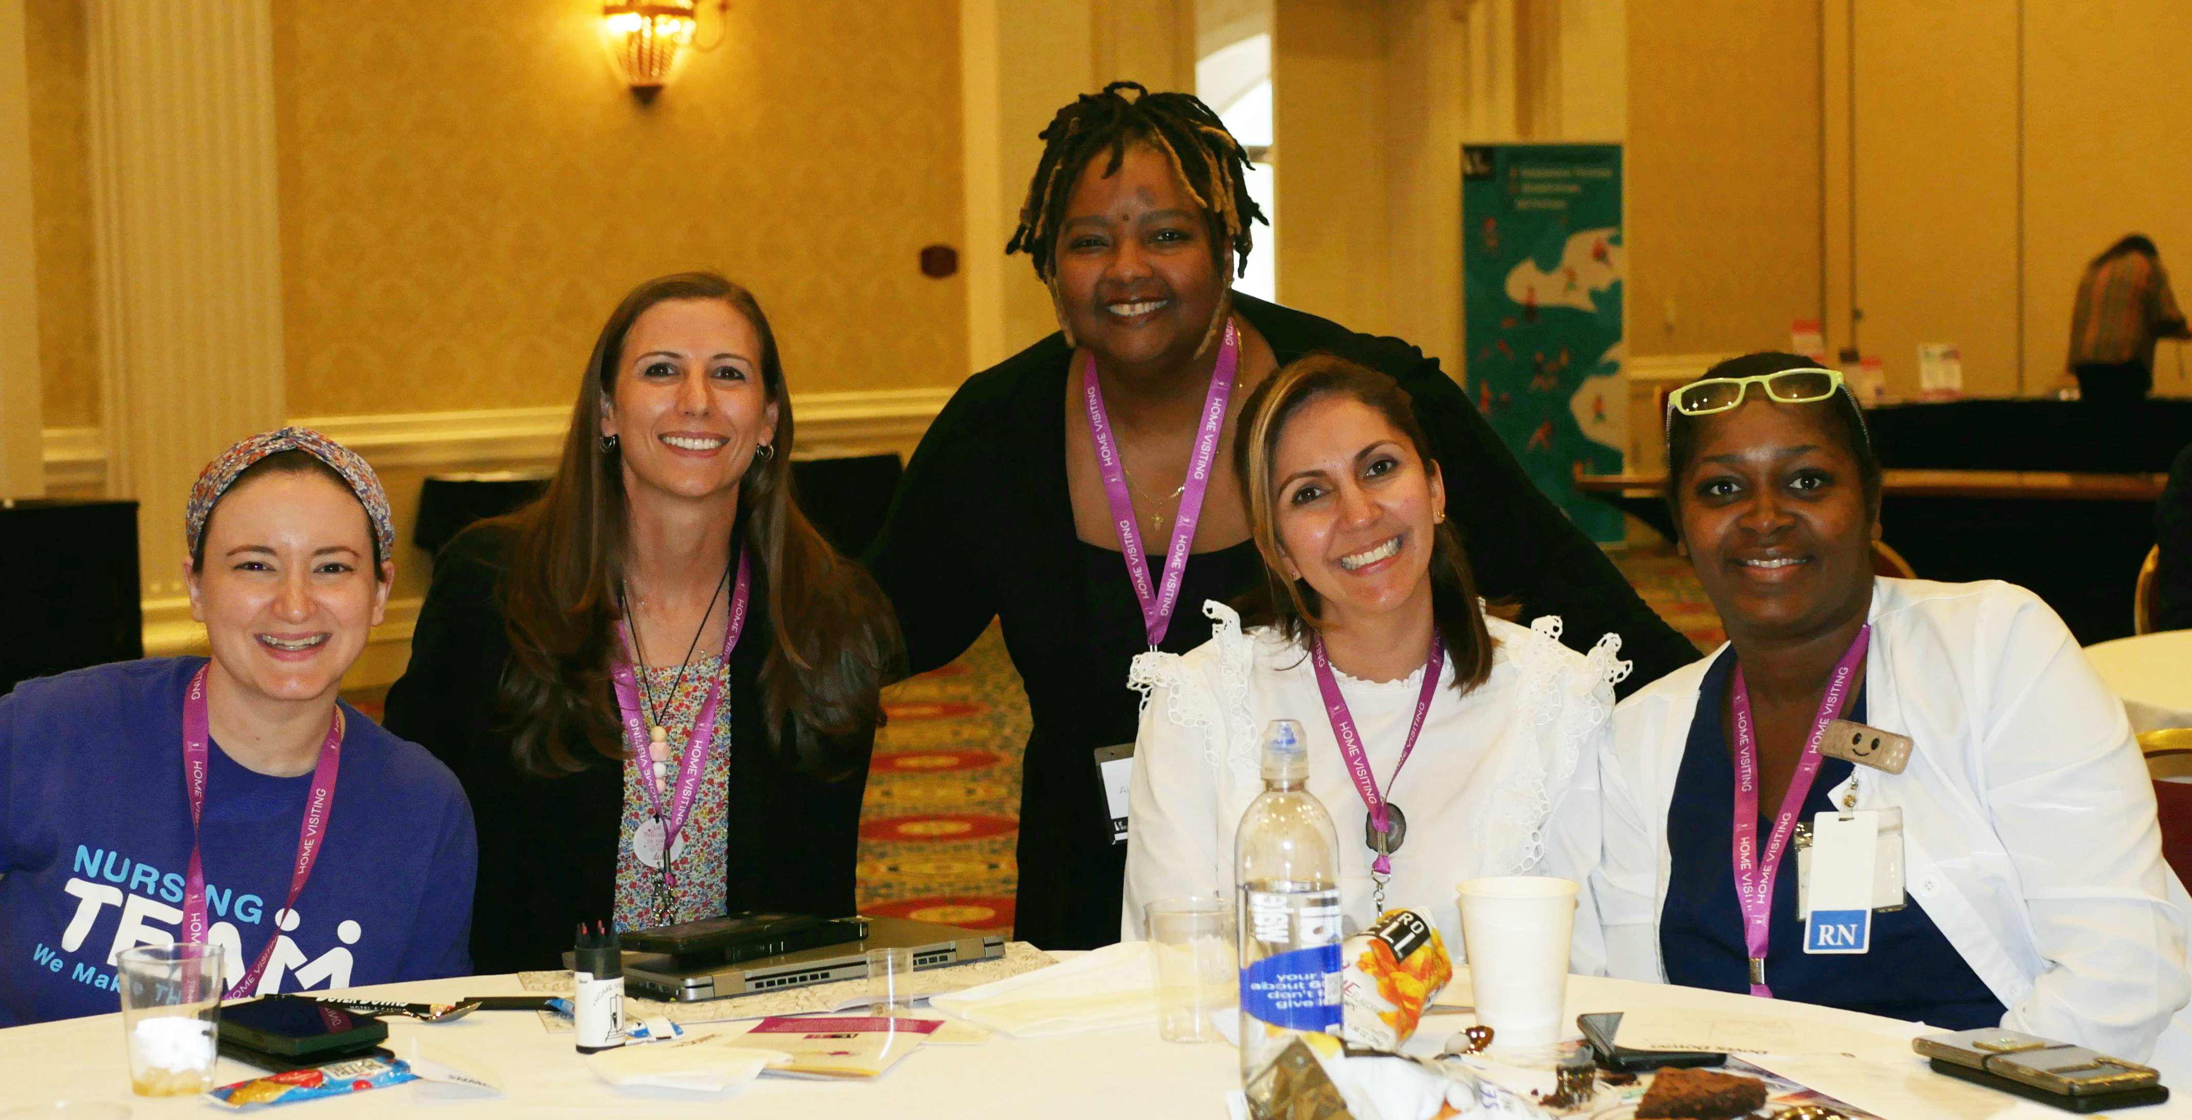

Slide 10
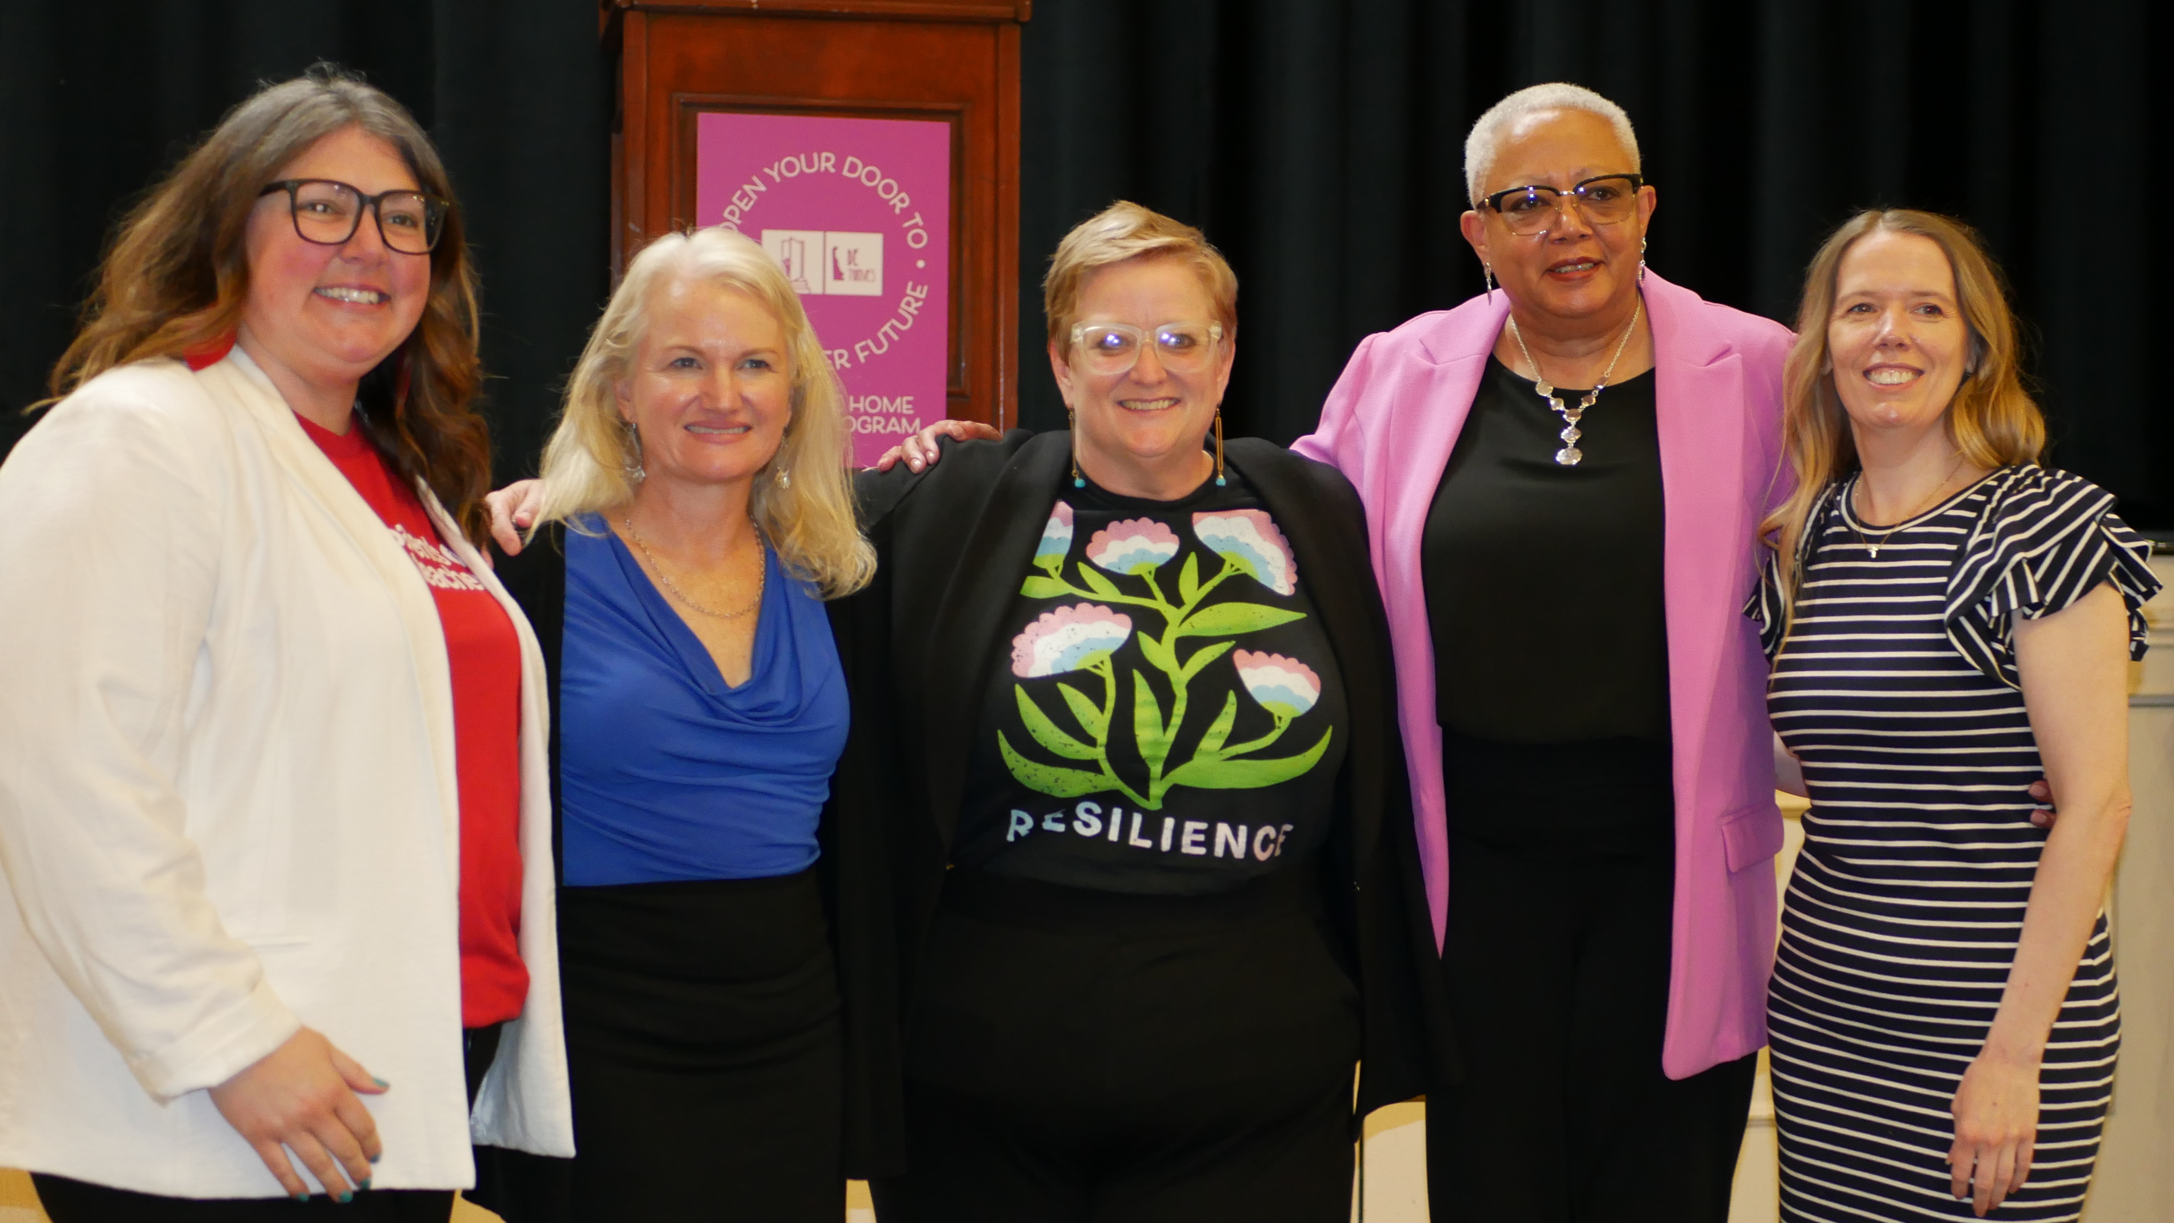
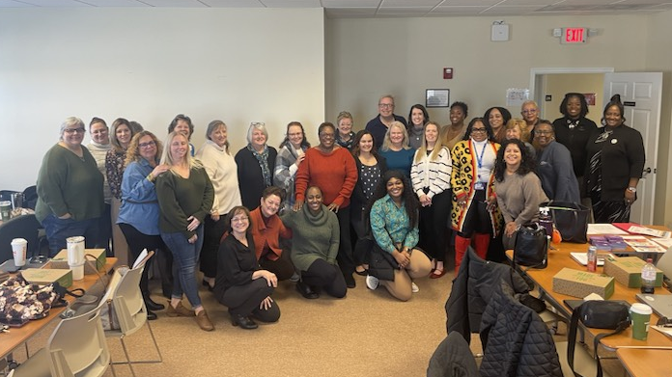
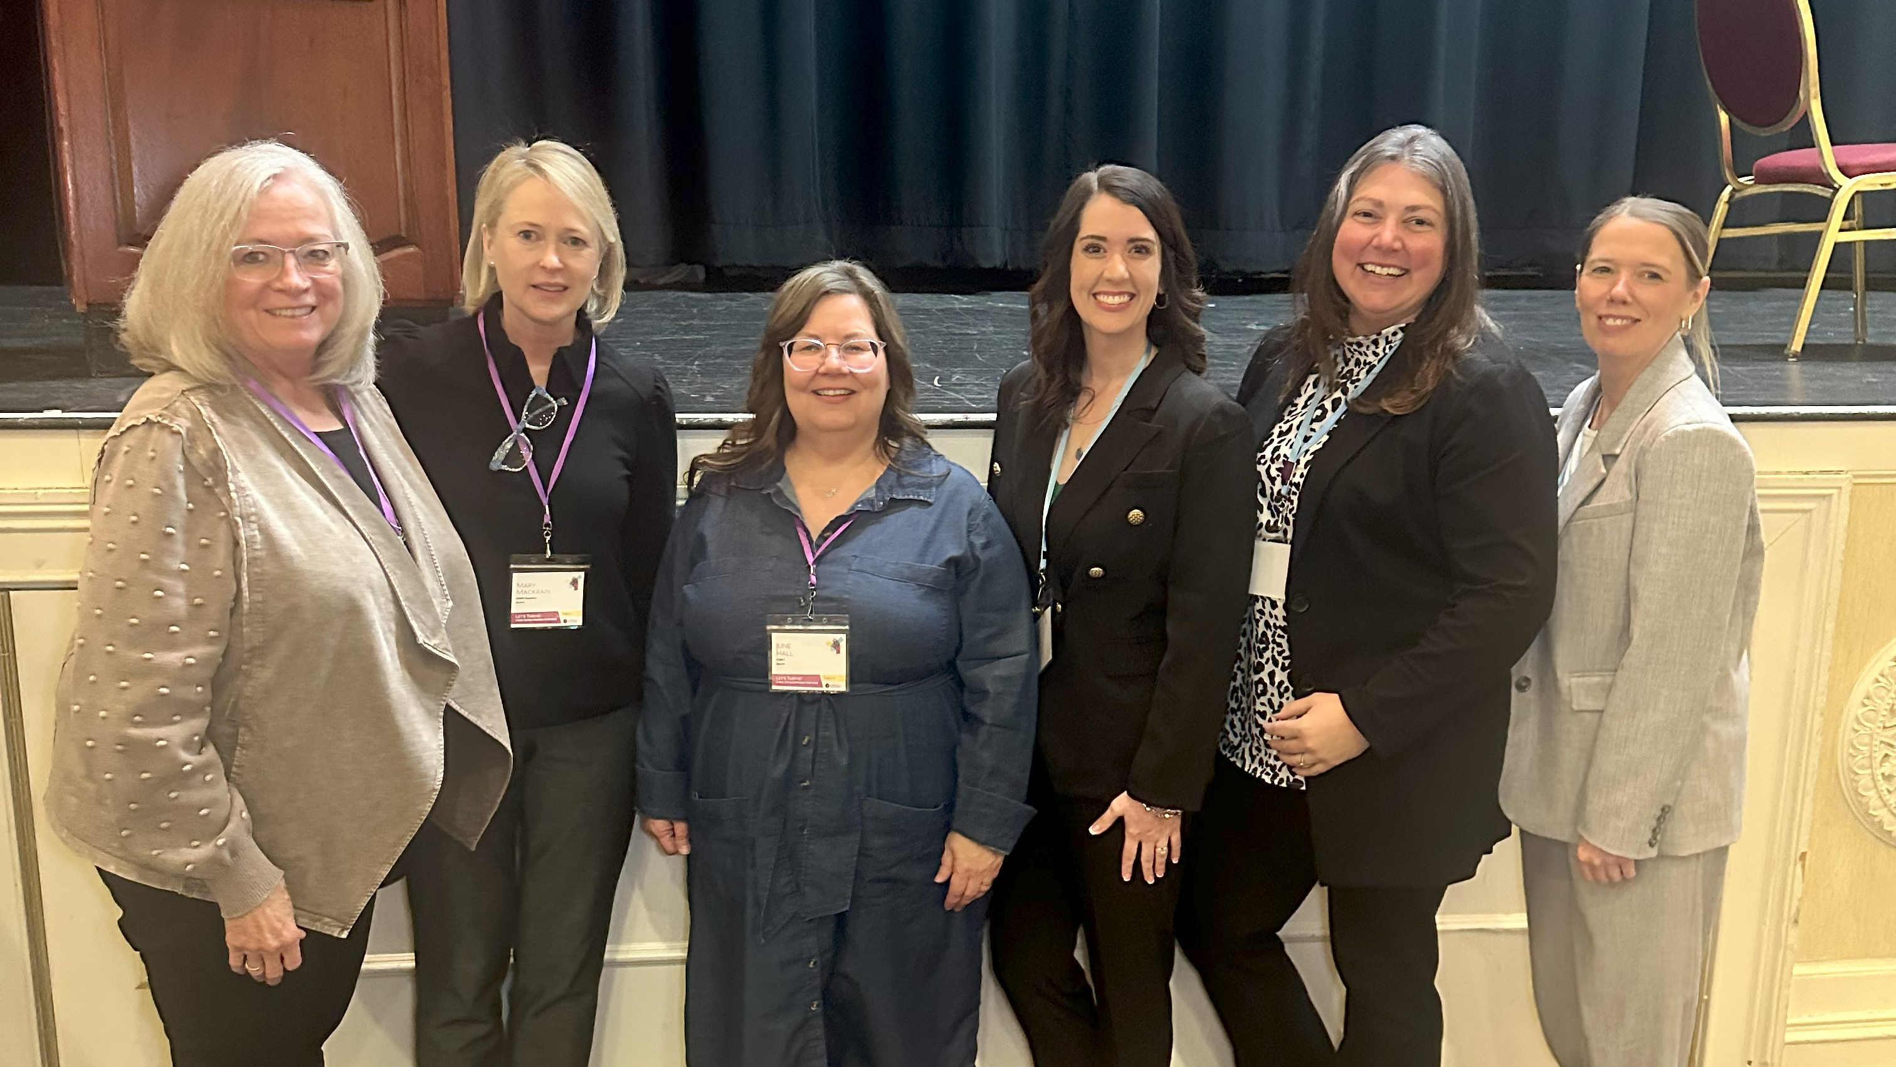
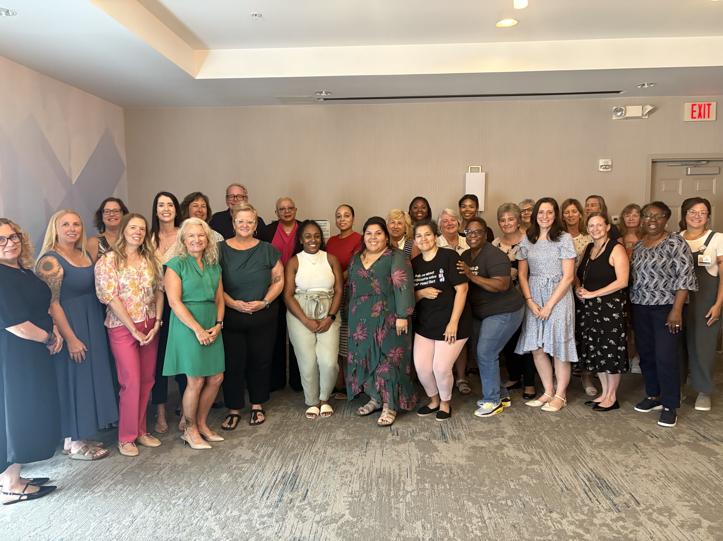

Slide 11
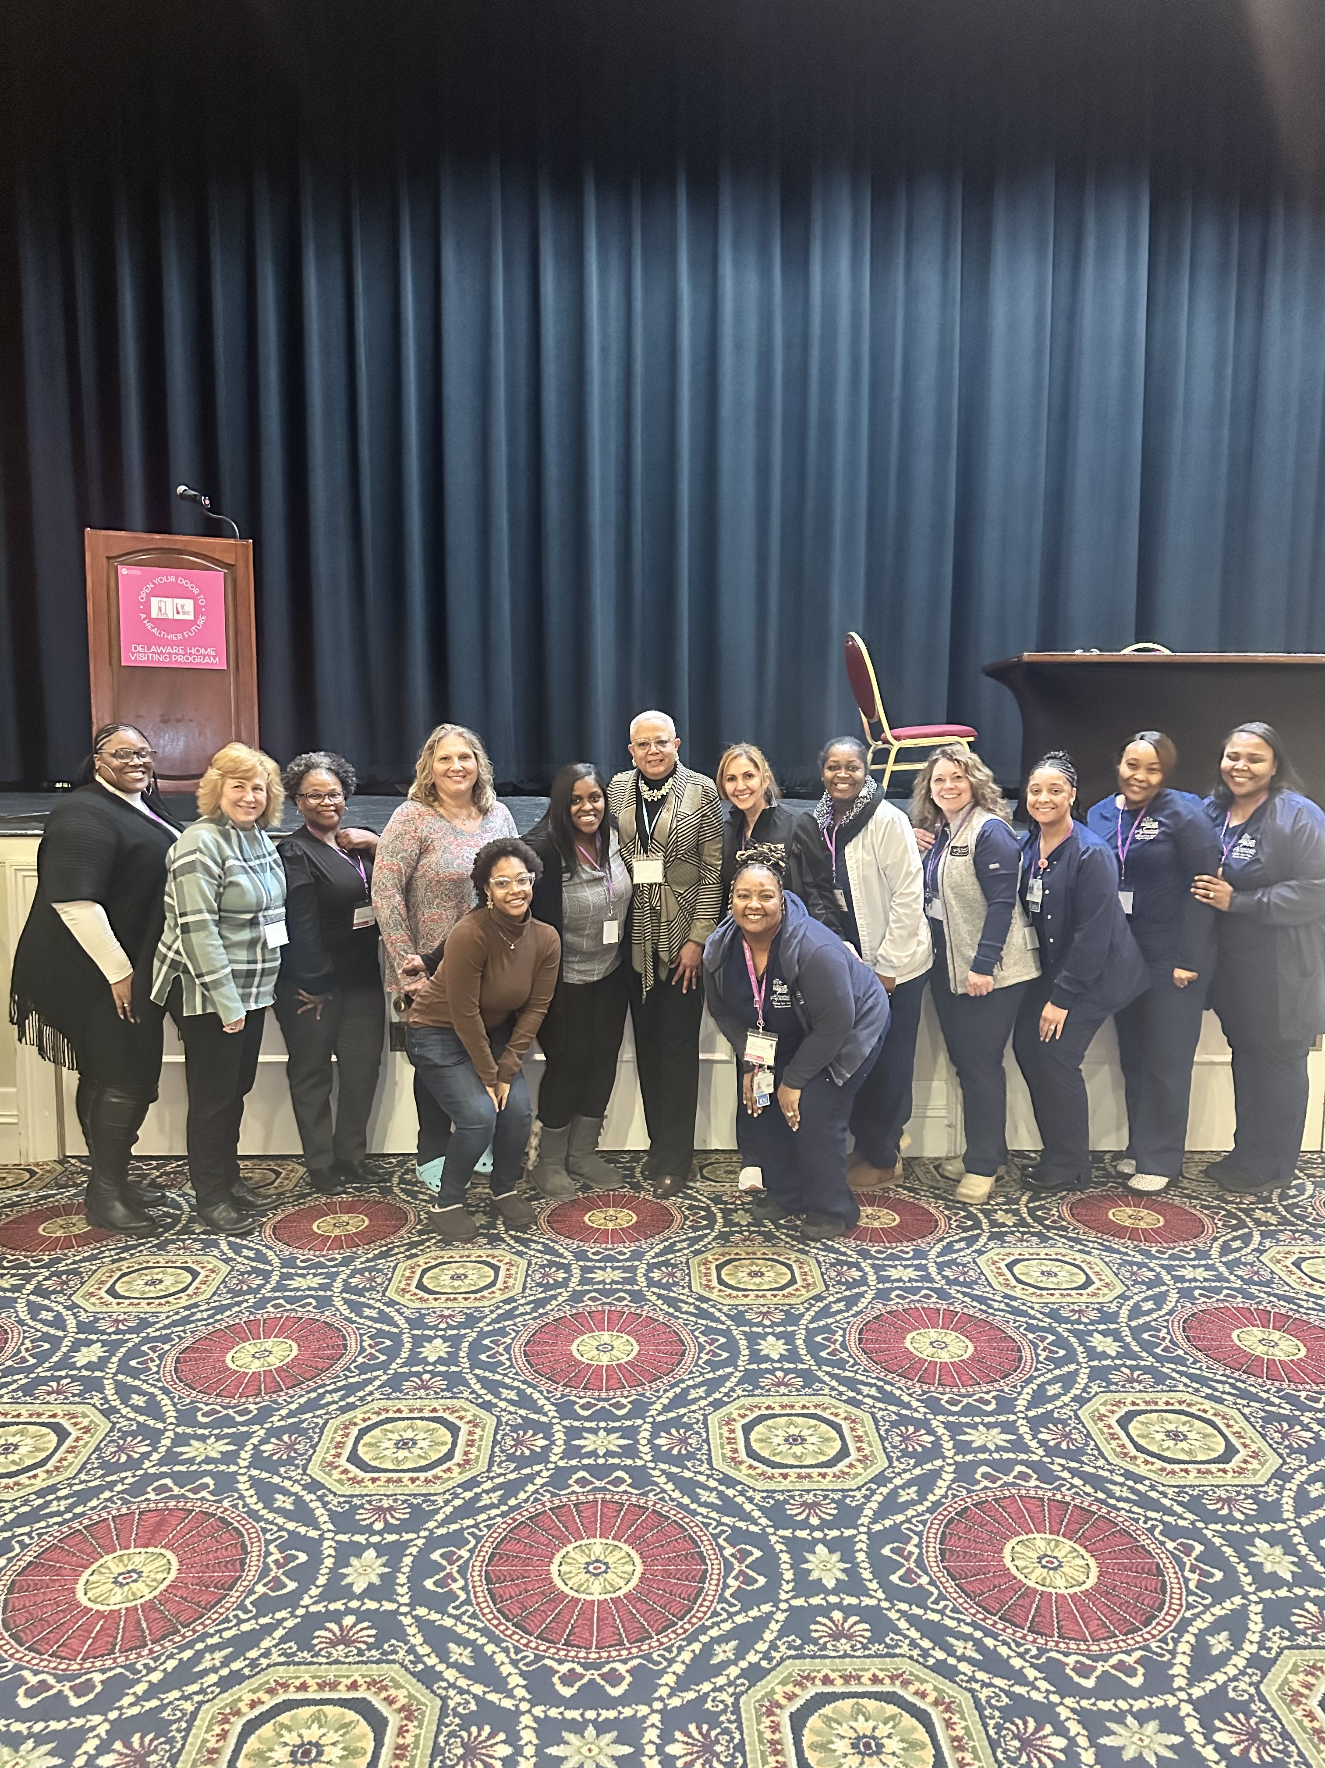
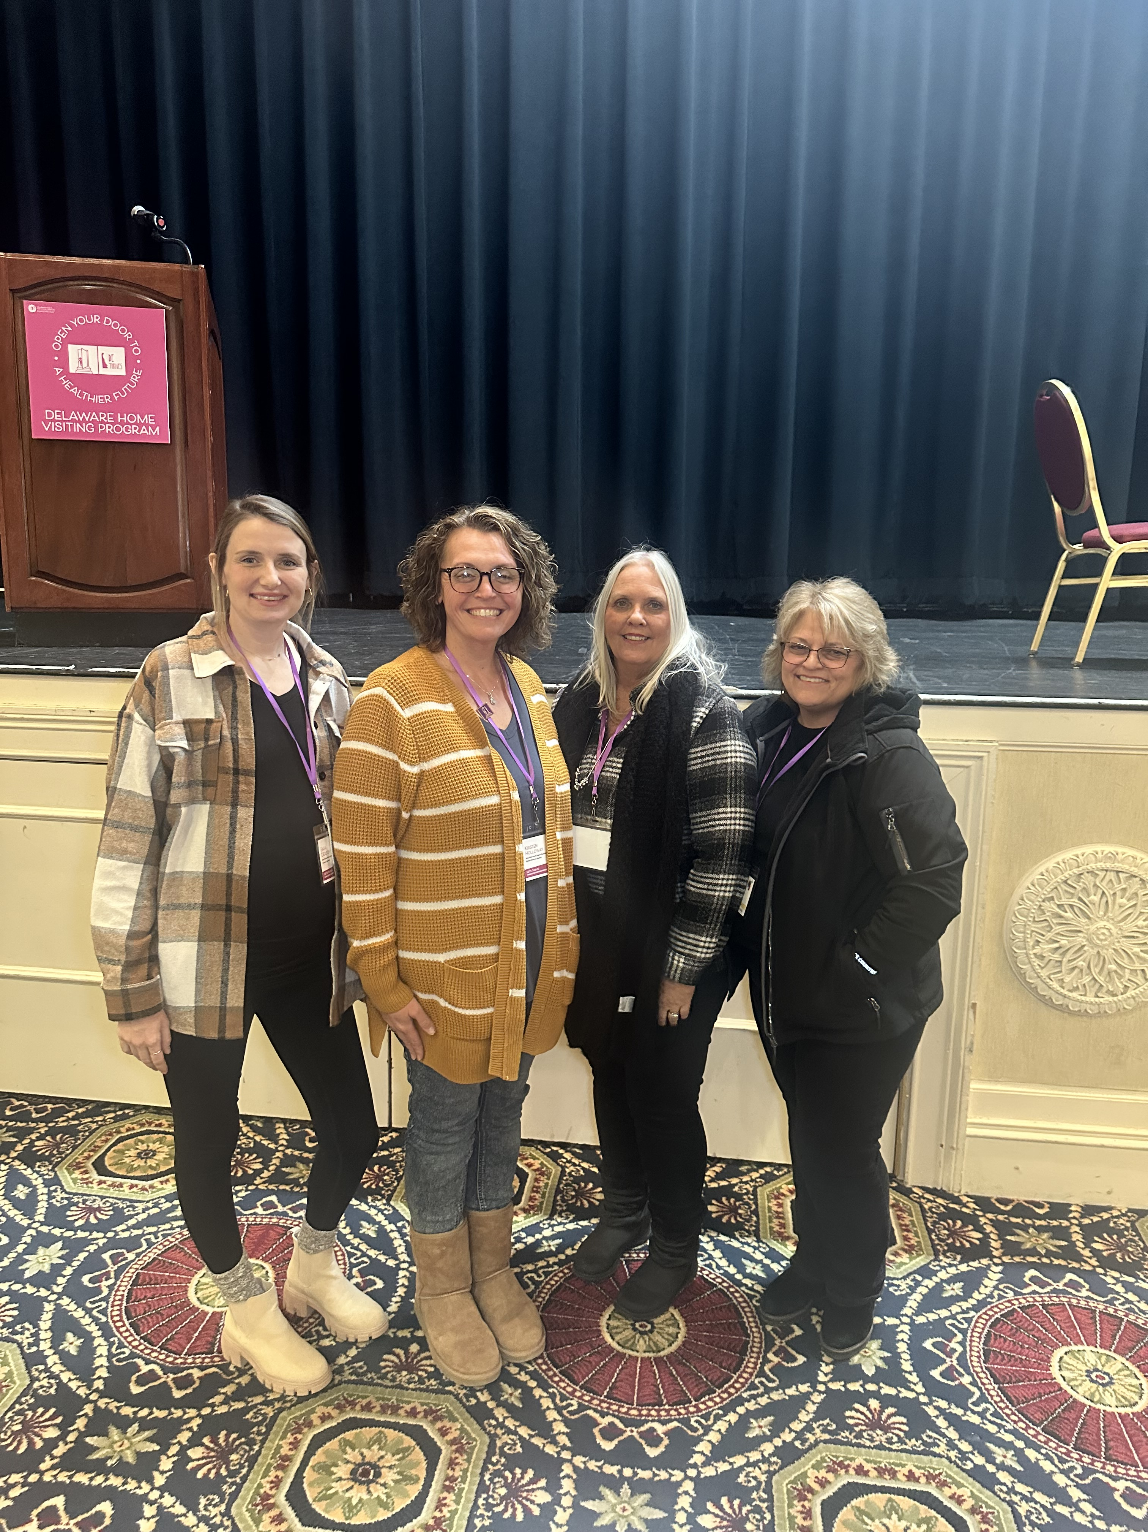
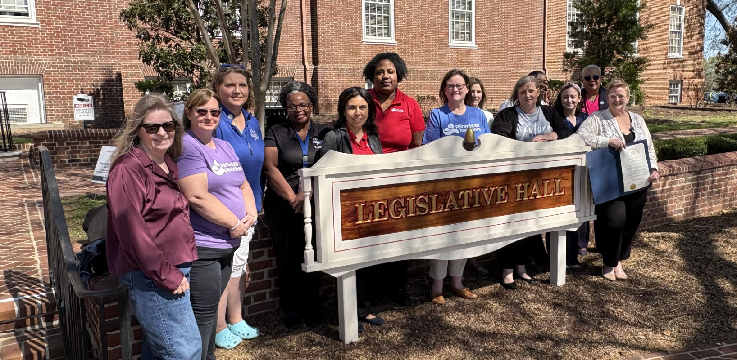

Slide 12
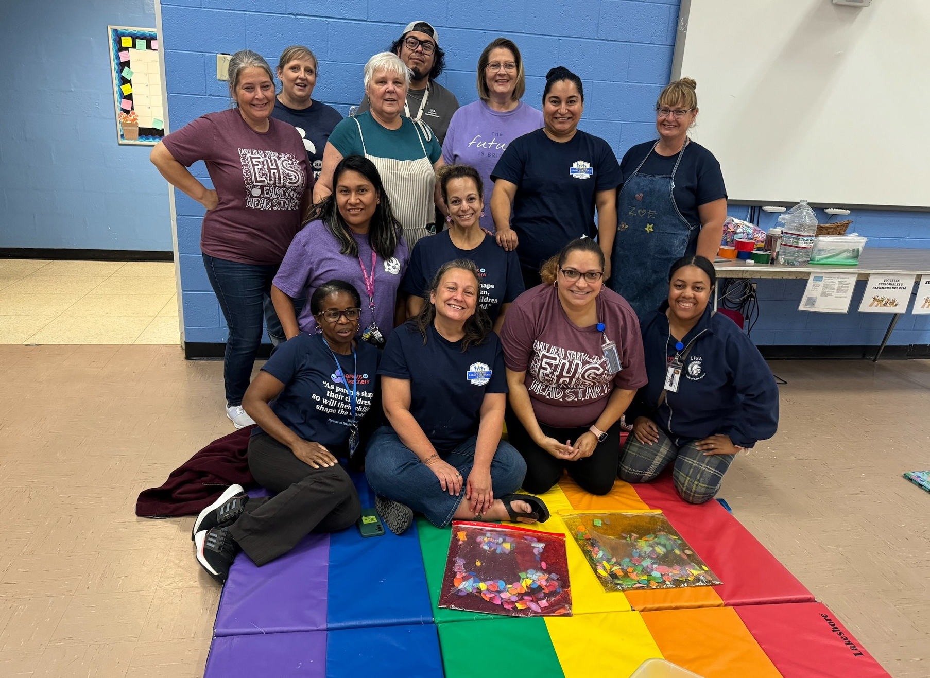

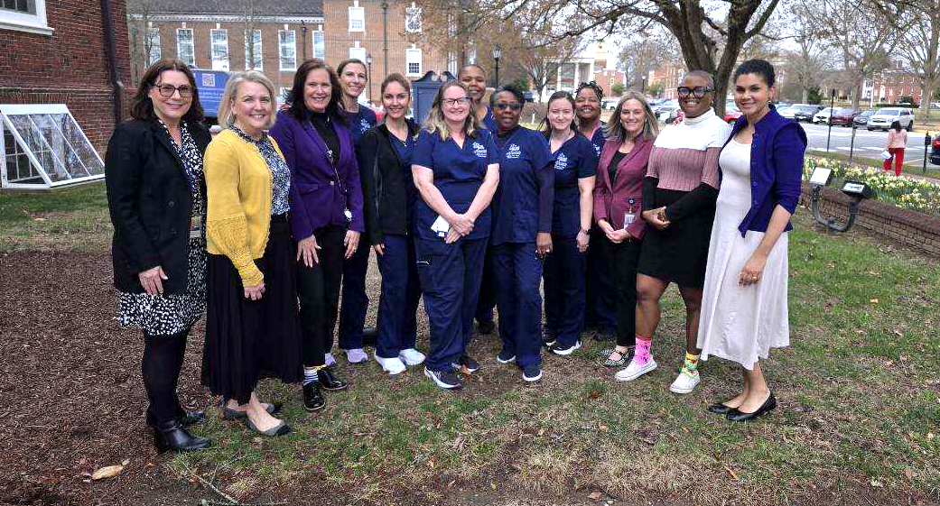
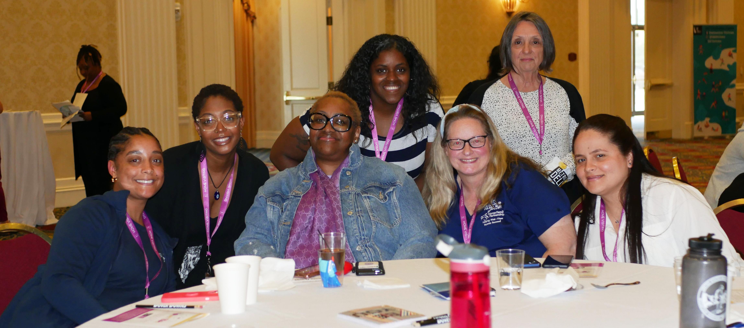

Slide 13
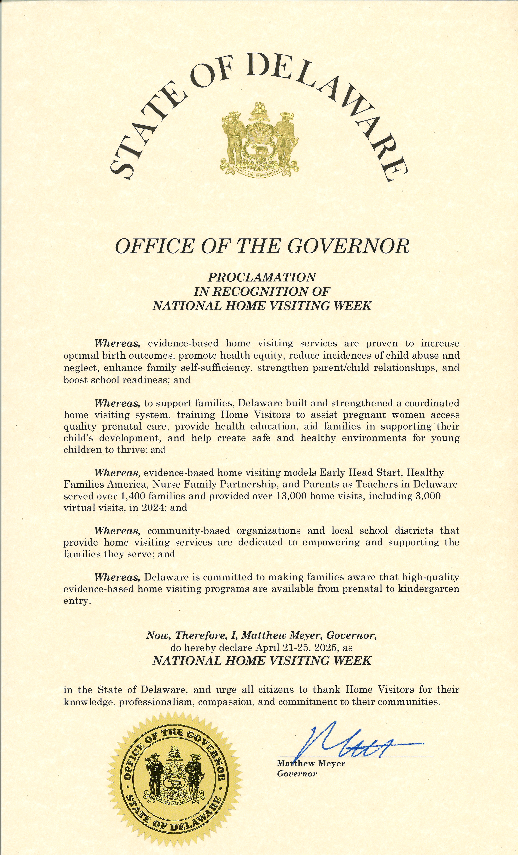

Slide 14

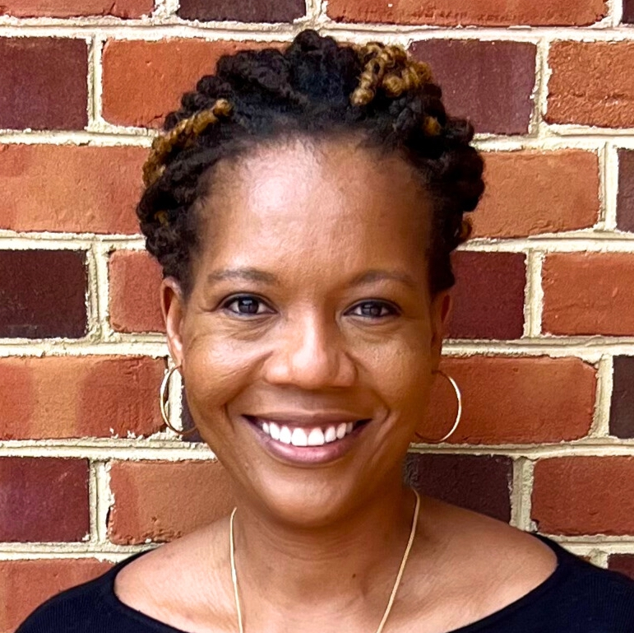
KEYNOTE PRESENTATION
Building Trust to Strengthen Families and Systems
REMONA ANTOINE
Senior Consultant, FranklinCovey

Slide 15
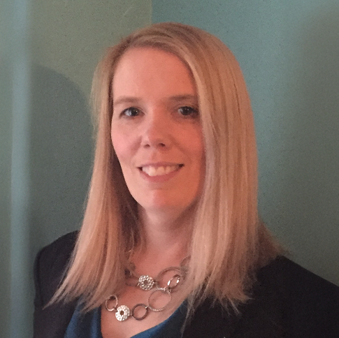
CLOSING AND NEXT STEPS
CRYSTAL SHERMAN
Chief
Maternal and Child Health Bureau
Division of Public Health
Delaware Department of Health and Social Services

Slide 16
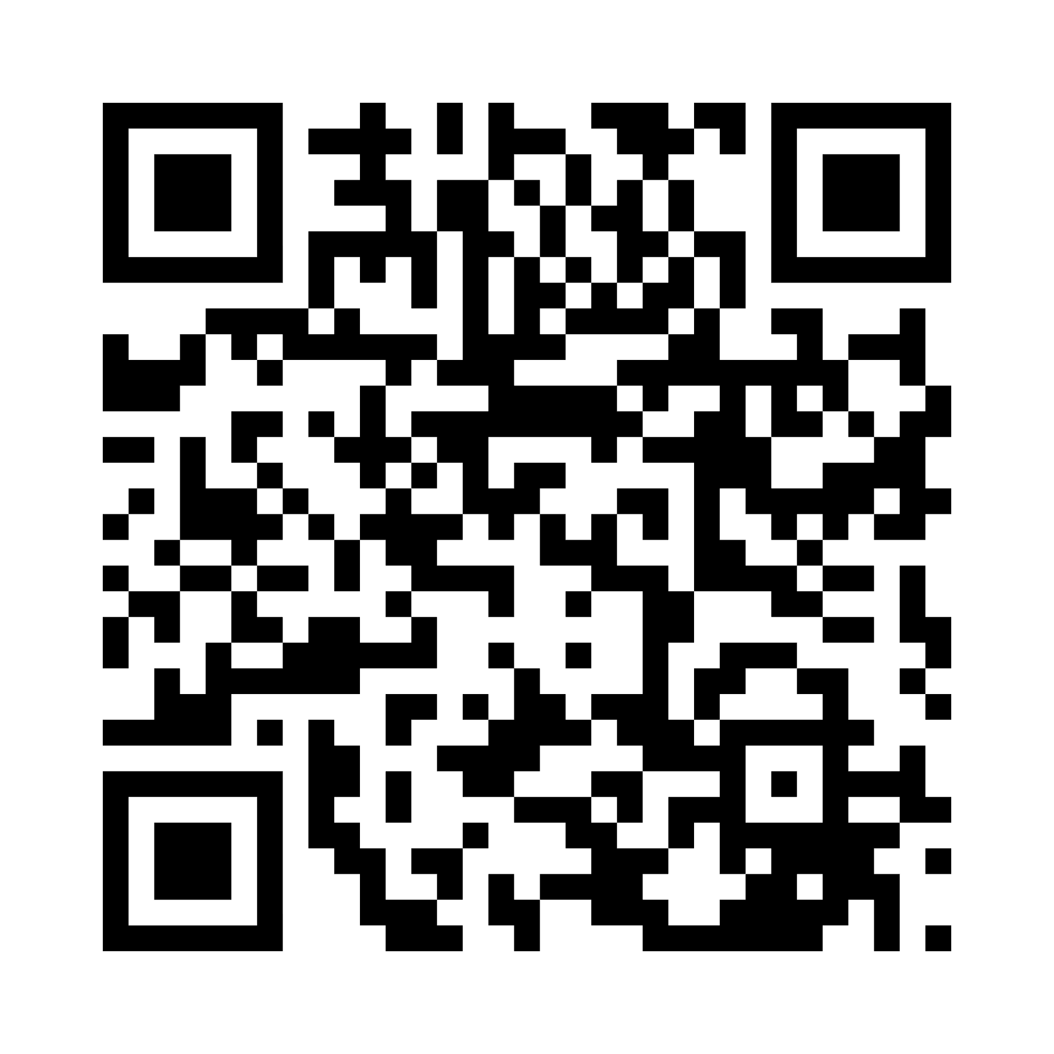
THANK YOU!
Please scan the code to take a quick post-event survey.
QR Code
FEEDBACK SURVEY

