Slide 1
DHMIC Summit 2024
Joia Crear-Perry, MD, FACOG

Slide 2
Mission
As an organization focused on the sexual reproductive health & wellbeing of Black women & birthing people world-wide, NBEC creates transnational solutions that optimize Black maternal, infant, sexual, & reproductive wellbeing. We shift systems & culture through training, research, technical assistance, policy, advocacy, & community-centered collaboration.
Vision
All Black Mamas, babies & their villages thrive.
Core Values
Leadership, Freedom, Wellness, Black Lives, Sisterhood

Slide 3
Objectives
Define Birth Equity
Identify shared language & tools for Birth Equity
Practice tools to apply towards Birth Equity & Respectful Maternity Care

Slide 5
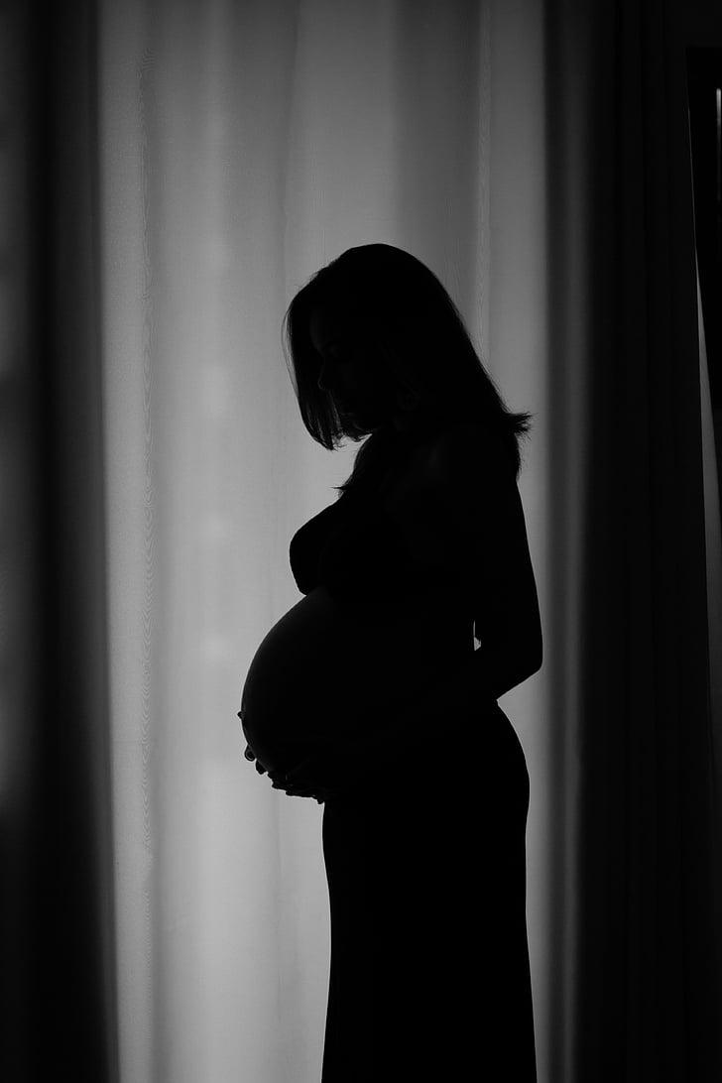
Black women in the U.S. suffer from life-threatening pregnancy complications twice as often as White women, and they die from pregnancy-related complications three to four times as often
as White women?
Why?

Slide 6
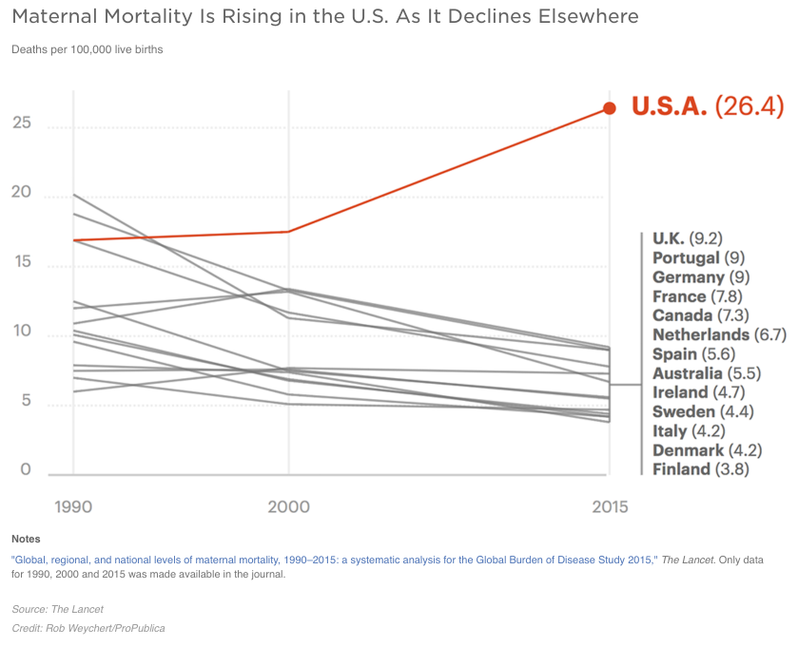
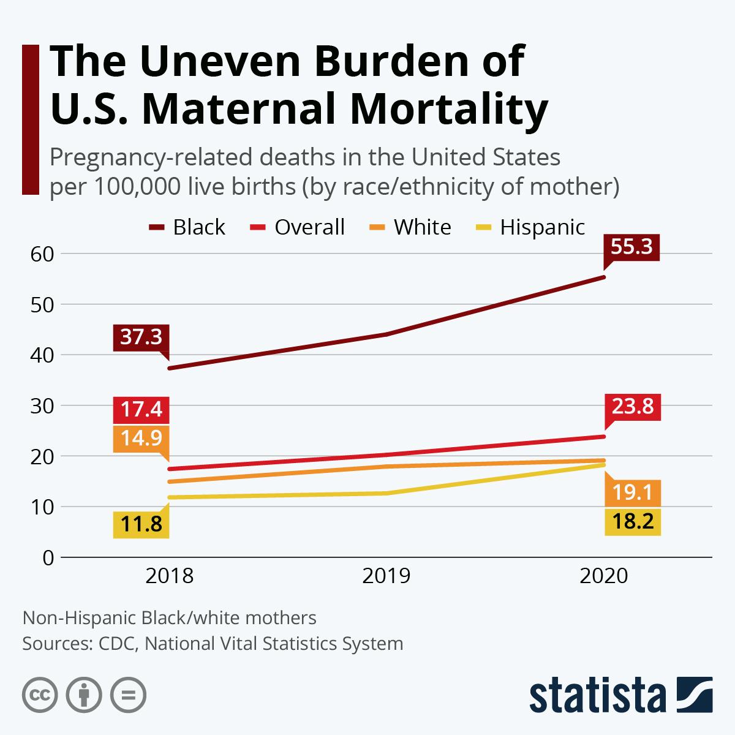
Maternal Mortality in the U.S.
Maternal Mortality rates in the U.S. have been rising since the 1990s.
The disparity in maternal mortality between Black & white women continues to widen.
Notes:
IMAGE SOURCE LINK(S):
(1) https://www.statista.com/chart/27465/pregnancy-related-deaths-in-the-united-states-per-100000-live-births/
(2) https://www.google.com/imgres?imgurl=https%3A%2F%2Fmiro.medium.com%2Fv2%2Fresize%3Afit%3A1400%2F0*-hqSpz13Az0zyoxr.png&tbnid=qXSEiM2DgcNgvM&vet=12ahUKEwjrz8Pc3eeBAxWGF2IAHTdpAj8QMygDegQIARBQ..i&imgrefurl=https%3A%2F%2Fmedium.com%2F%40markorton93%2Frecently-noted-maternal-mortality-in-america-4d295e989fc1&docid=KEeuPKfGXtB-bM&w=1024&h=768&itg=1&q=Maternal%20Mortality%20is%20rising%20in%20the%20U.S.%20as%20it%20declines%20elsewhere&client=safari&ved=2ahUKEwjrz8Pc3eeBAxWGF2IAHTdpAj8QMygDegQIARBQ

Slide 7
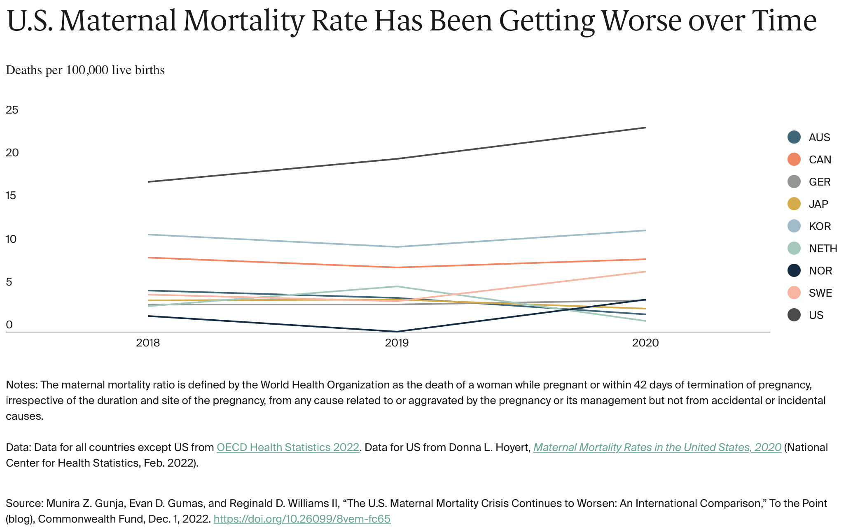
Maternal Mortality in the U.S.
Notes:
IMAGE SOURCE LINK: https://www.commonwealthfund.org/blog/2022/us-maternal-mortality-crisis-continues-worsen-international-comparison

Slide 8
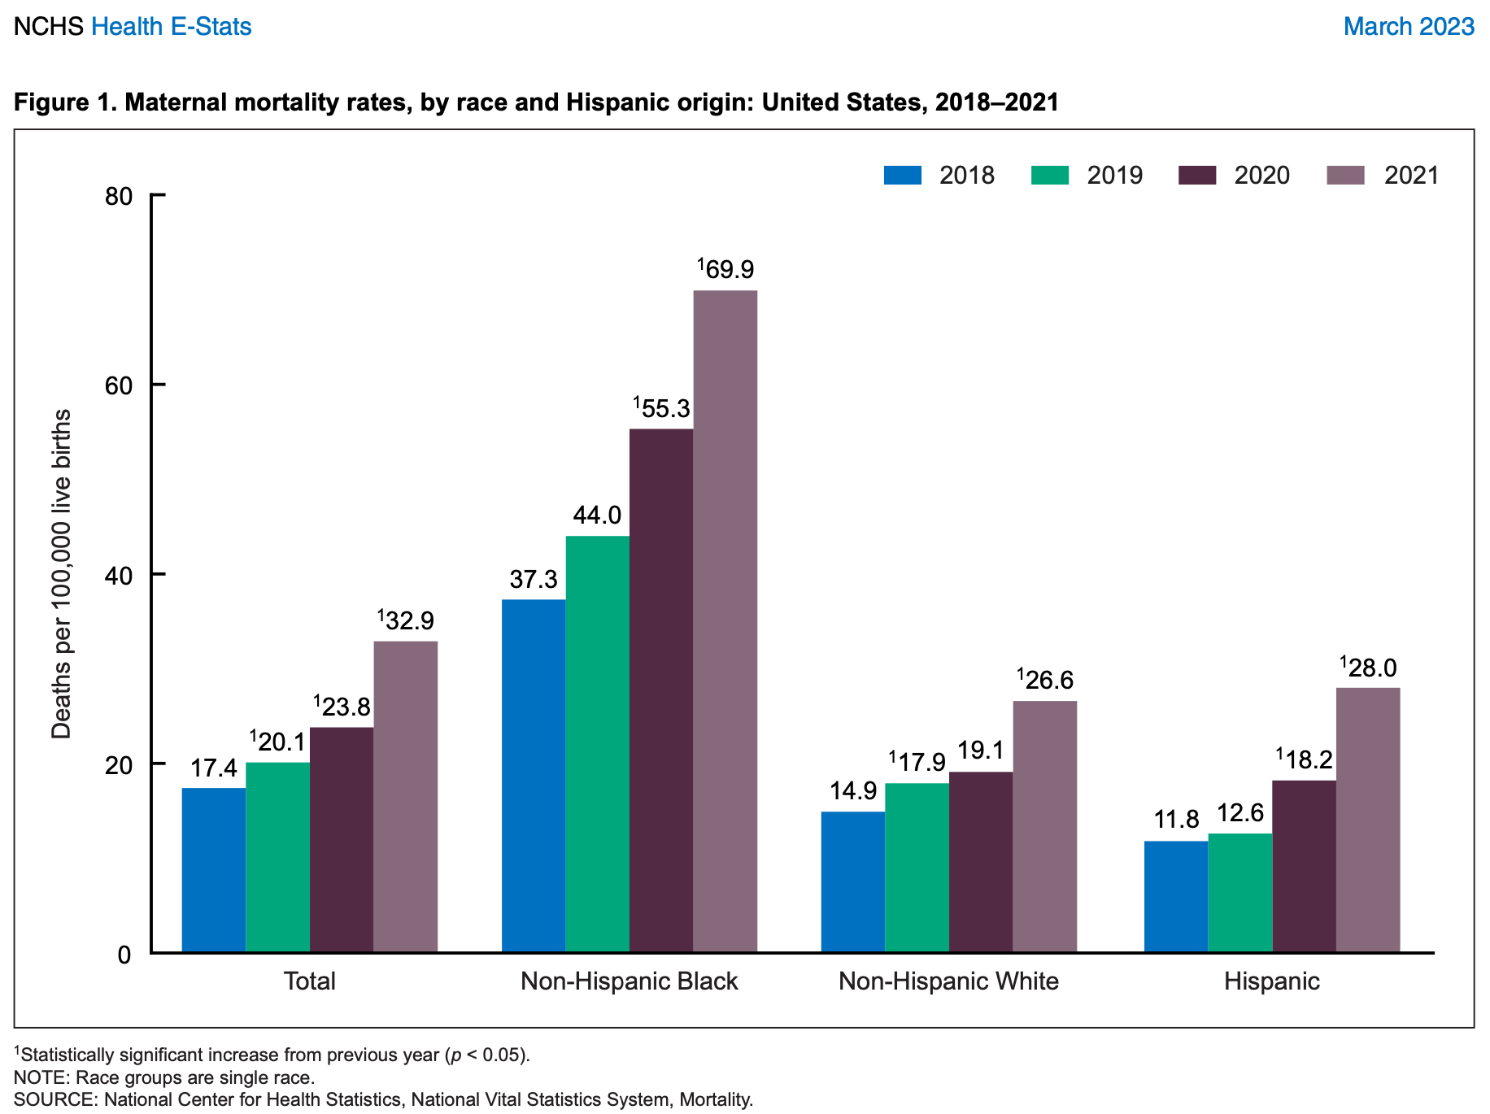
Notes:
IMAGE SOURCE LINK: https://www.cdc.gov/nchs/data/hestat/maternal-mortality/2021/maternal-mortality-rates-2021.pdf
RE: SOURCE - MMR in the US, 2021 National Center for Health Statistics (NCHS) Health E-Stats (March 2023) by Donna L. Hoyert

Slide 9
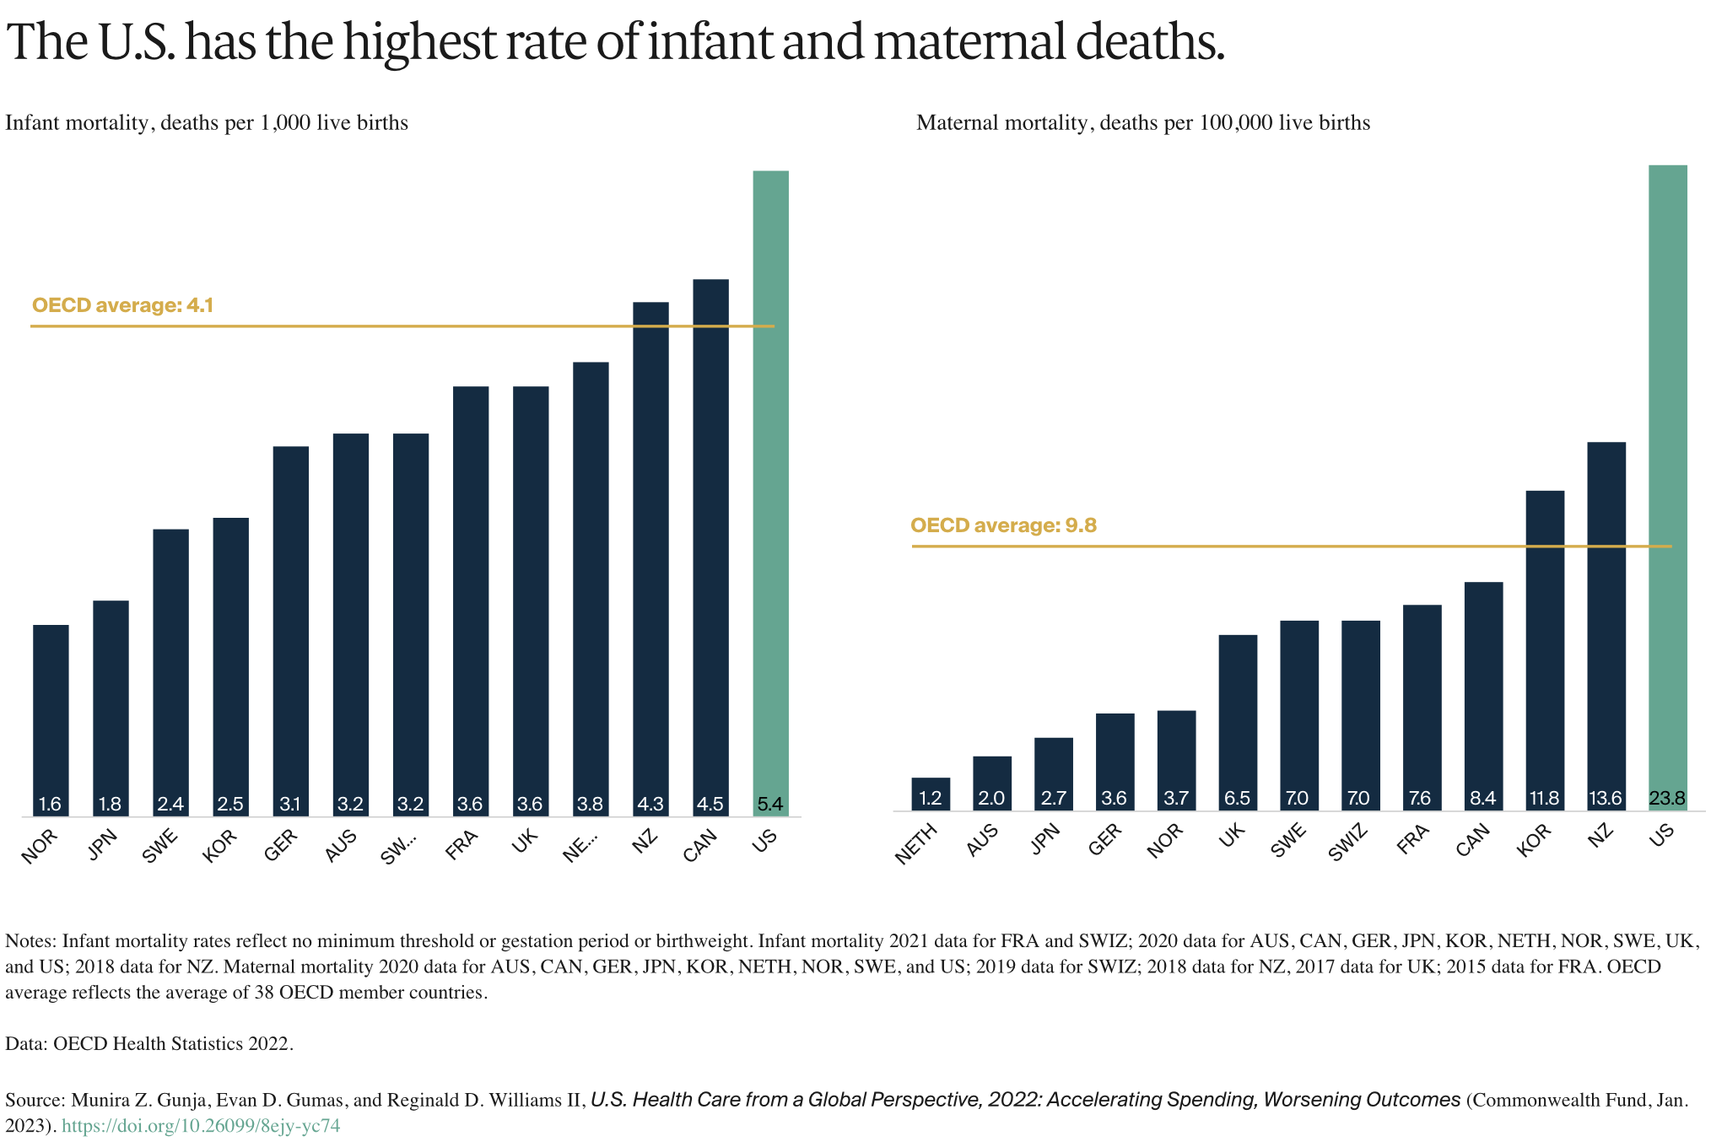
Infant & Maternal Mortality, OECD Health Statistics (2022)
Notes:
IMAGE SOURCE LINK: https://www.commonwealthfund.org/publications/issue-briefs/2023/jan/us-health-care-global-perspective-2022

Slide 10
Closer to home:
Premature birth is by far the leading cause of infant mortality in Delaware. In 2020 and 2021,
1 in 9 babies was born preterm in Delaware, which is 11.0% of live births.

Slide 11
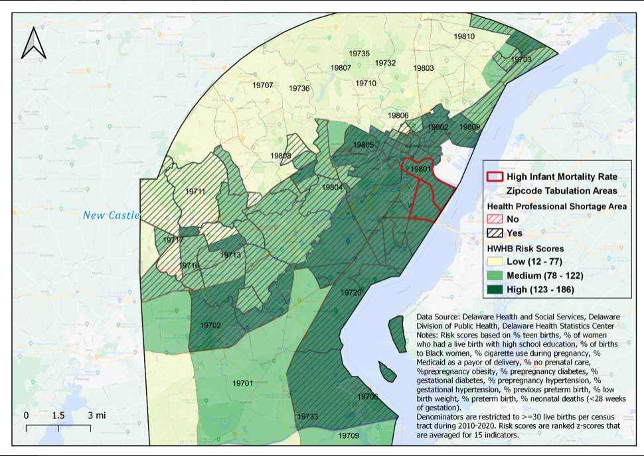
Healthy Women/Healthy Babies High Risk Zones
Racial disparities in infant mortality have been persistent with a 2.7 disparity ratio of
black/white infant deaths with the highest rate of infant mortality being in the City of
Wilmington and the overall lowest rate in Kent County

Slide 12
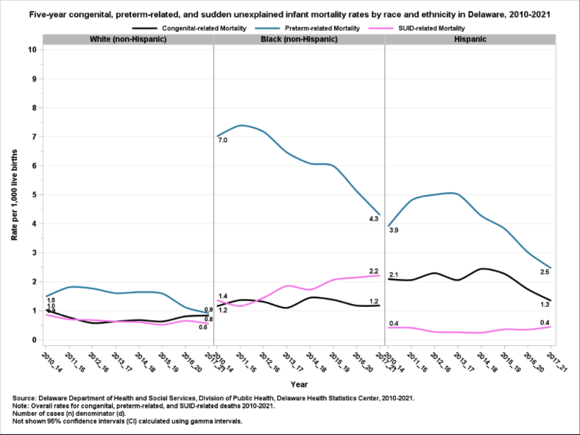
Sudden Unexplained IMR in DE
5-year sudden
unexplained infant
mortality rate for Black
(non-Hispanic)
increased by 57%!
While 5-year sudden
unexplained infant
mortality rate for White
(non-Hispanics)
decreased by 33%!

Slide 13
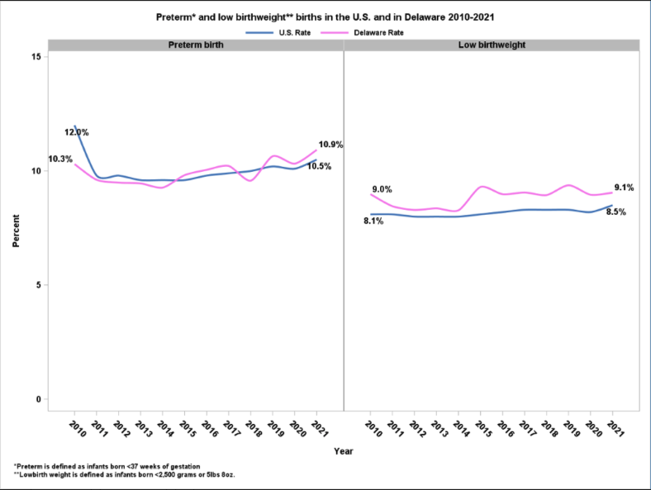
Preterm Birth in DE
Delaware’s preterm
births (<37 weeks
gestation) and low
birth weight (<2,500
grams or 5lbs 8oz.)
rates is higher than
the U.S. rates.

Slide 14
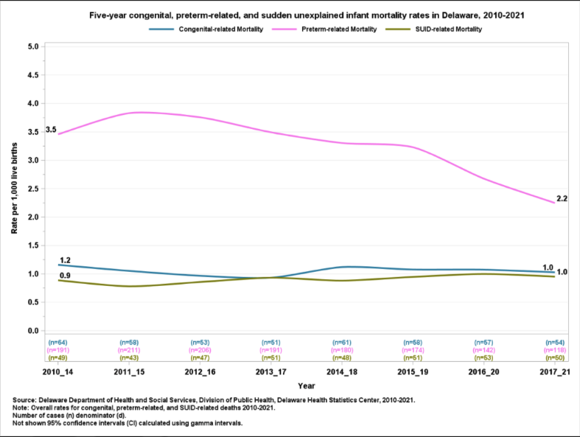
Preterm-related Mortality Rate in DE
The preterm-
related
mortality rate one of
the leading causes of
IMR decreased by
37% between
2010-2021.

Slide 15
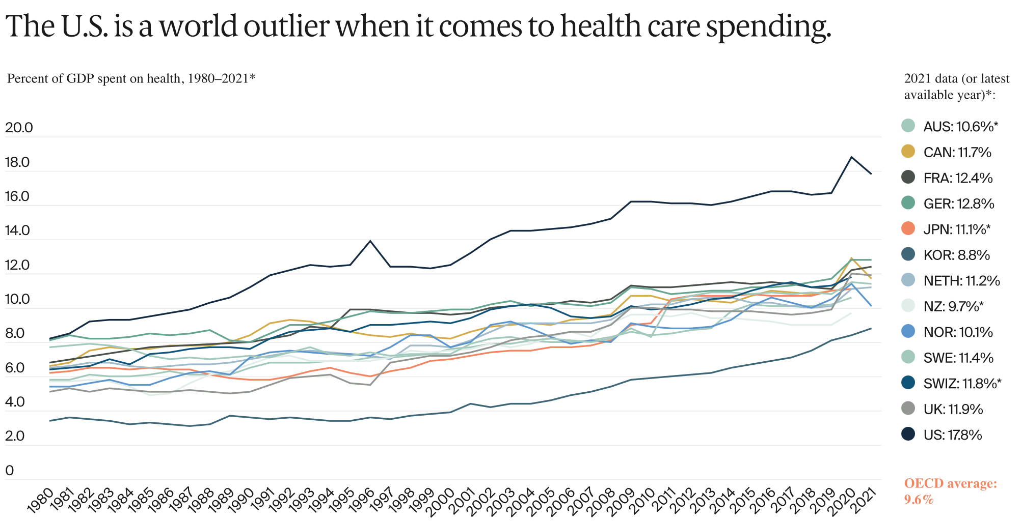
Notes:
US World Healthcare spending as a % of GDP
IMAGE SOURCE LINK: https://www.commonwealthfund.org/publications/issue-briefs/2023/jan/us-health-care-global-perspective-2022

Slide 16
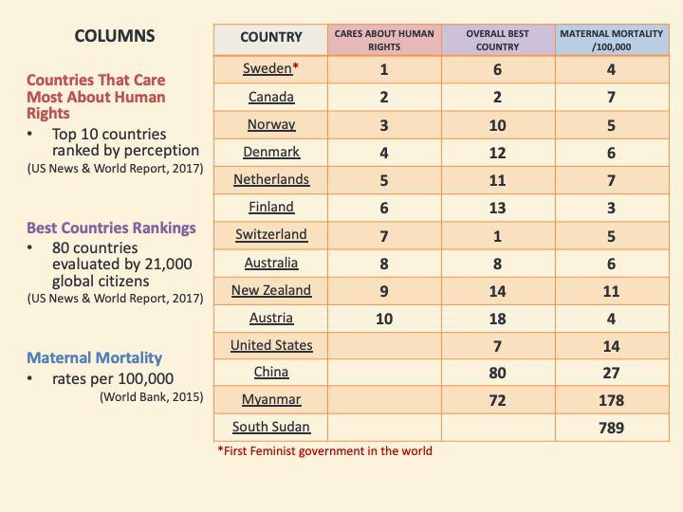

Slide 17
Human Rights – The Global Standard
Article 2.
Everyone is entitled to al the rights and freedoms set forth in this Declaration, without distinction of any kind, such as race, color, sex, language, religion, political or other opinion, national or social origin, property, birth or other status.
Article 25.
(1) Everyone has the right to a standard of living adequate for the health and well-being of himself and of his family, including food, clothing, housing and medical care and necessary social services
(2) Motherhood and childhood are entitled to special care and assistance. All children, whether born in or out of wedlock, shall enjoy the same protection.
Article 3.
Everyone has the right to life, liberty and security of person
Notes:
1948 Universal Declariation of Human Rights and the 1966 International Covenant on Economic Social and Cultural Rights

Slide 18
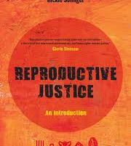
Reproductive Justice
We must…
The human right to maintain personal bodily autonomy, have children, not have children, and parent the children we have in safe and sustainable communities.
-Loretta Ross
Analyze power systems
Address intersecting oppressions
Center the most marginalized
Join together across issues and identities

Slide 19
Indicator ≠ Framework
Indicator
Framework
An indicator is a datapoint:
Measurement limited by current reality
A product of our past understanding of public health and science
Systems are more apt to adhere to specific prescribed indicators than to determine alternatives
A framework is a vision:
Expands understanding of current reality
Allows freedom to explore language of indicators
Exploration of alternatives to traditional data collection & application
Questions historical construction health systems

Slide 20
birth equity (noun):
1. The assurance of the conditions of optimal births for all people with a willingness to address racial and social inequities in a sustained effort.
Joia Crear-Perry, MD
National Birth Equity Collaborative
Notes:
Given the frameworks of Human Rights and Reproductive Justice, we wanted to define what Birth Equity means for our own organization and for systems. We make sure we capture what it means to advocate for all women and families to have the opportunity to have healthy births with no barriers.
Birth Equity is the assurance of the conditions of optimal births for all people with a willingness to address racial and social inequalities in a sustained effort.
Birth equity needs a sustained effort because the inequities in birth outcomes were created from centuries of oppressive practices and policies. It will not be resolved quickly, but will be a result of our collective sustained effort.

Slide 21
ROOT CAUSES & SOCIAL DETERMINANTS OF HEALTH

Slide 22
What are “Social Determinants of Health”?
“The social determinants of health are the conditions in which people are born, grow, live, work, & age.
These circumstances are shaped by the distribution of money, power, & resources at the global, national, & local levels.
Examples of resources include employment, housing, education, health care, public safety, & food access.”
Source: World Health Organization (http://www.who.int/social_determinants/sdh_definition/en/)
Notes:
Depending on what training or background you are coming from, you may be more or less familiar with the concept or the term “Social Determinants of Health”. This is an important concept in Public Health practice because it helps us to understand why some people and communities may struggle more than others to stay in good health. It helps us to see the “big picture”, to understand patterns of health and disease across populations, and to develop holistic solutions that enable people to lead healthy lives.

Slide 23
Root Causes
Institutional
Racism
Class Oppression
Gender
Discrimination
and Exploitation
LABOR
MARKETS
TAX
POLICY
Power and Wealth Imbalance
GLOBALIZATION
&
DEREGULATION
HOUSING
POLICY
EDUCATION
SYSTEMS
SOCIAL
SAFETY
NET
SOCIAL
NETWORKS
Safe
Affordable
Housing
Job
Security
Social Determinants of Health
Transportation
Living
Wage
Quality
Education
Availability
of Food
Social
Connection
& Safety
Psychosocial Stress / Unhealthy Behaviors
Disparity in the Distribution of Disease, Illness, and Wellbeing
Adapted by MPHI from R. Hofrichter, Tackling Health Inequities Through Public Health Practice.

Slide 24
SOCIAL CONSTRUCTION OF RACE

Slide 25
Anthropological Approaches Demonstrate…
RACE
ETHNIC GROUP
POPULATION
ANCESTRY
These are four different ways to describe, conceptualize and discuss human variation… and connot be used interchangebaly
Race is real, and it matters in society, but not how racists think it does.
Race is not a genetic cluster nor a population.
Race is not biology but racism has biological effects
Social constructs are real for those who hold them
Notes:
Anthropological approaches demonstrate that we approach race incorrectly, especially in healthcare
Race, ethnicity, population and ancestral are similar, but not congruent terms. They are different ways to describe, conceptualize and discuss human variation. Please do not use them interchangeably
Race has historically been used as a taxonomic categorization based on common hereditary traits (such as skin color) to elucidate the relationship between or ancestry and our genes.
Race is not a genetic cluster nor a population.
Race is not biology but racism has biological effects
The social construction of race is what we now need to understand. That social construct illuminated how racism works
Social construction: In the context of Critical Race Theory, “social construction” refers to the notion that race is a product of social thought and relations. It suggests that race is a product of neither biology nor genetics, but is rather a social invention.

Slide 26
AAPA Statement on Race & Racism (2019)
The human species shares 99.9% of our DNA in common. The evolutionary histories of commonly racialized traits in humans does not match the claims & assumptions of the doctrines of racist science presented by European colonialists.
“Race” does not accurately describe nor represent human biological variation.
“Race” is a colonial classification & status created by Euro-colonialists to generate capitalist profit & imperialism through the subjugation of colonized & racialized peoples. Anthropological sciences were borne out of this scientific classification of life in the broader field of natural history.
There are NO HUMAN RACES. There is ONE HUMAN SPECIES. THERE IS NO SUCH THING AS “THE HUMAN RACE”.
Fuentes A, Ackermann RR, Athreya S, Bolnick D, Lasisi T, Lee S, McLean SA, Nelson, R. 2019. “AAPA Statement on Race and Racism.” American Journal of Physical Anthropology. 169(3): 400–402.

Slide 27
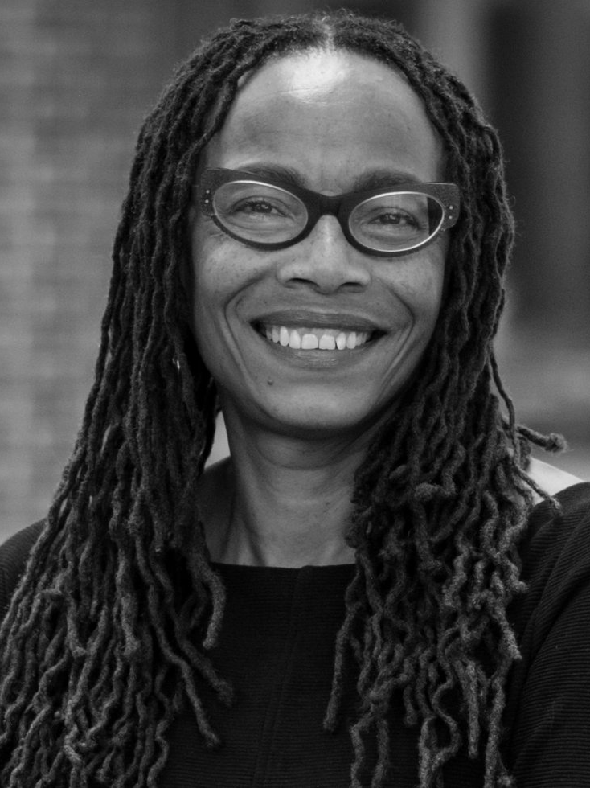
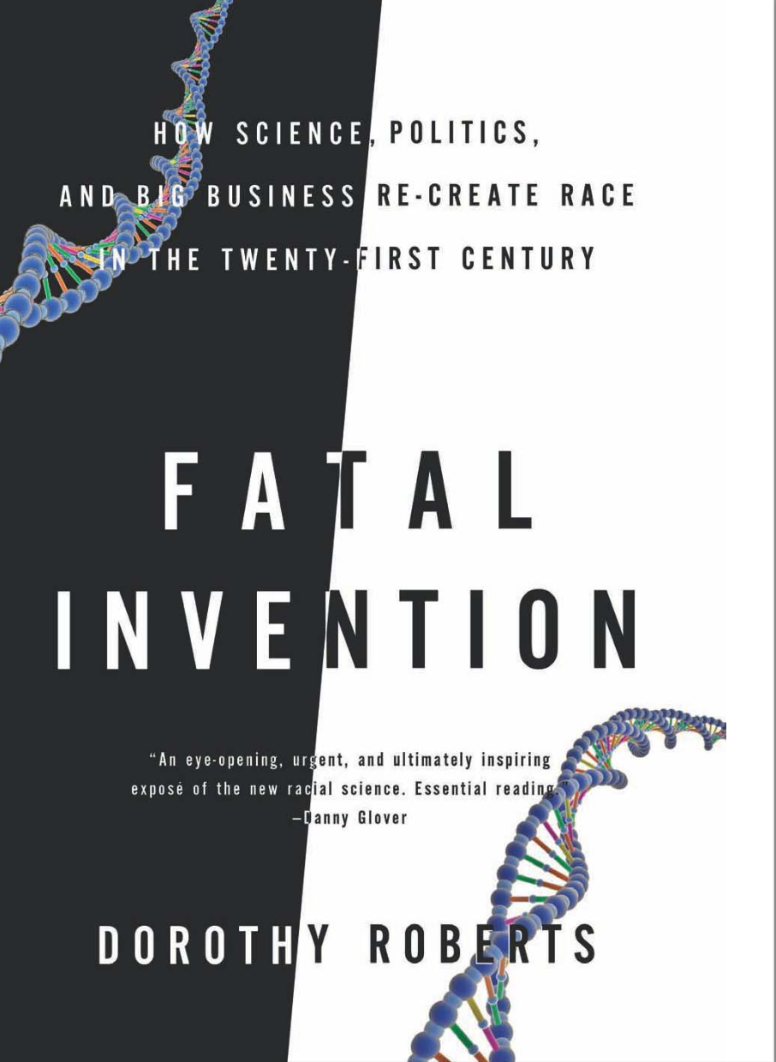
“Like citizenship, race is a political system that governs people by sorting them into social groupings based on invented biological demarcations. Race is not only interpreted according to invented rules, but, more important, race itself is an invented political grouping. Race is not a biological category that is politically charged. It is a political category that has been disguised as a biological one” (Roberts 2011:4).
“Race is the product of racism; racism is not the product of race” (Roberts 2011:25).
Sociologist Dorothy Roberts
Roberts, Dorothy E. 2011. Fatal invention: How science, politics, and big business re-create race in the twenty-first century. New York: New Press.
Notes:
“Like citizenship, race is a political system that governs people by sorting them into social groupings based on invented biological demarcations. Race is not only interpreted according to invented rules, but, more important, race itself is an invented political grouping. Race is not a biological category that is politically charged. It is a political category that has been disguised as a biological one.”
- Dorothy Roberts in Fatal Invention (2011:25)

Slide 28
McLean SA. 2020. “Social Constructions, Historical Grounds.” Practicing Anthropology. 42(3): 40–44.

Slide 29
RACISM, NOT RACE

Slide 30
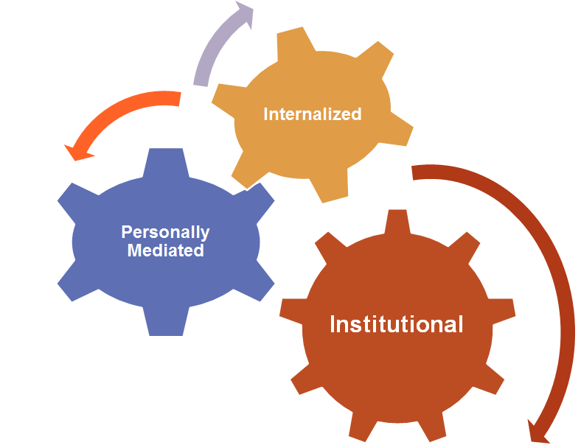
Levels of Racism
Notes:
Carmen and Joia
3 Levels of Racism (Camara Jones, MD, MPH)
Institutionalized Racism
•Historical perspectives regarding health and health care providers
Personally Mediated Racism
•Stereotyping
•The genetic excuse
Internalized Racism
•Low expectations of health care systems
•Acceptance that bad health is inevitable
Internalized racism These are private beliefs about race that reside inside our minds. (within Individuals)
Interpersonal racism When we bring our private beliefs about race into our interactions with others. (Between individuals)
Institutional racism Discriminatory treatment, unfair policies and practices, and inequitable opportunities and impacts, based on race. (Within Institutions)
Structural racism Racial bias across institutions and sociey that systematically privilege white people and disadvantage people of color.
Source: Race Forward

Slide 31
Levels of Racism
Institutional/Structural racism- the structures, policies, practices and norms resulting in differential access to the goods, services and opportunities of societies by race.
Personally mediated - the differential assumptions about the abilities, motives and intentions of others by race.
Internalized racism - the acceptance and entitlement of negative messages by the stigmatized and non stigmatized groups.
-Camara Jones, MD, PhD, Past President APHA
Notes:
Institutional/Structural racism- the structures, policies, practices and norms resulting in differential access to the goods, services and opportunities of societies by race.
Historical perspectives regarding health and health care providers
Personally mediated - the differential assumptions about the abilities, motives and intentions of others by race.
Stereotyping
The genetic excuse
Internalized racism - the acceptance and entitlement of negative messages by the stigmatized and non stigmatized groups.
Low expectations of health care systems
Acceptance that bad health is inevitable
-Camara Jones, MD, PhD, Past President APHA

Slide 32
Racism as a SDOH
Racism affects health both directly (i.e., via chronic stress) & indirectly (i.e., via race-based discrimination across multiple systems which creates differential access to high-quality schools, safe neighborhoods, good jobs, & quality healthcare, in other words, by shaping SDOH.)
Laster Pirtle argues that “racial differences in illnesses are not the result of biological or even behavioral differences in race but a result of racist, capitalist systems that structure people’s lives” (2020:505).
“…racial capitalism is a fundamental cause because it shapes access to flexible resources.” (Laster Pirtle 2020:505).
“A fundamental cause involves access to resources, resources that help individuals avoid diseases and their negative consequences through a variety of mechanisms. Thus, even if one effectively modifies intervening mechanisms or eradicates some diseases, an association between a fundamental cause and disease will reemerge. As such, fundamental causes can defy efforts to eliminate their effects when attempts to do so focus solely on the mechanisms that happen to link them to disease in a particular situation” (Link & Phelan 1995:81). [Emphasis added]
Laster-Pirtle WN. 2020. “Racial Capitalism: A Fundamental Cause of Novel Coronavirus (COVID-19) Pandemic Inequities in the United States.” Health Education & Behavior. 47(4):504–508.
Link BG, Phelan J. 1995. “Social conditions as fundamental causes of disease.” Journal of Health and Social Behavior. 35:80–94.
Notes:
Our common definition of racism needs to relate to the Social Determinants of Health so we can understand its connection. Racism (not “race”) is a driver of health inequities.
Racism affects health both directly (i.e., via chronic stress) and indirectly (i.e., via race-based discrimination across multiple systems which creates differential access to high-quality schools, safe neighborhoods, good jobs, and quality healthcare, in other words, by shaping Social Determinants of Health.)

Slide 33
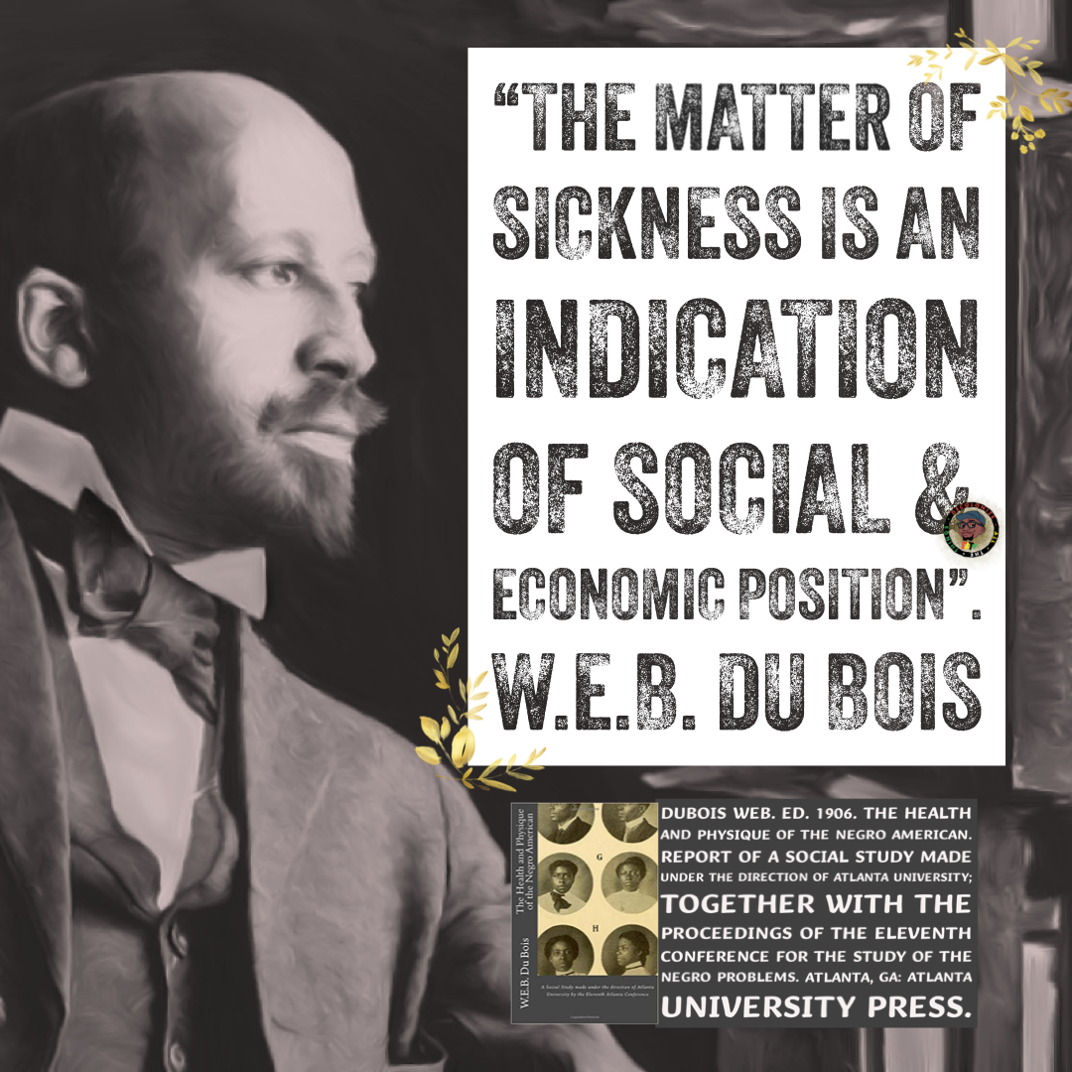
Racist Health Inequities
According to the Center for Disease Control (CDC), people who are racialized as Black in U.S. have the highest number of deaths in the top 10 causes of death (mortality) in the U.S.. The only other racialized group with mortality rates that high is Indigenous peoples.
As a legitimating rationale, racism is used to both (a) justify colonial capitalist exploitation, & (b) function as an ultimate cause of the overwhelming burden of illness amongst racialized & colonized peoples.
The racist distribution of disease should surprise NO ONE since (1) racialized groups continue to make up the masses of underpaid & overworked poor workers in the U.S., & (2) it is extremely difficult, in most, if not all cases impossible, to resist domination when you are sick &/or injured.
Notes:
Racialized & colonized peoples are overworked & underpaid to maintain the modern white capitalist status quo.

Slide 34
x
58 healthy premenopausal mothers/caregivers of either a healthy child or a chronically ill child.
Researchers found that the more years of caregiving, controlling for mother’s age:
1: the shorter the mother's telomere length
2: the lower the telomerase activity
3: the greater the oxidative stress
Significant correlations between perceived stress & all three markers of cellular aging across the entire sample of caregivers & non-caregivers
Exists across the continuum of normative stress levels, especially notable at the extremes (low & high perceived stress).
Notes:
http://www.pnas.org/content/101/49/17312

Slide 35
Chronic worry about racial discrimination may play an important role in Black-White disparities in preterm birth (PTB).
May help explain the greater PTB disparities among more socioeconomically-advantaged women.
Only measured overt experiences of racial discrimination, but it is likely that findings are similar for different types of racial discrimination (emotional psychological) & PTB.
Notes:
Chronic worry about racial discrimination may play an important role in Black-White disparities in preterm birth (PTB).
May help explain the greater PTB disparities among more socioeconomically-advantaged women.
Only measured overt experiences of racial discrimination, but it is likely that findings are similar for different types of racial discrimination (emotional psychological) and PTB.
Reported chronic worry about racial discrimination…
36.9% of Black women and 5.5% White women respectively
Rates were highest among Black women of higher income and education levels.
Chronic worry was significantly associated with PTB among Black women.

Slide 37
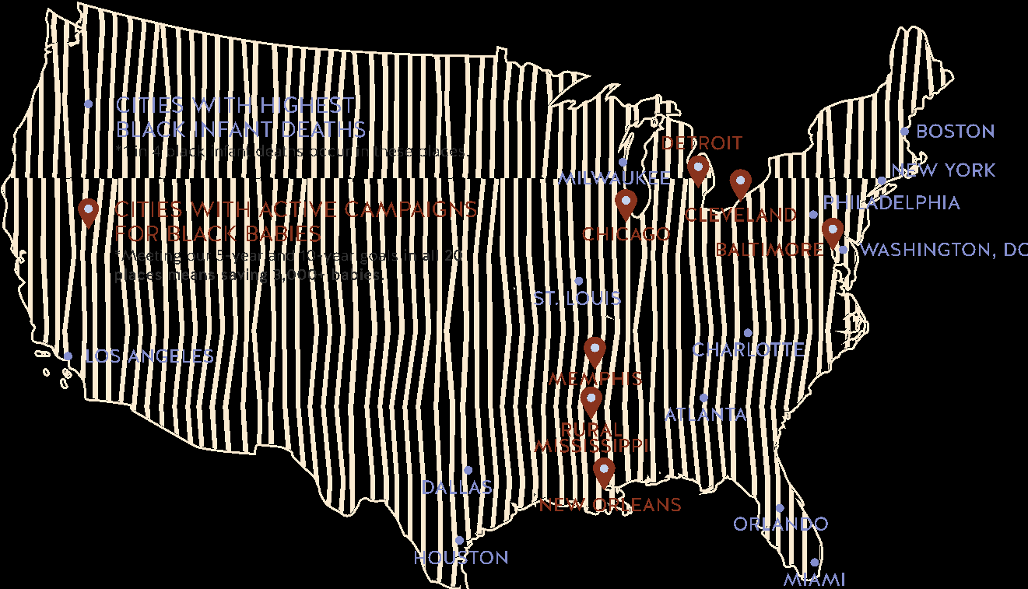
Campaign for Black Babies

Slide 38
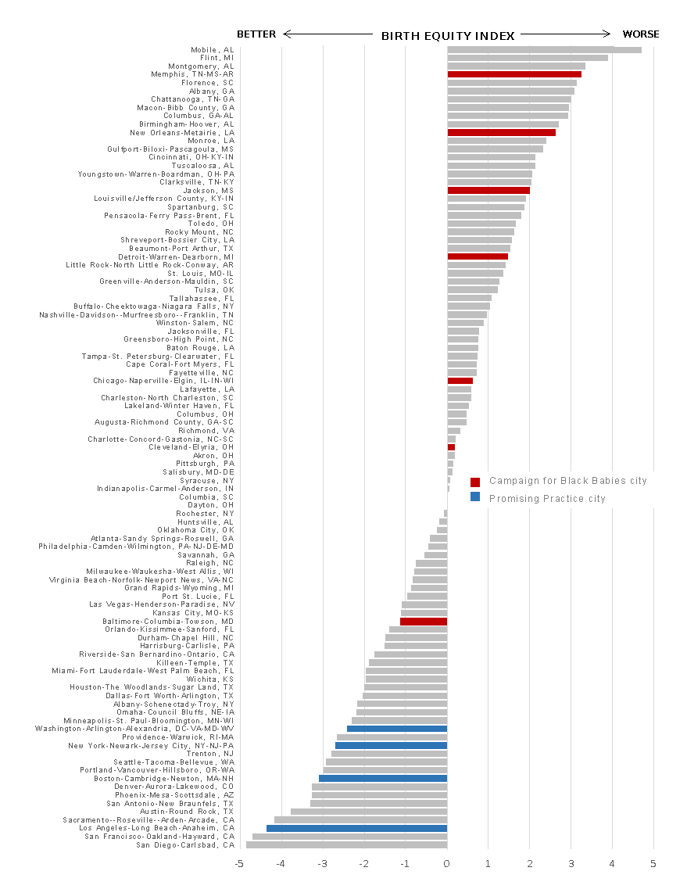
Birth Equity Index
Data tool to identify significant social determinants
A comprehensive set (50+) of social determinant indicators were selected to broadly define health and opportunities for better health within the social and physical environment of 20 US metro areas with some of the highest black infant mortality rates in the country. We identified those that were at least marginally associated with black infant mortality rates including:
prevalence of smoking and obesity among adult residents
number of poor physical and mental health days experienced by residents
percentage of residents with limited access to healthy foods
rates of homicide and jail admissions
air pollution
racial residential segregation (isolation)
rates of unemployment and low education among NH black residents
income inequality between black and white households
We used data-reduction techniques to combine values of these indicators into an overall index of black infant mortality social determinants, with higher values representing worse health conditions.
Notes:
https://pubmed.ncbi.nlm.nih.gov/28678200/

Slide 39
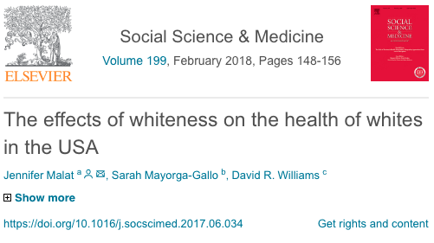
“White”
Whiteness and health:
Societal conditions
Individual social characteristics and experiences
Psychosocial responses
Notes:
Positive Health Consequences
“Positive illusions” and beliefs of American meritocracy promote self-enhancement and extend longevity
Psychological benefits from economic and social policies that favor dominant culture
Negative Health Consequences
Perceptions of white victimhood are common
57-62% of white Americans believe that life has changed for the worse since the 1950s
50-60% believe that discrimination against whites is as big of a problem as discrimination against blacks in the USA
Unmet expectations for success cause high levels of psychological distress
Lack of redemption narratives and coping mechanisms

Slide 41
POLICIES

Slide 42
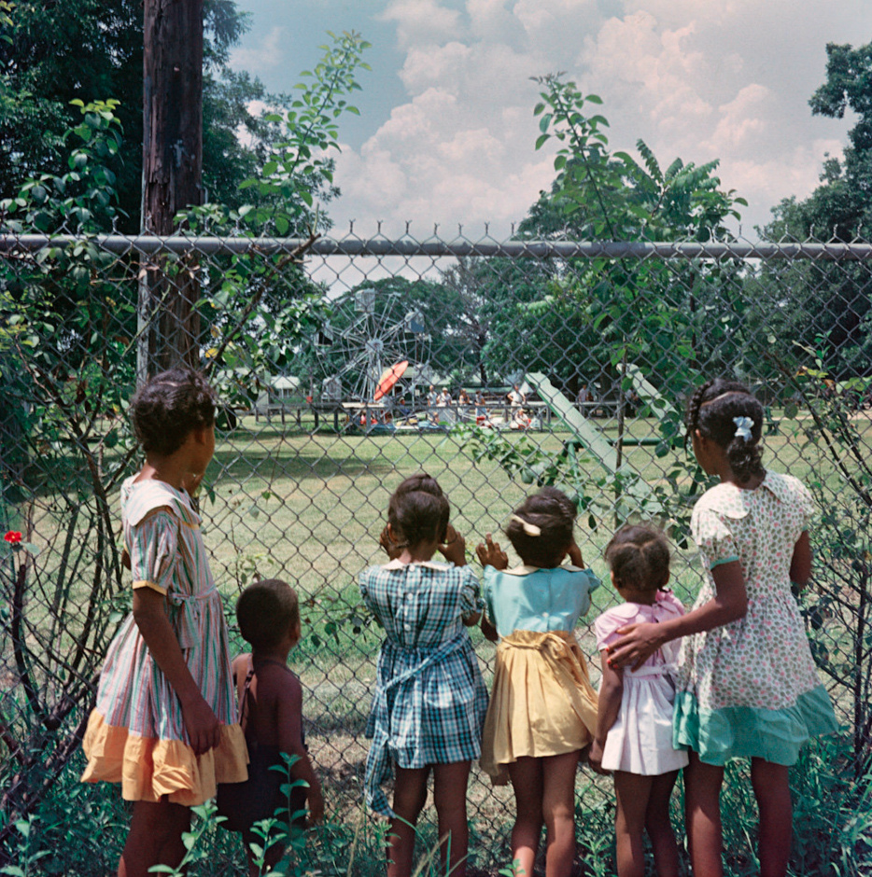
Racist Health Inequities:
Individual vs. Collective Accountability
“Racially discriminatory policies have usually sprung from economic, political, and cultural self-interests, self-interests that are constantly changing.”
Politicians seek political self-interest.
Capitalists seek increased
profit margins.
Cultural professionals seek professional advancement.
― Ibram X. Kendi, Stamped from the Beginning: The Definitive History of Racist Ideas in America
Notes:
“Racially discriminatory policies have usually sprung from economic, political, and cultural self-interests, self-interests that are constantly changing. Politicians seeking higher office have primarily created and defended discriminatory policies out of political self-interest—not racist ideas. Capitalists seeking to increase profit margins have primarily created and defended discriminatory policies out of economic self-interest—not racist ideas. Cultural professionals, including theologians, artists, scholars, and journalists, were seeking to advance their careers or cultures and have primarily created and defended discriminatory policies out of professional self-interest—not racist ideas.”
― Ibram X. Kendi, Stamped from the Beginning: The Definitive History of Racist Ideas in America

Slide 43
Racially Biased Narratives and Policy
White Opioid Narrative | Black Crack/Cocaine Narrative
White women are America’s sisters and daughters Opioids are an “epidemic of despair” for Middle America Considered a disease, not a moral failing No conclusions made about prenatal opioid use or future of exposed babies Public health response through special funding ($45 Billion) in fed. health care bill that threatened Medicaid (frontline insurance responder) Southern states that led in criminalizing black women are softening punitive polices for addicted mothers | Illicit drug use among white women at the time was equally prevalent Connoted careless Black motherhood in inner-city America “Crack babies” considered biologically inferior, eventual super-predators, and a longterm burden on fed. Assistance & service programs Pregnant drug users were convicted as killers, drug dealers and child abusers Mass incarceration of Black mothers through random drug tests, leveraging child removal and incarceration
Notes:
https://www.theatlantic.com/politics/archive/2017/07/what-the-crack-baby-panic-reveals-about-the-opioid-epidemic/533763/

Slide 44
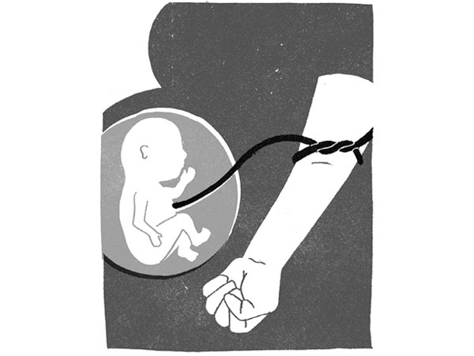
Lessons Learned from Substance Abuse
Dr. Claire Cole debunked the “crack baby” term with scientific data, determining effects of poverty are a bigger driver of poor long term developmental outcomes than drug abuse itself.
Understanding community context and humanizing the victims of drug addiction allowed for…
“Fetal/Neonatal Abstinence Syndrome” recognized over “Crack Babies”
Aid funding instead of increased criminal justice budgets
Data
Voice
Poor Policy
_________
Notes:
http://michiganradio.org/post/how-zip-codes-hid-water-crisis-flint#stream/0

Slide 45
OPPORTUNITIES

Slide 46
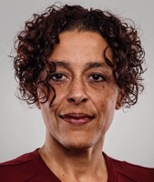
“What’s missing from the care of Black women is their centered voice, validation of experience, and freedom to choose and be informed. Black women need respectful care that is free of implicit and explicit bias. It is the provider’s responsibility to address those biases. To address the issue of maternal mortality we need care that originates from and is defined by Black women-led organizations, practitioners, and community members.”
Jessica Roach, MPH
Black Mamas Matter Alliance (2018). Setting the Standard for Holistic Care of and for Black Women. Retrieved from https://blackmamasmatter.org/resources/bmma-products/

Slide 47
Racial Equity Lens
The health care system alone isn’t equipped to overcome the inequities driven by income, language, education or racism.
Racial Equity Lens
Centers place, environment & social determinants
Addresses aggravated risk for specific local challenges
Addresses intergenerational & cumulative effects of structural racism on health
Notes:
because it was built in an institutionally racist American society.

Slide 48
Useful Resources
Racial Equity Analysis
What?
Why care?
Now what?
Root Cause Analysis
Identify systems vulnerabilities that impact patient safety and outcomes
Identify measurable systems-based corrective actions
Ensure follow-through and implementation
Ensure that leadership at all levels of the organization participate and hold staff accountable for RCAs
5 Whys Exercise
Identify an event or pattern that concerns staff
Identify tangible and intangible structures that are contributing to results
Brainstorm implications for action
How can you better apply existing tools in your daily work?

Slide 49
Get connected!
DEThrives.com website and social media platform (Facebook, Twitter, and
Instagram) to further promote and educate consumers and professionals on DHMIC strategic
priorities as well as maternal and child health initiatives, best practices, data and programming

Slide 50
Holistic Systems of Care
Mamatoto Village Doula Services
Washington, D.C.
Ancient Song Doula Services
Brooklyn, New York
Community engagement
Trauma informed story sharing
Community informed advocacy
Human centered design

Slide 51
RESPECTFUL MATERNITY CARE

Slide 52
Birth Equity during COVID-19
Alternatives to banning support persons:
Setting up telehealth doula services & lactation & prenatal care by providing birthing people iPad access (including data plans).
Offering vouchers for food & meal-delivery services.
Investing in home birth & birth centers to expand or maintain their current services.
Dr. Monica McLemore, Scientific American
Prioritizing COVID testing for pregnant women
Permanently extend Medicaid postpartum coverage to 1 year.
Laurie Zephyrin, StatNews

Slide 53
Segregationists
Assimilationists
Anti-Racists
Notes:
“Slavery was as customary as prisons are today. Few could imagine an ordered world without them.”
― Ibram X. Kendi, Stamped from the Beginning: The Definitive History of Racist Ideas in America
“Of course, racist planters could not admit that Black runaways were self-reliant enough to effect their own safety and happiness—to be free.”
― Ibram X. Kendi, Stamped from the Beginning: The Definitive History of Racist Ideas in America
“When you truly believe that the racial groups are equal, then you also believe that racial disparities must be the result of racial discrimination. Committed to this antiracist idea of group equality, I was able to self-critique, discover, and shed the racist ideas I had consumed over my lifetime when I uncovered and exposed the racist ideas that others have produced over the lifetime of America.
“Racially discriminatory policies have usually sprung from economic, political, and cultural self-interests, self-interests that are constantly changing. Politicians seeking higher office have primarily created and defended discriminatory policies out of political self-interest—not racist ideas. Capitalists seeking to increase profit margins have primarily created and defended discriminatory policies out of economic self-interest—not racist ideas. Cultural professionals, including theologians, artists, scholars, and journalists, were seeking to advance their careers or cultures and have primarily created and defended discriminatory policies out of professional self-interest—not racist ideas.”
― Ibram X. Kendi, Stamped from the Beginning: The Definitive History of Racist Ideas in America
“That is what it truly means to think as an antiracist: to think there is nothing wrong with Black people, to think that racial groups are equal. There are lazy and unwise and harmful individuals of African ancestry. There are lazy and unwise and harmful individuals of European ancestry. There are industrious and wise and harmless individuals of European ancestry. There are industrious and wise and harmless individuals of African ancestry. But no racial group has ever had a monopoly on any type of human trait or gene—not now, not ever.”
― Ibram X. Kendi, Stamped from the Beginning: The Definitive History of Racist Ideas in America

Slide 54
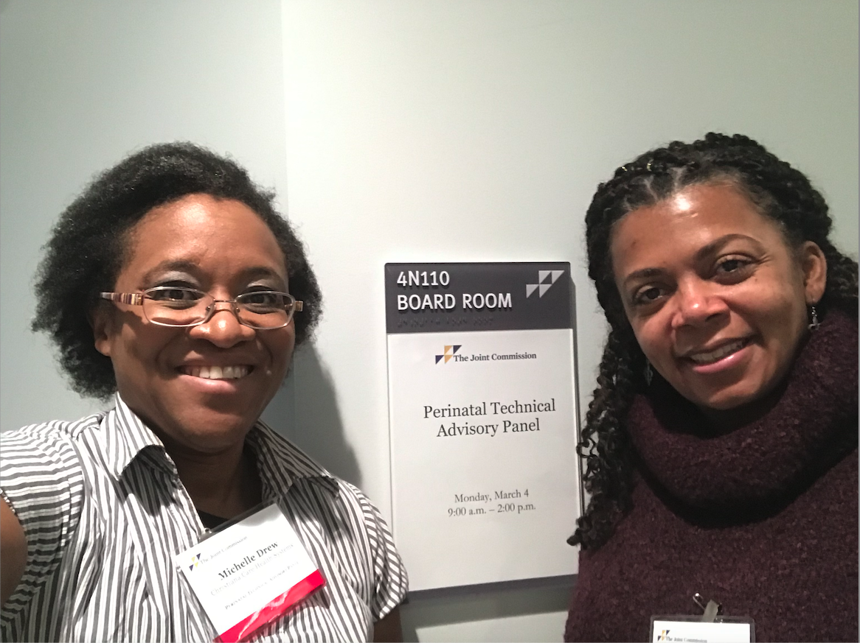
Thank you!
Visit us at birthequity.org
Joia Crear-Perry, MD
Founder & President
drjoia.nbec@gmail.com
@birthequity

