Slide 1
CONTINUITY OF CARE FOR WELL WOMEN
Community Health Workers,
Doulas, and Birth Workers

Slide 2
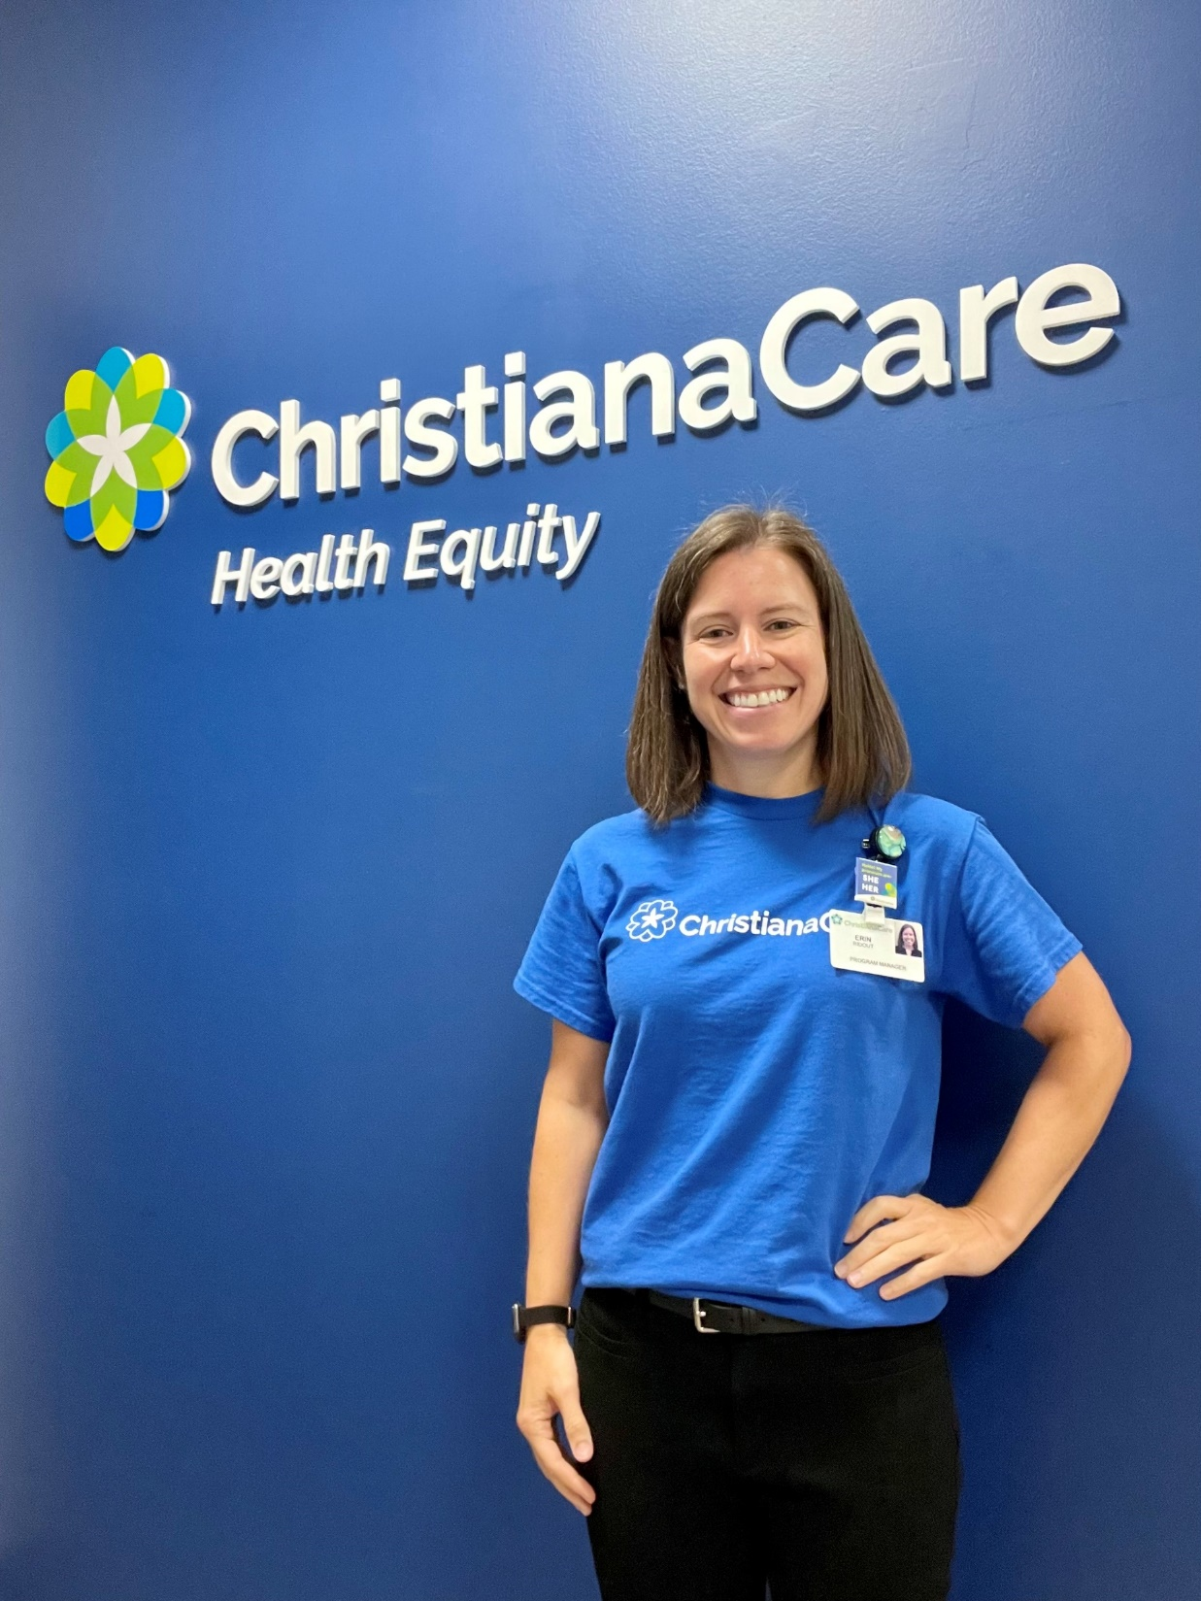
Erin Ridout, she/her
Health Equity Program Manager – Women’s Health
Coordinating Council, CHW Association of DE
Social work and public health background

Slide 3
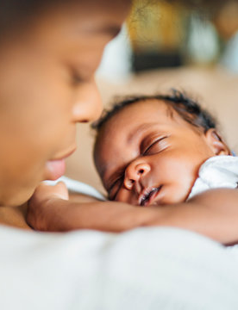
Areas of Focus
ChristianaCare:
Sharing Circles for Black Birthing Patients Focus groups that center and respond to the voices of the community
Preeclampsia Rates
Implicit Bias
CHW Association of DE:
CHW Certification & Sustainable Funding

Slide 6
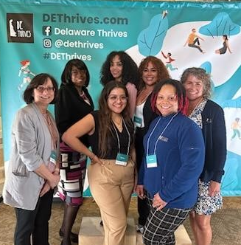
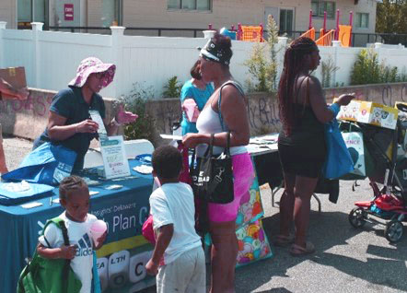
Community Health Workers Social Determinants of Health Program

Slide 7
Promoting Continuity of Care to Meet Health-Related Social Needs
Open to Delaware women ages 15-44
Clients and CHWs conduct SDOH assessment
Identify and prioritize needs
Connect to local resources
Trusting, longitudinal relationship
Mostly telephonic
Goal setting and achievement
Referrals to Home Visiting programs
Connect with us on DE Thrives
This project is in collaboration with the Division of Public Health (DPH) and the Delaware Healthy Mother and Infant Consortium (DHMIC) to improve health outcomes for women and children. Publication number DEDPH-MH-040924

Slide 8
Delaware Maternal and Child Death Review Commission Community Action Team
April L. Lyons-Alls, RN, MSN, MPA
Community Action Team Coordinator

Slide 9
Historical Timeline
25 July 2022
House Bill 340 Section 1. Amend § 301, Title 31 of the Delaware Code
Jan. 2023
Establishing CAT Application Process
Jan.–Feb. 2023
First Round of Applicants
July 2023
CAT Coordinator
Aug. 2023
Second Round of Applicants
Aug. 2023
Draft Governance & Structure of CAT
20 Sep. 2023
Kick-Off Meeting
Notes:
Changed the name from The Child Death Review Commission to MCDRC to more accurately reflect the work of the commission which includes women, It also established the Community Action team to expressly work to establish population level interventions based upon the findings/recommendations from the FIMR & MMR

Slide 10
What Things Really Are Really Important to Us!
Creating an Inclusive and Respectful Environment
Statewide Representation
Having the right mix of stakeholders at the table with equal representation from all three counties …
True Community Engagement
Community Empowerment
Provide the knowledge, skills and abilities needed to really be equal and contributing partners from start to finish
Notes:
Bullet1: Establishing the Ground Rules and Guiding Principles. setting the tone and the expectations for the group…
Principle 1: We will come to meetings mindful of creating a space that is brave, inclusive, respectful, welcoming and kind to all.
Always Maintain Confidentiality.
Tackle the Problem…Not the Person
Speak to Make a Difference*
State Views and Ask Genuine Questions*
Share all Relevant Information*
Use Specific Examples and Agree on What Words Mean*
Explain Reasoning and Intent*
Focus on Interests, Not Positions*
Discuss the Undiscussable Issues, The Elephant in the Room*
Jointly Design Next Steps*
*Source: Schwartz, R. (2016) 8 Ground Rules for Great Meetings. Meeting Management, Harvard
and Frequent Check-Ins… How your doing, how are we doing and what could we do better.

Slide 11
Creating an Inclusive & Respectful Environment
Established (5)CAT Guiding Principles
If there could be only one this is the most important…
We will come to meetings mindful of creating a space that is brave, inclusive, respectful, welcoming and kind to all!
Adopted Rules of the Rules
Adapted from Schwartz, R. (2016) 8 Ground Rules for Great Meetings. Meeting Management, Harvard
Notes:
Bullet 1: Principle 2: We will stay in our lane.
Principle 3: We will W.A.I.T- Why Am I Talking?
Principle 4: We will W.A.I.T.- Why Aren’t I Talking?
Principle 5: Listen Gently, Speak Gently.
Principle 6: Be Kind to Yourself as Well as Others!
Bullet 2:
Always Maintain Confidentiality.
Tackle the Problem…Not the Person
Speak to Make a Difference*
State Views and Ask Genuine Questions*
Share all Relevant Information*
Use Specific Examples and Agree on What Words Mean*
Explain Reasoning and Intent*
Focus on Interests, Not Positions*
Discuss the Undiscussable Issues, The Elephant in the Room*
Jointly Design Next Steps*

Slide 12
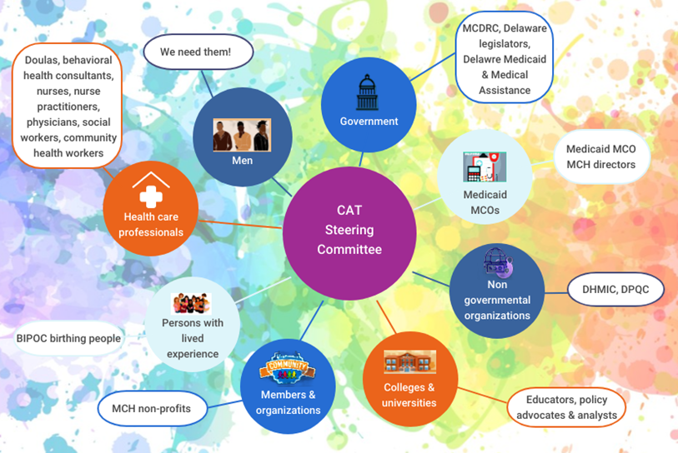
State-Wide
Multi-Sectored
Collaboration
Notes:
We are constantly asking…do we have the right representation? Is the mix between birthing persons with lived experience adequate or should be over-represented to ensure we are really capturing the voices of the people at the community level. Other considerations include ensuring representation from all three counties particularly Kent and Sussex.

Slide 13
“True Community Engagement”
…should create new power dynamics, and serve as “a catalyst for changing policies, programs and practices…”
…It’s about collaborating with and empowering communities and NOT only informing or surveying them or asking for their input on programs otherwise designed and led outside of the community.
…It’s about listening to local communities and recognizing the expert in every community member, and every leader representing the community.
Sources:
Centers for Disease Control and Prevention. Principles of community engagement. 1st ed. Atlanta (GA): CDC/ATSDR Committee on Community Engagement; 1997
Schiavo R. Health Communication: from theory to practice. Second Edition, Chapter 6 – Community Mobilization and Citizen Engagement. San Francisco: Jossey-Bass, an Imprint of Wiley; 2014. p. 179–218
Notes:
…It’s about working toward and celebrating community ownership of interventions, and research design, implementation and evaluation, while building trust, long-term relationships and willingness for participation among communities and their leaders.

Slide 14
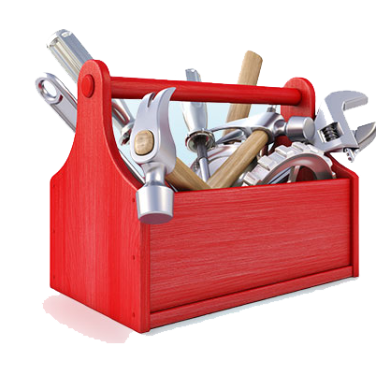
Community Empowerment & Capacity Building
Meet people where they are and gradually bring them along
Intentional about what goals we were setting for each meeting
Providing ongoing tools and resources for their respective toolboxes!
Notes:
We didn’t just want to dump a lot of information on folks. We took our time and were able to weave a story through the data. We are very fortunate to have a truly masterful epidemiologist who did an amazing job.

Slide 15
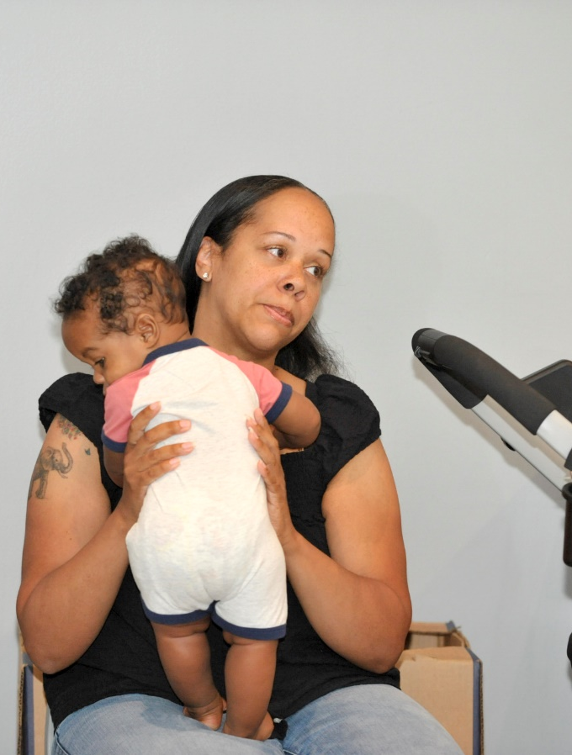
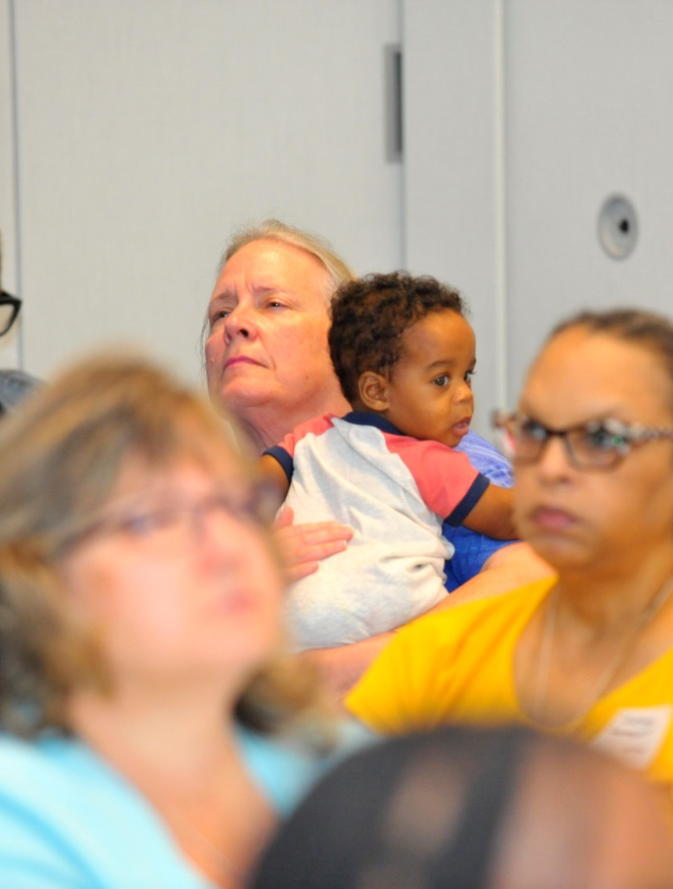
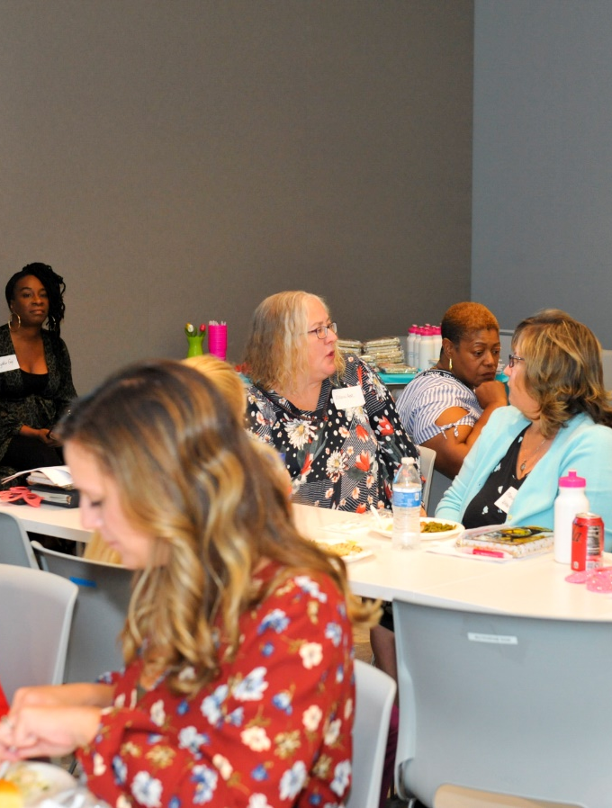
CAT Kick-Off Meeting 9/20/2023
Notes:
We have a one main imperative that is always remains top of mind. The first is to educate in a manner that does not intimidate or make anyone in the group feel diminished. We really work hard to meet people where they are because there is mixed skill level with respect to reading and interpreting data. This required the team to be very thoughtful about how information would be presented with the goal of slowly bringing folks along while simultaneously building capacity.

Slide 16
The CAT Process: From Findings & Recommendations to Action

Slide 17
COMMUNITY ACTION TEAM COLLABORATIVE STRUCTURE
The overall goal of the Fetal and Infant Mortality Review (FIMR) Committee is to enhance the health and well-being of women, infants and families by improving the community resources and service delivery systems available to them. FIMR thru its review process, identifies the factors associated with these deaths, determine if they represent system problems that require change, develop recommendations for change and assist in implementation of change.
Maternal and Child Death Review Commission- Pillar Organization
MMR
FIMR
DELAWARE VOICES for ACTION STEERING COMMITTEE
Findings/
Recommendations
The Maternal Mortality Review (MMR) Committee’s aim is to identify and conduct an in-depth, multidisciplinary review of pregnancy-related deaths and selected pregnancy-associated deaths. These reviews aid in describing and tracking factors associated with maternal deaths. MMR also identifies systems-wide issues which may have contributed to the deaths while also developing fundings and recommendations for change that will improve the health of mothers and infants in Delaware
The Steering Committee is the principal body to guide the work of the DEVA implementation teams. The overarching aim of this multisectoral group of CBOs, non-profits, managed care organizations, health systems and lived experience experts, is to develop and implement community driven interventions which originate from the findings and recommendations of the FIMR and MMR committees. These findings and recommendations specifically address contributors to maternal, fetal and infant mortality.
Community
Stakeholders
Maternal Mental Health
Preconception/ 4th Trimester Care
Quality of Services in Community
Community-based Services
DEVA
IMPLEMENTATION TEAMS
Notes:
Under the direction of the executive director, the MCDRC will serve as the pillar organization of the CAT providing administrative and logistical support to all CAT activities. The principal liaison will be the Executive Director of the MCDRC, and (3) technical assistant (TA) designees represented from the MMR, FIMR and will also include the MCDRC epidemiologist. The Work Groups/Implementation Teams are derived from the FIMR/MMR findings and recommendations via a forced ranking exercise we did during the second meeting.

Slide 18
Landscape Analysis
Key MCH Partners & Existing Community Initiatives
The Why’s
Reduce Waste
Avoid Duplication of Efforts
Promote Stewardship State/Agency Resources
Ensure Alignment /Eliminate Siloes
Increased Opportunities for Synergy
MMR
MCDRC
DHMIC
CAT
FIMR
DPQC
CI
Notes:
As we embark on our journey, we are in conversation with two of our biggest collaborators in this space. The Delaware Healthy Mother and Infant Consortium and the Delaware Perinatal Quality Collaborative

Slide 19
Our Amazing Team!
Kim Liprie, Executive Director, MCDRC
Dr. Meena Ramakrishnan, MD, MPH, Epidemiologist
Dr. Lisa Klein, DNP, RNC-OB, MMR Coordinator
Joan Kelley, RN, BSN, FIMR Coordinator
Johanna Gerisch, Fatality Review Assistant
Lianne Hastings, Fatality Review Coordinator

