Slide 1
Policy to Assure Quality, Equity, and Respectful Care for Women, Birthing People, and Infants
Presentation by Kay Johnson
Delaware Healthy Mother & Infant Consortium (DHMIC) 2023 Annual Summit: Renew, Reconnect, Recharge
April, 2023
Notes:
Good Morning. I am so pleased to be here with you today as an encore experience to my visit to Delaware in 2017. My thanks to Susan Noyes and the leadership of the Delaware Healthy Mother & Infant Consortium for inviting me back to speak with you.
Delaware is a leader in maternal and infant health, no doubt to the credit of many people in this room. You have collective wisdom, which I hope to glean through the day.
In my time this morning, I’d like to share some useful thinking about how we can adopt strategies that support recovery, resilience, and respect to improve the health of women, infants, and families.

Slide 2
Thanks for inviting me back to DHMIC Summit.

Slide 3
Starting perspective…What I believe
Equity depends upon strong and well-implemented public policies, along with respectful, team-based health care.
Every person should have the freedom to decide if and when to be a parent and raise a family.
Reproductive justice will be attained when all people have the economic, social, and political power and the means to make decisions about their bodies, sexuality, health, and families.
Clinical practice changes, QI, or individual behavior change are necessary but not sufficient to improve outcomes and end disparities.
To have equitable impact on the greatest number of women, children, and families, we must ensure effective public policies, programs, and services.
Data are not and never have been neutral.

Slide 4
Advancing health and equity for women in past two decades: MOVEMENTS AND Evolution

Slide 5
Shaping the Vision for Preconception Health and Health Care
CDC Recommendations for Preconception Health and Health Care in 2006, reaffirmed in 2011, and in 2014
“Preconception care aims to promote the health of women or reproductive age before conception and thereby improve pregnancy-related outcomes.”
“To improve the health of women and any children they may choose to have.”
Hani Atrash
Jeanne Conry
Denise D’Angelo
Karla Damus
Ann Dunlop
Dan Frayne
Jessie Hood
Brian Jack
Kay Johnson
Lorraine Klerman
Milt Kotelchuck
Michael Lu
Kiko Malin
Merry-K Moos
Christopher Parker
Sam Posner
Diana Ramos
Uma Reddy
Carolina Reyes
Cheryl Robbins
Sarah Verbiest
Lauren Zapata
Laurie Zephyrin
Johnson et al. Recommendations to improve preconception health and health care–United States: A report of the CDC/ATSDR Preconception Care Work Group and the Select Panel on Preconception Care. MMWR. 2006. 55(RR-6), 1–23.
Johnson & Baluff. Summary of Findings from the Reconvened Select Panel on Preconception Health and Health Care. 2015

Slide 6
Shaping the Vision for Well-Woman Care
Women’s Preventive Services
Aim: Every woman, every time -- attention to life course, to women’s wellness
Content of care defined by experts
Federal guidelines under ACA, updated
The power of guidelines is in their implementation
Claire Brindis
Haywood Brown
Cynthia Chuang
Jeanne Conry
Angela Dias
Rebekah Gee
Kimberly Gregory
Arden Handler
Marianne Hillemeier
Susan Kendig
Lois McCloskey
Maureen Phipps
Diana Ramos
Kweli Rashied-Henry
Alina Salganicoff
Ana Sanchez-Birkhead
Carol Weisman
Sarah Verbeist
Christopher Zahn
Senator Barbara Mikulski
Women’s Preventive Services Guidelines (HRSA, US HHS) https://www.hrsa.gov/womens-guidelines-2016/index.html; and https://www.hhs.gov/guidance/document/womens-preventive-services-guidelines-2016-1
Women’s Preventive Services Initiative (WPSI) https://www.womenspreventivehealth.org/;
WPSI 2021 Well-Women Chart. https://www.womenspreventivehealth.org/wp-content/uploads/WPSI_WWC_11x17_2021Update.pdf;
Institute of Medicine. Clinical Preventive Services for Women: Closing the Gaps. doi.org/10.17226/13181; Recommendations of the IOM Clinical Preventive Services for Women Committee: implications for obstetricians and gynecologists. doi:10.1097/GCO.0b013e32834cdcc6

Slide 7
The Bridging The Chasm Collaborative
Lois McCloskey, Judith Bernstein,
Ndidimaka Amutah-Onukagha, Jodi Anthony , Mary Barger, Candice Belanoff, Trude Bennett , Chloe E Bird, Denise Bolds , Burke-Weber Brenna, Rebecca Carter, Ann Celi, Breanna Chachere, Joia Crear-Perry, Chase Crossno , Alba Cruz-Davis , Karla Damus , Alissa Dangel , Zendilli Depina, Phyllisa Deroze, Colette Dieujuste, Annie Dude, Joyce Edmonds , Daniel Enquobahrie, Ebosetale Eromosele, Erin Ferranti, Mary Fitzmaurice, Christina Gebel, Linda Goler Blount, Ann Greiner, Sue Gullo, Amy Haddad, Nneka Hall, Arden Handler, Irene Headen, Lisa Heelan-Fancher, Teri Hernandez, Kay Johnson, Emily Jones, NeKeshia Jones, Stace Klaman, Barbara Lund, Monica Mallampalli, Lilly Marcelin, Cassondra Marshall, Bridgette Maynard, Shondra McCage, Suzanne Mitchell, Rose Molina, Suzi Montasir, Jacinda Nicklas, Alyson Northrup, Anna Norton, Ebere Oparaeke, Athena Ramos, Sue Rericha, Elena Rios, Joan Rosen Bloch, Cassie Ryan, Suzanne Sarfaty, Ellen Seely, Vivienne Souter, Martina Spain, Randiesa Spires, Suzanne Theberge, Tamara Thompson, Madi Wachman, Tina Yarrington, Lynn M Yee, Chloe Zera . Working Group Advisors; Janine Clayton , Christina Lachance. >70 stakeholders total.
Bridging the Chasm between Pregnancy and Health over the Life Course: A National Agenda for Research and Action
DOI: 10.1016/j.whi.2021.01.002
Progress toward eliminating institutional and interpersonal racism and bias as a requirement for accreditation of health care institutions.
Infrastructure support for community-based organizations.
Extension of holistic team-based care to the postpartum year and beyond, with doulas and community health workers.
Expansion of Medicaid coverage and quality and pay-for-performance metrics to link maternity care and primary care.
Systems to preserve maternal narratives and data across providers.
Alignment of research with women's lived experiences.

Slide 8
Shaping the vision for reduced maternal mortality
Accelerated movement led by Black women in medicine and politics
Includes Members of Congress, national expert panels, public health, and private organizations
Calling for:
End to excess and preventable pregnancy-related deaths among Black birthing people
Expanded Medicaid postpartum coverage
Improved access and quality in care
More culturally congruent, unbiased workforce
Care teams, including doulas, community health workers, midwives, and others
Addressing structural and institutional racism
Wanda Barfield
Linda Blount
Charlene Collier
Joia Crear Perry
Lekisha Daniel-Robinson
Eugene Declercq
Kimberly Gregory
Elizabeth Howell
Katy Kozhimannil
Michael Lu
Jeanne Mahoney
Elliott Main
Fleda Mask Jackson
Kate Menard
Diana Ramos
Jamilla Taylor
Laurie Zephyrin
Serena Williams

Slide 9
Shaping the Vision for Reproductive Justice
Reproductive justice – the human right to maintain personal bodily autonomy, have children, not have children, and parent children in safe and sustainable communities.
Beyond the limits of reproductive health and reproductive rights movement.
Understanding intersectionality.
Centering the most marginalized.
Addressing historical and current systemic racism in policies and practices.
Byllye Avery
Osub Ahmed
Monifa Bandele
Joia Crear-Perry
Kimberly Crenshaw
Dazon Dixon Diallo
Angela Doyinsola Aina
Lisa Fortuna
Elizabeth Dawes Gay
Christy Gamble
Marlene Gerber Fried
Elena Gutierrez
Marcela Howell
Kwajelyn Jackson
Zakiya Luna
Monica McLemore
Priscilla Ocen
Kimala Price
Loretta Ross
Karen Scott
Jael Silliman
Monica Simpson
See: Ross et al. Undivided rights: Women of color organizing for reproductive justice. Haymarket Books, 2016; Sister Song https://www.sistersong.net/

Slide 10
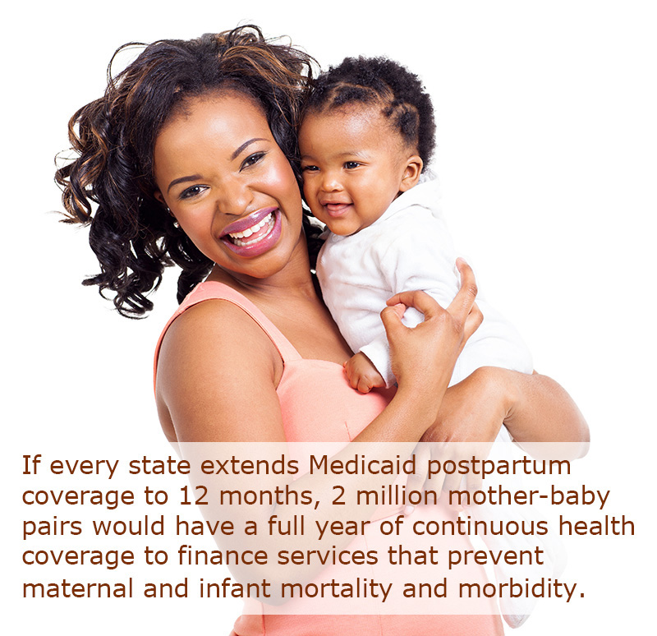
Federal policy action
All photographs used in this presentation are licensed by Kay Johnson from Adobe Stock. Please do not reuse.

Slide 11
Key topics of maternal health bills introduced last Congress
Coverage
Postpartum coverage extension
Quality
Perinatal Quality Collaboratives
Provider training (e.g. bias)
SDOH
Interagency task force on SDOH
Community-based programs
Workforce expansion & diversification
Pregnancy medical home / care coordination
Innovative payment models
Data & quality measurement
Reports from NASEM, GAO, and HHS, VA, USDA, Justice, etc.
Grants to states to implement best practices

Slide 12
Map shows action or proposals on extension of Medicaid postpartum coverage to one year, as of April 10, 2023
Source: Kaiser Family Foundation. https://www.kff.org/medicaid/issue-brief/medicaid-postpartum-coverage-extension-tracker/

Slide 13
Progress on 12 Components of Momnibus
1. Investments in social determinants of health that influence maternal health outcomes | 
2. Grants to community-based organizations to improve maternal health and promote equity. | 
3. Study risks facing veterans and support VA maternity care coordination programs. | 
4. Diversify the perinatal workforce to ensure culturally congruent maternity care and support. | 
5. Improve data collection and quality measures to understand causes of the US maternal health crisis and inform solutions to address it. | 
6. Fund maternal mental health equity programs. | 
7. Improve maternal health care and support for incarcerated moms.
8. Invest in digital tools like telehealth to improve maternal health in underserved areas.
9. Promote innovative payment models to incentivize high-quality maternity care.
10. Address COVID-19 and respectful maternity care in future public health emergencies. | 
11. Invest in community-based initiatives to reduce exposure to climate change-related risks.
12. Promote maternal vaccinations to protect the health and safety of moms and babies. | 
Clark M & Johnson K. Maternal Health Policies: Will Congress Act During the Lame Duck Session? Georgetown University Center for Children and Families. Blog. December 12, 2022.
https://ccf.georgetown.edu/2022/12/12/maternal-health-policies-will-congress-act-during-the-lame-duck-session/ Also see: Clark M. Permanent Medicaid Postpartum Coverage Option, Maternal Health Infrastructure Investments in 2022 Year-End Omnibus Bill. Georgetown University Center for Children and Families. Blog. January 2, 2023. https://ccf.georgetown.edu/2023/01/04/permanent-medicaid-postpartum-coverage-option-maternal-health-infrastructure-investments-in-2022-year-end-omnibus-bill/
Johnson, Zephyrin. Congressional Proposals to Address the Maternal Health Crisis Offer a Promising Roadmap for Change. Georgetown University Center for Children and Families. Blog. 10/22/21. https://ccf.georgetown.edu/2021/10/22/congressional-proposals-to-address-the-maternal-health-crisis-offer-a-promising-roadmap-for-change

Slide 14
Select Priorities Passed in Omnibus Bill FY23
Medicaid option for postpartum coverage extension now permanent.
Pregnant Workers Fairness Act
PUMP for Nursing Mothers Act
CDC
Perinatal Quality Collaboratives
Maternal Mortality Review Committees
HRSA maternal health
Alliance for Innovation on Maternal Health (AIM)
State Maternal Health Innovation Grants
Pregnancy medical home demonstration grants project
Healthy Start (maternal health)
Funds for community-based organizations and others to achieve equitable outcomes
Support to minority-serving institutions (new)
Maternal mental health
Into the Light for Maternal Mental Health Act (previously known as TRIUMPH for New Moms Act)
HRSA Screening and Treatment of Maternal Depression grants
National Maternal Mental Health Hotline (HRSA)

Slide 15
Blueprint for Addressing the Maternal Health Crisis
“The Biden-Harris Administration is committed to cutting the rates of maternal mortality and morbidity, reducing the disparities in maternal health outcomes, and improving the overall experience of pregnancy, birth, and postpartum for people across the country.
Goal 1: Increase Access to and Coverage of Comprehensive High-Quality Maternal Health Services, Including Behavioral Health Services
Goal 2: Ensure Those Giving Birth are Heard and are Decisionmakers in Accountable Systems of Care
Goal 3: Advance Data Collection, Standardization, Harmonization, Transparency, and Research
Goal 4: Expand and Diversify the Perinatal Workforce
Goal 5: Strengthen Economic and Social Supports for People Before, During, and After Pregnancy
White House Blueprint for Addressing the Maternal Health Crisis. June 2022. Reaffirmed December 2022.
https://www.whitehouse.gov/wp-content/uploads/2022/06/Maternal-Health-Blueprint.pdf

Slide 16
Post Dobbs Federal Response
“Reproductive health care, including access to birth control and safe and legal abortion care, is an essential part of your health and well-being. While Roe v. Wade was overturned, abortion remains legal in many states, and other reproductive health care services remain protected by law.” https://reproductiverights.gov/
Right to patient privacy protections (HIPAA)
Right to emergency care (EMTALA) including pregnancy related
Right to birth control (ACA), most plans with no out-of-pocket costs
Right to medication, without discrimination
Right to access abortion, FDA medication and some health plans
Right to other preventive services (WPSI), without cost sharing
Access to health coverage
Access to health care for uninsured

Slide 17
ACA preventive services benefits
Under ACA, most health plans must cover a set of preventive services (e.g., well visits, screening, immunizations) without cost-sharing
On August 1, 2012, women gained coverage for a set of women’s clinical preventive health services without cost-sharing. Now 58 million women.
Federal Women’s Preventive Services Initiative (WPSI) Guidelines are key.
Currently threatened by lawsuits.
Learn more from: Federal website with guidelines: https://www.hrsa.gov/womens-guidelines/index.html ; Women’s Preventive Services Initiative https://www.acog.org/About-ACOG/ACOG-Departments/Annual-Womens-Health-Care/Womens-Preventive-Services-Initiative; IOIM/NAS Women’s Clinical Preventive Services. http://nationalacademies.org/hmd/Reports/2011/Clinical-Preventive-Services-for-Women-Closing-the-Gaps.aspx ; Preventive Health Services (Website). https://www.healthcare.gov/coverage/preventive-care-benefits/ ; HHS Office of the Assistant Secretary for Planning and Evaluation (ASPE). Access to Preventive Services without Cost-Sharing: Evidence from the Affordable Care Act. (Issue Brief No. HP-2022- 01). January, 2022; Commonwealth Fund. https://www.commonwealthfund.org/publications/issue-briefs/2017/aug/how-affordable-care-act-has-helped-women-gain-insurance-and

Slide 18
Pressures on Reproductive Health are Stacking Up
Abortion services
Maternal mortality and morbidity
Family planning
Pre-existing health conditions
Underserved areas
Uninsured
The image shows wooden building blocks with text labels that identify issues related to reproductive health.
Photo licensed by Kay Johnson from Adobe Stock and adapted for this presentation.

Slide 19
Medicaid’s role in improving the health of women, birthing people, and infants
All photographs used in this presentation are licensed by Kay Johnson from Adobe Stock. Please do not reuse.

Slide 20
Source: Kaiser Family Foundation. Medicaid’s Coverage for Women. February 2022. https://www.kff.org/womens-health-policy/issue-brief/medicaid-coverage-for-women/

Slide 21
Medicaid and Family Planning Services
Medicaid accounts for 75% of all public funds spent on contraceptive services and supplies
Mandatory family planning benefit with federal match at 90%
Cost sharing prohibited for family planning and pregnancy services
Any willing provider and freedom of choice of provider
Most states cover all FDA approved contraceptives, plus related testing and counseling for STI, HIV, cervical cancer
28 states operate limited programs through an option (with state plan amendment – SPA) or waiver
Kaiser Family Foundation https://www.kff.org/womens-health-policy/issue-brief/financing-family-planning-services-for-low-income-women-the-role-of-public-programs/ and https://www.kff.org/womens-health-policy/issue-brief/medicaid-coverage-for-women/

Slide 22
Medicaid Coverage and Childbearing
Prenatal services
‒ Prenatal care (all)
‒ Case management (35)
‒ Smoking cessation (all)
‒ Prenatal vitamins & prescriptions (all)
‒ Group prenatal (12)
‒ Blood pressure (31)
‒ Substance use treatment
Birth services
‒ Hospital birth / labor, delivery, & newborn (all)
‒ Birth center deliveries (32)
‒ Doula services (9)
‒ Childbirth & parenting education (< half)
Care for maternal or infant complications (all)
Postpartum & interconception services
‒ Postpartum visits (all)
‒ Family planning (all)
‒ Breastfeeding (27)
‒ Maternal depression
‒ Clinical home visit
‒ Interconception care for high risk
Gomez I, Ranji U, Salfanicoff A, & Frederiksen B. Medicaid Coverage For Women. Kaiser Family Foundation. 2022. https://www.kff.org/womens-health-policy/issue-brief/medicaid-coverage-for-women/ Ranji U, Gomez I, Salganicoff A, Rosensweig C, Kellenberg & Gifford K. Medicaid Coverage of Pregnancy-Related Services: Findings from a 2021 State Survey. May 2022. https://www.kff.org/report-section/medicaid-coverage-of-pregnancy-related-services-findings-from-a-2021-state-survey-report/

Slide 23
Medicaid and CHIP coverage for infants
More than half babies—2.2 million infants enrolled in Medicaid.
6 in10 Black, AI/AN, and Hispanic infants.
(46% of total)
More than half of all children and youth 0-18.
Kaiser Family Foundation analysis of American Community Survey Data.
Sources: Johnson Group analysis of EPSDT data from Centers for Medicare and Medicaid Services, 2018.
Georgetown University Center for Children and Families analysis of data on young children from the American Community Survey.
Artiga et al. Medicaid Initiatives to Improve Maternal and Infant Health and Address Racial Disparities. Kaiser Family Foundation, 2020.
Brooks & Gardner. Snapshot of Children with Medicaid by Race and Ethnicity, 2018. Georgetown University Center for Children and Families, 2020.

Slide 24
Enrollment Processes Matter
“UNWINDING” post-COVID started April 1, 2023.
Federal law guarantees one year of continuous enrollment for babies with a Medicaid financed birth. >500,000 infants are not enrolled at least 90 days.
States postpartum coverage extensions similarly guarantee continuous coverage for one year.
New law (effective January 1, 2024) requires 12-months of continuous eligibility for all children <19 in Medicaid and CHIP.
All depend on effective state eligibility and enrollment processes.
> 2 million infants enrolled overall of
3.6 million total US births
Sources: Johnson K. K. Missing Babies: Best Practices for Ensuring Continuous Enrollment in Medicaid and Access to EPSDT. Johnson Group Consulting. 2021. https://ccf.georgetown.edu/wp-content/uploads/2021/03/missing_babies_EPSDT_Medicaid_finalJan2021_Johnson_edit061621.pdf
Park et al. Consolidated Appropriations Act, 2023: Medicaid and CHIP Provisions Explained. Georgetown Center for Children and Families. 2023. https://ccf.georgetown.edu/2023/01/05/consolidated-appropriations-act-2023-medicaid-and-chip-provisions-explained/

Slide 25
Recharge: Transformation?
Photographs used in this presentation are licensed by Kay Johnson from Adobe Stock. Please do not reuse.

Slide 26
5 Whys and Root Causes for Black Maternal Mortality
Zephyrin LC. Changing the Narrative and Accelerating Action to Reduce Racial Inequities in Maternal Mortality. Am J Public Health. 2021;111(9):1575-1577. doi:10.2105/AJPH.2021.306462.

Slide 27
Addressing Unequal Treatment
Need layers of change
Improve coverage, benefits, and costs.
Assure equitable access.
Implement practice guidelines.
Adopt anti-racist, anti-bias approaches in health care.
Use shared decision making.
Design and conduct QI efforts with an equity lens, not just measure disparities at the end.
Preconception/ Pre-Pregnancy Advice and Services, US, 2011-2013
Pazol, Robbins, Black, et al. (2017). Receipt of Selected Preventive Health Services for Women and Men of Reproductive Age - United States, 2011-2013. MMWR. 66(20), 1–31. https://doi.org/10.15585/mmwr.ss6620a1
Notes:
These data point to the possibility of unequal treatment and bias related to women’s race/ethnicity. Additional data show similar variations by health insurance type and/or income status.

Slide 28
What if the health care system changed?
Preventive services were delivered equitably, with structural barriers, bias, and disparities in practice eliminated.
Birthing people had a team of supportive providers— including doulas, midwives, doctors, nurses, community health workers, lactation consultants, and others—to support optimal outcomes.
Health providers listened to pregnant and birthing people, particularly BIPOC and those who are low-income, have low health literacy, or speak a language other than English.
Full year of postpartum coverage for mothers combined with babies continuous coverage together used to support for optimal health, mental health and well-being.
Coverage and access to full range of health care throughout life course – before, during, and beyond pregnancy.

Slide 29
Health Care System Transformation
More team-based, person-centered care
Benefits to address physical, mental, oral, and reproductive health
Full array of perinatal providers
Adequate provider payment rates
Financing for SDOH and care coordination
Focus on quality and safety
Strategies that promote equity
Doulas and CWH
PQC & Birthing Friendly hospitals
Maternal health homes
Anti-bias training
Birth centers & midwives
Equity oriented measures
Mental health care
Zephyrin L & Johnson K. Optimizing Medicaid Extended Postpartum Coverage to Drive Health Care System Change. Women’s Health Issues. 2022:S1049-3867(22)00091-3. https://doi.org/10.1016/j.whi.2022.08.008
Zephyrin L, et al. Community-Based Models to Improve Maternal Health Outcomes and Promote Health Equity. Commonwealth Fund. Issue Brief. March 4, 2021. https://www.commonwealthfund.org/publications/issue-briefs/2021/mar/community-models-improve-maternal-outcomes-equity

Slide 30
Working across a life course continuum
Women’s Health
Well-Woman Care
Family Planning Services
Birthing Care
Postpartum Care
Prenatal
Care
Preconception Care

Slide 31
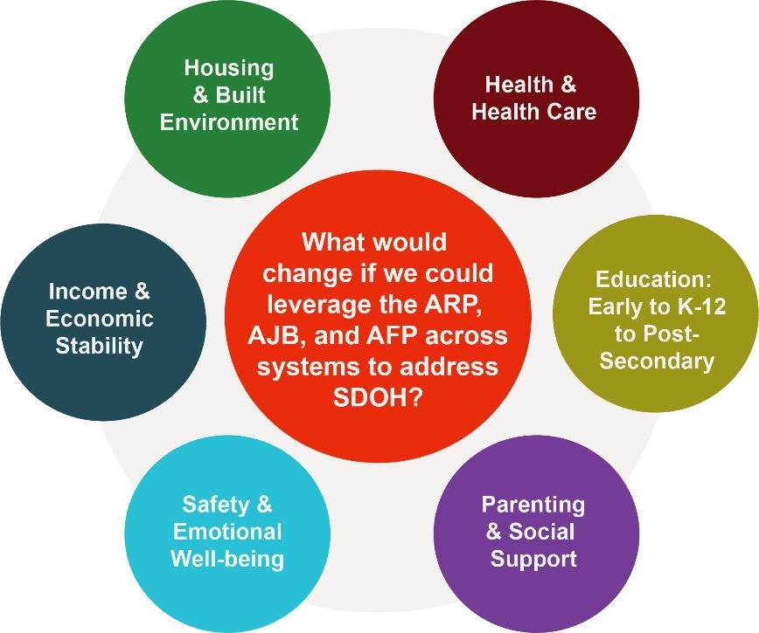
Advancing Equity
Adopt policy and structural changes to get at root causes.
Invest in health, economic security, education, and community building.
Income, tax credits, family leave
Health care across life course
Community-level investments
Education-early to higher ed
Bruner C, Hayes M, Houshyar S, Johnson K, & Walker-Harding L (May 2021). Dismantling Racism: 10 Compelling Reasons for Investing in a Relational/Community Health Workforce for Young Children and Their Families. InCK Marks Initiative. www.inckmarks.org or http://www.inckmarks.org/docs/newresources/InCKDiscussionBriefDismantingRacismMay20.pdf

Slide 32
Source: https://blog.greendot.org/juneteenth-is-a-holiday-of-celebration-reflection/
Seizing a window of opportunity:
A time to do better

Slide 33
Delaware & DHMIC again set the bar high
Strategic Goals
Elimination of disparities between White, Black, and Hispanic infant and maternal mortality
Reduction of preterm birth rate from 11% to less than 7% to be the lowest in the country.
Development of an innovative model of care that addresses both the health disparities and the reduction in preterm births.
Strategic priorities:
Increase engagement and outreach to our community
Ensure innovative model of care to address preterm birth and disparities
Create a strong policy agenda

Slide 34
Looking ahead, what can Delaware do?
1
Continue work on Black maternal health, with broader representation and understanding of structural racism.
2
Implement the Medicaid postpartum coverage, with attention to more than a visit.
3
Restore emphasis on preconception care through well-woman visits, with priority on SDOH.
4
5
Engage CBOs and those with lived experience in co-design of systems of care.
Use QI related to maternal and infant mortality and morbidity, focus on equity, including but limited to PQC.
6
Leverage payment innovation for change.

Slide 35
Thank you
Kay Johnson, age 18

