Slide 1
BRAIN SCIENCE TRAINING INSTITUTE
The Impact of Toxic Stress
on Pregnancy

Slide 2
IDENTIFY
UNDERSTAND
RECOGNIZE
IDENTIFY
The Role of the Brain and Stress Response System in Responding to Toxic Stress
The Impact of Toxic Stress and ACEs on Maternal Health and Preterm Births
Learning Objectives
The Impact of Inequality and Disparity on Maternal Health
Resiliency Strategies to Mitigate Toxic Stress and Leveraging the Reproductive Life Plan

Slide 3
MINDFULNESS ISN'T DIFFICULT. WE JUST NEED TO
REMEMBER TO DO IT.
- SHARON SALZBERG
Notes:
Reminder: Take care of yourself
Many of us have experienced our own trauma
Material can be challenging
Please feel free to take a break as needed

Slide 4
A threat or series of threats that overwhelms our nervous system, and impacts our mental, physical, social, emotional and spiritual well-being.
What is
Trauma?
ACUTE | CHRONIC | COMPLEX | HISTORICAL | VICARIOUS
Notes:
Trauma usually involves intense fear, threat to physiological or physical safety, and involves a sense of helplessness. It can also overwhelm a person’s ability to cope.
Acute: car accident
Chronic: child abuse, domestic violence
Complex: rape, gun violence
Historical: discrimination, oppression, violence,
Racial injustice (workplace discrimination, community violence, deportation)
Vicarious: being a therapist and witnessing the trauma of others
Ultimately trauma stresses our body

Slide 5
Types of Stress Response
POSITIVE
Brief increases in heart rate, mild elevations in stress hormone levels
TOLERABLE
Serious, temporary stress responses buffered by supportive relationships
TOXIC
Prolonged activation of stress responses, absent protective relationships
Notes:
Positive stress: normal and healthy (immunization shot, sexual intercourse)
Tolerable stress: Activates alert system, but able to regulate back down (injury)
Toxic stress: Prolonged (child abuse, caregiver substance abuse)
Can anyone name positive, tolerable and toxic examples of stress?

Slide 6
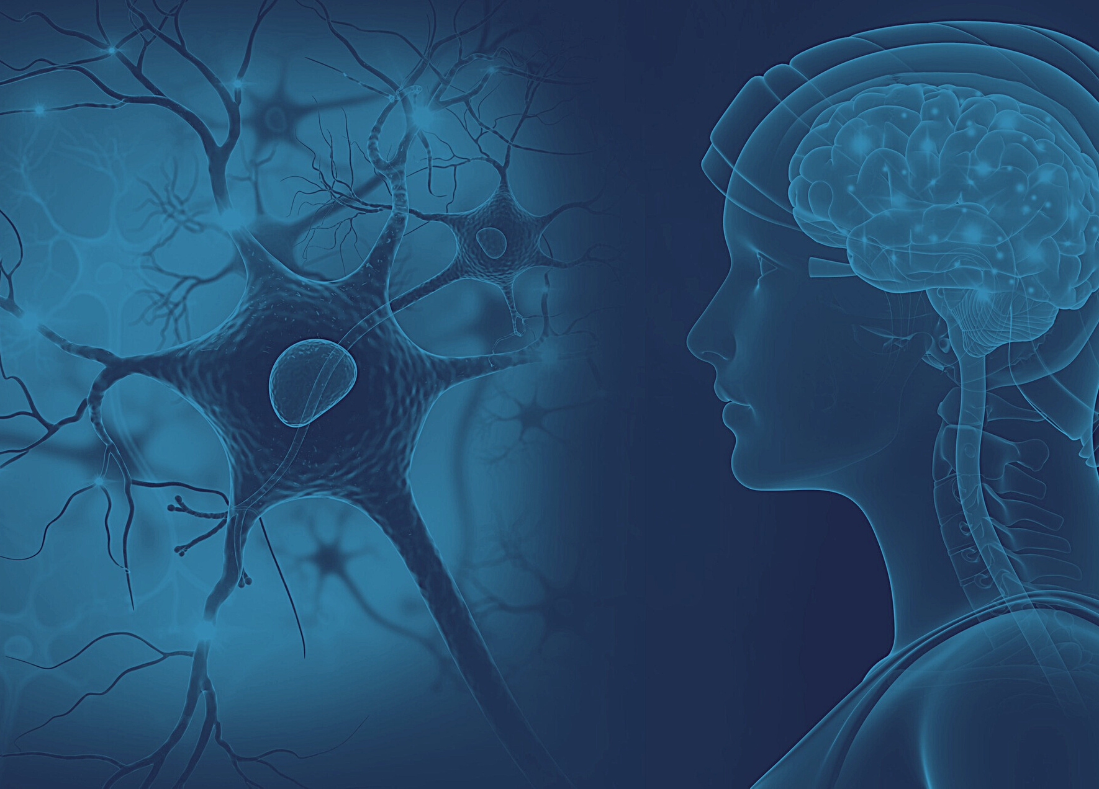
UPSTAIRS: "RATIONAL"
Cerebral Cortex
Thinking, Imagining, Planning
Weighing Pros vs Cons
Empathy & Self-Understanding
DOWNSTAIRS:"EMOTIONAL"
Toxic Stress
& The Brain's Role
Limbic region & Brain Stem
Basic Functions: Breathing, Heart
Oldest, Most Primitive
Strong Emotions: Fear & Anger
Notes:
Mention PFC here and amygdala but give example in next slide.

Slide 7
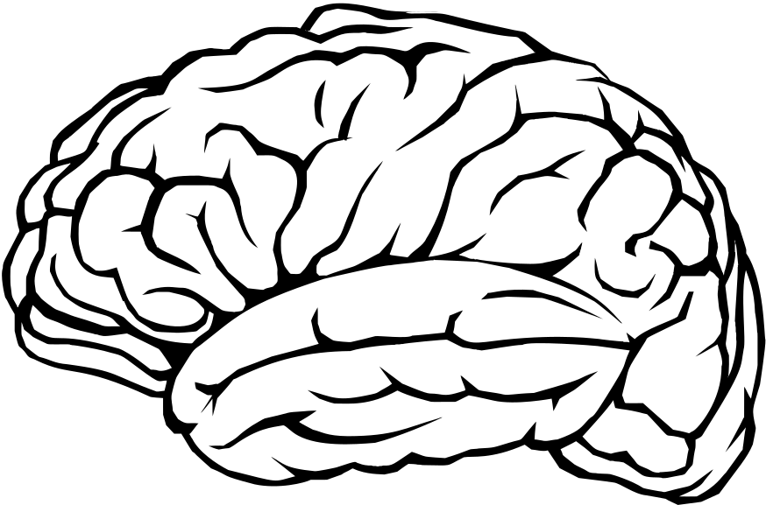
Understanding
Trauma
Operates unconsciously
Brain's alarm system
Reacts to threats, sending rapid signals to engage in a fear response
Allows us to act before we think
Blocks connections to upstairs / rational brain
THE AMYGDALA
Notes:
Found in the limbic area the amygdala operates unconsciously as the brains alarm system.
It hijakcs the upstairs brain reacting to threatening events and sending rapid signals to the brain and body to engage in a fear response and in order to react efficiently it blocks the connection to the upstairs brain.
**Internal adjustments to external environment
Show hand demonstration
Thumb (amybdala), Fingers (pre-frontal cortex, front of brain, amygdala flops the lid in the danders situations in order to react like in a fire

Slide 8
Three Survival Responses
HYPERAROUSAL
FIGHT
HYPERAROUSAL
FLIGHT
HYPOAROUSAL
FREEZE
Above normal responses where the body releases adrenaline and cortisol to actively and physically engage
Below normal response where the body disconnects and dulls its own pain
Notes:
Nervous Systems:
Sympathetic
Parasympathetic (reg/dys)
1. We don’t decide how we are going to react, unless maybe we have been trained (military, 1st responders, fire drill at school)
2. We may have a certain default reaction.
3. Dissociation allows less pain to be experienced.
We see dissociation in fight or flight, but more common in freeze
4. Give examples of what fight, flight, freeze look like.
ACTIVITY
Please stand up, and get into a position where you are bracing yourself for a big hug by a toddler running up to you. Stand with one foot in front of the other, bend your knees, and hands and arms out getting ready for the embrace. Remember to breathe. Lets stay here for 30 seconds. Notice how this feels. Imagine how easy this would be to get into fight or flight from this position you are in right now. For many children and adults who have gone through repeated traumatic experiences and have lived like this, they may always be in this stance, and always in this state of hyperarousal. This is what it feels like in their body, always ready to go.

Slide 9
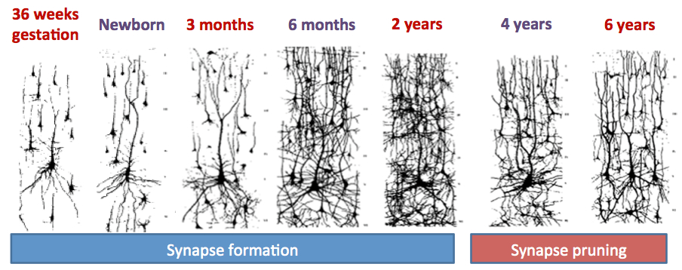
Source: BioSerendipity, 2019
Notes:
-We know stress is transferred in utero, brain health begins in the womb. Animal and human studies have shows that prenatal maternal stress affects the brain and behavior of the offspring/child. Prenatal stress: Effects on fetal and child brain development - PubMed (nih.gov)
Exposures to stress increases the risk for a child having a range of emotional, cognitive, and behavior problems later in life. (Depression, anxiety, ADHD). Specifically, we see in the brain, cortical thinning and an enlarged amygdala. Prenatal developmental origins of behavior and mental health: The influence of maternal stress in pregnancy - PubMed (nih.gov)
Other research is also starting to show a direct impact between prenatal stress and offspring HPA axis functioning, even at 6 years of age. The hypothalamic pituitary adrenal axis consists of the hypothalamus, pituitary gland, and adrenal glands. Together they basically support regulation, creation, and activation of hormones. This HPA axis is the major player in the neuroendocrine response to stress. The research suggests that stress during pregnancy is associated with long-term activation and changes of axis activity. Prenatal maternal psychopathology and stress and offspring HPA axis function at 6 years - PubMed (nih.gov)
HPA axis responsiveness to stress: Implications for healthy aging - PMC (nih.gov)

Slide 10
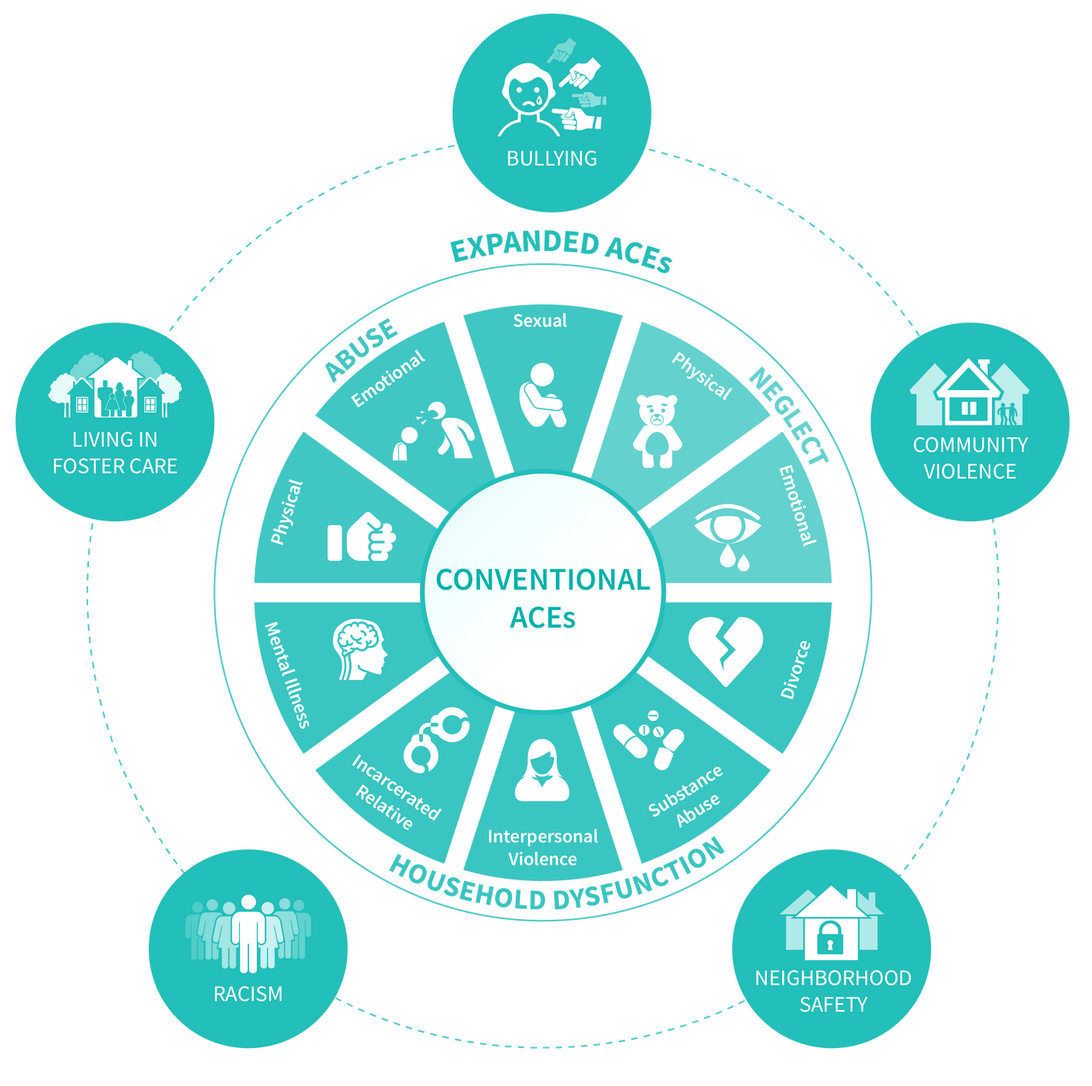
What are ACEs?
Adverse childhood experiences, are traumatic and toxic stress endured during childhood and teen years (0-17).
Notes:
SHANNON
Ask for show of hands if they’ve heard ACES
Original study in 1995
Linked childhood household stressors like abuse & neglect to an increased likelihood of adulthood illness, including chronic physical health issues
Found 1 in 6 adults had experienced at least one household ACE and are incredibly common
Found there was a dose response correlation and that 4 or more ACEs dramatically increased the likelihood of negative health outcomes

Slide 11
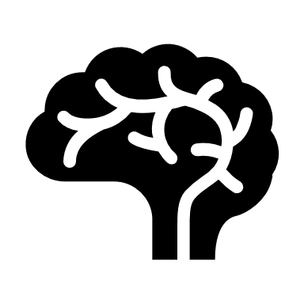
Discrimination is Trauma
Greater response in emotion regulation and fear inhibition networks
Heightened activation in region associated with threat vigilance
Compromises integrity of white matter in prefrontal cortex
Correlated with overall anxiety and depression.
Thinner gray matter in the cingulate cortices.
Notes:
SHANNON
We are now recognizing that it is not just what happens in the household. We understand that discrimination, current and historical, can critically alter that body’s response to stress. Not only does it affect the current but we now know it is transcribed into the dna and passed down to future generations. Studies have shown that people of color who experience frequent racism have heightened stress response pathways. Their stress response pathway is more sensitive and more responsive. It remains more vigilant. Physically, their brain has less gray matter in the cingulate cortices, which is implicated in learning, memory and social evaluation and is extensively connected to the amygdala. Racial discrimination impacts a person of color’s self-regulation and executive functioning skills, just like the original ACEs. Discrimination is correlated with increased depression and anxiety.

Slide 12
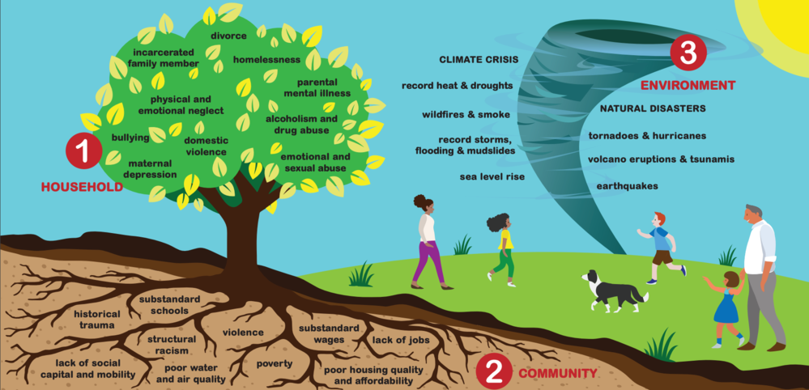
The 3 Realms of ACEs
Source: PACEs Connection
Notes:
SHANNON
Moving one step forward, we recognize three realms of ACEs.
Describe each section
Highlight community disparities that impact maternal health – community violence, substandard schools, poor infrastructure and medical care.
Notes: Highlight how the realms impact one another. They spiral off each other. Environment stressors can trigger household and community stressors and vice versa. Community ACEs are inequities which cause adversity in the household and continues to feed inequities and adversity in the community.
Metaphor: If our roots aren’t strong, then the tree can’t weather the storm.

Slide 13
The
Impacts
ON THE
INDIVIDUAL
Notes:
SHANNON
ACEs are implicated in poor outcomes around brain injury, mental wellbeing, maternal health, infectious disease, chronic disease, risky behaviors, and socioeconomic factors.
Individuals with 4 or more ACES are:
2x more likely to smoke
2x more likely to have cancer or heart disease
32x more likely to have learning or behavioral problems in school
7x more likely to end up in prison
12x more likely to attempt suicide
We know this about the pregnant mother who is sitting in the exam room today and we know how that toxic stress will be passed down in utero, exposing the infant to higher levels of stress. To ensure a healthy mother and healthy infant, we need to do more than just address the physical health during pregnancy.
We’ll look closer at the impacts of toxic stress on pregnancy as well.

Slide 14
Nightmares / Trouble Sleeping
Flashbacks
Hypervigilance
Constant Thinking About Trauma
Avoiding Reminders
Feeling Scared for "No Reason"
Feeling Angry, Guilty, Sad or Shameful
Physical Complaints & Problems
Consequences
of Trauma
Exposure
Notes:
SHANNON
But ACEs and toxic stress don’t just have long term implications. When that toxic stress response hijacks the upstairs brain and floods the nervous system with cortisol it obviously leads to emotional and behavioral impacts in the present. These are common symptoms of PTSD, however they’re also common symptoms of toxic stress, even in the absence of a diagnosis. Exposure to toxic stress and trauma create hypervigilance – an amygdala on extra alert. The hypervigilance and extra sensitivity of the downstairs brain creates trouble sleeping.
Sleep is critical in processing our experiences. When sleep is disrupted, it affects the brain’s ability to store explicit/factual memories – the sense of “I know this because…” and only stores implicit, unconscious memories where the brain and body remember sensations but the rational brain doesn’t make the connection.
This leads to “triggers” or experiences where implicit memories are alerted and the stress response is set off without a known cause. It also leads to intense, downstairs brain feelings like fear, anger or guilt with no known cause. Eventually, the frequent triggering of the stress response and high levels of cortisol take a toll on the body and individuals will have physical complaints as well, like stomach pain or headaches.

Slide 15
Impulse Control
Emotional Regulation
Flexible Thinking
Self-Monitoring
Social Skills
Working Memory
Planning / Prioritizing
Task Initiation
Comprehension
Organization
Executive
Functioning
SOCIETAL EXPECTATIONS
Notes:
SHANNON
Conversely, this impacts the ability to develop, strengthen and utilize the upstairs brain, which is responsible for executive functioning. Essentially, being able to have strong executive functioning is the same as being able to meet the expectations of society. Someone with strong executive functioning is able to #adulting.
Highlight examples: plan and organize, self-regulate, comprehend
Relate to how a pregnant mother might be impacted – can they comprehend what they’re being told to do, can they plan and prioritize their appointments and needs, can they tune in to their body and maintain their regulation?

Slide 16
research says
Women diagnosed with PTSD in the year before birth were 35% more likely to go into labor and deliver prematurely.
High levels of stress can cause high blood pressure leading to premature labor and low-birth weights.
Black women are 50% more likely to have a premature baby than white women.
c
National Institute of Mental Health. (n.d.). Post-traumatic stress disorder (PTSD). NIH Publication No. 08-6388. Retrieved January 6, 2016, from http://www.nimh.nih.gov/health/publications/post-traumatic-stress-disorder-ptsd/index.shtml
Shaw JG, Asch SM, Kimerling R, Frayne SM, Shaw KA, Phibbs CS. Posttraumatic stress disorder and risk of spontaneous preterm birth. Obstet Gynecol. 2014 Dec;124(6):1111-1119. doi: 10.1097/AOG.0000000000000542. PMID: 25415162.
Notes:
SHANNON
A study on women veterans and pregnancy concluded that it was not psychiatric conditions or risk behavior that was inducing preterm labor, it was the stress triggering biologic pathways that induce labor.
It further showed that even in the absence of active PTSD symptoms, they had the same rates of preterm labor as someone never diagnosed with PTSD. They had healed their minds but their bodies still carried the impacts.
We also know discrimination creates stress so it may not come as a surprise to then identify that black women are 50% more likely to have a premature baby. Toxic stress is implicated in this.
Gestational Diabetes and Hypertensive Disorders of Pregnancy Among Women Veterans Deployed in Service of Operations in Afghanistan and Iraq | Journal of Women's Health (liebertpub.com)

Slide 17
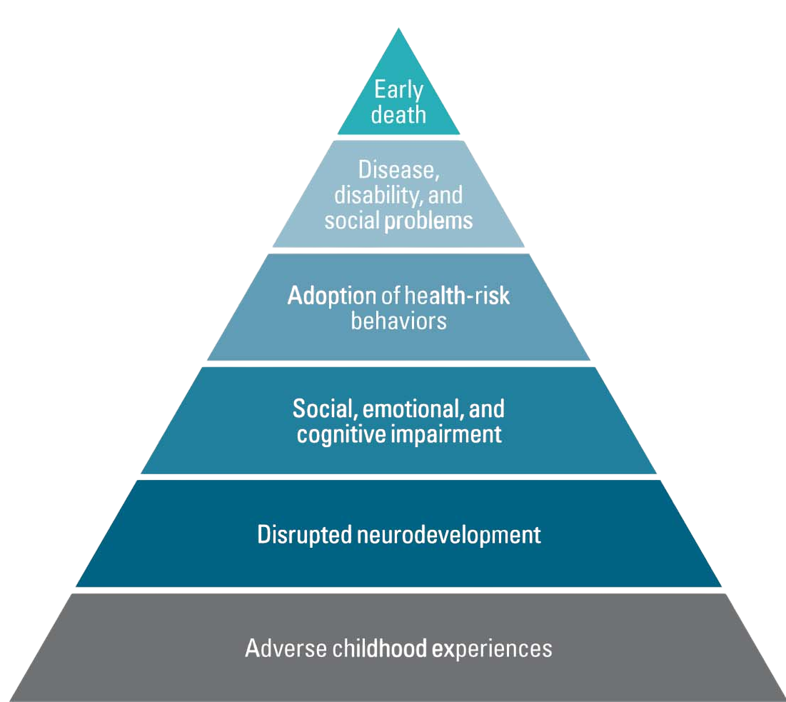
research says
Between 2017 and 2021, mental health conditions contributed to 46% of maternal deaths
Substance use contributed to 63% of maternal deaths
1 in 10 mothers who experienced 4+ ACEs with no known chronic conditions were 4x more likely to give birth preterm.
Hardcastle, K., Ford, K. & Bellis, M.A. Maternal adverse childhood experiences and their association with preterm birth: secondary analysis of data from universal health visiting. BMC Pregnancy Childbirth 22, 129 (2022). https://doi.org/10.1186/s12884-022-04454-zv
Notes:
SHANNON
More specifically research shows a high association between preterm birth and with previous accounts of childhood sexual abuse.
Read the stats on the slide
Explain the pyramid. ACEs > disrupted neurodevelopment > social-emotional impairments (less executive functioning) > increased risky behavior > chronic disease, disability and lower SES > early death

Slide 18
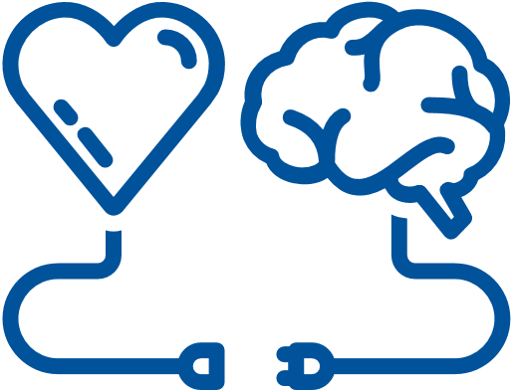
the good news
The same research that helps us understand ACEs also provides the strategies for prevention, intervention, and healing.
Prenatal screening for PTSD symptoms, mental health, and substance use
Integrate Reproductive Life Plan
Provide quality, trauma and equity informed care for all
Support access to education and information
McDonnell CG, Valentino K. Intergenerational Effects of Childhood Trauma: Evaluating Pathways Among Maternal ACEs, Perinatal Depressive Symptoms, and Infant Outcomes. Child Maltreat. 2016 Nov;21(4):317-326. doi: 10.1177/1077559516659556. Epub 2016 Jul 27. PMID: 27457410.
Notes:
SHANNON
Resiliency and hope
We can mitigate the impacts.
SCREENING
Research indicated that total ACEs predicted elevated PTSD and depression during treatment, but family dysfunction ACEs did not. By doing routine screening, we can support mothers with interventions to disrupt the intergenerational transmission of risk.
2. REPRODUCTIVE LIFE PLAN
We’ll go more into this one next
3. PROVIDING TRAUMA INFORMED CARE PRACTICES
Providing respectful care that honors choices, culture, traditions, preferences, preferred language, religion, etc. at a literacy level aligned with the individual. Understanding that what has happened to them shows up in their care and relaying values of safety and trust.
4. SUPPORTING ACCESS TO EDUCATION AND INFORMATION
Not just about pregnancy, childbirth, and decisions commonly made throughout the pregnancy and birth experience but about other supports and needs as well.

Slide 19
What's WRONG with you?!
What HAPPENED to you?
WHAT'S RIGHT WITH YOU?
HOW CAN I HELP YOU?
Notes:
SHANNON
At the end of the day, taking on a trauma informed approach to working with our families is about shifting from “What’s wrong with you…” to instead asking “what’s happened to you,” “what’s going right,” and “how can I help.” And truly, even if we don’t specifically know what “happened,” we can safely assume the families in our care have experienced toxic stress, wiring their brains and bodies to be more dysregulated and live downstairs, and therefore how we can help is to help them rewire their brains for regulation and be better caregivers themselves.

Slide 20
The brain is made of billions of neurons that connect with each other by firing, or sending electrical charges to one another.
Brains can create new pathways, adapting and changing throughout our life span.
Pathways are created by repeating a pattern of thoughts or images.
Learning
to Self
Regulate
WHAT FIRES TOGETHER
WIRES TOGETHER
Notes:
SHANNON
We're going to take ourselves back to the brain again. We've learned how toxic stress changes the brain. Resiliency changes the brain as well.
Define neuron pathways:
Our brain is made of billions of neurons. These neurons talk to each other by sending of electrical charges. Every time a neuron sends a charge to another neuron, a connection is made. Over time, those connections build pathways in the brain. As we reuse the same pathway again and again, we increase the myelin sheath around that pathway, which lets speeds up the pathway making it faster and stronger. This is commonly called, what fires together wires together. So for example, I have a pathway in my brain that ties my shoes. When my brain senses that its time to tie my shoes, it activates neuron A which immediately talks to B then C, etc. And I can do it without thinking because this is a very strong pathway.
Review toxic stress pathways:
Our toxic stress responses create those same pathways. When the amygdala sounds the alarm, hijacks the upstairs brain and activates the nervous system's stress response, it is physically building that pathway in the brain. The next time the amygdala sounds the alarm, it is likely going to choose that same pathway and strengthen it.
Define neuroplasticity:
But, the great thing about our brains is that we can always create new pathways. This is a concept called neuroplasticity. By building and using resiliency strategies, we can create new pathways in the brain to help buffer against the toxic stress pathways.
Handwriting Activity
Link to regulation skills & mindfulness:
If we want to increase our window of tolerance and our upstairs pathways, we need to practice our regulation skills. If we want to reduce the impact of bias in our reactions, we need to practice mindfulness. Through practice, we’re able to create and strengthen new architecture in the brain.

Slide 21
Techniques for Engagement
Connection
Choice
Context
It is a biological imperative, competing with the desires to be safe right now.
If we don't have enough choice, we can feel trapped and restricted.
The ability to understand information provided to us and the world.
Notes:
We need these three elements to feel regulated, to feel at ease. However, during this time of COVID, all three of these elements are being challenged. We will see how these elements come up later when we discuss the impact of COVID on children, but it also increases are potential to experience compassion fatigue and burnout more.
-identify and manage emotions, match arousal and energy to fit the situation, concentrate on tasks, and empathize with others.
This brings us to connection in the classroom, choice in the classroom, and context, the ability to understand and take in new information.

Slide 22
REALIZES
The prevalence of ACEs and the impact of trauma and potential paths for recovery
RECOGNIZES
TRAUMA INFORMED PRACTICE
The signs and symptoms of trauma in clients, staff, and others involved in organizations
RESPONDS
By integrating knowledge about trauma throughout agency's policies and practices
RESISTS
Actively resists re-traumatization of everyone involved in the system
Notes:
Organizations also have a responsibility to practice trauma informed principles and create resiliency within their organizations. Having a trauma informed practice within your organization starts with 4 Rs: Realize, Recognize, Respond, Resist
Realize the prevalence of ACEs and their impact both on those they serve and within their staff.
Recognize the signs of toxic stress in the clients and staff.
Respond by integrating trauma informed work throughout policies and procedures
And Resist re-traumatizing clients and staff through integrating the trauma informed approach.

Slide 23
Acknowledgement
Strengths
Based
Safety
CORE
PRINCIPLES
Trust
Collaboration
Choice
& Control
Compassion
Notes:
From the 4 Rs, we have 7 core principles to begin to apply trauma informed practices into the organizations.
Acknowledgement: Recognizing that trauma is pervasive
Safety: Ensuring policies and procedures facilitate a safe culture and environment
Trust: Providing flexibility, transparency,
Choice and Control: Ensuring those being served or those providing the service are empowered, Offering real choices, promoting democratic principles and examining power issues within the organization
Compassion: Understanding and being able to identify fight, flight, freeze responses. Being aware of other’s emotions.
Collaboration: Doing with and not doing to
Strengths Based: Focusing on strengths and not deficits

Slide 24
REPRODUCTIVE
LIFE PLAN
Notes:
One of the ways to focus in one improving birth outcomes is to use the Reproductive Life Plan to see be able to both assess and improve patient's insight into their own health- whether we are talking about preconception, prenatal or interconception.
We can show patients that we are interested in their view of their lives
Asking about how they see their future

Slide 25
What do you want your life to look like in 5 years?
Notes:
Philinda- we can ask "what do you want your life to look like a certain amount of time
Let's take a minute where I'll ask you to asses that for yourself.

Slide 26
Choose the Words that Describe Your Future
Satisfying
Career
Goals
Healthy
Happy
Enthusiastic
Children
Going places
Serious
Relationship
Values
Service
Responsible
Dating
Married
Own a house
Independent
Friendships
Calm
Make my own
decisions
Parenting
Education
My own
apartment
Love
Active
Single
Travel
Exciting
Successful
Volunteer
Easy
Relaxing
Leader
Stable
Spirituality
Notes:
Warm up activity “Life Words” handout
Choose at least 5 words or phrases to describe what you would like your life to look like in 5 years. Alternatively or additionally, you can write in words at the bottom
(Give 1.5 minutes to complete)
Now turn to someone near you and share
What is one thing that you heard your partner say?
We can use that activity to enhance connection to our patient

Slide 27
CLINICAL EMPATHY
Eye contact
Let patient know that you're listening
Be aware of your body language
Be curious about your patient
Record details that humanize your patient
Show support to your patient
Look for deeper ways to empathize with your patient
Notes:
The reproductive life plan can be a great tool to practice clinical empathy
Particularly, curiosity, learning details that humanize your patient, showing support, and deeper levels of empathy

Slide 28
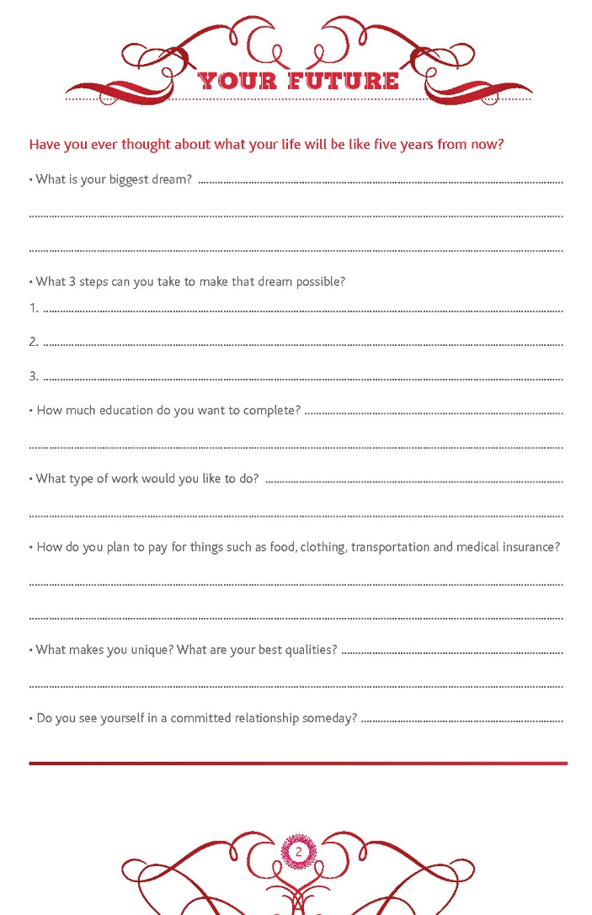
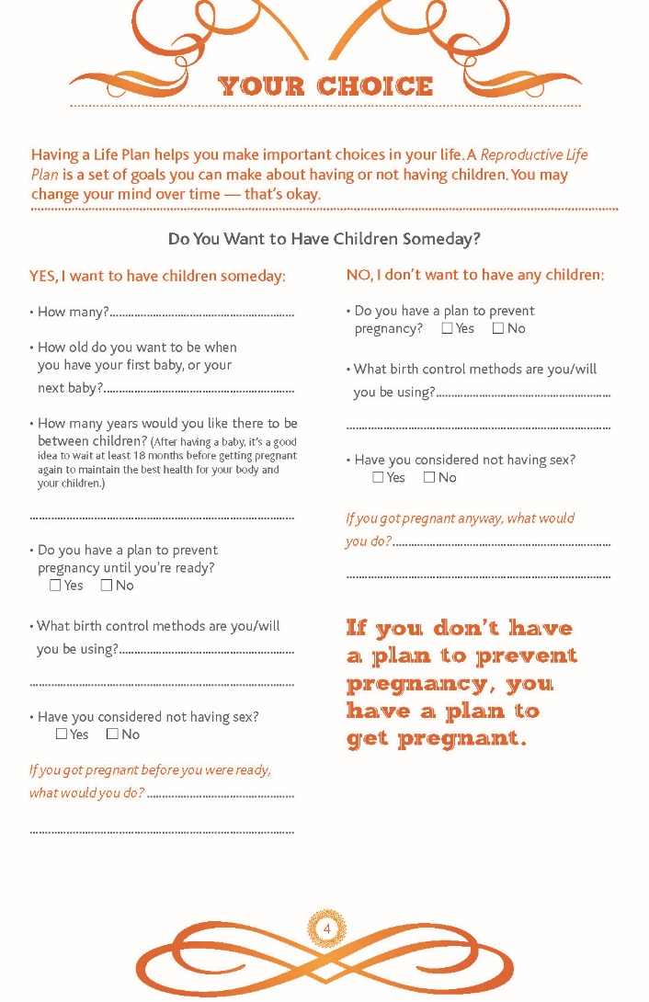
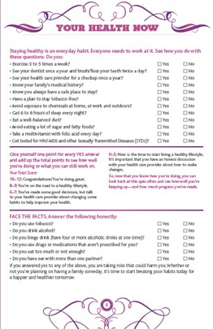
RLP Discussion Points
What do your want your life to look like?
Do you want to have children? birth spacing
What healthy habits are in place or could be added
Notes:
Based on the response, when you are working with a patient you might want to push into a particular page in the RLP
The 6 main section are
What do you want your life to look like?
Do you want to have children and birth spacing?
What healthy habits do you already have in place or would they want to add or enhance?

Slide 29
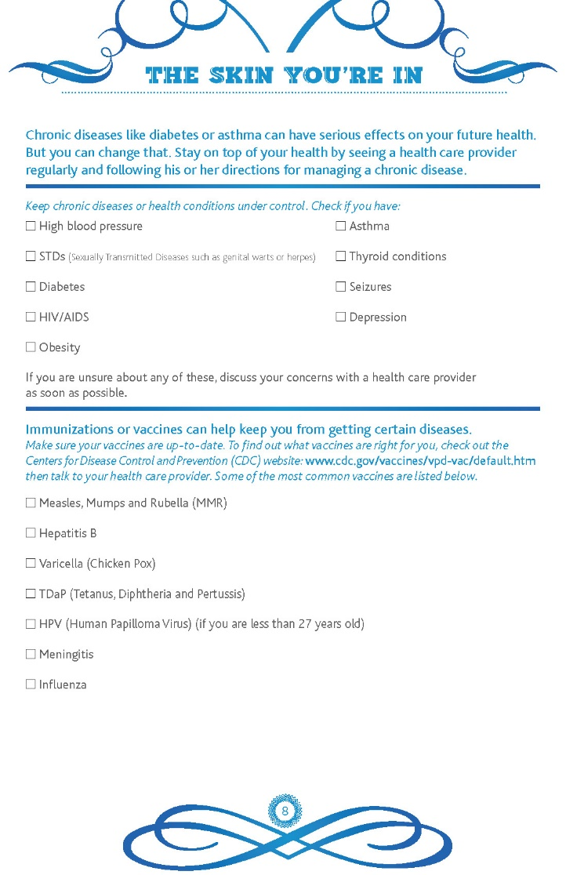
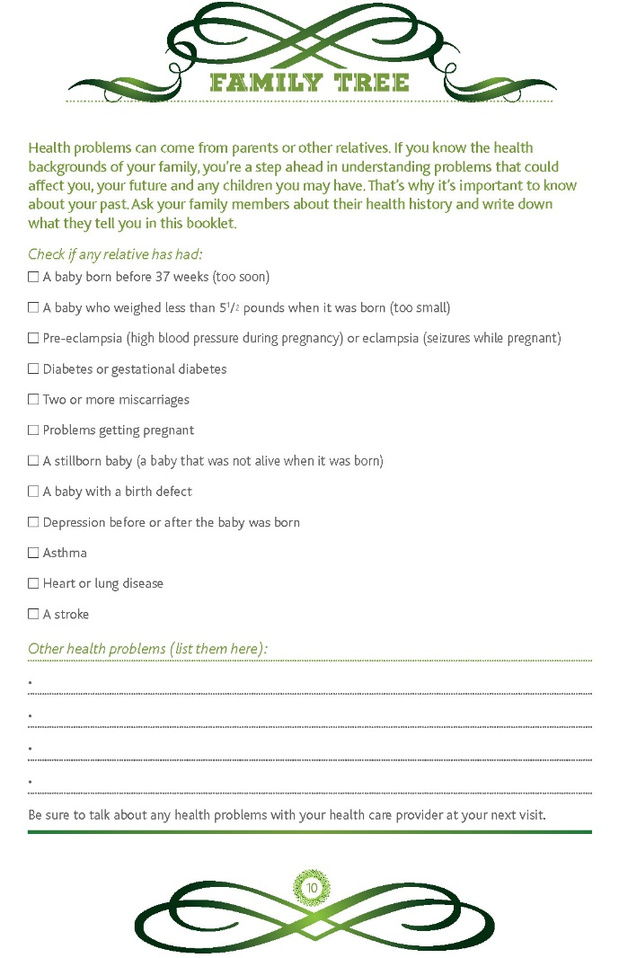
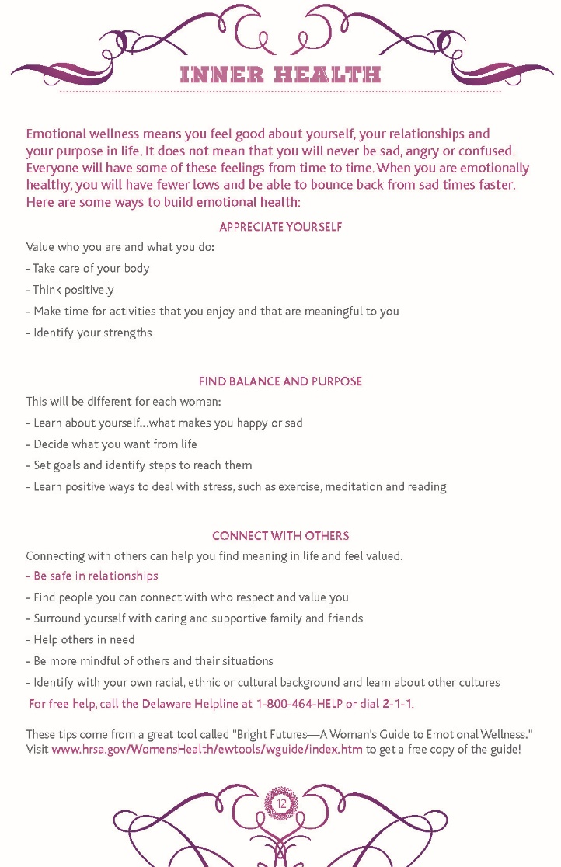
RLP Discussion Points
What Chronic Conditions affect you?
Genetic /Family Health Factors
Your Emotional Well being and Mental Health
Notes:
What chronic condition affect them?
What are their genetic/family health factors
Emotional Well being and mental health

Slide 30
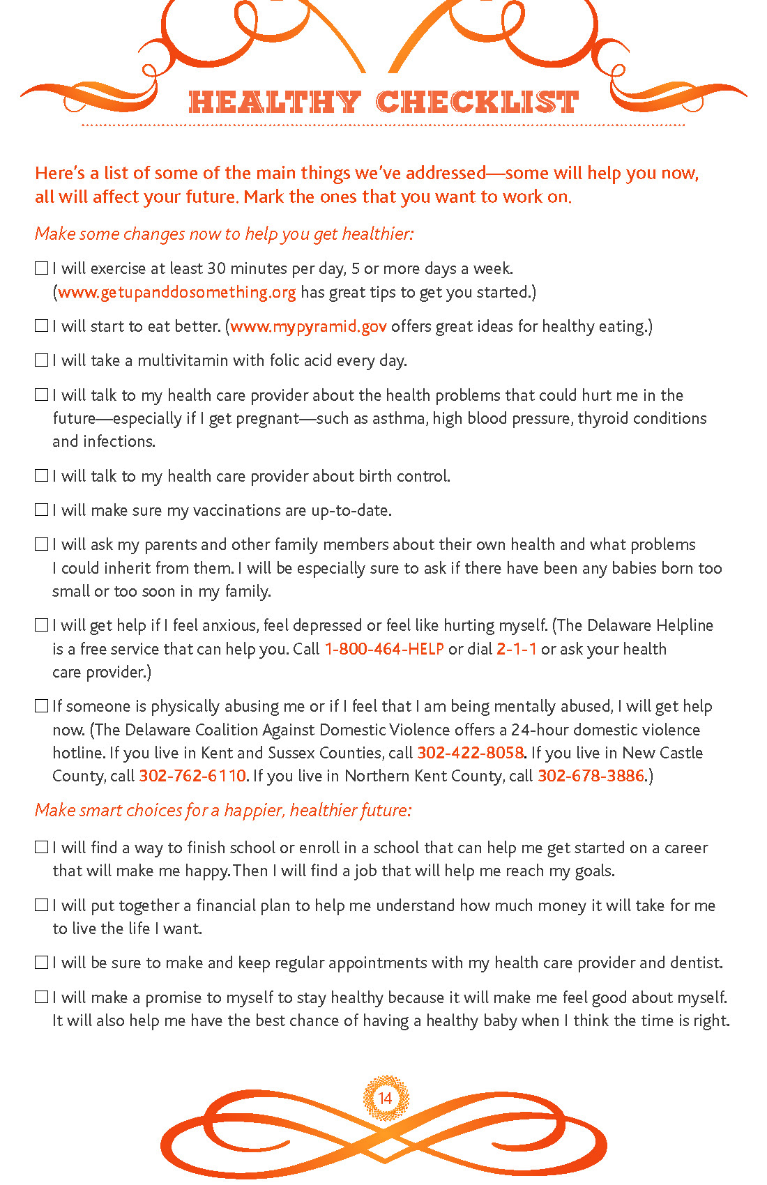
HEALTHY
CHECKLIST

Slide 31
RLP Implementation
WHO
HOW
WHAT
IDENTIFY
Will receive training on RLP and complete the screenings?
Who will be screened?
How will you integrate the RLP with your clients?
For example, at what visits will you use the RLP?
Develop a protocol around where patients will be screened and what tools will be used.
Referral resources for the patients identified needs
Areas needed for training.
Notes:
You can make this a team thing-how can you accomplish these goals with your team
CHWs, social workers, medical assistants, nurses

Slide 32
FEEDBACK
Something You Learned?
Emotions to the Topics?
What You Liked Today?
What Didn't Work?
What Did You Take Away?

Slide 33
Resources
American Psychological Association (2012). Building your resilience. https://www.apa.org/topics/resilience
Center on the Developing Child. (n.d.). Toxic stress. Harvard University.
https://developingchild.harvard.edu/science/key-concepts/toxic-stress/
Centers for Disease Control and Prevention, Kaiser Permanente. The ACE Study Survey Data [Unpublished Data]. Atlanta, Georgia: U.S. Department of Health and Human Services, Centers for Disease Control and Prevention; 2016.
Dana, Deb. (2021). Safe and Connected: A polyvagal guided path for re-imagining our world [PowerPoint slides]. PESI
Dong, T.S., et al. (2022). How discrimination gets under the skin: Biological determinants of discrimination associated with dysregulation of the brain-gut microbiome system and psychological symptoms. Biol Psychiatry. Doi: 10.1016/j.biopsych.2022.10.011
Gough, N.R., 2019). Neuron and Glia Remodeling Contribute to Male Behavior. BioSerendipity . https://www.bioserendipity.com/neuron-and-glia-remodeling-contribute-to-male-behavior/.﻿
Hardcastle, K., Ford, K. & Bellis, M.A. (2022). Maternal adverse childhood experiences and their association with preterm birth: secondary analysis of data from universal health visiting. BMC Pregnancy Childbirth 22 (129). https://doi.org/10.1186/s12884-022-04454-zv
McDonnell CG, Valentino K. Intergenerational Effects of Childhood Trauma: Evaluating Pathways Among Maternal ACEs, Perinatal Depressive Symptoms, and Infant Outcomes. Child Maltreat. 2016 Nov;21(4):317-326. doi: 10.1177/1077559516659556. Epub 2016 Jul 27. PMID: 27457410.
Molenaar NM, Tiemeier H, van Rossum EFC, Hillegers MHJ, Bockting CLH, Hoogendijk WJG, van den Akker EL, Lambregtse-van den Berg MP, El Marroun H. (2018). Prenatal maternal psychopathology and stress and offspring HPA axis function at 6 years. Psychoneuroendocrinology, 99 (120-127). doi: 10.1016/j.psyneuen.2018.09.003.
National Institute of Mental Health. (n.d.). Post-traumatic stress disorder (PTSD). NIH Publication No. 08-6388. Retrieved January 6, 2016, from http://www.nimh.nih.gov/health/publications/post-traumatic-stress-disorder-ptsd/index.shtml
Onyebuchie, O., et. al. (2022). Indirect effects of racial discrimination on health outcomes through prefrontal cortical white matter integrity. Biological Psychiatry: Cognitive Neuroscience and Neuroimaging. doi:10.1016/j.bpsc.2022.05.004
Samantha Artiga et al., “Racial Disparities in Maternal and Infant Health: An Overview,” Kaiser Family Foundation, November 10, 2020, https://www.kff.org/report-section/racial-disparities-in-maternal-and-infant-health-an-overview-issue-brief/.
Shaw JG, Asch SM, Kimerling R, Frayne SM, Shaw KA, Phibbs CS. Posttraumatic stress disorder and risk of spontaneous preterm birth. Obstet Gynecol. 2014 Dec;124(6):1111-1119. doi: 10.1097/AOG.0000000000000542. PMID: 25415162.
Shah NS, Wang MC, Kandula NR, Carnethon MR, Gunderson EP, Grobman WA, Khan SS. (2022). Gestational diabetes and hypertensive disorders of pregnancy by maternal birthplace. Am J Prev Med. doi: 10.1016/j.amepre.2021.10.007.
Starting Strong. (n.d.). Types of stress: Positive, tolerable, and toxic stress. University of Oregon.

Slide 34
CONTACT INFORMATION
Kiera McGillivray: kiera.mcgillivray@cffde.org
Shannon Fisch: Shannon.fisch@cffde.org
Philinda Mindler: Philinda.mindler@cffde.org

