Slide 1

Bridget Buckaloo MSN, RN
Director of Women’s & Children’s Services
Operationalizing Resources and Strategies to empower Women in the 4th Trimester

Slide 2

ACOG Committee Opinion Number 736 May 2018
Optimizing Postpartum Care

Slide 3
ACOG Committee Opinion Number 736 May 2018
Optimizing Postpartum Care
ACOG Committee Opinion Number 736, May 2018-Presidential Task Force on Redefining The Postpartum Visit– Optimizing Postpartum Care
“The 4th Trimester”- Reframing the traditional visit from a single episode of care to ongoing well woman care- Paradigm shift

Slide 4
ACOG Committee Opinion Number 736 May 2018
Postpartum Care Current State…
Currently, postpartum care is often fragmented between the OB-GYN/pediatrician
Approximately 40% of women attend their ppv
Underutilization affects disease management, contraceptive access
Women with limited resources have an even lower ppv rate
Women naturally tend to put the focus on the newborn
“I’m o.k.”
Women have to navigate the postpartum transition for 4-6 weeks
“lack of attention”
There is an urgent need to reduce maternal morbidity and mortality
More than half of pregnancy related deaths occur after childbirth

Slide 5
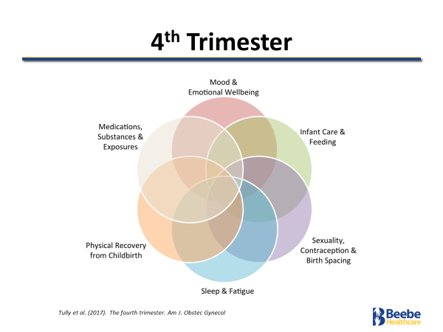
4th Trimester

Slide 6
The 4th Trimester
Future State: The 4th Trimester
Postpartum Care should be ongoing process
Individualized to meet the woman’s needs
ALL women should have contact with OB provider within 1-3 weeks post birth, followed by
Ongoing care as needed-Can be managed by Nursing
Conclude with:
Comprehensive postpartum visit no later than 12 weeks post birth
Women with Hypertensive disorders should be seen 7-10 days after birth
Severe hypertensive patients should follow up 3-5 days

Slide 7
Future State: The 4th Trimester-Benefits
Provides opportunity for maternal risk reduction and health promotion
Focus on follow-up care for chronic conditions- which may mean transitioning from obstetric providers to disease specific specialists
Opportunity to focus on maternal wellbeing and well woman care
Early interventions to provide resources and supports for breastfeeding
Person-centered contractive care and family planning

Slide 8
ACOG Committee Opinion Number 736 May 2018
Reframing the Postpartum Visit
Assessment to include:
Physical
Chronic Disease management- who will coordinate care?
Social- What does her support look like?
Psychological well-being:
Mood/PPD screening
Infant care/feeding
Sexuality
Contraception
Birth spacing

Slide 9
Reframing the Postpartum Visit: Barriers
Limited reimbursement
Access to appointments in already busy Ob/Gyn practice schedules
Care coordination requires staff and time
Provider opinions/views in a group practice setting
Providers and staff being uncomfortable addressing maternal mental health needs
Lack of access for referrals to chronic care specialists or mental health providers
Transportation barriers

Slide 10
The 4th Trimester
Reframing the Postpartum Visit
Optimizing Care and Support will require policy changes
Reimbursement policy should reflect an on-going process vs. a singular episode
Will require OB-GYN’s and Nurses at the forefront of all policy efforts
Aligns with Healthy People 2020 goals to increase postpartum visit attendance rates
Develop a “Postpartum Care Plan…”

Slide 11
The 4th Trimester
The Postpartum Care plan…
Suggested Components of the Postpartum Careplan:
Postpartum visits
Infant feeding plan
Reproductive life Plan/contraception/birth spacing
Pregnancy complications
Adverse pregnancy outcomes
Mental health
Postpartum problems
Chronic health problems

Slide 12
The 4th Trimester
Creative Strategy to Optimize postpartum care
Plan: Utilize a Women’s Health Navigator as a strategy to:
Improve the postpartum visit rate
  All patients
  High risk patients
Address mental Health/screen for PPD
Discuss contraceptive planning
Discuss birth spacing
Address social determinants

Slide 13
The 4th Trimester
Creative Strategy to Optimize postpartum care
Round on at least 50% of postpartum patients(initially)
Revisit contraceptive plan chosen on admission
Utilize Bedsider.org materials for education
Discuss Birth Spacing
Utilize DE thrives materials
Schedule ppv
Access to outpatient office EMR
Schedule high risk patients 7-10 days out
Review S/S of PPD
Utilize Postpartum Support International (PSI) Perinatal Mental Health Discussion Tool
Provide Nurse Navigator contact materials to provide bridge support

Slide 14
The 4th Trimester
The Future….
Champion the “4th Trimester”
Advocate for Policy change
ACOG
AWHONN
AAP
AAFP
Keep the conversation going! Talk about Well Woman Care…Tell 2 friends!
Develop a real postpartum care plan?
Change the way we deliver prenatal care?

