Slide 1
Maximizing Postpartum Medicaid Coverage: What every state, provider, and mother should know
Kay Johnson
Delaware Healthy Mother & Infant Consortium (DHMIC) 2023 Annual Summit: Renew, Reconnect, Recharge
Breakout session.
April 18, 2023

Slide 2
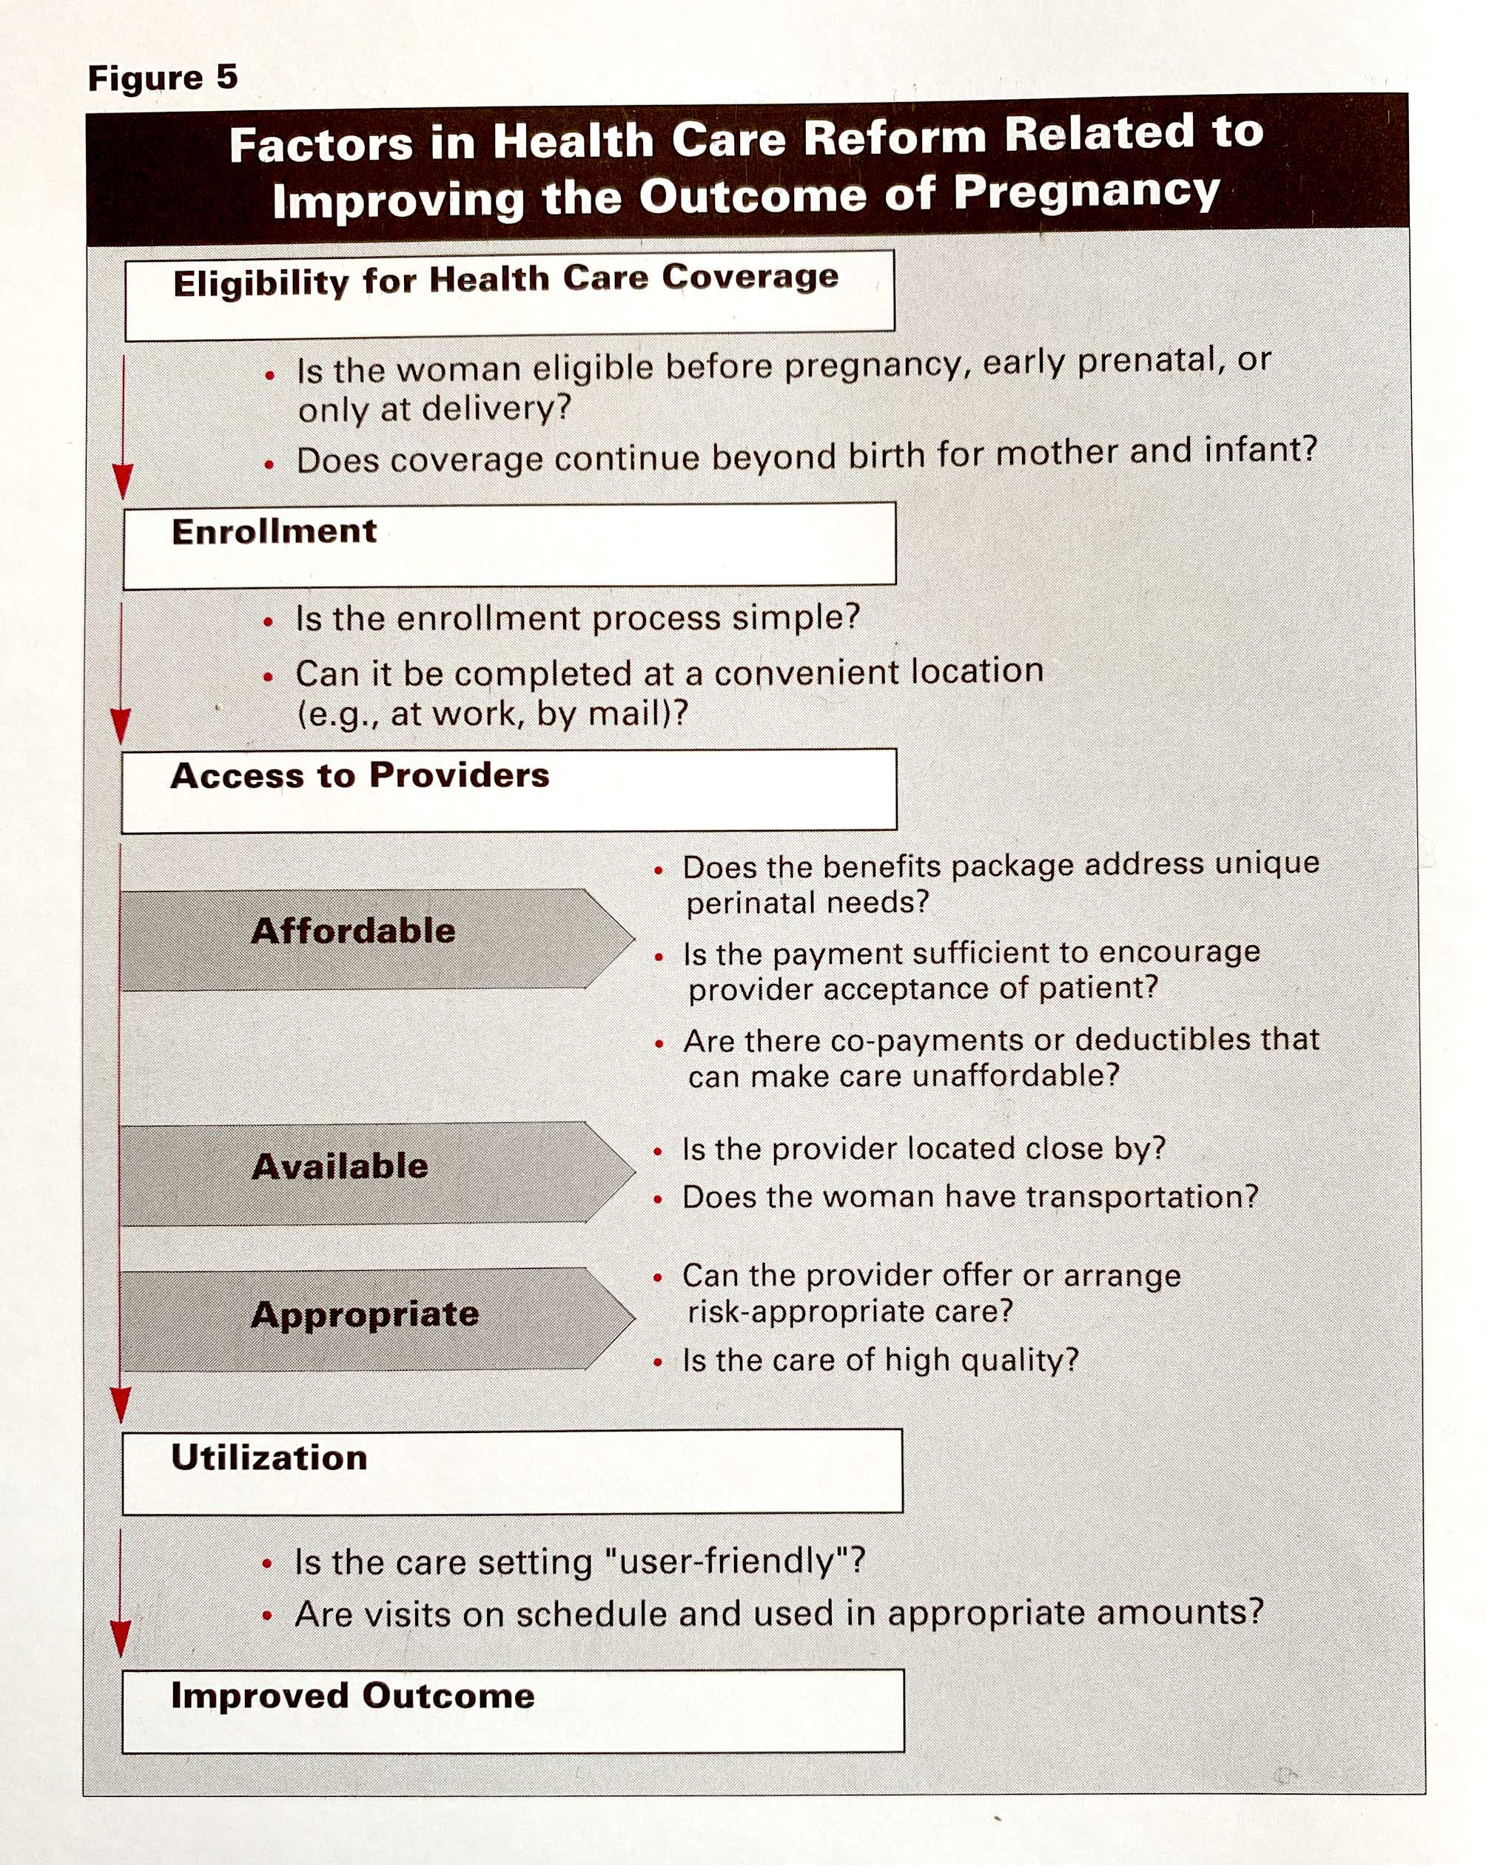
Let’s learn from the past
In expansion of Medicaid for prenatal care, the focus was largely on eligibility.
Few focused on access and quality.
Then evaluation studies focused on outcomes.
Few studies focused on the process, barriers, and other factors between eligibility and outcomes.
Toward Improving the Outcome of Pregnancy: The 90s and Beyond (TIOP II). March of Dimes. 1993. p.63.

Slide 3
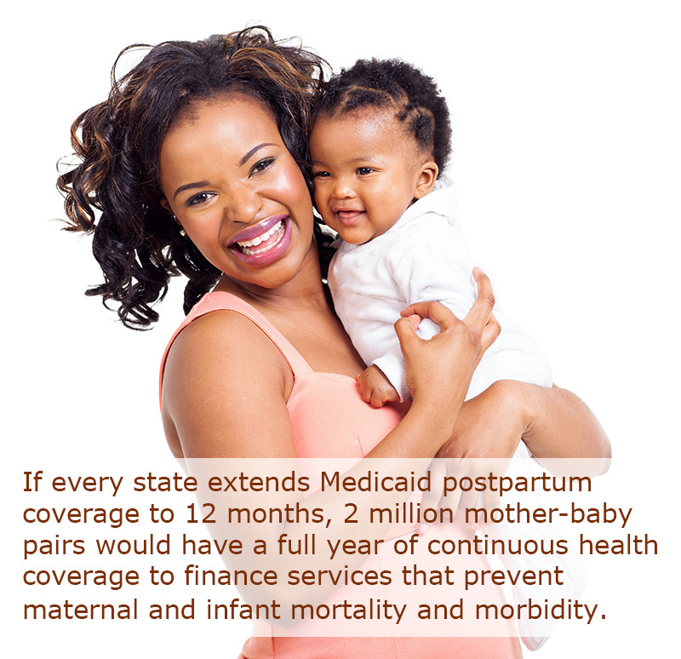
Implementation of Postpartum Extended Coverage
Eligibility is important but not sufficient.
Enrollment processes matter.
Access to care critical.
Appropriateness of care – medically and culturally
Thinking beyond the postpartum visit to make a difference.

Slide 4
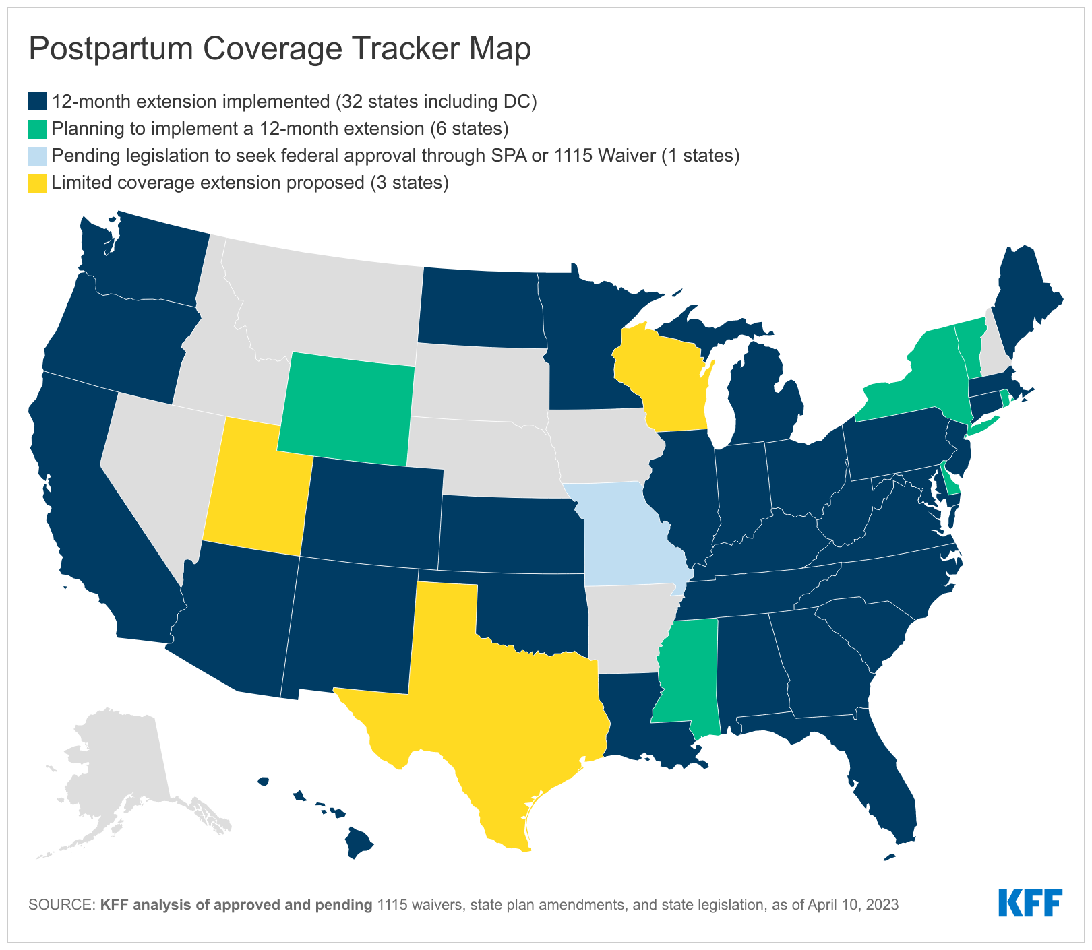
Map shows action or proposals on extension of Medicaid postpartum coverage to one year, as of April 10, 2023
Source: Kaiser Family Foundation. https://www.kff.org/medicaid/issue-brief/medicaid-postpartum-coverage-extension-tracker/

Slide 5
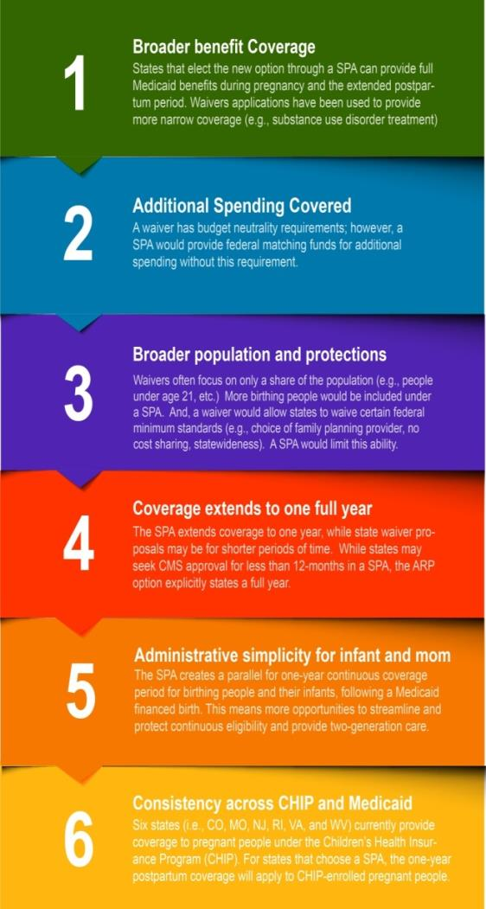
Medicaid Postpartum Coverage Extension
Using state plan amendment (SPA) has advantages over waivers.
Extending coverage is first step.
Assuring quality and comprehensive services to birthing people essential to making coverage matter and improving health.
Clark, M, Burak EW. Opportunities to Support Maternal and Child Health through Medicaid's New Postpartum Coverage Extension. Georgetown University Center for Children and Families. July 2022.
Zephyrin L, Johnson K, Coleman A, Nuzum R. State Options for Extending Medicaid Postpartum Coverage. Commonwealth Fund Blog. https://www.commonwealthfund.org/blog/2021/state-options-extending-medicaid-postpartum-coverage

Slide 6
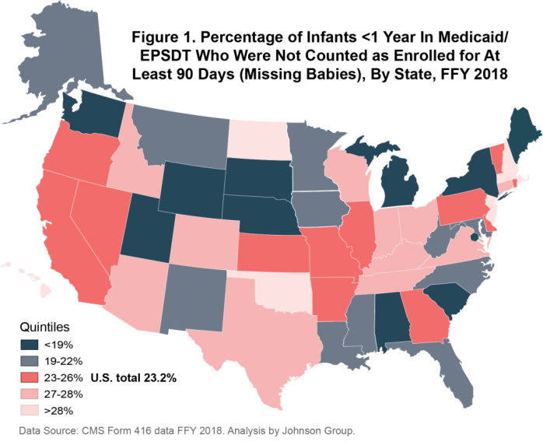
Enrollment Processes Matter
Federal law guarantees one year of continuous enrollment for babies with a Medicaid financed birth.
State adopted postpartum coverage extensions similarly guarantee continuous coverage for year.
Continuous coverage depends on effective state eligibility and enrollment processes.
DE 27% in 2020
Sources: Johnson K. Missing Babies: Best Practices for Ensuring Continuous Enrollment in Medicaid and Access to EPSDT. 2021.
https://ccf.georgetown.edu/wp-content/uploads/2021/03/missing_babies_EPSDT_Medicaid_finalJan2021_Johnson_edit061621.pdf

Slide 7
https://www.cdc.gov/prams/prams-data/selected-mch-indicators.html
Notes:
This slide illustrates one way states can look deeper into the context for preconception health and health care using 2017 data from the Pregnancy Risk Assessment and Monitoring System know as PRAMS. (34 states, NYC, and Puerto Rico)
It shows the percentage of women who had certain experiences in the months prior to giving birth for Delaware, and all PRAMS. It includes:
health coverage in the month prior to pregnancy,
a health care visit in the 12 months before pregnancy,
depression in the 3 months before pregnancy,
multivitamin use in month before pregnancy, and whether or not the pregnancy was intended.
Note that except for depression, the desired percentage would be 90-100%. None of these indicates reaches 70%.

Slide 8
https://www.cdc.gov/prams/prams-data/selected-mch-indicators.html
Notes:
This slide illustrates one way states can look deeper into the context for preconception health and health care using 2017 data from the Pregnancy Risk Assessment and Monitoring System know as PRAMS. (34 states, NYC, and Puerto Rico)
It shows the percentage of women who had certain experiences in the months prior to giving birth for Delaware, and all PRAMS. It includes:
health coverage postpartum,
a postpartum care visit,
postpartum depression symptoms,
use of any postpartum contraception, and
whether or not the mother and baby had benefit of any breastfeeding at 8 weeks after the birth.
Note that except for depression, the desired percentage would be 90-100%. Only postpartum visits are in that range.

Slide 9

Barriers reported by mothers enrolled in Medicaid
In 1988, the IOM/NAS identified four categories of obstacles to timely prenatal care.
Recent systematic review (34 studies) found most frequently mentioned barriers to prenatal and postpartum care were structural.
  Delay for enrollment in Medicaid
  Challenge finding providers who accept Medicaid
  Lack of provider continuity
  Transportation and childcare hurdles
  Legal system concerns.
Individual-level / personal factors also interfered with timely use of prenatal and postpartum care.
Among those who accessed care, racism and discrimination, experiences of disrespect related to race, insurance status, age, substance use, and language were common. Coercive counseling also reported.
Financial
Capacity
Practices
Personal
Racism, Discrimination, and Disrespect
Bellerose M, Rodriguez M, Vivier PM. A systematic review of the qualitative literature on barriers to high‐quality prenatal and postpartum care among low‐income women. Health Services Research. 2022;57(4):775-85; Institute of Medicine, Committee to Study Outreach for Prenatal Care. Prenatal Care: Reaching Mothers, Reaching Infants. Brown SS, editor. Washington DC: National Academies Press. 1988.

Slide 10
Evidence of Impact
ACA Medicaid expansion increased preconception and postpartum coverage, but limited evidence of increased health care use or improved birth outcomes. Some studies found:
  Narrowed disparities in rates of prenatal and postpartum visits.
  Fewer repeat hospitalizations for mothers.
  Greater use of treatment for perinatal depression.
In Texas, increased use of contraceptive services, decreased incidence of short interval pregnancies, and increased utilization of mental health and SUD services.
Bellerose M, Collin L, Daw JR. The ACA Medicaid Expansion And Perinatal Insurance, Health Care Use, And Health Outcomes: A Systematic Review: Systematic review examines the effects of expanding Medicaid on insurance coverage, health care use, and health outcomes during preconception, pregnancy, and postpartum. Health Affairs. 2022 Jan 1;41(1):60-8.
Wang X, Pengetnze YM, Eckert E, Keever G, Chowdhry V. Extending postpartum Medicaid beyond 60 days improves care access and uncovers unmet needs in a Texas Medicaid health maintenance organization. Frontiers in Public Health. 2022 May 3;10:841832.
Steenland MW, Wherry LR. Medicaid Expansion Led To Reductions In Postpartum Hospitalizations: Study examines the impact of Medicaid expansion on postpartum hospitalizations of low-income enrollees. Health Affairs. 2023 Jan 1;42(1):18-25.
Steenland MW, Trivedi AN. Association of Medicaid Expansion With Postpartum Depression Treatment in Arkansas. JAMA Health Forum 2023 Feb 3;4(2):e225603-e225603).

Slide 11
Improving Postpartum and Interconception Care
Increase the use and quality of postpartum visits in Medicaid.
  Extend postpartum coverage.
  Increase access to community support and care coordination.
  Use managed care contract language.
  Increase quality, using women-centered care and payment reforms.
  Measure - ACOG-NCQA (PCPI) 4-part focus on depression, breastfeeding, diabetes, and contraception.
Interconception Care
  Aim to provide women who had an adverse pregnancy outcome with care to reduce risks that may affect the woman’s health and any future birth she may choose to have.
  More like chronic care model, with care coordination and supports.
  “Almost all of the women in need of interconception care are already known to the medical system.” (Klerman)
Bigby, Anthony, Hsu, Fiorentini & Rosenbach. Recommendations for Maternal Health and Infant Health Quality Improvement in Medicaid and the Children’s Health Insurance Program. Mathematica for CMS. December 2020.
For more on Physician Consortium for Performance Improvement®(PCPI), see: https://www.ahrq.gov/sites/default/files/wysiwyg/CHIPRA-BMI-Maternity-Care-Measures.pdf
Johnson, Gee, Applegate. Improving Medicaid: Three decades of change to better service women of childbearing age. Clinical OB-GYN. 2014; Johnson K. Addressing women's health needs and improving birth outcomes: results from a peer-to-peer state Medicaid learning project. Commonwealth Fund, 2012; Institute for Healthcare Improvement. http://www.ihi.org/resources/Pages/Changes/ChangestoImproveChronicCare.aspx

Slide 12
Women’s Preventive Services Guidelines
New and Updated WPSI Guidelines Topics (effective 2023)
Well-Woman Preventive Visits Recommend that women receive at least one preventive care visit per year beginning in adolescence and continuing across the lifespan (i.e., annual preventive visit), as well as pre-pregnancy (preconception), prenatal, postpartum and interpregnancy visits.
Obesity Prevention in Midlife Women (NEW)
Breastfeeding Counseling, Services, and Supplies (prenatal, perinatal, postpartum)
Contraception (full range of FDA approved methods, some plans exempt)
Screening and counseling for Sexually Transmitted Infections (STIs)
Screening for Human Immunodeficiency Virus Infection (HIV) (three categories)
Unchanged WPSI Guidelines Topics
Breast Cancer Screening for Average-Risk Women
Screening for Anxiety
Screening for Cervical Cancer
Screening and Counseling for Interpersonal and Domestic Violence
Screening for Diabetes Mellitus after Pregnancy
Screening for Gestational Diabetes Mellitus (prenatal)
Screening for Urinary Incontinence
Health Resources and Services Administration. Women's preventive Services Guidelines. (Website. Dated January 2022.) Guidelines updated December 2021. https://www.hrsa.gov/womens-guidelines/index.html

Slide 13
Opportunities in Medicaid Postpartum Extension:
More team-based, person-centered care
Doulas and CWH
PQC & Birthing Friendly hospitals
Maternal health homes
Anti-bias training
Birth centers & midwives
Equity oriented measures
Mental health care
Health Care System Transformation
  Offer full benefits to address physical, mental, oral, and reproductive health
  Include full array of perinatal providers
  Set adequate provider payment rates
  Augment financing for SDOH and care coordination
  Focus on quality and safety
  Use strategies to advance equity
Zephyrin L, Johnson K. Optimizing Medicaid Extended Postpartum Coverage to Drive Health Care System Change. Women’s Health Issues. 2022 Sep 15:S1049-3867(22)00091-3. https://doi.org/10.1016/j.whi.2022.08.008

Slide 14
Perinatal Quality Collaboratives (PQC)
PQCs are adopting core practices to advance birth equity, reduce disparities and confront racism and bias in perinatal care.
  Make commitments to equity
  Educate on causes of inequities and mitigation strategies
  Collect accurate data by race/ethnicity
  Focus on social determinants/drivers of health
  Include all birth settings and community-based providers
  Integrating patient and community knowledge, experiences, and narratives in the QI work.
Mason CL, Collier CH, Penny SC. Perinatal quality collaboratives and birth equity. Current Opinion in Anesthesiology. 2022 Jun 1;35(3):299-305; Levine A, Souter V, Sakala C. Are perinatal quality collaboratives collaborating enough? How including all birth settings can drive needed improvement in the United States maternity care system. Birth. 2022;49(1):3; Henderson ZT, Ernst K, Simpson KR, Berns S, Suchdev DB, Main E, McCaffrey M, Lee K, Rouse TB, Olson CK. The National Network of State Perinatal Quality Collaboratives: a growing movement to improve maternal and infant health. Journal of Women's Health. 2018 Mar 1;27(3):221-6.

Slide 15
Performance of Medicaid Matters for Child Health & Equity
More than half of all babies—2.1 million infants enrolled in Medicaid.¹
6 in 10 Black, Indigenous, and Latinx infants.²
  (46% of total)
How can we leverage the opportunity to support mother-baby pairs with family-centered care?
Kaiser Family Foundation analysis of American Community Survey Data.
1. Johnson analysis of EPSDT 416 data from Centers for Medicare and Medicaid Services, FFY 2020.
2. Artiga et al. Medicaid Initiatives to Improve Maternal and Infant Health and Address Racial Disparities. Kaiser Family Foundation, 2020.

Slide 16
Centering Equity in Perinatal Care
Understand root causes of disparities
Shift away from “mother blame” frame and apply reproductive justice frame
Advance policies and programs that promote birth equity
Ensure optimal perinatal mental health
Operationalize Medicaid expansion
Advocate for policies to remove structural barriers and shift social drivers
Know that the data are not neutral – redesign needed.
“The inequities experienced by racialized and marginalized communities will persist until there are sustained efforts to address the social and structural determinants of health as well as the root causes (e.g., racism…) that contribute to these disparate outcomes.”
Clark, Aja, et al. "Centering equity: Addressing structural and social determinants of health to improve maternal and infant health outcomes." Seminars in Perinatology. 2022.

Slide 17
Selected References
US Department of Health and Human Services. Reproductive Rights. (Website). https://reproductiverights.gov/
Bellerose M, Collin L, Daw JR. The ACA Medicaid Expansion And Perinatal Insurance, Health Care Use, And Health Outcomes: A Systematic Review: Systematic review examines the effects of expanding Medicaid on insurance coverage, health care use, and health outcomes during preconception, pregnancy, and postpartum. Health Affairs. 2022 Jan 1;41(1):60-8.
Bellerose M, Rodriguez M, Vivier PM. A systematic review of the qualitative literature on barriers to high‐quality prenatal and postpartum care among low‐income women. Health Services Research. 2022;57(4):775-85.
Bigby, Anthony, Hsu, Fiorentini & Rosenbach. Recommendations for Maternal Health and Infant Health Quality Improvement in Medicaid and the Children’s Health Insurance Program. Mathematica for CMS. December 2020.
Centers for Medicare and Medicaid Services. Prenatal and postpartum care: Postpartum care. Medicaid. (Website) https://www.medicaid.gov/state-overviews/scorecard/postpartum-care/index.html.
Clark A, Wescott P, Mitchell N, Mahdi I, Crear-Perry J. Centering equity: Addressing structural and social determinants of health to improve maternal and infant health outcomes. Seminars in Perinatology. 2022 Aug 29 (p. 151661).
Clark, M, Burak EW. Opportunities to Support Maternal and Child Health through Medicaid's New Postpartum Coverage Extension. Georgetown University Center for Children and Families. July 2022
Clark M, Bargeron E, & Corcoran A. Medicaid Expansion Narrows Maternal Health Coverage Gaps, But Racial Disparities Persist. Georgetown University Center for Children and Families. September 2021. https://ccf.georgetown.edu/wp-content/uploads/2021/09/maternal-health-and-medex-final.pdf
Clark M & Johnson K. Maternal Health Policies: Will Congress Act During the Lame Duck Session? Georgetown University Center for Children and Families. December 12, 2022. https://ccf.georgetown.edu/2022/12/12/maternal-health-policies-will-congress-act-during-the-lame-duck-session/
Declercq, Barnard-Mayers, Zephyrin, & Johnson. How New State Abortion Bans and Restrictions Could Worsen Access to Maternal Care and Health Outcomes. Commonwealth Fund, Dec. 2022. https://doi.org/10.26099/z7dz-8211
Daw JR, Kolenic GE, Dalton VK, et al. Racial and Ethnic Disparities in Perinatal Insurance Coverage. Obstetrics and Gynecology. 2020;135(4):917-924. https://doi.org/10.1097/AOG.0000000000003728
Daw JR, Winkelman TN, Dalton VK, Kozhimannil KB, & Admon LK. (2020). Medicaid expansion improved perinatal insurance continuity for low-income women. Health Affairs. 2020; 9(9):1531-1539. https://www.healthaffairs.org/doi/10.1377/hlthaff.2019.01835
Hart J, Crear-Perry J, Stern L. US Sexual and Reproductive Health Policy: Which Frameworks Are Needed Now, and Next Steps Forward. American Journal of Public Health. 2022 Jun;112(S5):S518-22.
Health Resources and Services Administration. Women's preventive Services Guidelines. (Website). Guidelines updated December 2021. https://www.hrsa.gov/womens-guidelines/index.html
Johnson K. Medicaid and CHIP Coverage for Women and Children: Politics and Policy. Chapter 20. In Russell S. Kirby and Sarah Verbiest, Editors, Kotch’s Maternal and Child Health: Programs, Problems and Policy in Public Health, Fourth Edition. Burlington, MA: Jones and Bartlett Learning, 2022.
Johnson, Gee, Applegate. Improving Medicaid: Three decades of change to better service women of childbearing age. Clinical OB-GYN. 2014;
Johnson K. Addressing women's health needs and improving birth outcomes: results from a peer-to-peer state Medicaid learning project. Commonwealth Fund, 2012; Institute for Healthcare Improvement. http://www.ihi.org/resources/Pages/Changes/ChangestoImproveChronicCare.aspx
Johnson K, Rosenbaum S, & Handley, M. The Next Steps to Advance Maternal and Child Health in Medicaid: Filling Gaps in Postpartum Coverage and Newborn Enrollment. Health Affairs Blog/Forefront. January 9, 2020 https://www.healthaffairs.org/do/10.1377/forefront.20191230.967912/full/
Johnston E, McMorrow S, Alvarez Caraveo C, & Dubay L. Post-ACA, More Than One-Third of Women With Prenatal Medicaid Remained Uninsured Before or After Pregnancy. Health Affairs. 2021;40(4):571–578. https://www.healthaffairs.org/doi/10.1377/hlthaff.2020.01678
Johnston EM, & McMorrow S. The Relationship Between Insurance Coverage and Use of Prescription Contraception by Race and Ethnicity: Lessons from the Affordable Care Act. Women’s Health Issues. 2020 Mar-Apr;30(2):73-82. https://doi.org/10.1016/j.whi.2019.11.005.
Kaiser Family Foundation. Medicaid’s role for women. Factsheet. https://www.kff.org/medicaid/fact-sheet/medicaids-role-for-women/. March 29, 2019. Also see Women’s Health Insurance. November 8, 2021. https://www.kff.org/other/fact-sheet/womens-health-insurance-coverage/
Mason CL, Collier CH, Penny SC. Perinatal quality collaboratives and birth equity. Current Opinion in Anesthesiology. 2022 Jun 1;35(3):299-305.
Steenland MW, Wherry LR. Medicaid Expansion Led To Reductions In Postpartum Hospitalizations: Study examines the impact of Medicaid expansion on postpartum hospitalizations of low-income enrollees. Health Affairs. 2023 Jan 1;42(1):18-25.
Steenland MW, Trivedi AN. Association of Medicaid Expansion With Postpartum Depression Treatment in Arkansas. JAMA Health Forum 2023 Feb 3;4(2):e225603-e225603).
Wang X, Pengetnze YM, Eckert E, Keever G, Chowdhry V. Extending postpartum Medicaid beyond 60 days improves care access and uncovers unmet needs in a Texas Medicaid health maintenance organization. Frontiers in Public Health. 2022 May 3;10:841832.
Yates L, Birken S, Thompson TA, Stuart GS, Greene S, Hassmiller Lich K, Weinberger M. A qualitative analysis of Medicaid beneficiaries perceptions of prenatal and immediate postpartum contraception counseling. Women's Health. 2022 Sep;18:17455057221124079.
Zephyrin LC. Changing the Narrative and Accelerating Action to Reduce Racial Inequities in Maternal Mortality. Am J Public Health. 2021 Sep;111(9):1575-1577. https://doi.org/10.2105/AJPH.2021.306462
Zephyrin L, Johnson K. Optimizing Medicaid Extended Postpartum Coverage to Drive Health Care System Change. Women’s Health Issues. 2022 Sep 15:S1049-3867(22)00091-3. https://doi.org/10.1016/j.whi.2022.08.008.
Zephyrin L, Johnson K, Coleman A, Nuzum A. State options for extending Medicaid postpartum coverage. Commonwealth Fund. https://www.commonwealthfund.org/blog/2021/state-options-extending-medicaid-postpartum-coverage. August 11, 2021.

