Slide 1
Understanding and Effectively Addressing Racial Inequities in Health
David R. Williams, PhD, MPH
Florence & Laura Norman Professor of Public Health
Chair, Department of Social and Behavioral Sciences
Professor of African & African American Studies and of Sociology
Harvard University

Slide 2

Covid-19 Worsening Health Inequities
So far, over 990,000 people have died from Covid-19 in the U.S.
That’s more people than the entire population in 6 states:
  -- Alaska, Vermont, Wyoming,
  -- North Dakota, South Dakota, Delaware
  and Washington, DC
pixabay
New York Times, April 25, 2022
This Photo by Unknown Author is licensed under CC BY-NC-ND

Slide 3
Decline: Life Expectancy at Birth, 2019-2020
Changes (Years)
Hispanic Male
Black Male
Black Female
Hispanic Female
White Male
White Female
Arias et al, NVSS July 2021

Slide 4
Racial Inequities In Health Are Persistent Over Time

Slide 5
Life Expectancy by Race, 1950-2020
78.8
77.6
76.1
77.3
74.4
74.7
69.1
70.6
71.7
71.8
71.8
69.1
68.1
63.6
64.1
60.8
NCHS, Health United States Chartbook, 2019; Arias et al, NVSS July 2021

Slide 6
What Drives these Large Racial Inequities
in Health?

Slide 7
There are large Inequities in Health by Socioeconomic Status (SES) in the U.S. and elsewhere
There are Large Racial/Ethnic Differences in Socioeconomic Status

Slide 8
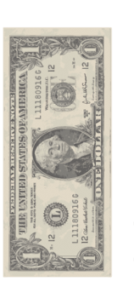











Median Household Income and Race, 2018
Racial Differences in Income are Substantial:
1 dollar
1.23 dollar
73 cents
59 cents
59 cents
Whites
Asians
Hispanics
Am Indians*
Blacks
U.S. Census Bureau, Semega et al., 2019; * For 2017; US Census Bureau, ACS, 2017
Notes:
Add American Indians American Indian Report 2-014
Slide 2: home ownership slide… **** ( homeownershP0

Slide 9

Reducing Racial Inequities are on a Treadmill
In 1978, Black households
earned 59 cents for every dollar of income that White households earned
In 2018, the gap is still 59 cents to the dollar
This Photo by Unknown is licensed under CC BY-NC

Slide 10
Large racial gaps in income markedly understate the racial gap in economic status

Slide 11




Median Wealth and Race, 2016
For every dollar of wealth that Whites have,
Blacks have 10 cents
Latinos have 12 cents
Other Races have 38 cents
Dettling et al., FEDS Notes, Federal Reserve Board (SCF), 2017

Slide 12

What Low Economic Status Means
We are in the same storm but in different Boats
Pixels

Slide 13
Added Burden of Race

Slide 14
Life Expectancy at Age 25
Based on Level of Education
6.4-year gap
White
70
75
80
85
Age
5-year gap overall
Black
5.3-year gap
Overall
0-12 years
College graduate
Murphy, NVSS 2000; Braveman, Cubbin, Egerter, Williams, Pamuk, AJPH, 2010; NLMS 1988-1998

Slide 15
Life Expectancy at Age 25
Race Still Matters
White
3.1-year gap between
HS dropouts
4.2-year
gap between
college grads
Age
70
75
80
85
Black
Blacks with a college degree have a lower life expectancy than Whites with only a high school degree
0-12 years
12 years
Some college
College graduate
Murphy, NVSS 2000; Braveman, Cubbin, Egerter, Williams, Pamuk, AJPH, 2010; NLMS 1988-1998

Slide 16

Why Racial Inequality Exists
What does America Think?
MS Online Pictures; Photo by Unknown Author

Slide 17
Solution to Inequality: More Effort
Blacks would do as well as whites if they only tried harder
Vandermaas-Peeler et al, 2018, Pub Relig Res Institute, American Values Survey

Slide 18
Solution to Inequality: More Effort
Blacks would do as well as whites if they only tried harder
Vandermaas-Peeler et al, 2018, Pub Relig Res Institute, American Values Survey

Slide 19
Solution to Inequality: More Effort, Whites
Blacks would do as well as whites if they only tried harder
Vandermaas-Peeler et al, 2018, Pub Relig Res Institute, American Values Survey

Slide 20
What does Scientific Research Clearly Say?
Racism and Racial Discrimination are alive, well, pervasive and thriving in America

Slide 21
The House that Racism Built
Racism as a societal system
Social Forces
Political
Legal
Economic
Religious
Cultural
Historical Events
Williams, Lawrence, Davis, Vu, ‘Understanding how Discrimination Can Affect Health,’ HSR, 2019

Slide 22
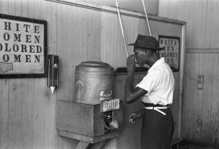
Racism Defined
Racism: an organized system that,
-- categorizes and ranks
-- devalues, disempowers, and
-- differentially allocates opportunities/resources
The development of racism is typically undergirded by an ideology of inferiority in which some population groups are regarded as being inferior to others
This leads to the development of
-- negative attitudes/beliefs (prejudice and stereotypes) to out-groups, and
-- differential treatment (discrimination) by individuals and social institutions
Bonilla-Silva, 1996; Williams 2004

Slide 23
The House that Racism Built
Racism as a societal system
Structural or Institutional Racism (e.g. Segregation))
Social Forces
Political
Legal
Economic
Religious
Cultural
Historical Events
Williams, Lawrence, Davis, Vu, ‘Understanding how Discrimination Can Affect Health,’ HSR, 2019

Slide 24
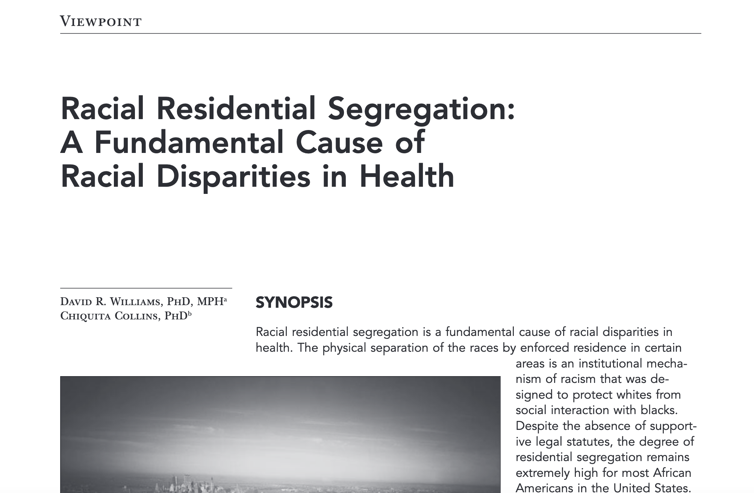
Centrality of Segregation in Creating Racial Inequities
David R Williams & Chiquita Collins, Public Health Reports, 2001

Slide 25

Racial Segregation Is …
One of the most successful domestic policies of the 20th century
"the dominant system of racial regulation and control" in the U.S
John Cell, 1982

Slide 26

How Segregation Works
Segregation is like a burglar at mid-night. It slips into the community, awakens no one, but once it shows up, valuables disappear:
Quality Schools
Safe playgrounds
Good jobs
Healthy environment
Safe housing
Transportation
Healthcare
Pixabay.com

Slide 27
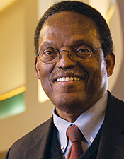
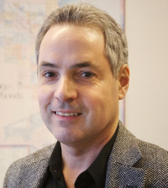
Racial Differences in Residential Environment
In the 171 largest cities in the U.S., there is not even one city where whites live in equal conditions to those of blacks
“The worst urban context in which whites reside is considerably better than the average context of black communities.”
Sampson & Wilson 1995

Slide 28


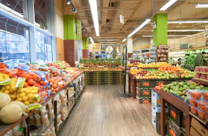
Neighborhood Opportunity Index
Institutions: number & quality of schools, early childhood centers
Influences shaping norms and expectations: (high school graduation rate, adults with high skill jobs)
Economic Resources: income, home ownership, employment, public assistance
Environmental Quality: air, water, soil pollution, hazardous waste sites
Resources for health: green space, healthy food outlets, walkability
Acevedo-Garcia, 2020, Diversitydatakids.org
Shutterstock.com

Slide 29
Percentage of Children at Neighborhood Opportunity Level
100 largest Metropolitan areas
D. Acevedo-Garcia 2020, Diversitydatakids.org

Slide 30
Segregation is the central driver of the Large Racial/Ethnic Differences in SES

Slide 31
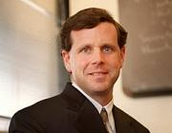
Residential Segregation and SES
A study of the effects of
segregation on young
African American adults
found that the elimination
of segregation would erase
black-white differences in:
  Earnings
  High School Graduation Rate
  Unemployment
And reduce racial differences in single motherhood by two-thirds
David Cutler & EL Glaeser, Quarterly J Economics, 1997

Slide 32
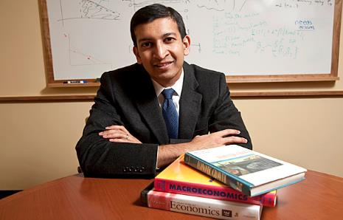
An Intergenerational Study
Inequity usu. studied in one generation
Intergenerational analysis, linking parents & kids, US pop,1989-2015
  Black boys have lower earnings than white boys in 99% of Census tracts in America (controlling for parental income)
Why? They live in neighborhoods that differ in access to opportunity
Black boys do well in neighborhoods with good resources (low poverty) and good race-specific factors (high father presence, less racial bias)
The problem: there are essentially no such neighborhoods in America
Raj Chetty et al, 2020, Quarterly Journal of Economic Research, 2020. The Opportunity Atlas

Slide 33

Inequities by Design
Racial inequities in SES that matter for life & health do do not reflect a broken system
Instead, they reflect a carefully crafted system, functioning as planned – successfully implementing social policies, many of which are rooted in racism
They are not accidents or acts of God
Racism has produced a truly “rigged system”

Slide 34
Segregation and Medical Care

Slide 35

South LA: A Segregated Community
Elevated levels of preexisting comorbidities
Epidemic of poorly controlled chronic diseases
South LA has 10 times fewer MDs than average US community
Shortage of primary care MDs; Severe shortage of specialists
Lowest number of hospital beds (per pop.) in LA county
Three times more diabetes than the rest of California
Diabetic amputation is among most frequent surgical procedures performed
Life expectancy is 10 years shorter than state of CA
Pixabay.com
Elaine Batchlor, Health Affairs Blog, May 4, 2021

Slide 36

Context of MLK Community Healthcare
Medicaid is most common insurance
Average ER visit in LA earns:
~$2,000 from commercial insurers
~$650 from Medicare
~$150 from Medicaid
Lifelong reduced access and quality of care contributes to poorer management of disease and worse outcomes
Historic and ongoing underfunding of care in segregated communities has created a separate and unequal Health system
uclahealth.org
Elaine Batchlor, Health Affairs Blog, May 4, 2021

Slide 37

Segregation, SES, Stress and Health
Lower economic status, living in disadvantaged, segregated, neighborhoods leads to to higher levels of exposure and greater clustering of:
1. Economic Stressors
2. Psychosocial Stressors
3. Physical & Chemical Stressors
Williams, J Health and Social Behavior, 2016 photo from pixels.com

Slide 38
The House that Racism Built
Racism as a societal system
Structural/ Institutional Racism (e.g. Segregation))
Social Forces
Political
Legal
Economic
Religious
Cultural
Historical Events
Individual Discrimination
Williams, Lawrence, Davis, Vu, ‘Understanding how Discrimination Can Affect Health,’ HSR, 2019

Slide 39
Individual Discrimination
Experiences of discrimination are an added source of Toxic Stress

Slide 40
Every Day Discrimination
In your day-to-day life how often do these happen to you?
  You are treated with less courtesy than other people.
  You are treated with less respect than other people.
  You receive poorer service than other people at restaurants or stores.
  People act as if they think you are not smart.
  People act as if they are afraid of you.
  People act as if they think you are dishonest.
  People act as if they’re better than you are.
  You are called names or insulted.
  You are threatened or harassed.
  What do you think was the main reason for these experiences?
Williams, Yu, Jackson, Anderson, J Health Psychology, 1997

Slide 41
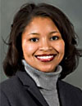
Everyday Discrimination is Associated With:
-- coronary artery calcification
-- inflammation (C-reactive protein)
-- inflammation (IL-6)
-- blood pressure
-- lower birth weight
-- cognitive impairment
-- poor sleep
-- mortality
-- visceral fat
-- telomere length
-- arterial stiffness
-- incident CVD events
Tene Lewis
Sources: Lewis et al., Psy Med, 2006; Lewis et al., Brain Beh Immunity, 2010; Lewis et al., J Gerontology: Bio Sci & Med Sci 2009; Earnshaw et al., Ann Beh Med, 2013; Barnes et al., 2012; Lewis et al, Hlth Psy, 2012; Barnes et al., J Gerontology: Bio Sci & Med Sci, 2008; Lewis et al., Am J Epidemiology, 2011; Hailu et al, Ann Epi, 2020; Bromfield et al, Hlth Psych, 2020; Everson-Rose et al, AJE, 2015; Kershaw et al, Hlth Psych, 2016

Slide 42
Hidden Ways in which Stressors linked to Race and Racism Adversely affect Health

Slide 43

Worry About Safety of Children
Study of black women found that most live with a heavy burden of stress due to concern about the racism their children might experience
Over 70% were very concerned:
-- that their children might be harmed by
the police
-- that their children might get stopped in
a predominantly white neighborhood
A.Vines & D. Baird Journal National Med Assoc, 2009
Unsplash.com

Slide 44

Police Stops and Mother’s Health
A study of over 3,000 mothers in 20 cities (Fragile Families Study)
23% of urban youth are stopped by the police by the age of 15
Mothers of youth who were stopped by the police are more than twice as likely to report both depression- and anxiety-related sleep difficulties.
Unsplash.com
Dylan Jackson & Kristin Turney, Journal of Urban Health, 2021

Slide 45

Exposure to Traumatic Videos
Study of black and Latinx adolescents (11-19 years old)
Assessed viewing race-related, traumatic images or videos online: seeing persons from own ethnic group 1) beaten, 2) arrested or detained, or 3) being shot by the police
Exposure to online traumas in prior year linked to higher PTSD and depressive symptoms
Need to assess and facilitate coping with race-related materials
B. Tynes et al., J Adolescent Health, 2019
Shutterstock.com
Notes:
.

Slide 46

Police Violence and Health
Frequent media reports of incidents of police violence directed to black, Latino, and Native American communities
These are stressors that negatively affect health of larger community
Recent national, quasi-experimental study:
Police killings of unarmed blacks lead to declines in mental health among blacks
in general population for
3 months after event
No effect on whites
Bor, Venkataramani, Williams & Tsai, The Lancet, 2018

Slide 47
Consequences of the cumulative exposure to discrimination and other stressors
“Accelerated Aging”
“Premature Aging”
Biological “Weathering”
Earlier Onset of Chronic Disease

Slide 48
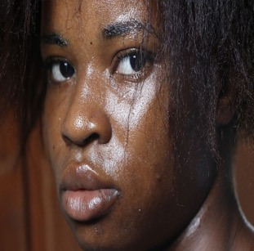
Weathering
Chronological age captures duration of exposure to risks for groups living in adverse living conditions
U.S. blacks are experiencing greater physiological wear and tear, and are aging, biologically, more rapidly than whites
It is driven by the cumulative impact of repeated exposures to psychological, social, physical and chemical stressors in their residential, occupational and other environments, and coping with these stressors
Compared to whites, blacks & US-born Latinos experience higher levels of stressors and greater clustering of stressors
pixabay
Geronimus et al, Hum Nature, 2010; Sternthal, Slopen & Williams, DuBois Review, 2011

Slide 49
Earlier Onset of High Blood Pressure
Behavioral Risk Factor Surveillance System, 2015

Slide 50
The House that Racism Built
Cultural Racism
(e.g. Stereotypes, Stigma, Implicit & Explicit biases)
Racism as a societal system
Social Forces
Political
Legal
Economic
Religious
Cultural
Historical Events
Institutional/ Structural Racism (e.g. Segregation))
Individual Discrimination
Williams, Lawrence, Davis, Vu, ‘Understanding how Discrimination Can Affect Health,’ HSR, 2019

Slide 51
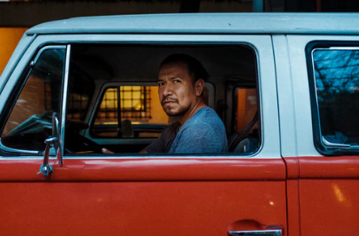
Negative stereotypes about race remain deeply embedded in our culture
These Stereotypes Trigger Racial Discrimination that Reduces Access to Societal Resources

Slide 52
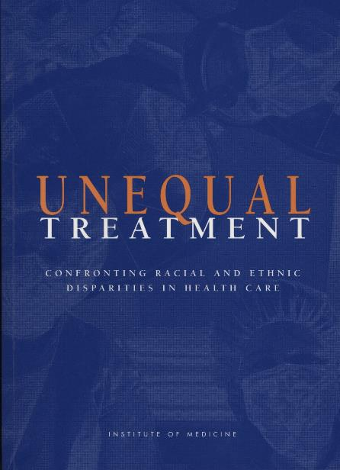
Racial Bias in Medical Care

Slide 53


Race and Access to Specialty Care
Analysis of 10 years of data (2008 to 2017) of all patients admitted for heart failure (HF) at BWH
Compared to Whites, Blacks and Latinos were less likely to be admitted to cardiology and more likely admitted to general medicine service (GMS)
Admission to GMS linked to higher 30-day readmission rates
On cardiology service, patients have better outcomes and better amenities (private rooms, etc)
Women and older age (>75) were also less likely to be admitted to cardiology
Results adjusted for covariates (eg, neighborhood SES, comorbidity, insurance, and having seen a cardiologist or PCP)
L.A. Eberly et al, Circulation: Heart Failure, 2019
Pixabay.com

Slide 54

Physician Race and Newborn Survival
Study of 1.8 million hospital births in Florida from 1992 to 2015
When cared for by white doctors, black babies are 3 times more likely than white newborns to die in the hospital
Disparity cut in half when black babies are cared for by a black doctor
Biggest drop in deaths in complex births and in hospitals that deliver more black babies
No difference between MD race & maternal mortality
Brad Greenwood, et al. PNAS, 2020

Slide 55
What Can We Do?

Slide 56
Strategy Number 1
Building More Health into the Delivery of Medical Care

Slide 57
Building More Health into the Delivery of Medical Care
Ensuring Access to Care for All

Slide 58

Colorectal Cancer (CRC) Intervention
State of Delaware fully funds a CRC screening program promoting colonoscopy in 2002
Provides reimbursement for uninsured residents up to 250% of Federal poverty level (FPL)
Other state residents eligible through other insurance
Cancer screening nurse navigator system added in 2004, at each of the 5 acute care hospital sites
Cancer treatment program added in 2004: covers costs of cancer care for 2 years for newly diagnosed uninsured if income under 650% FPL
Special outreach efforts for African Americans
S Grubbs et al. J Clin Oncology, 2013
This Photo by Unknown Author is licensed under CC BY-SA
This Photo by Unknown Author is licensed under CC BY-SA

Slide 59
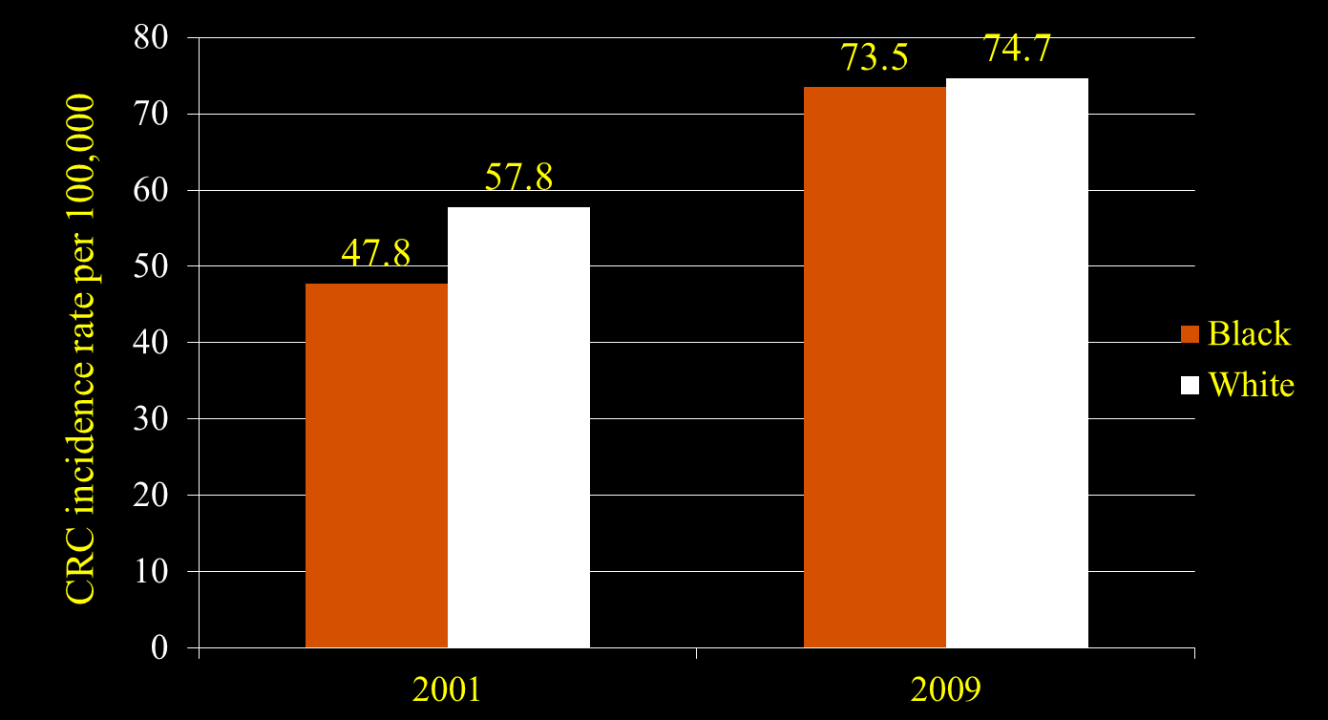
Eliminated screening disparities
3 – year average, age adjusted
S Grubbs et al. J Clin Oncology, 2013

Slide 60
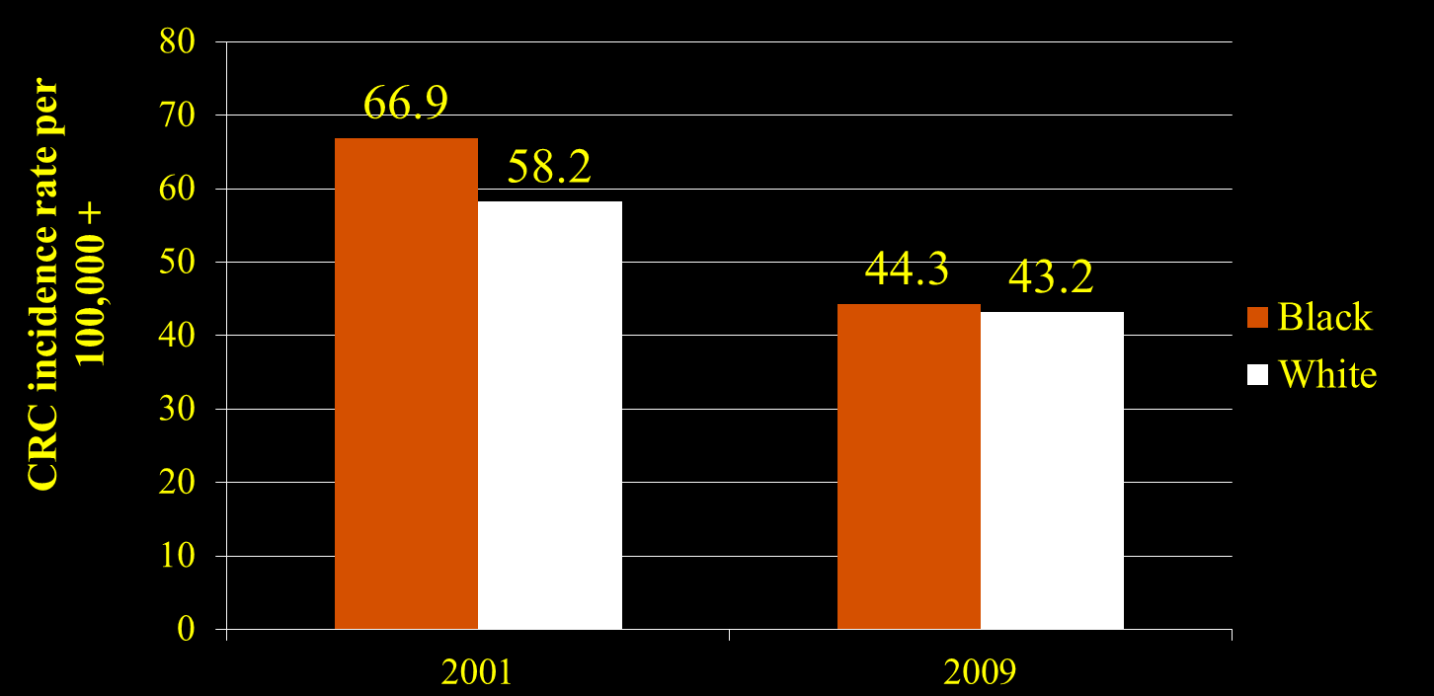
Equalized Incidence rates
3 – year average, age adjusted
S Grubbs et al. J Clin Oncology, 2013

Slide 61
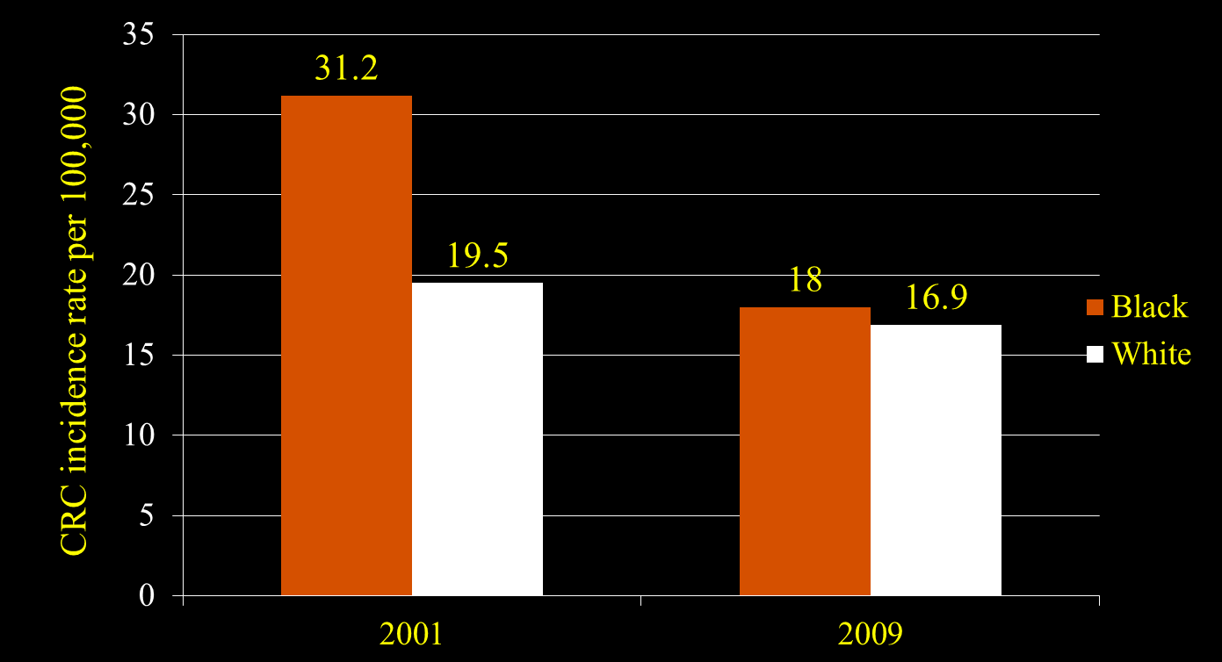
Near Elimination of Mortality Difference
3 – year average, age adjusted
S Grubbs et al. J Clin Oncology, 2013

Slide 62

Lessons from Delaware
Full access to care, with outreach and patient navigation can reduce some disparities
If done nationally, 4,200 fewer blacks would get CRC each year, and 2,700 fewer would die
The annual cost of screening ($1M) and treatment ($6M) was $7 million
Annual savings (due to reduced incidence & earlier diagnosis): $8.5M
Net Savings from the program: $1.5M per year
S Grubbs et al. J Clin Oncology, 2013 wikipedia

Slide 63
Building More Health into the Delivery of Medical Care
Diversifying the Workforce to meet the Needs of all Patients

Slide 64
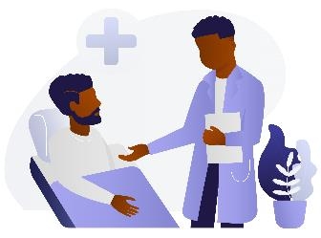
Physician Race & Health Care
A RCT of 1,300 Black men
Recruited from barbershops and flea markets
Given a coupon for a free health care screening at a Saturday clinic for
-- blood pressure,
-- body mass index,
-- cholesterol,
-- diabetes
Men randomized to see black doctors or not
$50 incentive for clinic attendance
Free Uber rides if need for transportation
Alsan, Garrick, Graziani, American Economic Review, 2019 Black Illustrations

Slide 65

Black Doctors and Black Health
Men who saw a Black Doctor
29% more likely to talk about other health problems
47% more likely to do screening for diabetes
56% more likely to get a flu vaccine
72% more likely to do screening for cholesterol
Alsan, Garrick, Graziani, American Economic Review, 2019
MS Online Pictures; Photo by Unknown Author

Slide 66

Progress (or lack thereof) in Medicine
In 2014, there were 27 fewer African American males in the first year of Medical School than there had been in 1978 (36 years earlier)
In the mid-1960s, 2.9% of all practicing physicians in the US were black
In 2019, 5% of MDs were black (6% were Hispanic; 0.3% Indigenous)
MS Online Pictures; Photo by Unknown Author
AAMC, Altering the Course, 2015; Deville et al. JAMA Internal Med, 2015; AAMC, 2019

Slide 67

Provider Cultural Competence
Study of 437 people living with HIV/AIDS and 45 providers
Created 20-item scale, self-rated cultural competence
Racial disparities were found in the receipt of ARVs, self-efficacy and viral suppression among patients of low cultural competence providers
Minority patients whose providers were high (vs low) on cultural competence, more likely to be on ARVs, have high self-efficacy and report complete ARV adherence
When cultural competence was high, no racial disparities
Somath Saha et al., Journal General Internal Medicine, 2013 pixabay

Slide 68
Cultural Competence Scale (Selected)
Family & friends as important to health as doctors
Social history contributes to how I care for patients
I am familiar with lay beliefs my patients have
I ask my patients about alternative therapies they use
I find out what patients think is cause of their illness
I involve patients in decisions about their health care
S. Saha et al., Journal General Internal Medicine, 2013

Slide 69
Building More Health into the Delivery of Medical Care
Provide Care that Addresses the Social context

Slide 70
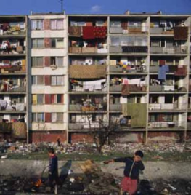
Care that Addresses the Social context
Why treat illness and send people back to live in the same conditions that made them sick in the first place?

Slide 71
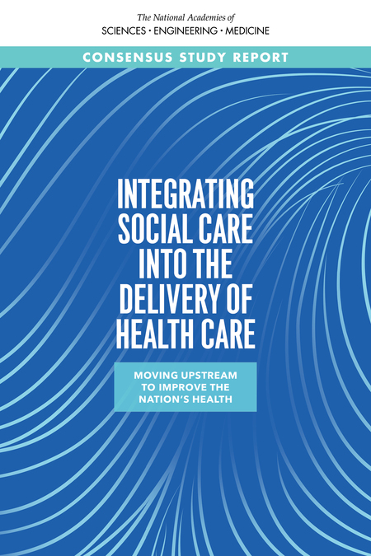
Recent Report: National Academy of Medicine
Many opportunities for health care systems and professionals to address the social needs of patients

Slide 72
The 5 As:
Health Care System Activities that Address Social Needs
Awareness
Activities that identify social risks and assets
Adjustment
Activities that focus on altering clinical care to accommodate identified social barriers
Assistance
Activities that provide assistance in connecting patients with relevant social care resources
Alignment
Activities that facilitate synergies and invest in and deploy social care assets in the community
Advocacy
Activities that work with partner social care organizations to promote policies that facilitate creations and redevelopment of assets or resources to address health and social needs
Individuals
Communities
K Bibbins-Domingo, JAMA 2019

Slide 73
Transportation-Related Examples

Slide 74
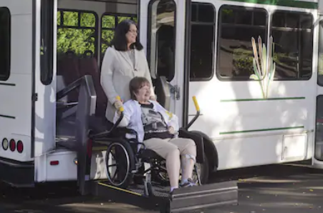
Awareness
Ask patients about their access to transportation
K Bibbins-Domingo, JAMA 2019; Shutterstock

Slide 75

Adjustment
Reduce the need for in-person health care appointments by using other options such as tele-health appointments
K Bibbins-Domingo, JAMA 2019; Shutterstock

Slide 76
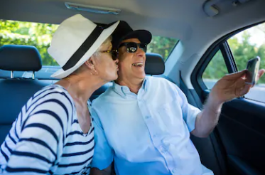
Assistance
Provide transportation vouchers so that patients can travel to health appointments; vouchers can be used for ride-sharing services or public transit
K Bibbins-Domingo, JAMA 2019; Shutterstock

Slide 77
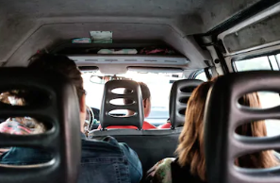
Alignment
Invest in community ride-sharing
K Bibbins-Domingo, JAMA 2019; Shutterstock

Slide 78
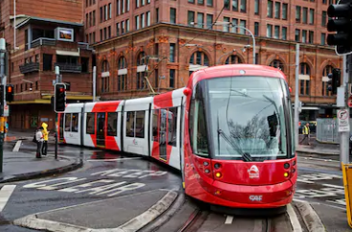
Advocacy
Work to promote policies that fundamentally change the transportation infrastructure within the community
K Bibbins-Domingo, JAMA 2019; Shutterstock

Slide 79
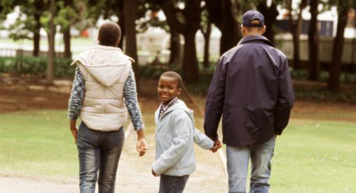

There’s More to Health than Health Care
Social & Economic
Opportunities & Resources
Income
Education
Medical
Care
Racial Bias
Social Status
Personal
Responsibility
Affordability
Neighborhood
Conditions
Coverage
Access
Community
Resources
Working
Conditions
Living & Working Conditions
in Homes & Communities
Housing
© 2008 Robert Wood Johnson Foundation. All rights reserved.
79
Notes:
4/25/22
79

Slide 80
What Else Can We Do?

Slide 81

Strategy Number 2
Create Communities of Opportunity to minimize, neutralize and dismantle the systems of racism that create inequities in health
MS Online Pictures; Photo by Unknown Author

Slide 82

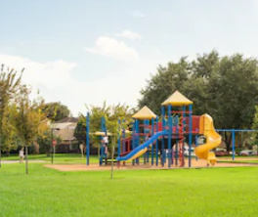
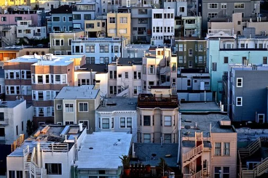
Reducing Inequities
Address Place-Linked Determinants of Health
Enrich the quality of neighborhood environments
Increase economic development in poor areas
Improve housing quality and the safety of neighborhood environments
Shutterstock; Pixabay

Slide 83

Communities of Opportunity
Invest in early Childhood
Reduce Childhood Poverty
Enhance Income and Employment Opportunities for Youth and Adults
Improve Neighborhood and Housing Conditions
Enhance economic opportunities to build strong families/reduce disparities in marriage
Raise Awareness levels of Racial Inequities and Build Political Will to Address them
David R Williams & Lisa Cooper, Int J Environmental Res & Public Health, 2019
Shutterstock

Slide 84

Carolina Abecedarian Project (ABC)
1972-77, economically disadvantaged
children, birth to age 5, randomized
to an early childhood program
80% of children Black
Program offered a safe and nurturing environment, good nutrition and pediatric care
At age 21, fewer symptoms of depression, lower marijuana use, more active lifestyle, and better educational & vocational assets
In mid-30’s, lower levels of risk factors for CVD & metabolic disease. Effects stronger for males
Campbell et al. AJPH, 2008; Campbell et al, Science, 2014 pixabay

Slide 85
Carolina Abecedarian Project (ABC)
Example: systolic BP 143 mm Hg in male controls vs. 126mm Hg in the treatment group
One in 4 males in control group met criteria for metabolic syndrome compared to none in the treatment group
Lower BMI at zero to 5 yrs equals a lower BMI in their 30s
Campbell et al. AJPH, 2008; Campbell et al, Science, 2014

Slide 86
Communities of Opportunity
Improve Neighborhood and Housing Conditions

Slide 87
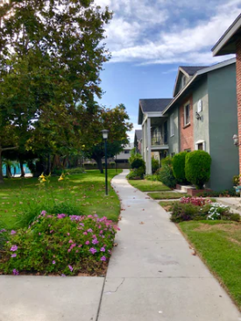
Moving to Opportunity
The Moving to Opportunity Program randomized families with children in high poverty neighborhoods to move to less poor neighborhoods.
10 to 15 years later, movers had lower levels of obesity, severe obesity & diabetes risk (HbA1c)
Unsplash.com
Ludwig et al. NEJM, 2011

Slide 88
Innovative Initiatives from Healthcare Institutions

Slide 89
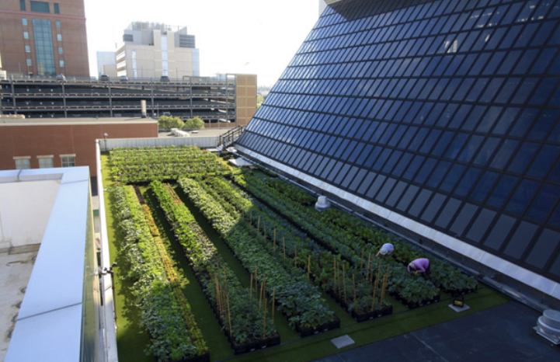
Rooftop Farm
Boston Medical Center implements rooftop farm to distribute high-quality produce to patients and their families, employees and visitors
Musicus et al, Am J Pub Hlth, 2019

Slide 90
Rooftop Farm
Farm contributes produce to hospital cafeterias, inpatient meal services, teaching kitchen, and preventive food pantry
Installation and roof modification cost $300,000
2,243 milk crate planters, growing more than 25 crop varieties and two beehives
One fulltime farmer, part-time assistant and hospital employee volunteers
Musicus et al, AJPH, 2019

Slide 91
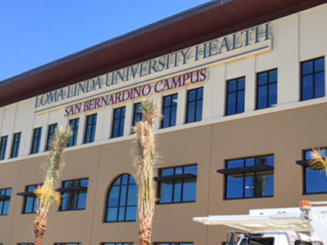
Loma Linda U Health: Addressing Community Needs
San Bernardino, CA, - one of the most disadvantaged cities in U.S.
Nearby Loma Linda University Medical Center intervenes
It builds a $68 Million, 157,000 sq. ft. clinic and education space
It has 124 exam and procedure rooms, 24 dental operatories
It is the largest specialty-based & teaching health center (THC) FQHC in the nation
Richard Hart, myll.llu.edu/news of the week July 2016

Slide 92
Loma Linda U Health: Addressing Unemployment
It also addresses a social determinant in the community
Only ~20% of high school graduates obtain any additional education
So the top floor is a “Gateway College”, to lower unemployment & provide job skills for high school graduates
The Gateway College offers certificate Programs: Certified Nurse’s Assistant, Pharmacy Tech, Surgical Tech, Community Health Worker
Richard Hart, myllu.llu.edu/news of the week July 2016

Slide 93

Dignity Health: Addressing Access to Affordable Housing
Housing is an economic and social stressor for many families
Addressing housing is a priority for improving health and supporting neighborhood stability
Dignity Health (a health care system) invested $90 Million (low interest loans) to organizations that develop affordable housing from abandoned buildings
Pablo Bravo Vial, J of Catholic Hlth Association, September-October, 2019

Slide 94
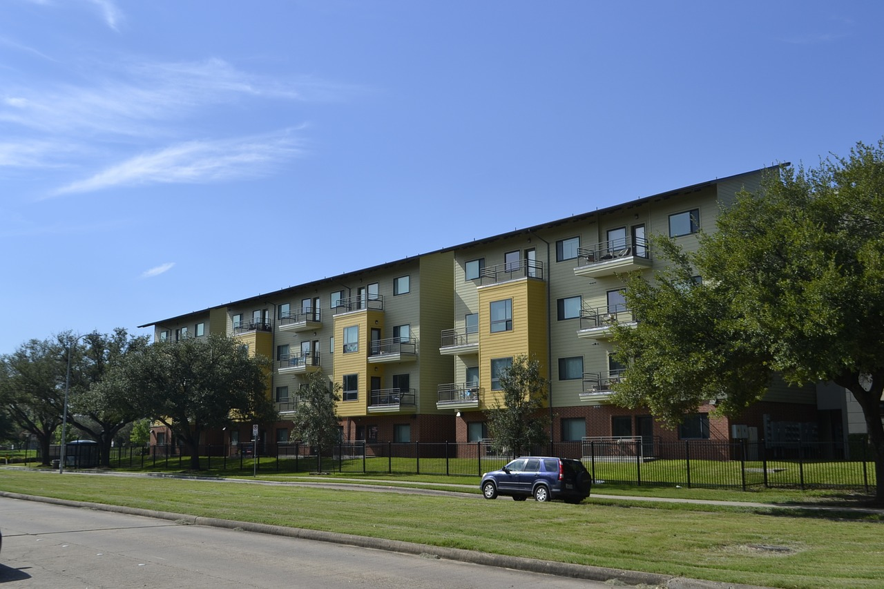
Dignity Health: Addressing Access to Affordable Housing
Partnered with more than 30 housing development projects
In Stockton, CA, 131 foreclosed homes & 3 apartment buildings refurbished
In Los Angeles, 600 housing units created or preserved
Pablo Bravo Vial, J of Catholic Hlth Association, September-October, 2019

Slide 95

Rush University Medical Center Equity Framework
Example of a Comprehensive Approach to Reducing Inequities in Socioeconomic Status and Health by an Academic Medical Center
MS Free Photo: Photo by Unknown Author
David Ansell et al. NEJM Catalyst, May, 2021

Slide 96
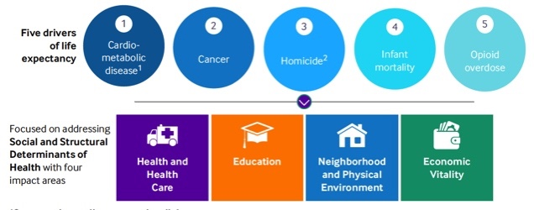
Reduce Life Expectancy Gap by 50% by 2030
David Ansell et al, NEJM Catalyst, May, 2021

Slide 97

Rush Anchor Mission Initiative: Local Economic Impact
Employment Preference Initiative
Using local labor for capital projects
Career ladder development
Apprenticeship Initiatives
Local purchasing program
Impact investing in local community
Financial education locally
Incentivize employee volunteering
Leveraging employee expertise (e.g., teaching skills class) in local communities
Invest locally and develop talent
David Ansell et al. NEJM Catalyst, May, 2021

Slide 98
What Is Holding Us Back?
What are the Barriers we have to Address?

Slide 99

--We need to raise awareness levels of the challenges (health and social) faced by disadvantaged racial/ethnic populations
-- We need to build the science base that will guide us in developing the political will to address racial and other social inequities in health
-- We need to build empathy, that is, identify how to tell the story of the challenges of the disadvantaged in ways that resonates with the public
3 Challenges linked to Communication
Unsplash.com

Slide 100
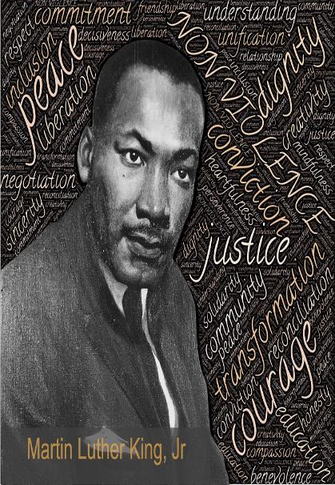
"True compassion is more than flinging a coin to a beggar; it understands that an edifice which produces beggars needs restructuring.”

Slide 101
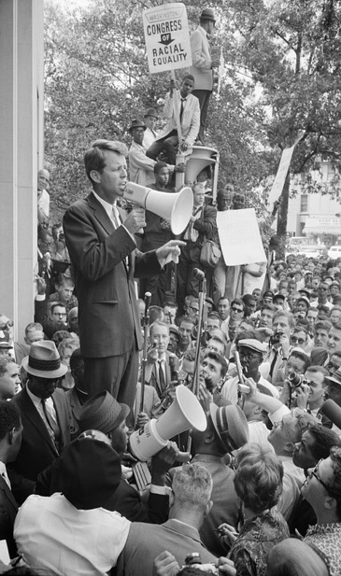
A Call to Action
“Each time a man stands up for an ideal, or acts to improve the lot of others, or strikes out against injustice, he sends forth a tiny ripple of hope, and those ripples build a current which can sweep down the mightiest walls of oppression and resistance.”
- Robert F. Kennedy

Slide 102
Further Reading
David R Williams & Lisa A. Cooper, “Reducing Racial Inequities in Health: Using What We Already Know to Take Action.” International Journal of Environmental Research and Public Health, 16 (4), 606, 2019.
,

