Slide 1


Operationalizing Perinatal Equity, Quality and Safety in Materno-toxic
Zones - Every Person, Every Time.
Jennie Joseph LM, CPM
Founder and Executive Director
www.commonsensechildbirth.org

Slide 2
Objectives:
This presentation provides ways to create safety for patients, families AND their perinatal healthcare providers by exploring the underlying systems of marginalization and discrimination which are so often harmful, and sometimes even lethal. We will look at an MCH system which mitigates these risks while encouraging mutual respect and dignity for all.
During the session, topics covered will include each level of the perinatal hierarchy; from the grass roots right through to the specialist regional perinatology teams, as well as methods of access and approaches to increase linkages and improve safety.
At the end of this presentation participants will be able to:
Describe the impact of persistent racial disparities in perinatal outcomes on all members of society including health care providers
Review the strengths and challenges of their local perinatal resources and systems as they relate to patient and provider safety
Describe one or more small change that they can personally implement and start practicing immediately
Understand one or more technique to apply this knowledge in their own practice, facility or agency
Recognize their role in supporting and collaborating with community-embedded providers, organizations and life-saving projects dedicated to improving the health of marginalized women and babies in their area

Slide 3
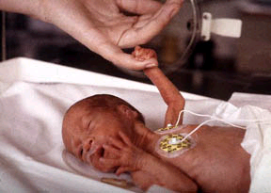
Our Babies are Dying!
Twice as many African American babies being born:
Too SOON
Too SMALL
Too SICK
to survive the first year of life
Notes:
Here is what you get when you don’t provide patient centered maternity care – the USA has the worse outcomes in the developed world for mothers, with a ranking of 57th in the world for infant mortality and 48th for maternal mortality
Horrific statistics like this, that we may have become numb to in the USA, a little too accustomed to hearing – statistics that if they were in regards to any other highly-resourced nation we might actually be outraged.
AD LIB HERE

Slide 4
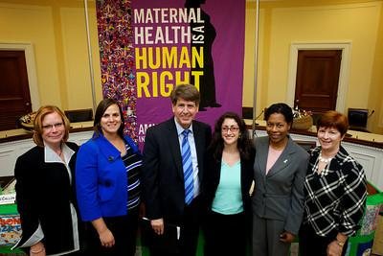
Women are Dying Too!
Two to three women die every day during pregnancy, birth or their postpartum in the USA.
There is an alarming increase
in severe pregnancy-related
complications that nearly cause
death, known as ‘near miss’
incidents.
50,000+ per year
Three to four times as many African American women are dying as white women
Capitol Hill Briefing - Amnesty International 2010
Notes:
Around 700 women dying annually and with 3-4 times as many African American women dying due to pregnancy related causes as white women. Worse yet, 50K near–miss occurrences every year – mothers who nearly died or who are seriously ill or disabled due to pregnancy, birth or postpartum. Mothers who may or may not be sharing their stories, because who do you tell……who is listening…….. dare I say it, who even cares? We do a poor job of supporting women, especially postpartum where within 2 days of giving birth you are essentially on your own, out the door, with a newborn, perhaps an abdominal scar and your unanswered questions……..You have no access to your provider, you may call, but you may also get the run around – it’s all about that six week postpartum visit, seriously, a pap smear at six weeks falls woefully short of providing patient-centered care OR support! Are we surprised that postpartum depression and PTSD is rife, that American women are suffering, families are struggling…….. we are culpable though, if we continue to let this stand… !

Slide 5
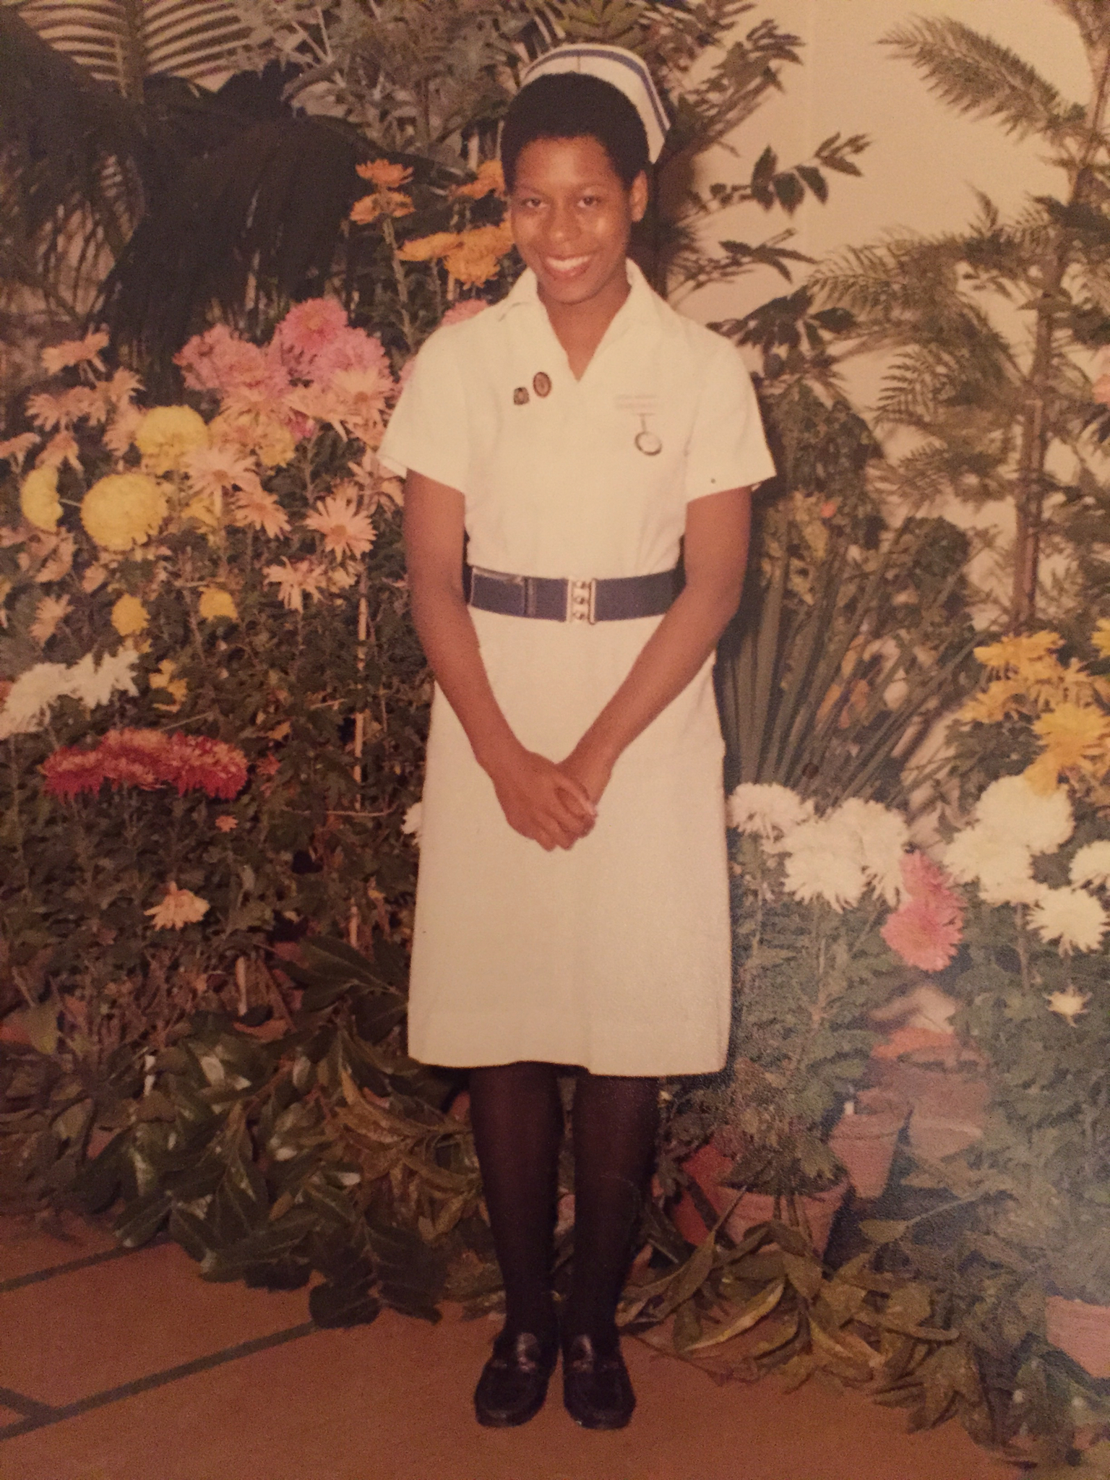
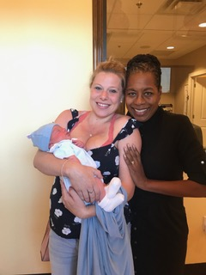
I am a midwife …….. Midwife means ‘with woman’
London – circa 1981
Winter Garden, Florida 2019
Copyright Jennie Joseph 2021
Notes:
I’m a midwife, and I’ve been in the field for 40 years– 10 of them in the UK, and 30 in the US. I emigrated to the states in 1989. So I’ve also been a practitioner AND a patient in both countries.
As a midwife in practice in Central Florida I am part of women’s stories on a daily basis, and I see the difference that providing unimpeded access to patient-centered, midwifery model care can make on her, and in fact on every person that comes through our doors. I see mostly marginalized women, uninsured or low income, and women of color who are often traumatized and tell stories of being re-traumatized, belittled, blamed, disrespected or even turned away at medical offices, at clinics and hospitals due to who they are, or who they are perceived to be. I also see affluent women, educated women, with ‘good insurance’, especially those of color, who have equally been unable to get answers to their questions, or timely responses to their concerns, perhaps not turned away but not feeling comfortable either, and certainly wishing they were somewhere else.

Slide 6

We act differently when it’s our family
If the patient isn’t centered EVERYBODY is suffering
- patients suffer, their loved ones suffer, providers suffer, health systems suffer
Copyright Jennie Joseph 2021
Notes:
You probably have a story of your own, or your close friend or your family member, a story that even now might reduce you to tears as you remember perhaps that sense of helpless unease, fear, frustration, powerlessness, or maybe even shame. For women, many of our stories are related to pregnancy, delivery, postpartum and gynecological experiences and some of these stories never leave us.
We all want the same thing if we happen to end up being a patient, right? - to be the center of the experience, to be respected, to be listened to, to be understood and invited to share in the decision making. And when that is missing people suffer, patients suffer, their loved ones suffer, providers suffer, health systems suffer – if the patient isn’t centered EVERYBODY is suffering. Yeah…. So Midwifery IS patient centered care – always has been – always will be . Midwifery means ‘with woman’ and seeing as we are talking about maternal health, in fact we are really talking about saving lives, women’s lives, babies lives, we really should talk about the midwifery model of care, because in this context MIDWIFERY MATTERS.

Slide 7
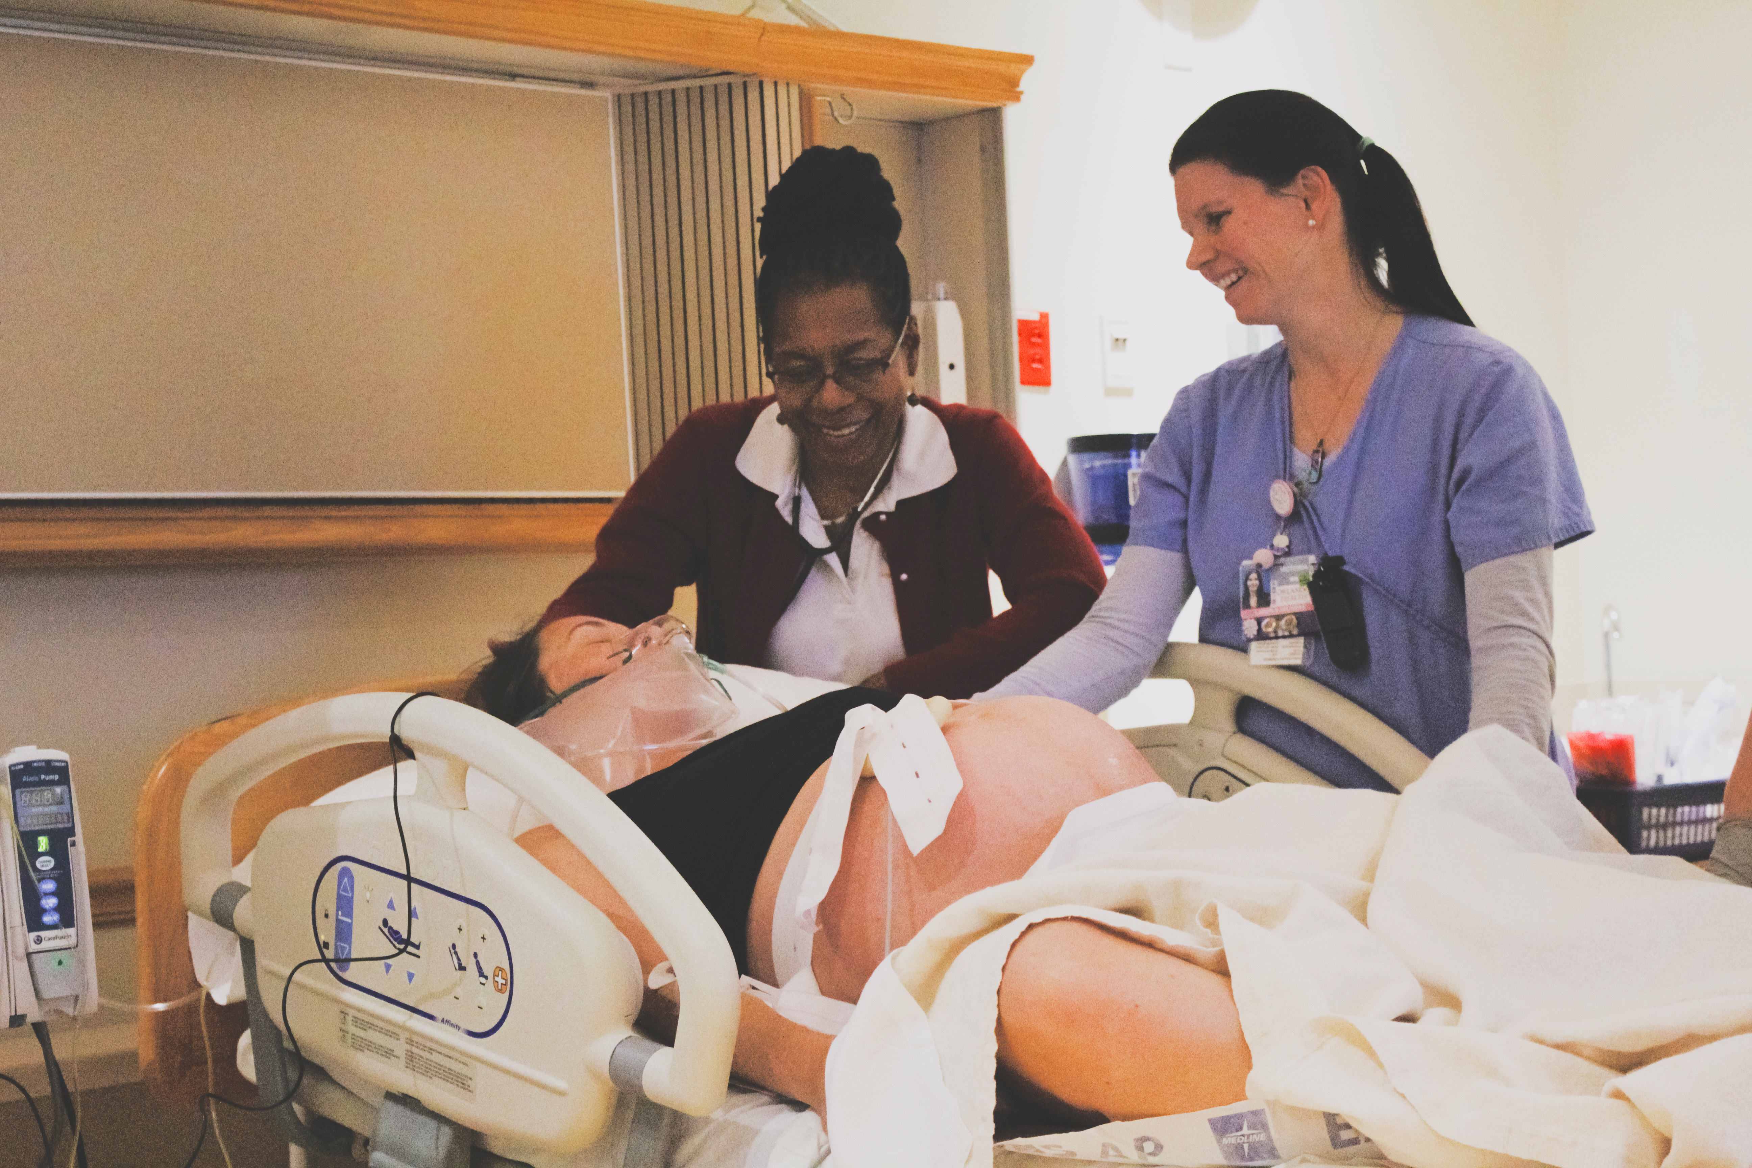

Slide 8
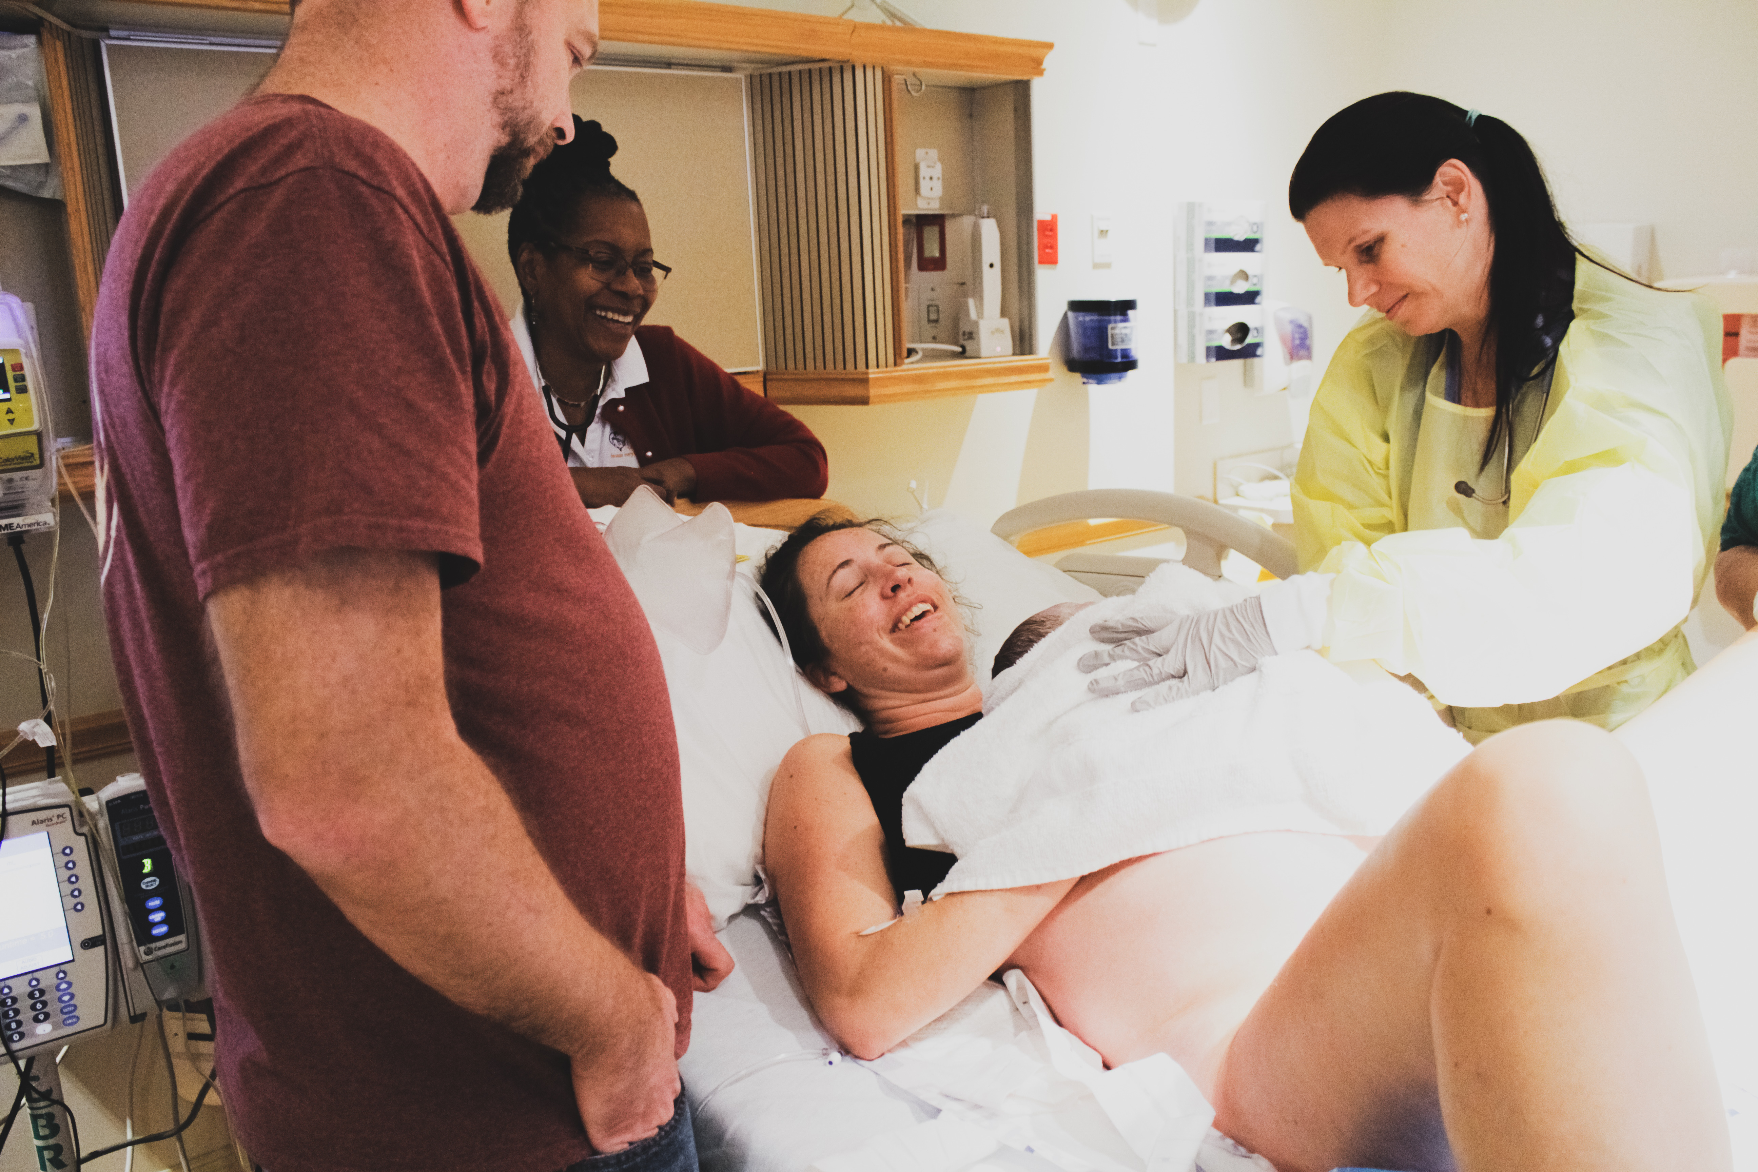
Copyright Jennie Joseph 2021
Notes:
So why is it so hard for us to consider access to quality health care as a human right? Why do we feel some of us ‘deserve’ different treatment, different quality care? What is really ‘centered’ if it is not the patient? Is it the provider? The practice? The hospital? The risk-managers? The shareholders? Is it the ‘system? In my opinion the system is broken, we spend the most money per capita on health care, yet something is not quite right. It seems that centering these specific ways of being, perpetuate structural and historical inequities and biases which allow, and sometimes even overlook, the unequal care and practices which may maintain the business model and the corporate bottom line, but perhaps really just hurt people.
(this is a mom who had to transfer from my birthing center during labor to finish her delivery in the hospital – yup, sometimes those babies are just a bit too hefty to come through.., but with a timely transfer and continued support she managed to deliver safely, and without a cesarean section – the blessing of collaborative interdisciplinary teams that will also center the mother/baby dyad). But that’s not happening every time, that’s not how it’s working for all women ………)

Slide 9
Materno-toxic Zones or Environments
I coined the phrase ‘materno-toxic’ as a way to describe what I see as the ‘environmental’ impact on a mother, whether pregnant or parenting, which creates such toxicity around her that she, the mother/baby dyad, or her children, are not safe.
Or in other words – if you yourself wouldn’t want to be in her shoes, exchange places with her or be in her situation, it’s likely she’s experiencing materno-toxicity, she is compromised.
Copyright Jennie Joseph 2021

Slide 10

Ah, but it’s those social determinants of health………those Materno-toxic neighborhoods
© Copyright Jennie Joseph 2013
Notes:
Obviously disenfranchised neighborhoods are materno-toxic zones, not conducive to, or supportive of health, power or well-being in any way. Let’s not fall into the trap of thinking that poor obstetric outcomes must be inextricably linked to social determinants of health though, of women making poor choices, not caring about their babies, and other convenient tropes, that would be too easy………. And in fact that might make for a really simple fix too, right? Just ensure all people have all their social needs met and we’re done!

Slide 11
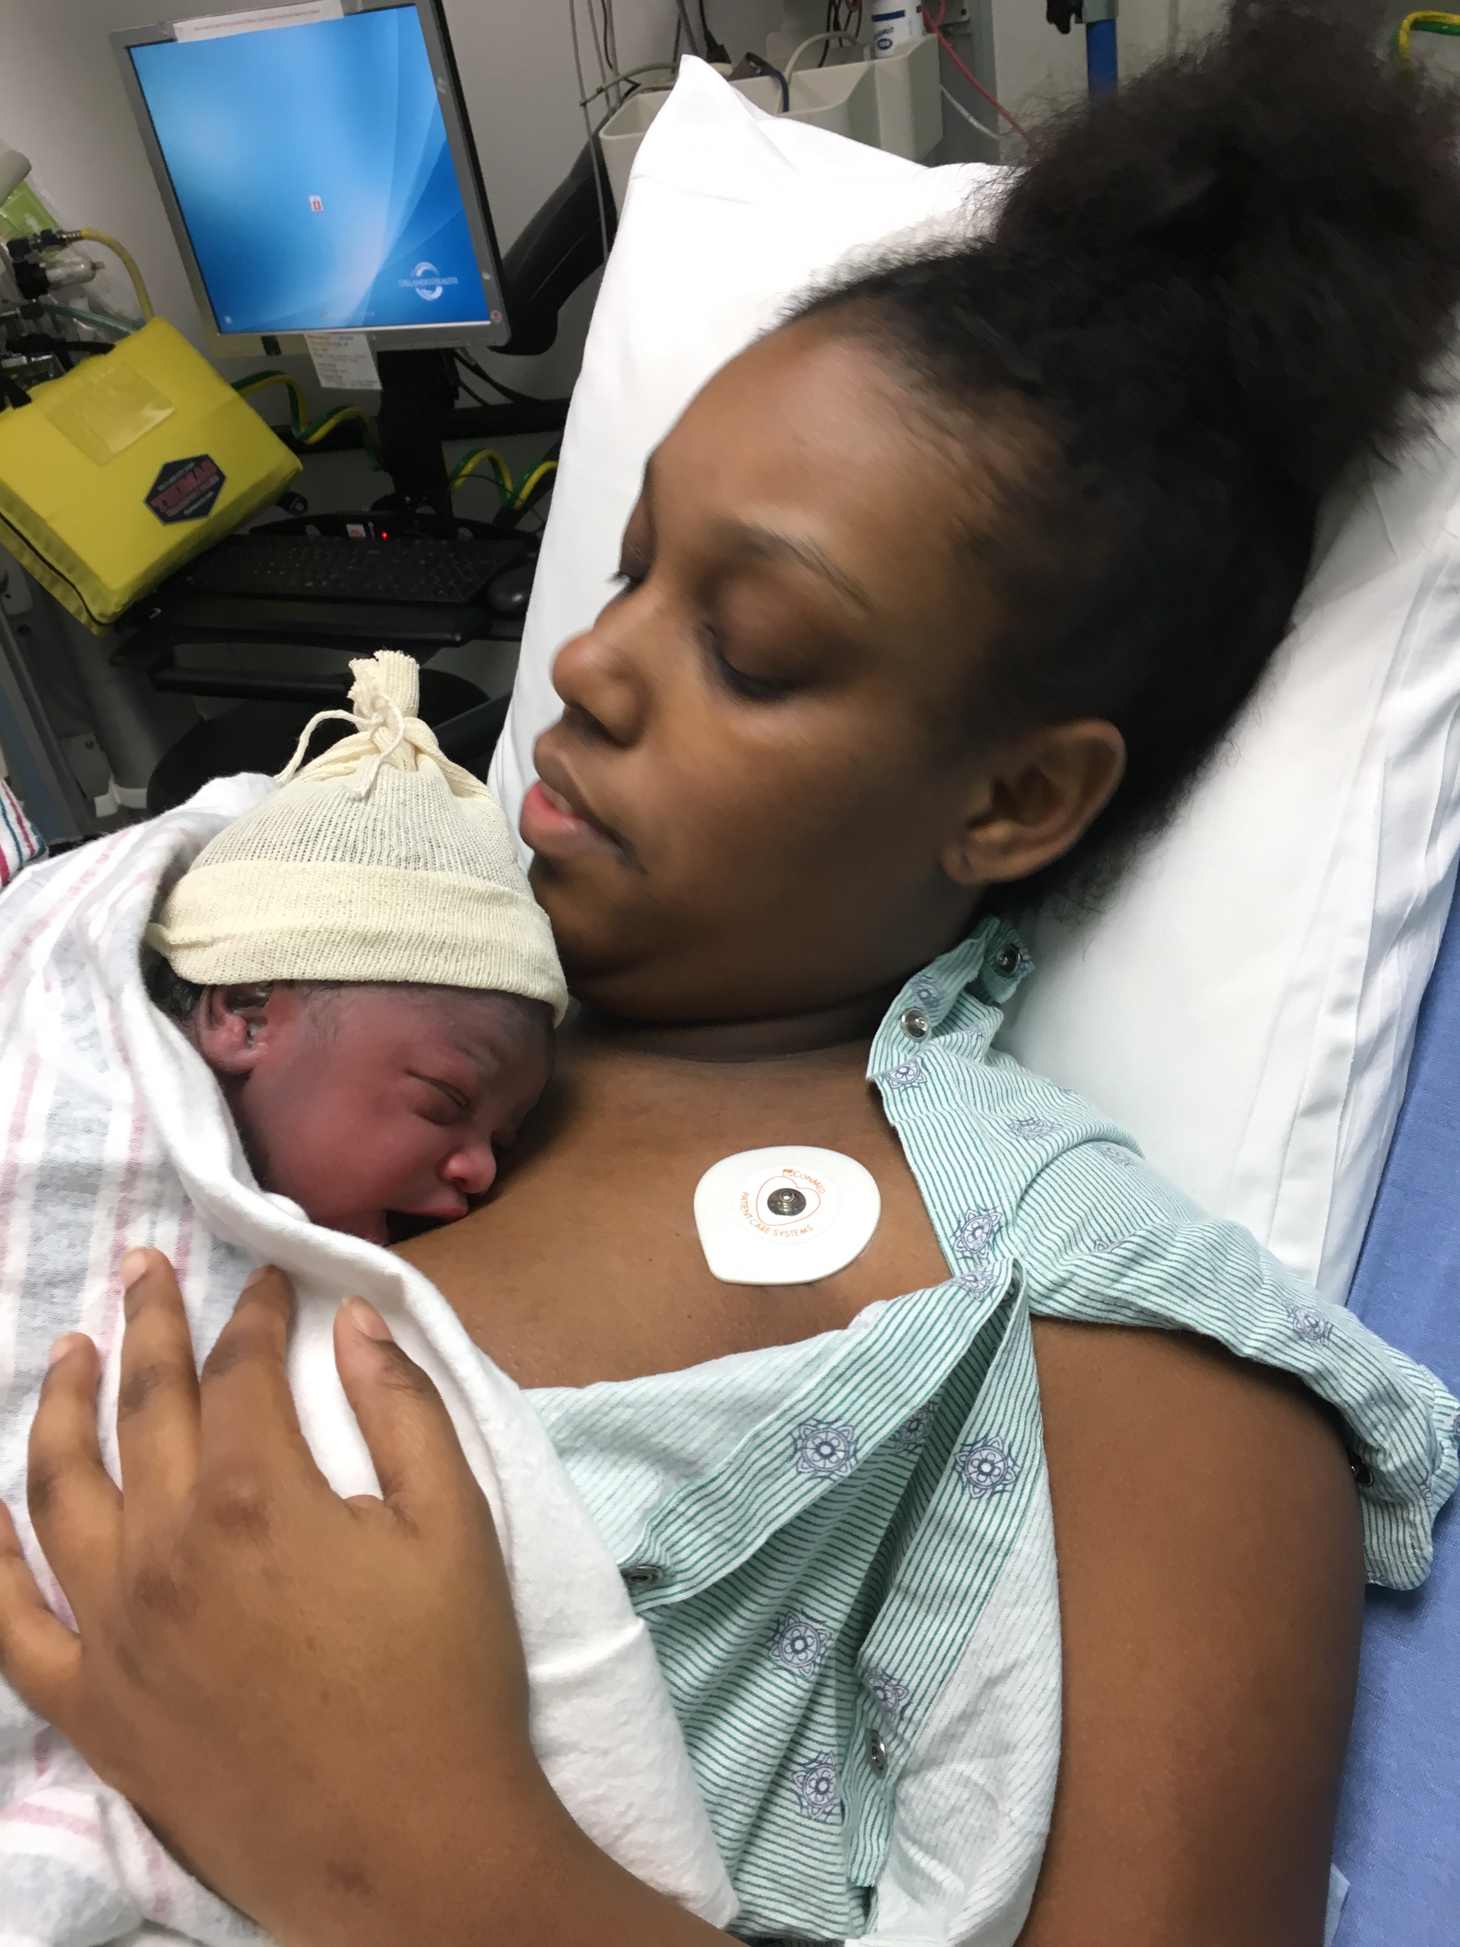
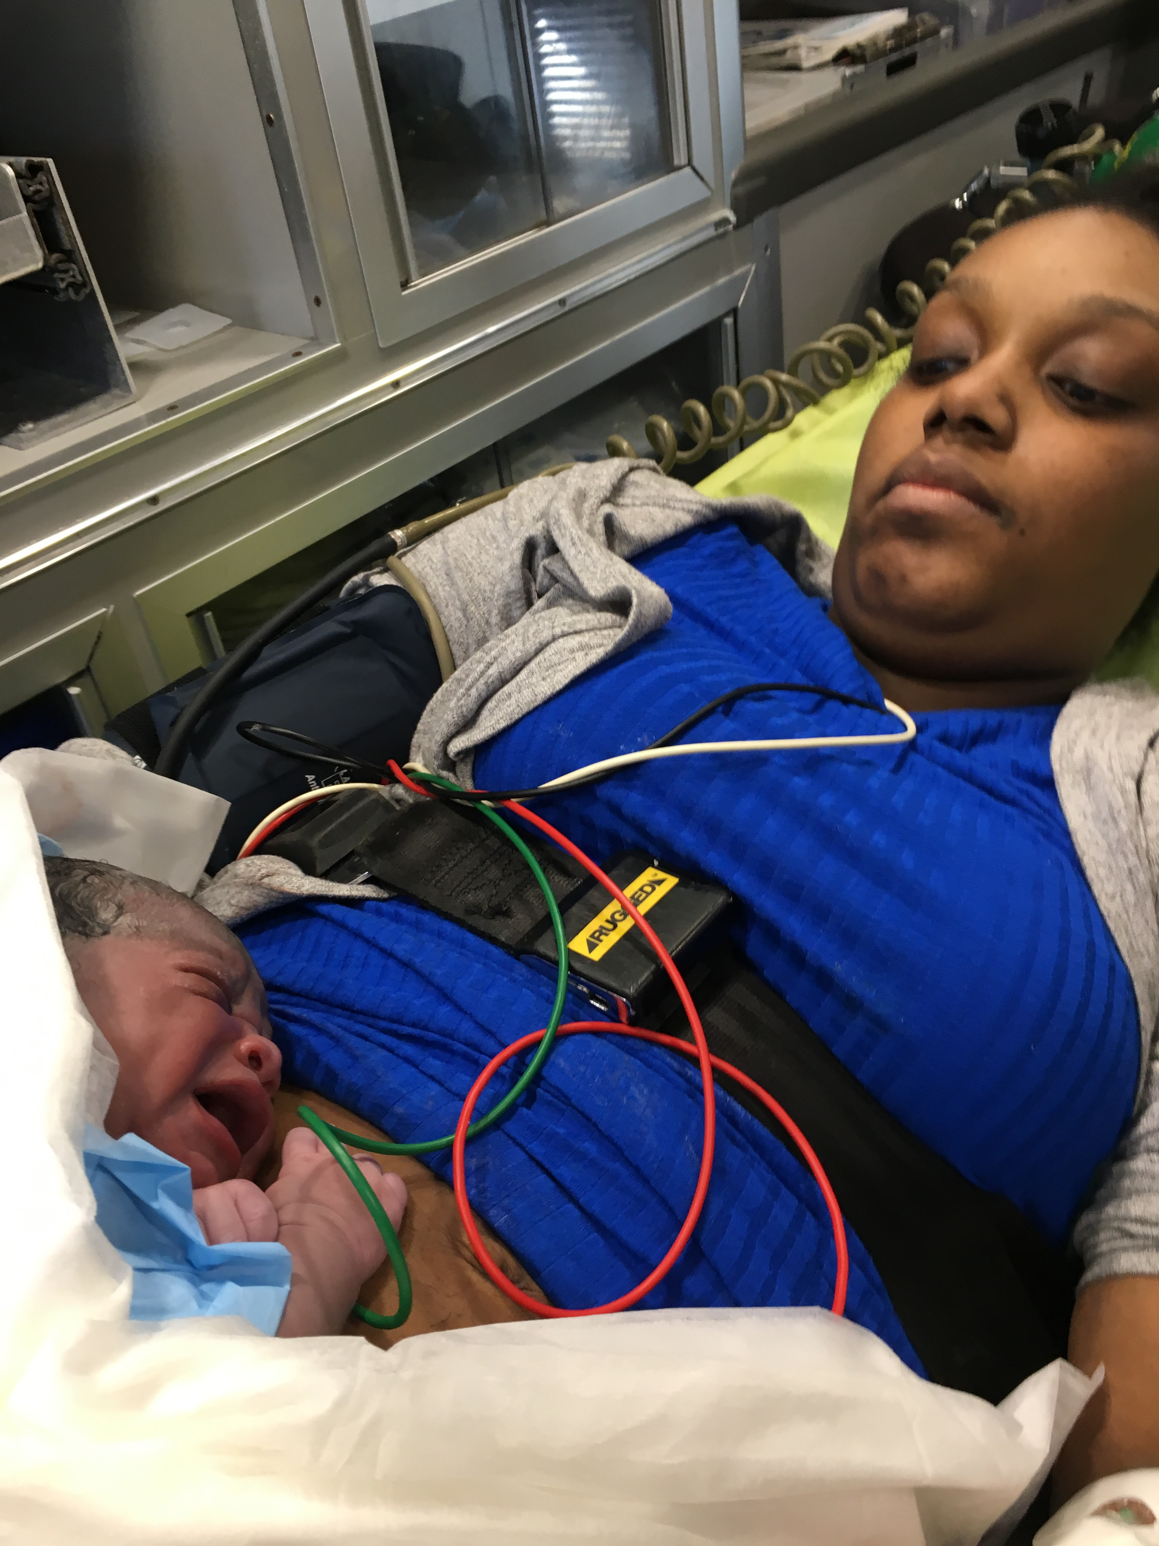
Pop-Up Toxicity – the Mobile MTZ
Notes:
Sadly, there’s more to this…… I talk a lot about what I call ‘Pop Up Toxicity’ – the kind that nearly killed Serena Williams. The kind that ‘pops –up’ immediately, consciously or unconsciously, as a response to WHO you are - your race, your color, your socio-economic status, your able-bodied-ness, your weight, sexual orientation and so on. That intersectional TOXICITY, in it’s response to your ‘other-ness’ – that toxicity which is oblivious to your education, insurance status, money, power or even celebrity. That toxicity which deeply permeates medical spaces and hospital systems because it is structural and institutional and is condoned.

Slide 12
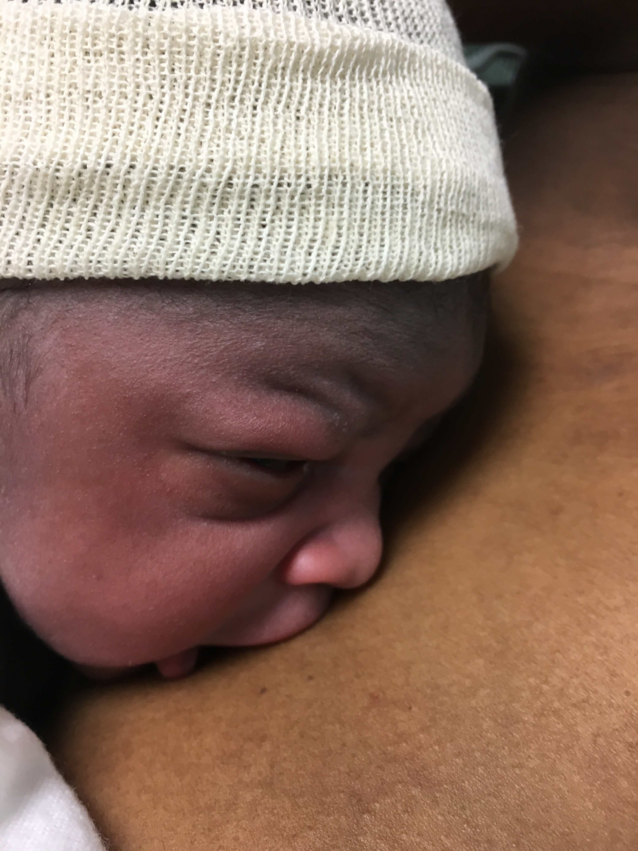
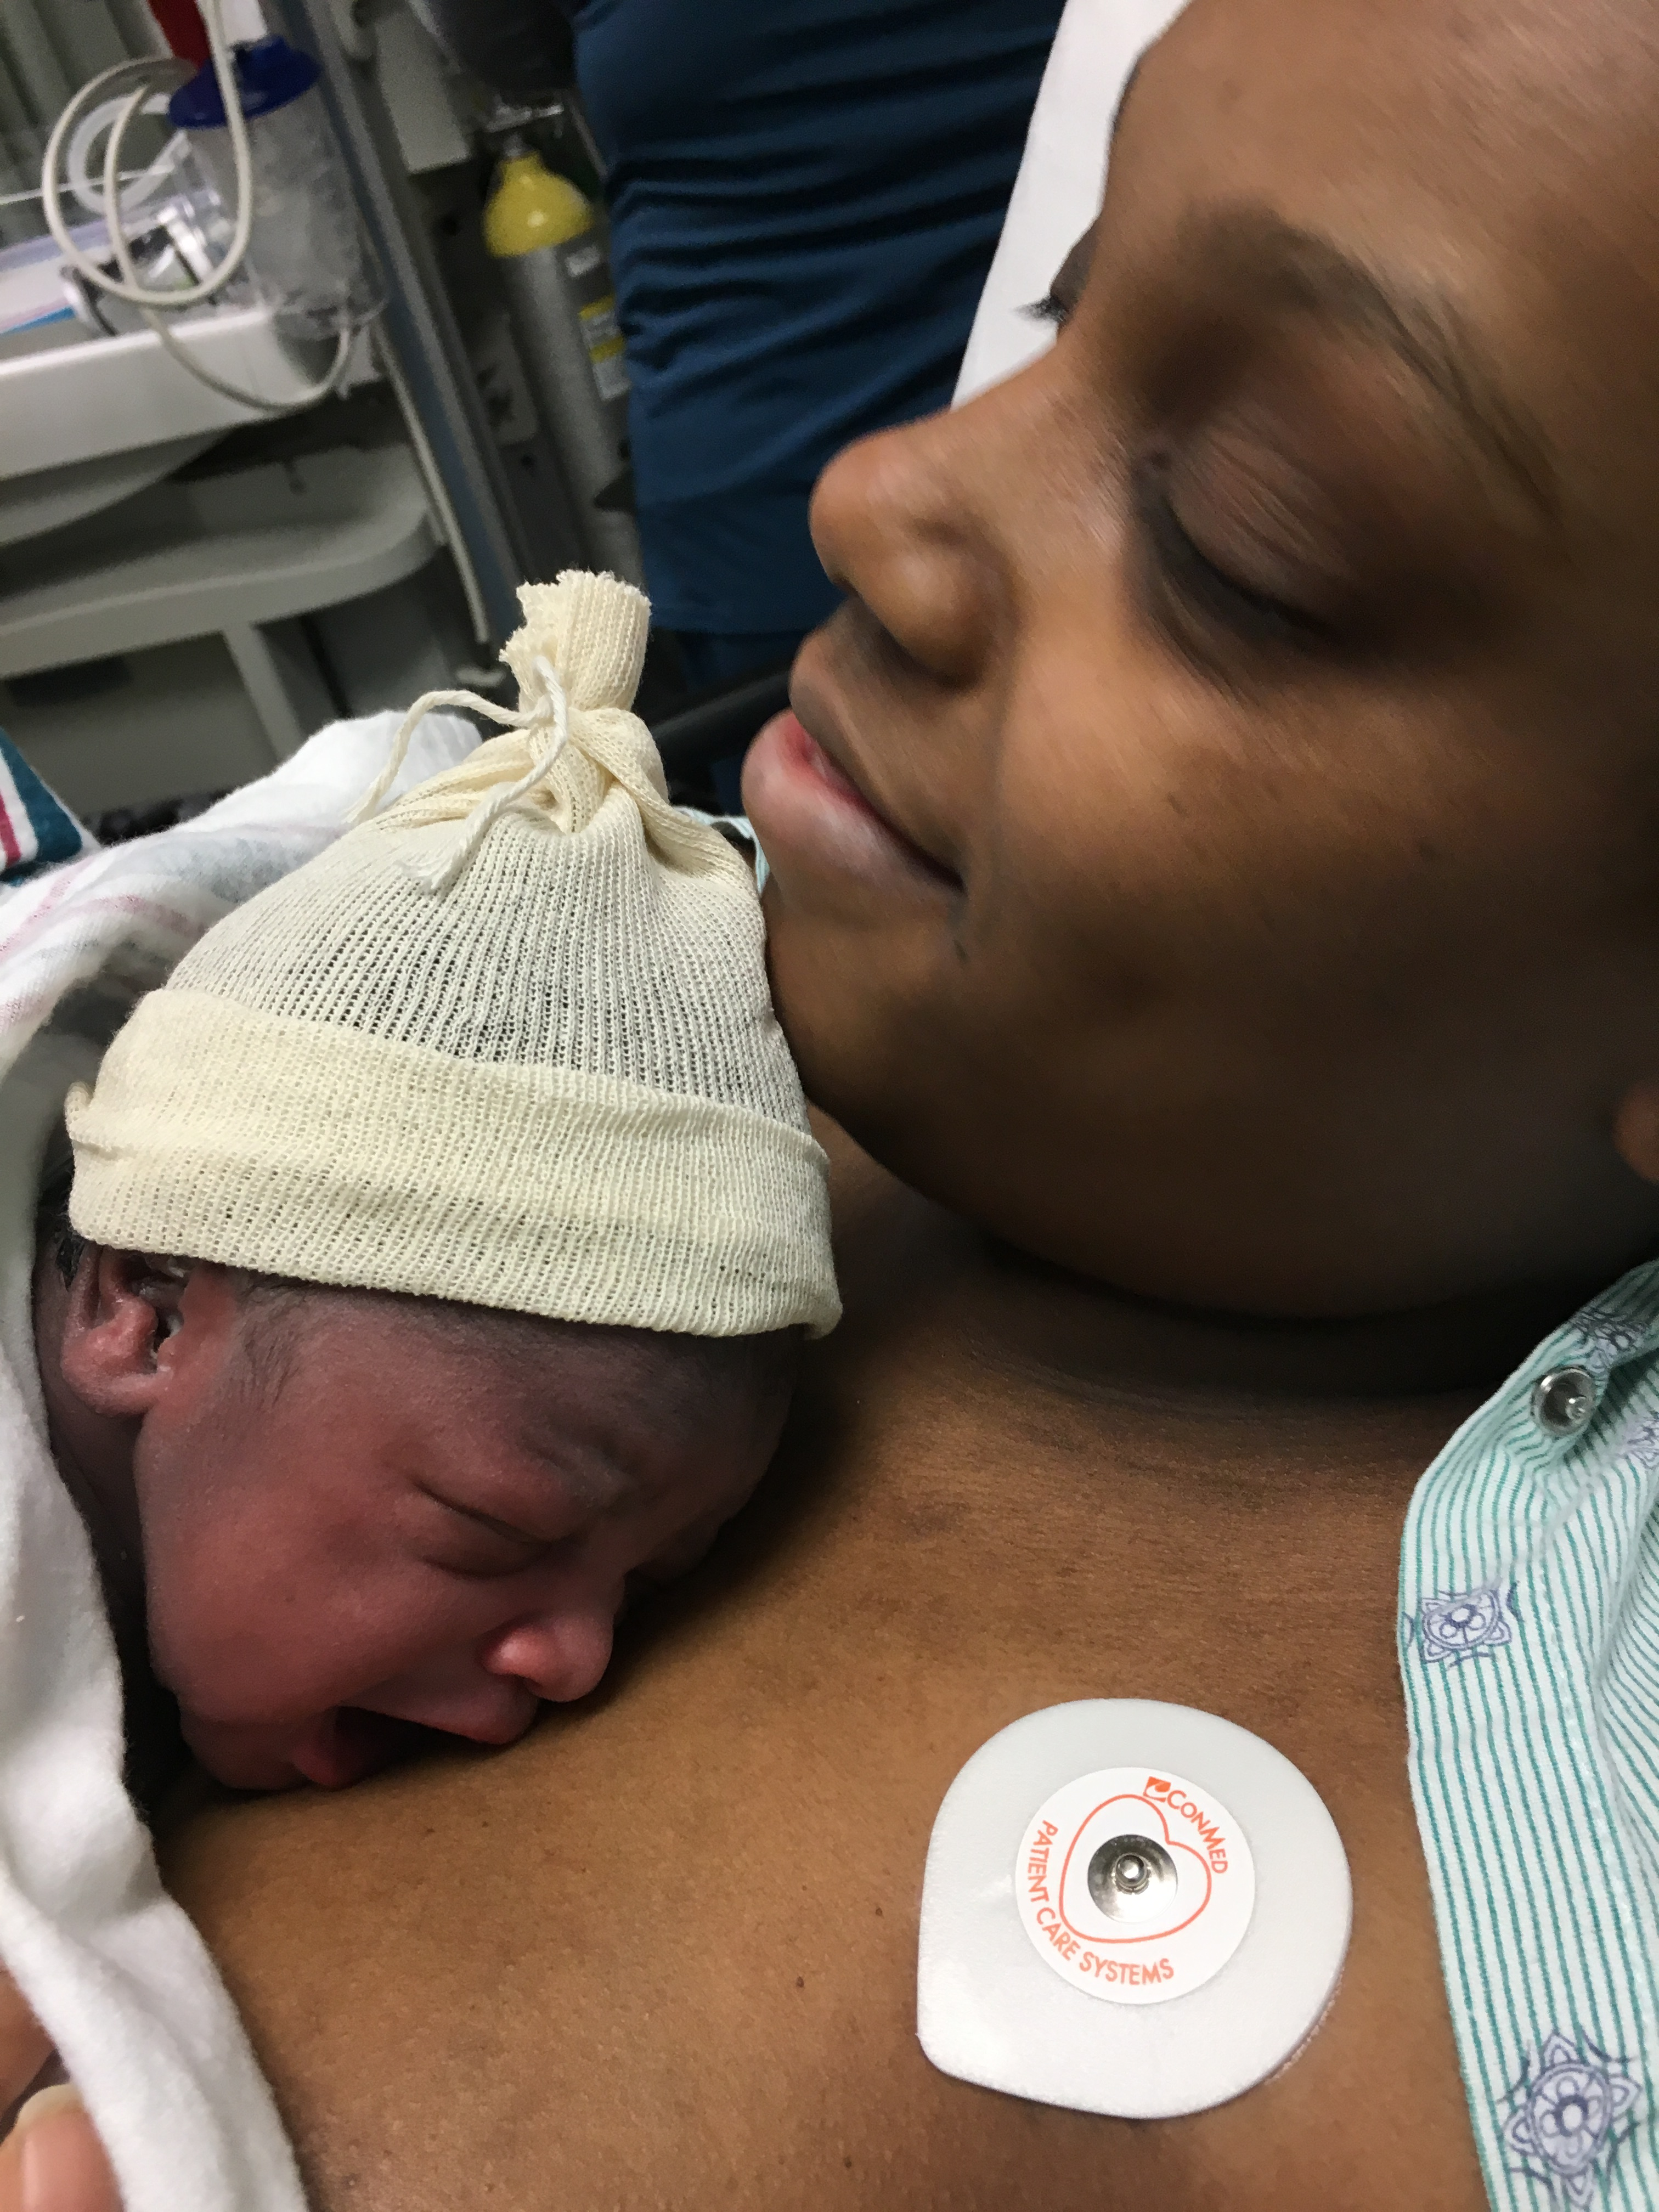

Slide 13
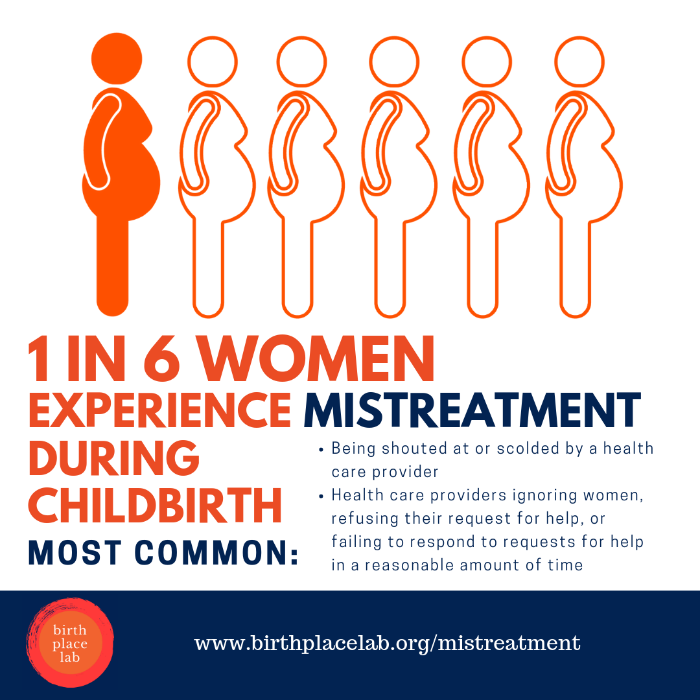
Vedam, S., Stoll, K., Taiwo, T. K., Rubashkin, N., Cheyney, M., Strauss, N., . . . & the GVtM-US Steering Council. (2019).
“The Giving Voice to Mothers study: Inequity and mistreatment during pregnancy and childbirth in the United States”. Reproductive Health, June 11, 1-18. DOI: 10.1186/s12978-019-0729-2
Notes:
A recently published study looked at mistreatment of women during childbirth, and confirms what I hear from women all the time. These data are about the actual birth experience but absolutely hold true for the antepartum, postpartum and women’s health care in general. 1 in 6 women mistreated, that’s a lot of women, across all demographics.

Slide 14
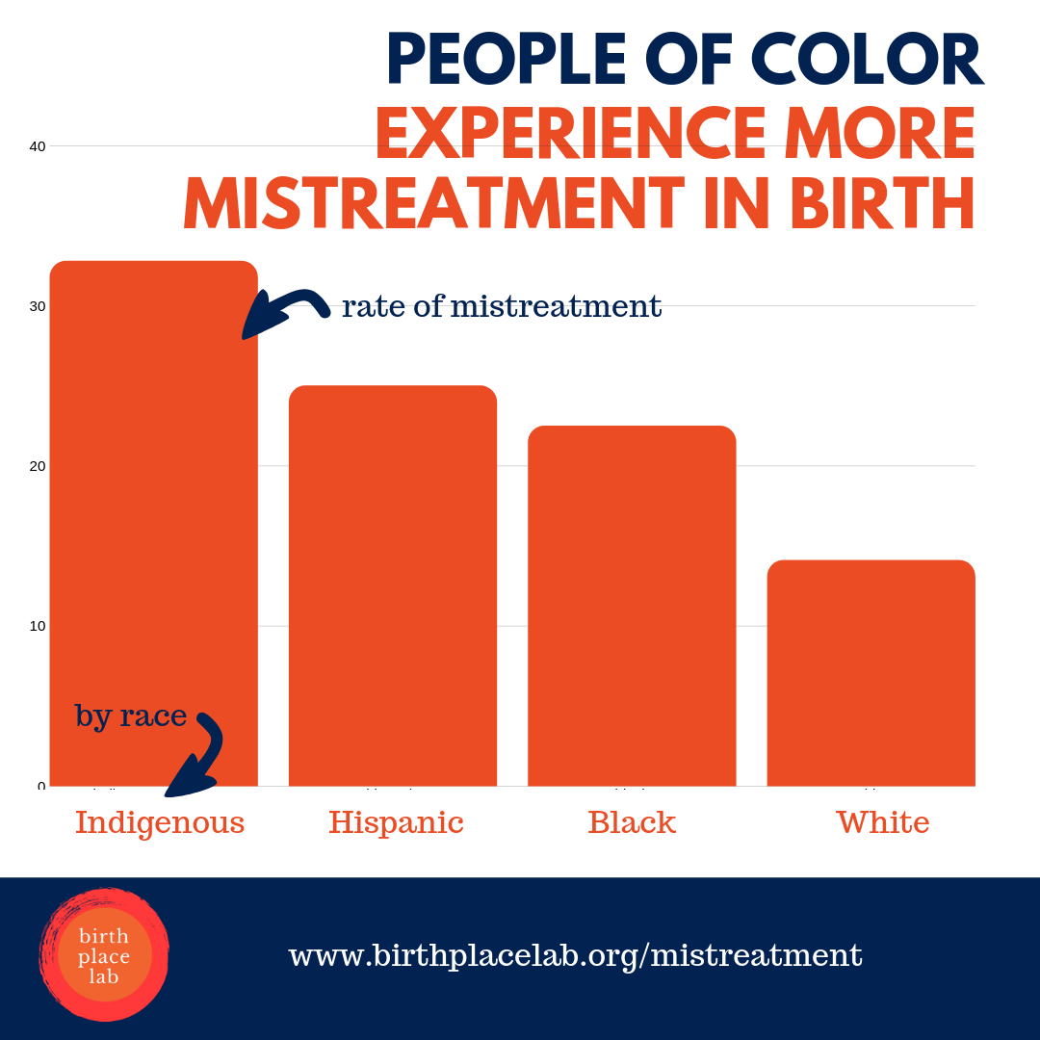

Slide 15
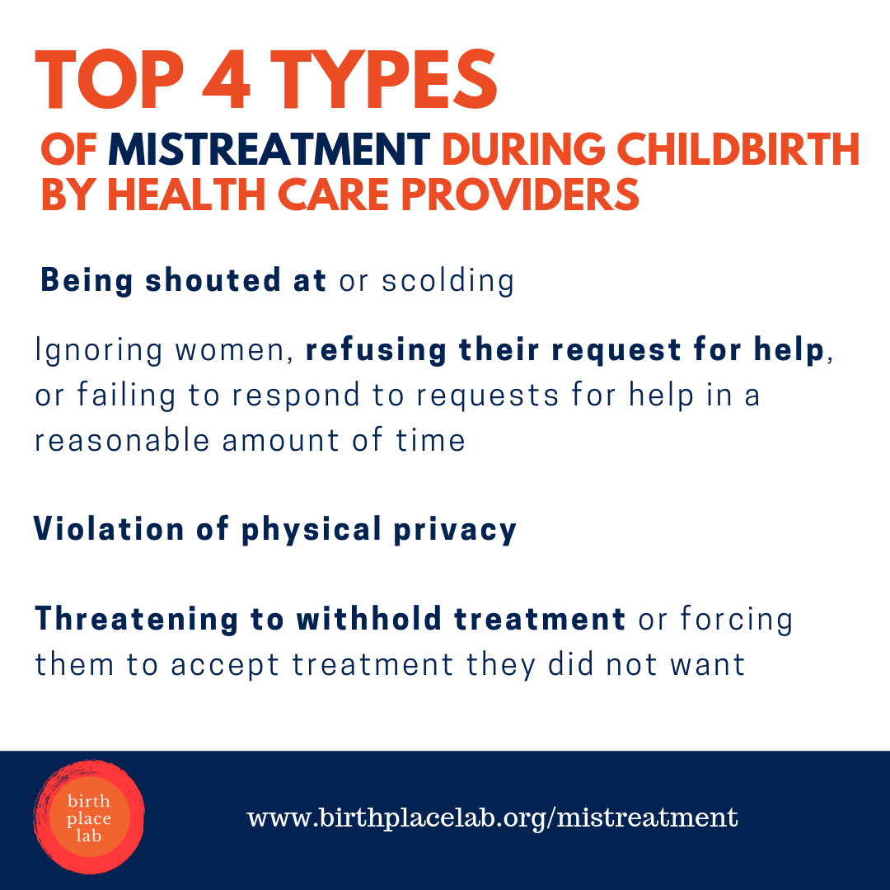
Notes:
This is a quantitative review, we have no shortage of qualitative studies, because when we ASK, IF we ask, women will tell……. I wonder why we won’t listen?
Here is what you get when you don’t provide patient centered maternity care – the USA has the worse outcomes in the developed world for mothers, with a ranking of 57th in the world for infant mortality and 48th for maternal mortality
Horrific statistics like this, that we may have become numb to in the USA, a little too accustomed to hearing – statistics that if they were in regards to any other highly-resourced nation we might actually be outraged.

Slide 16
Evidence Based Outrage?
Black Lives Matter: Claiming a Space for Evidence-Based Outrage in Obstetrics and Gynecology
“What is notably absent, with the exception of three isolated commentaries, is the use of the phrase (Black Lives Matter) in medical literature. We are trained as clinician and researchers to operate within the world of testable hypotheses and restrained conclusions. Where, then, is the space for evidence-based outrage in medicine? What P value would be necessary to conclude that persistent health disparities are unacceptable?
As subspecialist obstetricians–gynecologists, we use data from our field to demonstrate the significant disparities Black women face across their reproductive lives, and conclude that these outcomes are not only statistically significant, but morally significant and fundamentally unjust.”
Eichelberger, Doll et al…….

Slide 17

POLICY & ETHICS
To Prevent Women from Dying in Childbirth, First Stop Blaming Them
Two-thirds of all U.S. maternal deaths are considered preventable. Racism—not race—is a critical factor
By Monica R. McLemore on May 1, 2019
Monica R. McLemore is an assistant professor in the family health care
nursing department and a clinician-scientist at Advancing New Standards
in Reproductive Health at the University of California, San Francisco.
She maintains a clinical practice at Zuckerberg San Francisco General.

Slide 18
Materno-toxic Zones
The current situation:
Materno-toxic Zones can be lethal, leading to increase in morbidity and mortality continually widening the racial disparity in perinatal outcomes.
The impact on providers is also devastating due to vicarious trauma, moral injury, a sense of helplessness and an overall lack of power.
What can we do?
We can mitigate this devastating conundrum by providing Respectful Maternity Care to those suffering in these MTZs and by acknowledging the truth about what is behind these disparities…….
Copyright Jennie Joseph 2021

Slide 19
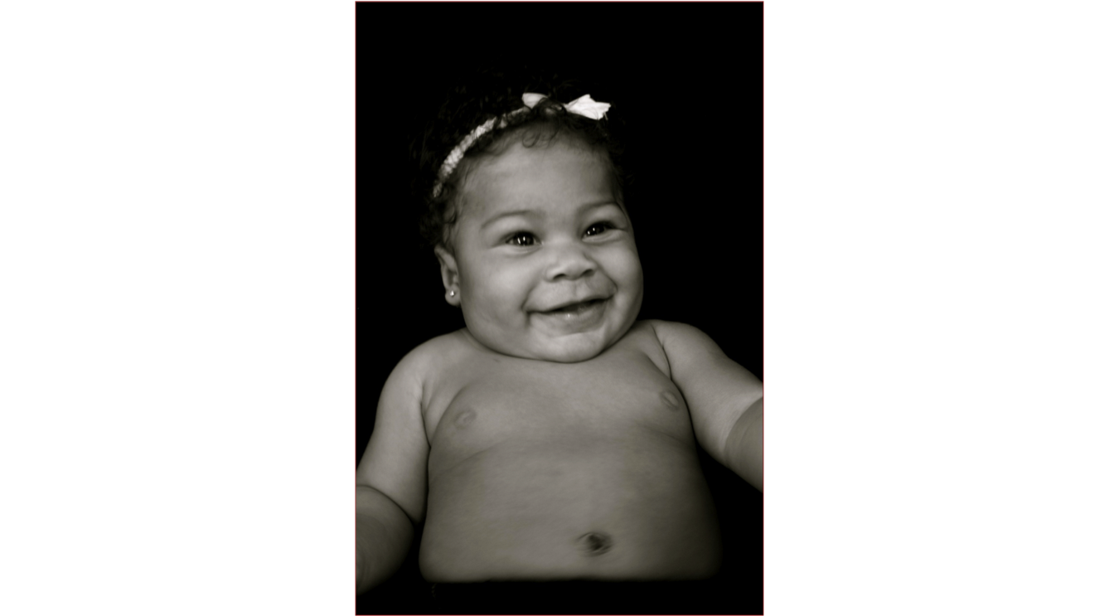
The Fundamental Premise
Our mission is to inspire change in maternal child health care systems worldwide; to re-empower the birthing mother, father, family and community by supporting the providers, practitioners and agencies that are charged with their care.
Every person wants a healthy baby and every person deserves one
The JJ Way® Tenets
Access
Connections
Knowledge
Empowerment
Copyright Jennie Joseph 2021
Notes:
If you’ve had a baby you already know what I am talking about, if you haven’t yet, I know this resonates with you, - or if you have ever loved someone who was having a baby, you also know. . NO matter who you are, or what you are doing in life, how you are behaving or what zip code you live in – this holds true.

Slide 20
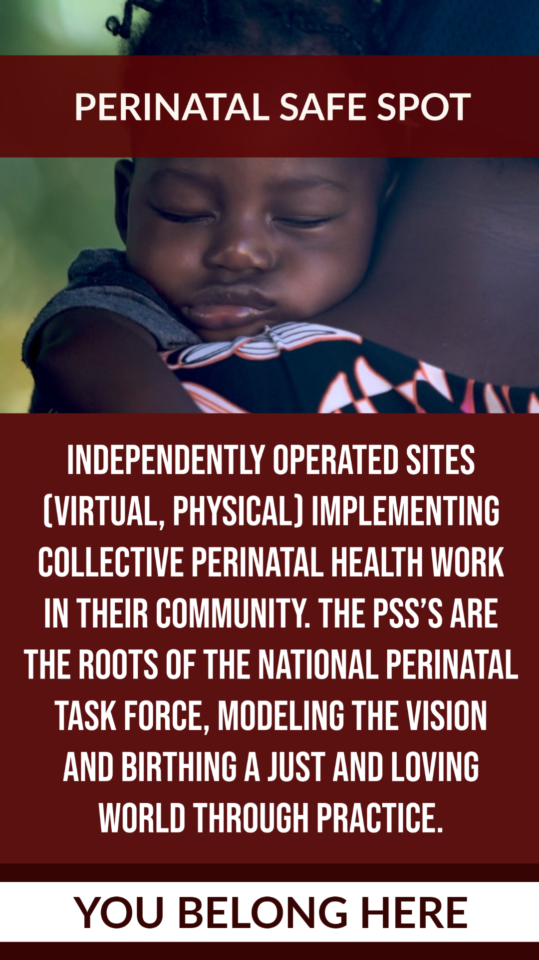

National Perinatal Task Force
Notes:
-How are we building a movement? (Paula) (add in this is a place where anyone who is doing this work Does belong! There’s a place for everyone that is committed to doing this work. There are different ways to be a member, we will get to that a little later in the session)

Slide 21
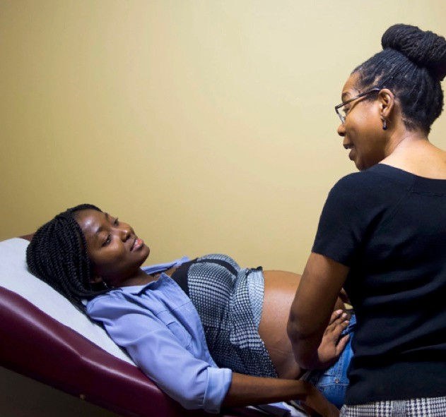
Critical Focus Points:
 | Safety Quality Workforce Development
The Solution
^{Method:} The JJ Way® Model of Maternity Care
provides quality prenatal and postpartum care with the goal of eliminating disparities due to race and socio-economic class.
collaborative, team-based approach based on four tenets:
-access
-connection
-knowledge
-empowerment

Slide 22
Safety
The Solution
for the community-at-large
birthing people and their families
safer systems for stakeholders, providers, agencies, and institutions
We must
embrace and invest in proven
and protective solutions led by Black and Indigenous People of Color
doing so will improve outcomes for all

Slide 23

Quality
Quality
The Solution
hospital systems and public health systems must commit to:
financial support strategic partnerships
strong collaborative protocols with all community-based perinatal actors and agencies who serve BIPOC and marginalized childbearing people.
quality and oversight is dependent on:
full support, integration, and public endorsement of the interdisciplinary perinatal health continuum
*Community Friendly Hospital Designation/Status
cross-sectoral and equitable partnerships structural community supports

Slide 24
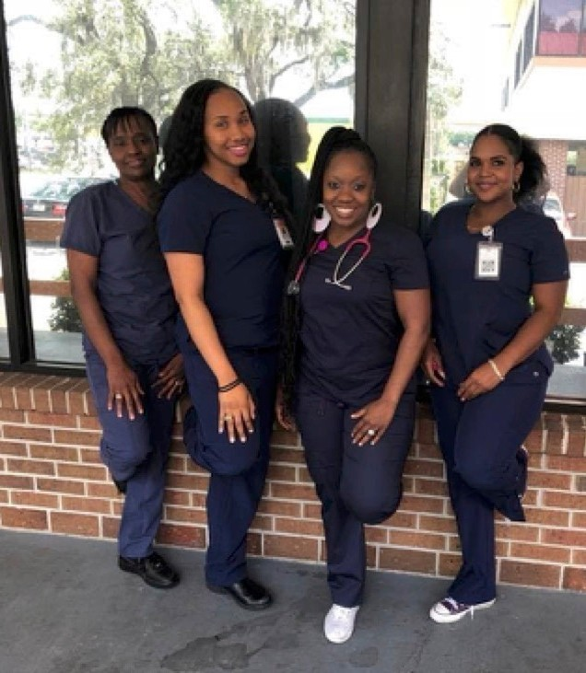
Workforce Development
Workforce
^{Qu}D^{al}e^{it}v^{y}elopment
The Solution
grow and diversify the pipe-line for future perinatal careers educate the current workforce
-to replicate protective models and clinical behaviors
-to support or begin the integration of structural changes
Certification Endorsement
Economic Accountability
through fair reimbursement

Slide 25
Trauma-Informed Care – for Safety, Quality, Workforce Development

Slide 26
Rights of Childbearing Women
(World Health Organization)
Right to information and informed consent
Right to companion of choice when possible
Confidentiality, privacy
Dignity, respect
Equality and freedom from discrimination
Right to continuous care and attention
Notes:
In 2012, the World Health Organization adopted a statement that identified respectful care of childbearing women as a human right. The rights that are listed on this slide (read them one by one) should become the focus of our work in improving the care of women.
ADVANCING MATERNAL HEALTH AS A HUMAN RIGHTS ISSUE - BMMA

Slide 27

Safe Motherhood –
Respect for her humanity……….

Slide 28

A SAFER SYSTEM
Could it be possible that creating a culture and environment that supports all pregnant people could make the difference between health, gestational age, birth weight and breastfeeding rates in women at risk for poor maternal health outcomes in the USA?
Notes:
So I created a model of care in the early 2000s, a midwifery model that I felt might make some impact on the racial disparities in infant and maternal health – the fact that black women and babies were dying disproportionately in the USA , from preventable causes ……..yes, preventable! I asked my self this question……….

Slide 29
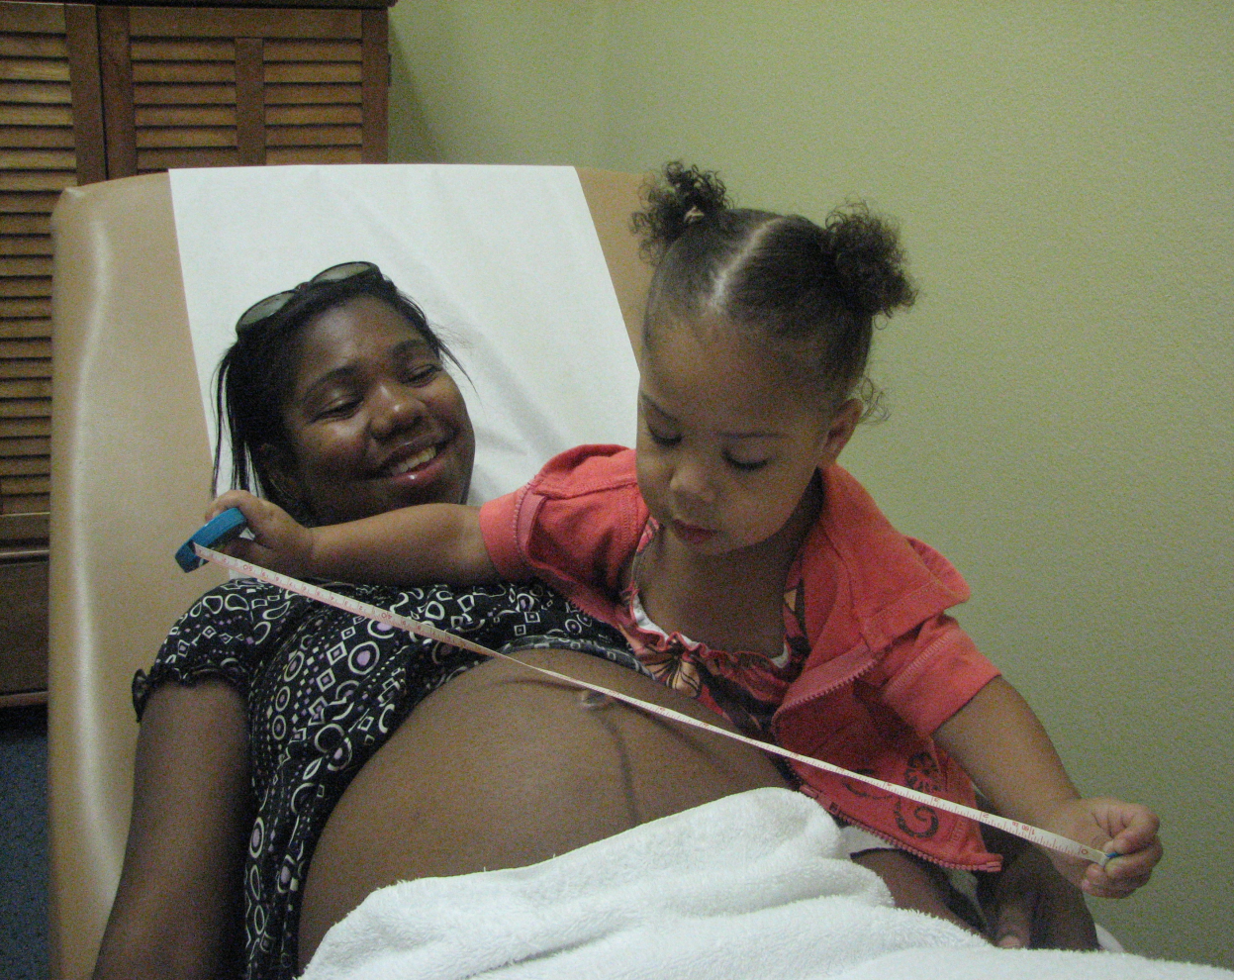

www.perinataltaskforce.com
Notes:
Additionally we train and develop perinatal providers – we start them really early! – in order to build a pipeline to career paths that will strengthen and diversify our maternal health care service providers. (Issa was absolutely a terror when it came time to measure her mommy’s belly at EVERY prenatal visit – it was always best to just give up the tape measure and get out of her way!) Our program trains and certifies doulas, childbirth educators, lactation educators, community health workers, medical assistants and community midwives with a specific focus on strong interdisciplinary collaborations and community relationships to mitigate maternal and infant mortality – that’s also The JJ Way!

Slide 30
LISTEN!
Say something like “tell me more.”
Listen to the tone of voice
Listen to the words the person chooses. This will tell you a lot about their level of health literacy, so you will know how to explain the diagnosis and treatment.
Make a conscious effort to listen and not to interrupt.
Say back what you heard
Notes:
We often forget to introduce ourselves. If a stranger is entering your home, you would ask him to introduce himself to the other members of your family. Before she trusts you with her care, the mother wants to know who you are, and what is your role. Also, you should learn the name of the mother and use it when you speak to her. At the same time, you will want to begin to create a partnership with mother. In your own words, find a way to say that “I am here if you need me. I am here to help you.”

Slide 31
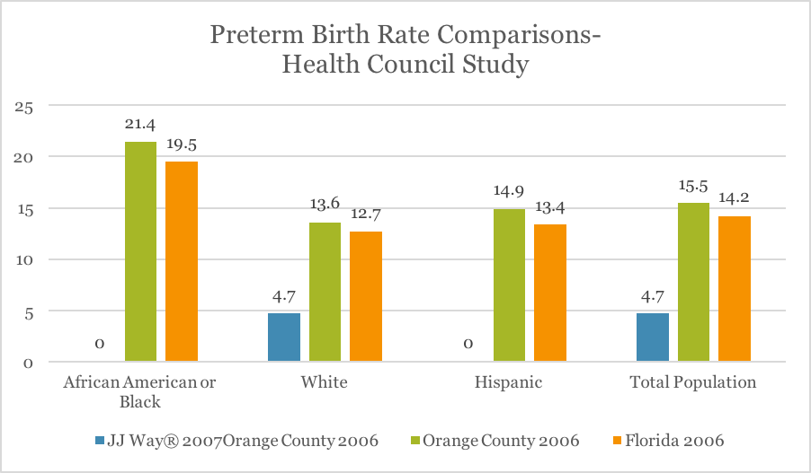
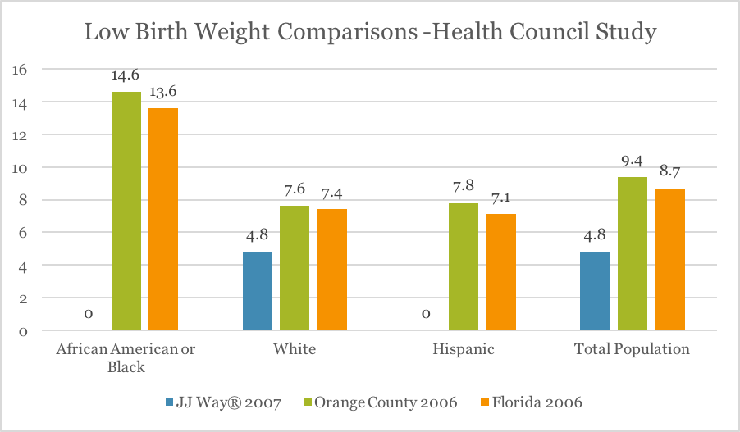
Preterm Birth and Low Birth Weight by Race 2006 - 2007
Notes:
In 2007 – we conducted our first study, a study of 100 of our highest -risk patients, we enrolled them prospectively and waited to see what happened. Voila! We were surprised – but we had no premature or low birth weight babies among the African American and Latina women – none! Compared to the county and state percentage that same year, we had eliminated the racial disparity. Not just dropped a couple of points but totally gone! And that year the African American women were at a 1 in 5 risk of having a preterm birth in Florida!

Slide 32
Elimination of the Racial Disparity 2007
No low birth weight or premature infants born to African American or Hispanic women in the 2007 Study
100 ‘Easy Access Clinic’ women enrolled
95% of babies weighed an average 7lbs 7ozs
95% of women delivered at 39 weeks

Slide 33
Cornerstones of SAFE Perinatal Care
1. Access
2. Connections
3. Knowledge
4. Empowerment
The findings of this study matched
women with the same age, race, and zip code from
the Florida Vital Statistics database and revealed
statistically significant longer gestational periods
and lower preterm birth rates for Women of Color
who were cared for within the model in 2014
Notes:
Throughout our work we weave these four essential tenets, for both patients and staff – we know that if we provide access points and support connections, the knowledge we share will benefit and empower us all. The outcomes speak for themselves and prove that we are doing works. This equity model mitigates persistent poor outcomes and consistently results in less prematurity, less low birth weight, healthy weight, full-term, breastfeeding babies, healthier moms, and less perinatal depression.
We are standing with women, families and communities for access to SAFE, QUALITY maternity care with dignity and power for ALL.

Slide 34
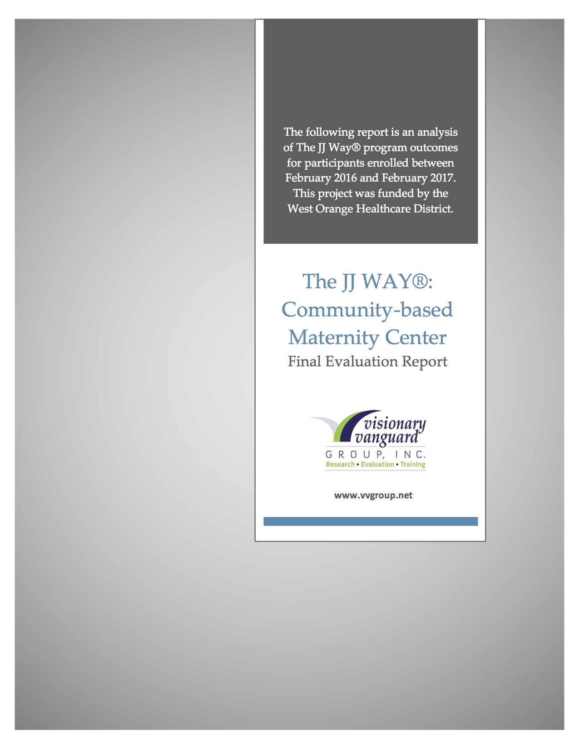
Community-based Maternity Center Evaluation 2017

Slide 35
Conclusions of the 2017 Study
Zero Disparities in Preterm Birth Rates
The disparity between the preterm rates for African-American and Black women has been erased.
The preterm birth rates for African-American and Black women was actually lower (8.6%) than the rates of their White counterparts in Orange County (9%), the state of Florida (9%) and across the nation (9%). February 2016 and February 2017, a total of 256 women received services
African-American and Black women (who generally have the worse birth outcomes locally, statewide and across the country) who received care had lower preterm birth rates (8.6%) than individuals of the same race in Orange County (13%) the state of Florida (13.3%) and the nation (13%)
White women also fared well as their preterm birth rates were lower (5%) than White women in Orange County (9%) and the state of Florida(9%)
The positive outcomes are also reflected in the preterm rate comparisons of Hispanic women who received care. The preterm rates for Hispanic women (4%) were less than half of the rates of Hispanic women in Orange County(9.3%) and the state of Florida (8.9%)

Slide 36
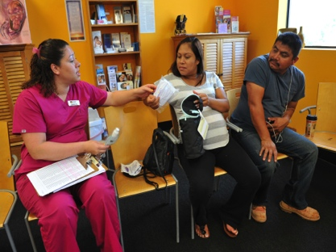
Access, Connections, Knowledge, Empowerment
© Copyright Jennie Joseph 2021
Notes:
So at commonsense childbirth we use my codified midwifery model of care at all our clinics - to offer Access, Connections, Knowledge and Empowerment to every patient, every time AND to the staff who provide their care. We run clinics in English, Spanish and Portuguese. Mothers choose where they deliver – hospital with a physician or birth center with our midwives, but they have unrestricted access to staff and continuity of patient centered care throughout their maternity care with us regardless of delivery site or provider choice.
Moms going through our programs have more agency, more power, they can fend for themselves – we teach their partners and family members to become advocates – how to navigate the system, how to ‘center the mother’ as well, what to look out for, what questions to ask whenever they are not under our direct care. They can identify ‘non-patient centered care’, they know what it looks like, what it feels like, they can recognize bias and discrimination – conscious and unconscious, they can call it out, and where necessary they can protect themselves. Would that kind of support have enhanced your patient experience?

Slide 37
Commonsense Solutions
Community-based, community-owned and community-led perinatal providers and practices using doulas, lactation educators, community health workers, medical assistants, nurses and midwives are:
PROTECTIVE in all materno-toxic zones and situations
Able and willing to create and navigate in a ‘team’ approach to maternity care
Providing quality, culturally-congruent, perinatal care meeting women where they ‘are’ – physically, mentally, emotionally and even financially
Able to train and support other willing providers and agencies in interdisciplinary and collaborative practice
Notes:
Community-based, community-owned and community-led perinatal providers and practices using doulas, lactation educators, community health workers, medical assistants, nurses and midwives are:
PROTECTIVE in all materno-toxic zones and situations
Able and willing to create and navigate a ‘team’ approach to maternity care
Providing quality, culturally-congruent, perinatal care where women ‘are’ – physically, mentally, emotionally and even financially
Able to train and support other willing providers and agencies in interdisciplinary and collaborative practice

Slide 38
What do we need?
ACCESS to what? Safe, quality maternity care for ALL women
ACCESS to who? Appropriate level providers, with cultural humility and willingness to acknowledge the true dangers for women
ACCESS to where? All sites, all levels of care – home birth, clinic, birth center, hospital
Who else has ACCESS issues?
Providers need
ACCESS to understanding the inbuilt historical and structural harms of disconnected, broken and unwieldly medical systems;
ACCESS to cultural humility training, and training to reach in, and work collaboratively, with underserved communities and providers
Students need
ACCESS to scholarships, grants, loans for training, and establishing sustainable community-based perinatal practices
Notes:
We need Safe, quality maternity care for ALL women
We need Appropriate level providers, with cultural humility and willingness to acknowledge the true dangers for women
We need access to all sites, all levels of care – home birth, clinic, birth center, hospital
Providers need support and training to understand the impact of structural issues
Diverse students need financial support to begin, attain, maintain and sustain their career path and practices
We need ACTION, we need JUSTICE

Slide 39
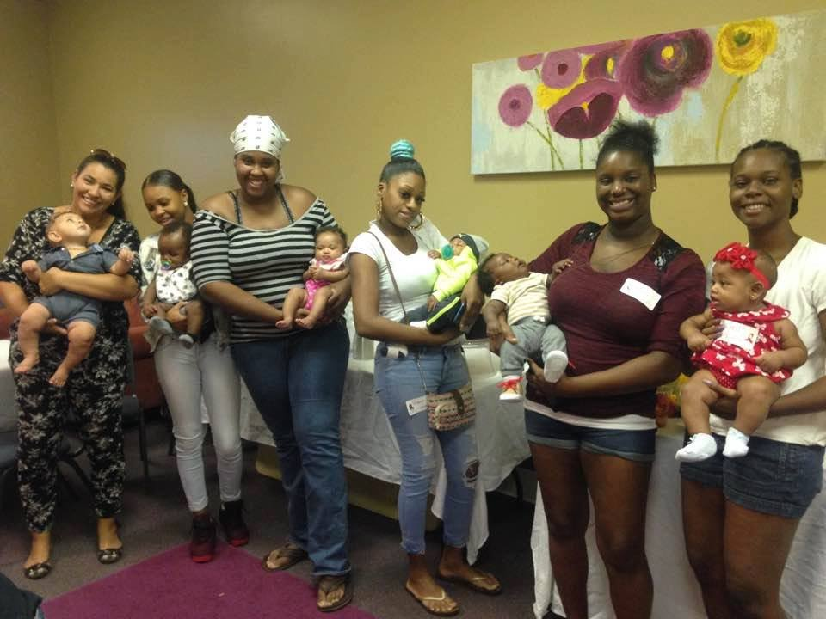
© Copyright Jennie Joseph 2021
Notes:
Here are some postpartum moms from my clinic in Orlando – please notice the juicy baby thighs, oh the rolls! Here’s what you get when you DO ‘center the patient’ – centering the woman, the mother/baby dyad – we see them as one unit, a pair; centering her partner, her family and her supporters. All the people essential to her health – because at the end of the day we all need people, and for those of us who don’t have anyone, WE, stand in that gap and facilitate connections to build relationships.
At Commonsense Childbirth we developed a maternity medical home, which includes prenatal and postpartum clinics called Easy Access Clinics, and a birth center with natural and water birth options, with the intention that no one is turned away for care, no matter what, and that all women are centered and fully supported throughout their pregnancy and birth experience. That means WE take on the onus and responsibility of situating the mom, working with her financially, her insurance or lack of insurance, her social and emotional and mental health needs, her fears and concerns as well as her maternity healthcare – wrap around services, what we call prenatal care plus – that’s The JJ Way!

Slide 40
What Can YOU Do?
Am J Public Health. 2016 October; 106(10): 1771–1772.
Published online 2016 October. doi: 10.2105/AJPH.2016.303313
Black Lives Matter: Claiming a Space for Evidence-Based Outrage in Obstetrics and Gynecology
Kacey Y. Eichelberger, MD,Kemi Doll, MD, Geraldine E. Ekpo, MD, and Matthew L. Zerden, MD, MPH
Vedam, S., Stoll, K., Taiwo, T. K., Rubashkin, N., Cheyney, M., Strauss, N., . . . & the GVtM-US Steering Council. (2019).
“The Giving Voice to Mothers study: Inequity and mistreatment during pregnancy and childbirth in the United States”. Reproductive Health, June 11, 1-18. DOI: 10.1186/s12978-019-0729-2
To Prevent Women from Dying in Childbirth, First Stop Blaming Them
Two-thirds of all U.S. maternal deaths are considered preventable. Racism—not race—is a critical factor
By Monica R. McLemore on May 1, 2019
This article was originally published with the title "How to Reduce Maternal Mortality" in Scientific American 320, 5, 48-51 (May 2019)
doi:10.1038/scientificamerican0519-48

Slide 41
www.commonsensechildbirth.org www.perinataltaskforce.com
jennie@commonsensechildbirth.org
@jenniejoseph

